Slide 1
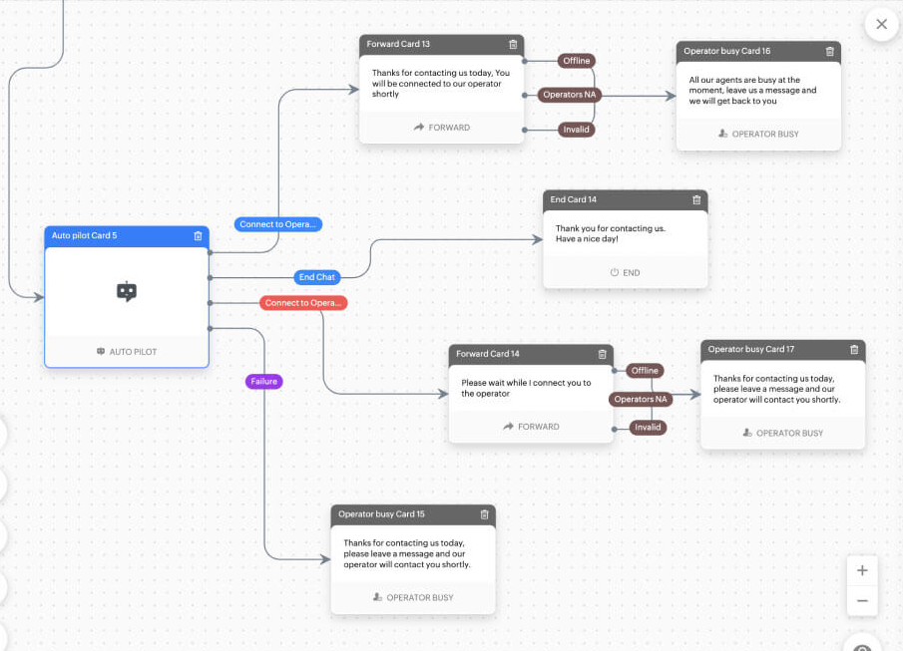
Develop an Automated Email Response Chatbot
Problem Statement:
Handling a large volume of repetitive customer inquiries leads to delays in response and increased workload for customer support teams. The project aims to automate email responses to improve efficiency and customer satisfaction.
Algorithm
Naive Bayes: A simple algorithm that predicts responses based on the probability of certain words appearing in customer inquiries.
SVM: A more complex algorithm that draws a boundary between different types of inquiries to classify them.
Data Source:
Customer Inquiries and Responses: A dataset containing questions from customers (e.g., about products, order status, tech support) and the corresponding answers.
Expected Output:
➔Accurately categorizes inquiries
➔Generates appropriate responses
➔Reduces manual workload
➔Improves response times
➔Enhances customer satisfaction
Team Members:
Reeshmanth Chowdary. D – 2320030321
Surya Vamshi Yadav. M – 2320030251
Tejashwini Mudiraj. A – 2320030443

