Slide 1

In-House Internship – Cornerstone Project
Final Review
In-House Internship Management System
Presented by
B L V Surya Prakash (25B21CS066)
T Naga Sai Charan (25B21CS070)
Tanatswa Hilary Gendere (24B11CS529)
Blessed Zambezi (24B11CS537)
Department of Computer Science and Engineering

Slide 2

Presentation Outline
1. Abstract
2. Introduction
3. System Analysis
4. Database Design
5. System Design
6. System Implementation
7. Future Enhancements
8. References
9. Conclusion

Slide 3
ABSTRACT
The In-House Internship Management System (II2) is a full-stack web application designed to digitize and streamline the entire internship lifecycle within Aditya University.
The system provides functionalities such as student onboarding, project allocation, daily status tracking, task submissions, review management, and attendance monitoring — reducing manual effort and errors.
II2 aims to improve data accuracy, accessibility, and security by adopting a structured, role-based, and centralized approach with four roles: Admin, HOD, Faculty, and Student.
The application is developed using React (Vite) for the frontend, Node.js/Express for the backend, MongoDB for persistent data storage, and Docker for containerized deployment.

Slide 4
INTRODUCTION
In any university, managing in-house internship programs across multiple departments is a critical and continuous task.
Traditional manual systems are time-consuming, error-prone, and difficult to scale as the number of students, projects, and departments grows.
An automated In-House Internship Management System simplifies the complete internship workflow and improves institutional efficiency.
This project focuses on developing a role-based web application for effective internship management covering Admin, HOD, Faculty, and Student workflows.

Slide 5
SYSTEM ANALYSIS
Functional Requirements:
The system allows Admin to add departments, programs, faculty, HODs, and students with full profile details.
It provides functionality to manage projects — create, assign to faculty/students, track status — and bulk import/export via Excel.
Authorized Faculty users can mark attendance, assign tasks, review submissions, and track student daily status reports.
The system supports HOD-level monitoring of all students and projects within their department.
Students can view their assigned project, submit daily status updates, complete tasks, and track their own attendance and review history.
The system supports searching and filtering students, projects, and tasks across all roles.

Slide 6
SYSTEM ANALYSIS
Hardware Requirements
Processor: Intel Core i5 or above
RAM: Minimum 8 GB
Storage: 20 GB free disk space
Input Devices: Keyboard, Mouse
Output Device: Monitor
Software Requirements
Operating System: Windows 10+ / Ubuntu 20.04+
Runtime: Node.js v18+ (LTS) | Frontend: React 18 + Vite + MUI
Backend: Express.js | Database: MongoDB (Mongoose ODM)
Containerization: Docker & Docker Compose | Web Server: Nginx
CI/CD: Jenkins Pipeline | Version Control: Git / GitHub

Slide 7
Database Design
The system uses MongoDB — a NoSQL document database — to store all internship-related information efficiently via Mongoose ODM.
It consists of 10 core collections (models): User, Department, Program, Project, Task, TaskSubmission, Review, Attendance, DailyStatus, and Setting.
The design helps in reducing data redundancy and improving data organization through document-based references.
Each User is linked to a Department using an ObjectId reference, and each Project links to both Department and assigned User(s).
The database ensures data integrity using primary ObjectId keys, unique constraints (e.g. email), and enum validations on role and status fields.

Slide 8
Database Design
Database Tables:
User Collection :
Stores user credentials and profile for all four roles (Admin, HOD, Faculty, Student)
Field Name | Data Type | Key | Description
_id | ObjectId | Primary Key | Auto-generated MongoDB document ID
name | String | — | Full name of the user
email | String | Unique, Required | University email (domain-restricted login)
password | String | Required | Bcrypt-hashed password
role | String (enum) | Required | admin | hod | faculty | student
department | ObjectId → Dept | Foreign Ref | References the Department collection
isActive | Boolean | Default: true | Account active / frozen status

Slide 9
Database Design
Database Tables:
Department Collection :
Stores department details (CSE, IT, ECE, MBA, etc.) and links to HOD user
Field Name | Data Type | Key | Description
_id | ObjectId | Primary Key | Auto-generated department ID
name | String | Required | Department name (e.g. CSE, IT, ECE)
hod | ObjectId → User | Foreign Ref | References the HOD user
emailDomain | String | — | Allowed email domain suffix for registration
description | String | — | Department description

Slide 10
Database Design
Database Tables:
Project Collection :
Stores internship project details and links to Department, Faculty, and Students
Field Name | Data Type | Key | Description
_id | ObjectId | Primary Key | Auto-generated project ID
title | String | Required | Project title
department | ObjectId → Dept | Foreign Ref | Owning department reference
faculty | ObjectId → User | Foreign Ref | Assigned faculty guide
students | [ObjectId → User] | Foreign Ref | Enrolled students list
status | String (enum) | — | active | completed | pending
skills | [String] | — | Required skills for the project

Slide 11
Database Design
Database Tables:
Attendance Collection :
Stores daily student attendance records marked by Faculty
Field Name | Data Type | Key | Description
_id | ObjectId | Primary Key | Auto-generated attendance ID
student | ObjectId → User | Foreign Ref | Student being marked
date | Date | Required | Attendance date
status | String (enum) | — | present | absent | late
markedBy | ObjectId → User | Foreign Ref | Faculty who marked attendance

Slide 12
SYSTEM DESIGN
Modules:
Auth Module: Handles login, OTP-based password recovery, JWT token issuance, email domain restriction, and role-based access guards.
Admin Module: Manages departments, programs, faculty, HODs, students, projects, tasks, reviews, attendance, analytics, bulk import/export, mail, and system settings.
Faculty Module: Allows faculty to view assigned students, create and grade tasks, mark attendance, conduct reviews, and track daily status submissions.
HOD Module: Provides department-level oversight of students, projects, tasks, and attendance with summary views and approval capabilities.
Student Module: Enables students to view their project, submit daily status, complete tasks, attend reviews, and track their attendance and profile.
Analytics & Report Module: Generates internship health dashboards, department-wise statistics, task completion rates, and attendance summaries for Admin review.

Slide 13
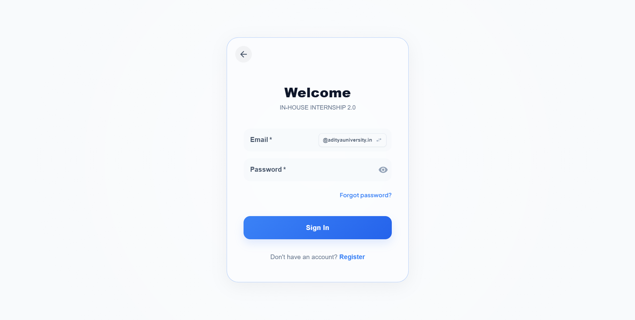
System Implementation
Login Window:
This window allows authorized users to enter their email and password to access the In-House Internship Management System.

Slide 14
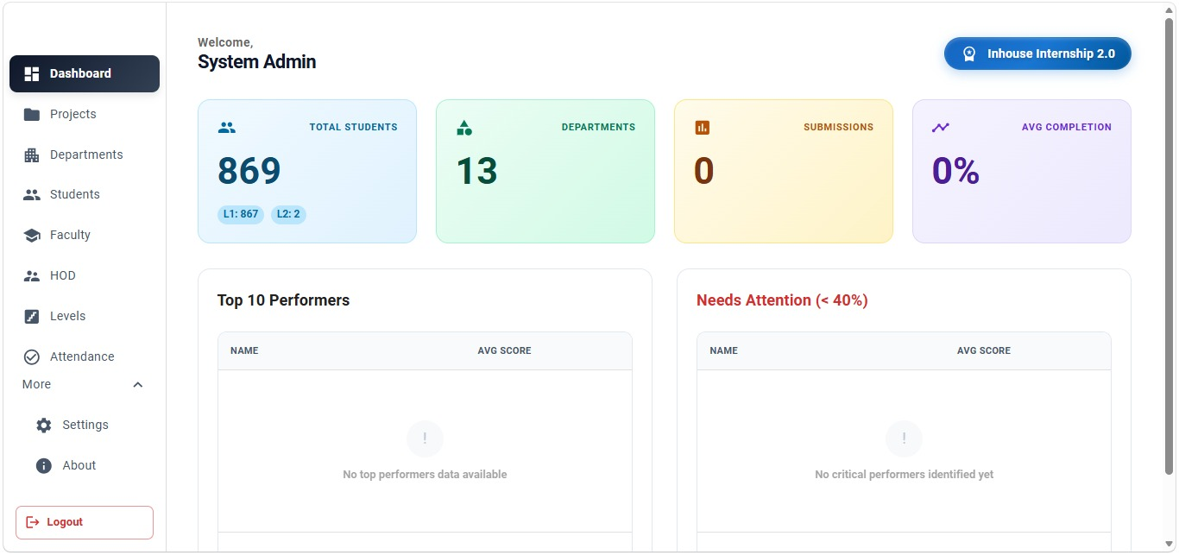
System Implementation
Admin Dashboard:
After login, the Admin is presented with a navigation dashboard to perform all management operations.

Slide 15
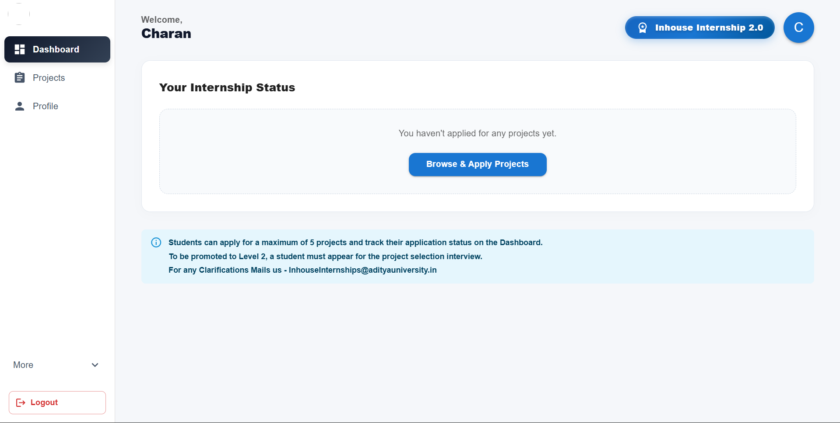
System Implementation
Student Dashboard:
This window enables the student to view project details, submit daily status, complete tasks, and track attendance and review history.

Slide 16
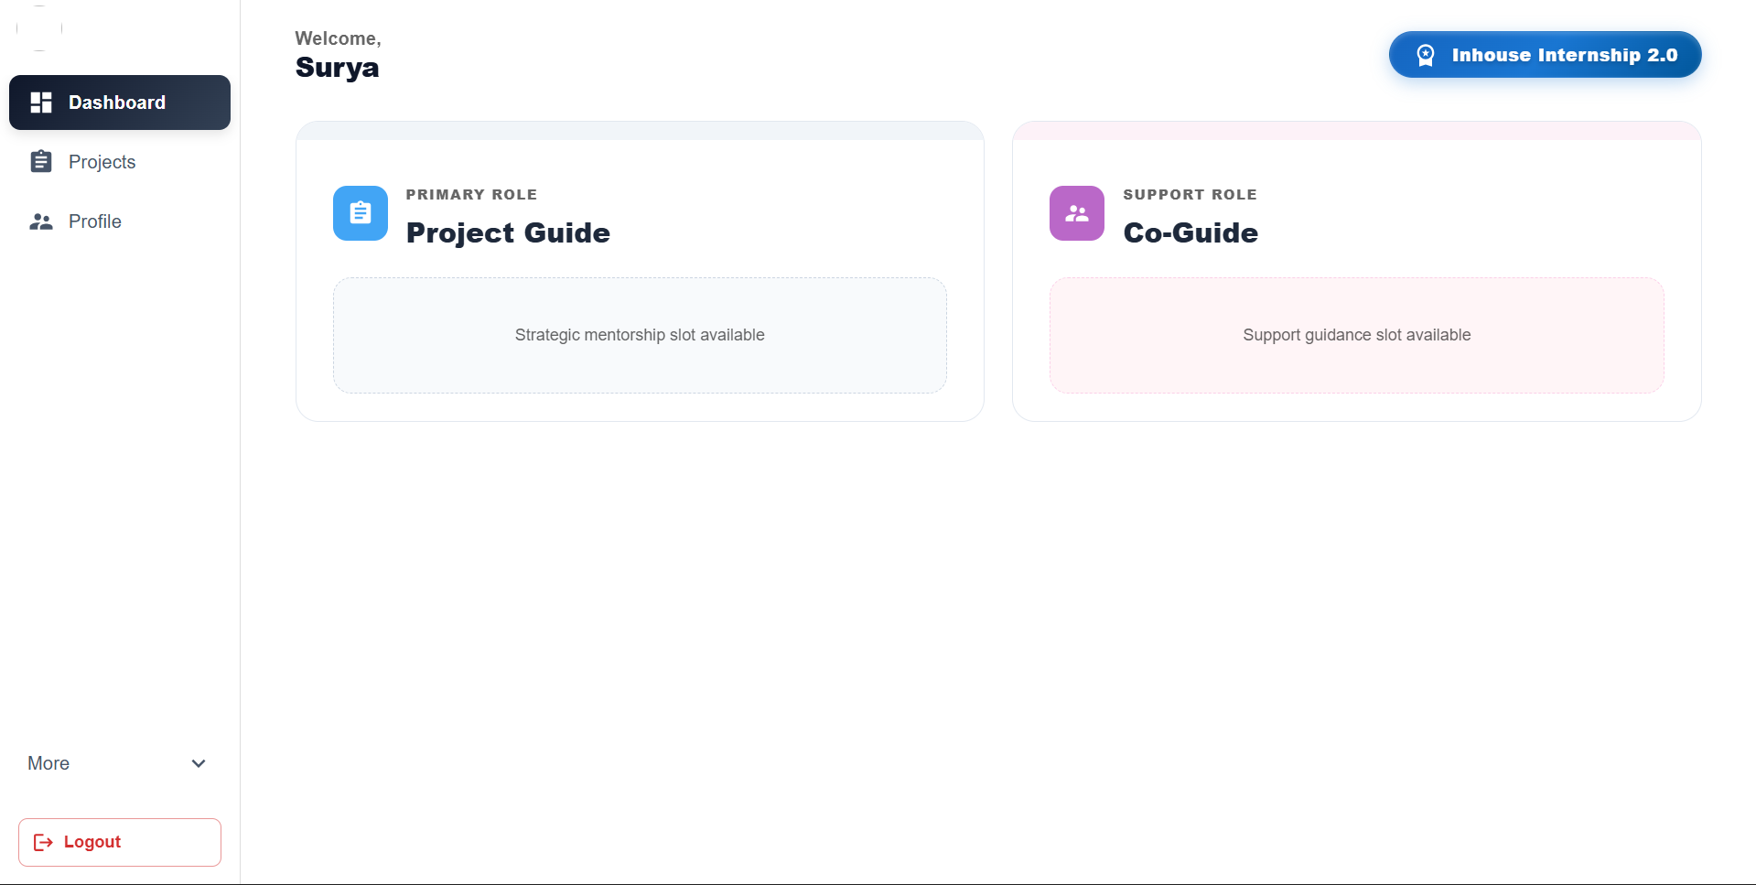
System Implementation
Faculty Dashboard:
This window allows the faculty to apply projects as Guide or Co-guide.

Slide 17
Future Enhancements
The In-House Internship Management System developed in this project provides core functionalities for managing the internship lifecycle. However, the system can be further enhanced by adding advanced features to improve its functionality and usability. Some possible future enhancements include:
Mobile Application: Developing a React Native mobile app for students and faculty to access dashboards and submit updates on the go.
AI-Based Project Matching: An intelligent recommendation engine to match students to projects based on skills, academic performance, and interests.
Certificate Generation: Automated internship completion certificates with QR-code-based verification upon successful program completion.
Video Review Integration: Embedding video conferencing (Jitsi / Google Meet) for remote internship reviews with auto-recorded session logs.
Payroll / Stipend Management: Adding stipend calculation, payslip generation, and tax management features for paid internship programs.

Slide 18
References
The following references were used during the development of the In-House Internship Management System:
MongoDB Documentation – Official Mongoose ODM & MongoDB Atlas Guides. https://www.mongodb.com/docs
React Documentation – React 18 Official Docs, Hooks & Router. https://react.dev
Express.js Guide – Node.js/Express REST API best practices. https://expressjs.com
Docker Documentation – Docker Compose, Dockerfile & Networking. https://docs.docker.com
JWT Reference – JSON Web Tokens introduction and Node.js usage. https://jwt.io
Nodemailer – Node.js email-sending library. https://nodemailer.com
MUI (Material UI) – React component library used in the frontend. https://mui.com
Vite Build Tool – Next-generation frontend tooling. https://vitejs.dev

Slide 19
CONCLUSION
The In-House Internship Management System (II2) was successfully developed as a full-stack web application for Aditya University.
It replaces fragmented, manual internship management with an efficient, role-aware digital solution.
The system provides key functionalities like student onboarding, project allocation, task management, reviews, attendance tracking, and analytics.
It ensures data accuracy, security, and easy accessibility through JWT authentication, OTP recovery, and role-based access control.
Technologies like React, Node.js, Express, MongoDB, Docker, Nginx, and Jenkins enabled reliable and scalable performance.
The system improves institutional transparency, reduces administrative workload, and supports data-driven internship program management.

Slide 20
THANK YOU

