Slide 1

ENTERPRISE PLATFORM
NovaCRM
Business Management Platform
One Platform.
Complete Business Control.
Confidential · Enterprise Sales Deck · 2026

Slide 2
About NovaCRM
A unified operating system for modern enterprises
NovaCRM brings HRMS, Projects, CRM, Finance readiness, Inventory, Helpdesk, and Automation into one secure workspace — replacing fragmented tools with a single source of truth for people, customers, and delivery.
HRMS
→
Projects
→
CRM
→
Finance
→
Inventory
→
Helpdesk
→
Automation

Slide 3






Business Problems
What fragmented operations cost every growing company
Disconnected Software
Manual HR
Excel Sheets
Poor Collaboration
No Visibility
Delayed Decisions

Slide 4






Why NovaCRM
Outcomes that matter to leadership teams
✓ Centralized Operations
✓ Higher Productivity
✓ Real-Time Analytics
One workspace for people, projects, and revenue
Less switching, faster execution, clearer ownership
Live KPIs for attendance, delivery, and sales
✓ Enterprise Security
✓ Modular Architecture
✓ Cloud Ready
RBAC, audit logs, encryption-ready controls
Adopt modules as your organization scales
Accessible anywhere with modern web architecture

Slide 5
Platform Overview
Everything connected. One enterprise graph.
HRMS
Projects
CRM
Payroll
Analytics
Automation
NovaCRM
Helpdesk
Reports
Recruitment
Attendance
Inventory
Finance
Shared data model · Unified permissions · Cross-module workflows

Slide 6
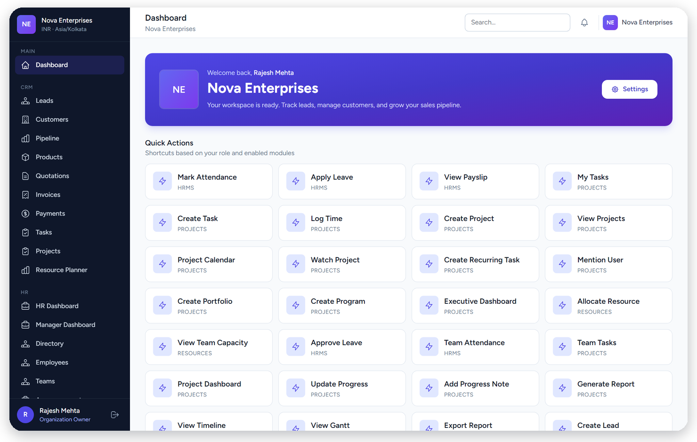
Executive Dashboard
Command center for the entire organization
Highlights
• KPI cards
• Revenue & pipeline
• Employees & attendance
• Projects & tasks
• Quick actions
• Notifications

Slide 7
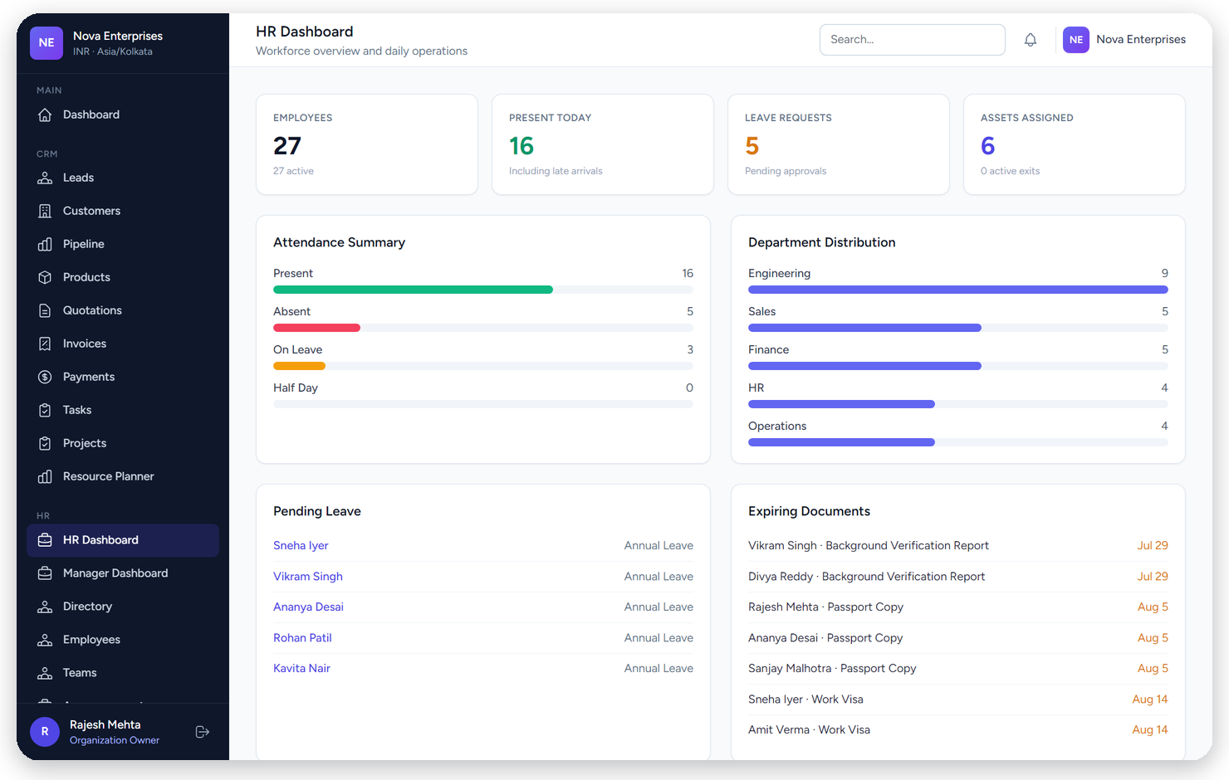
HRMS Dashboard
Workforce health at a glance
Highlights
• Employee count
• Attendance summary
• Leave requests
• Department distribution
• Upcoming birthdays
• Expiring documents

Slide 8
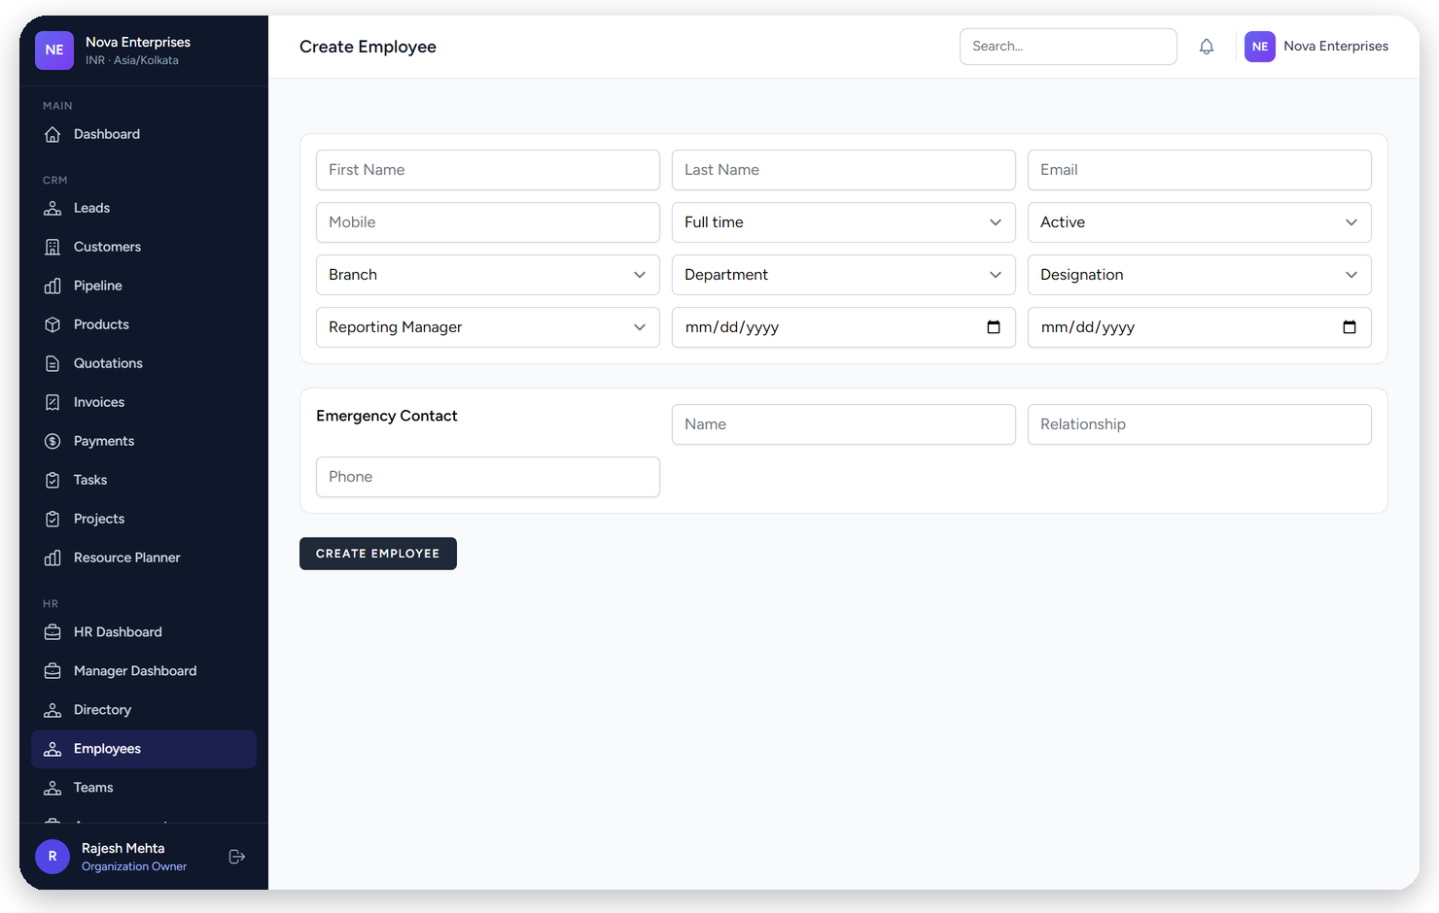
Employee Management
Complete employee lifecycle records
Highlights
• Employee profile
• Documents
• Assets assigned
• Reporting structure
• Departments
• Timeline history

Slide 9
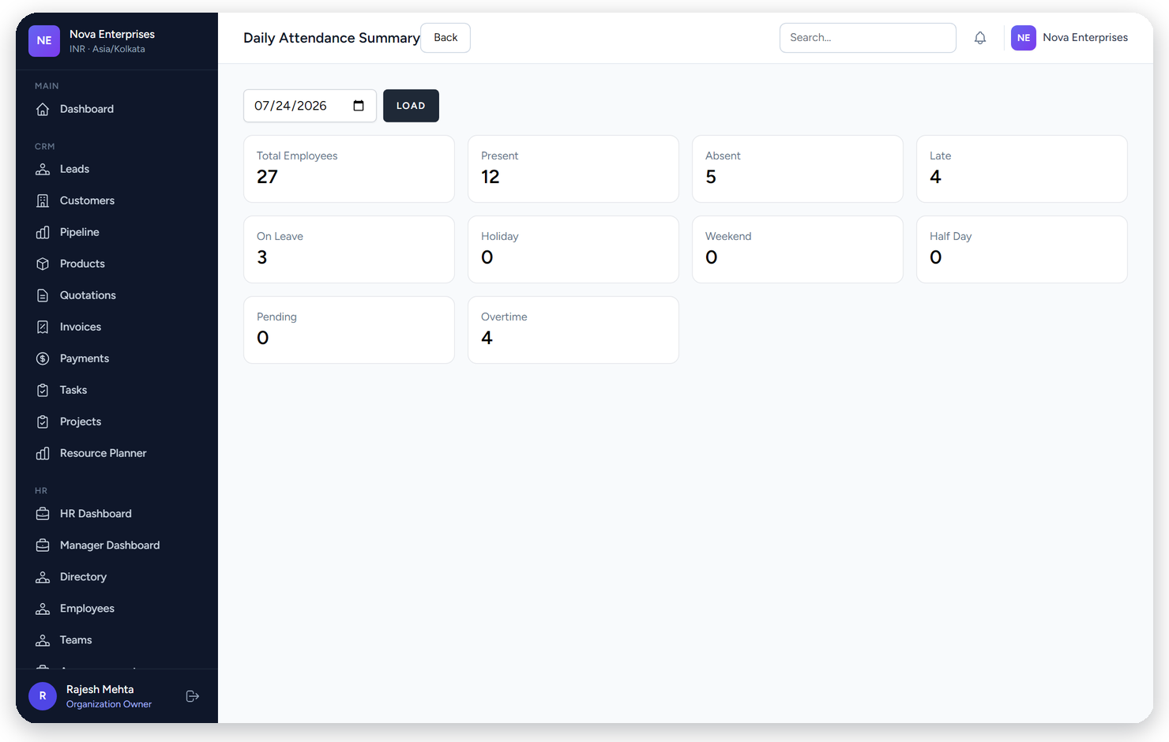
Attendance Management
Shifts, daily records, and monthly visibility
Highlights
• Daily attendance
• Monthly summary
• Shift management
• Corrections workflow
• Present / late / leave
• Manager visibility

Slide 10
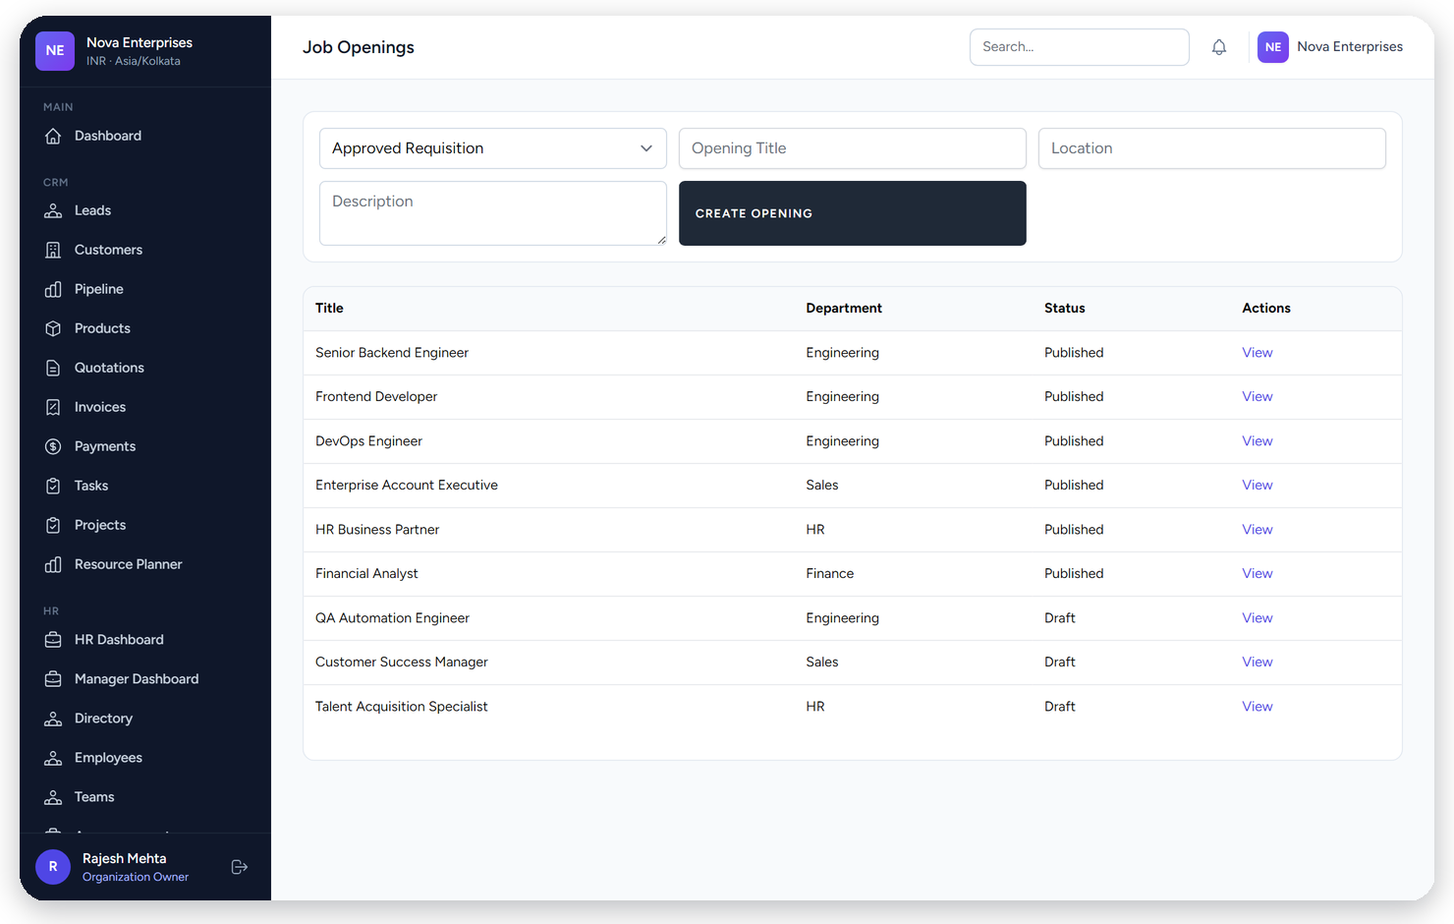
Recruitment
From requisition to offer in one pipeline
Highlights
• Job openings
• Candidates
• Interview rounds
• Offer management
• Hiring analytics
• Career portal ready

Slide 11
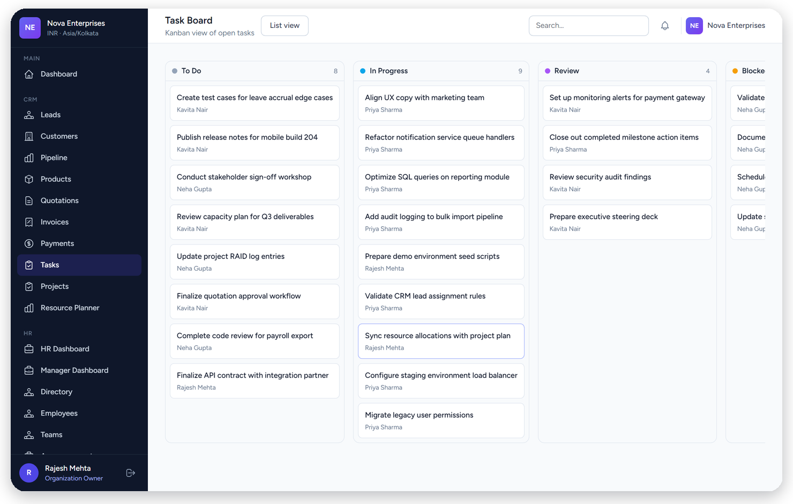
Task Management
Kanban, timeline, and collaborative execution
Highlights
• Kanban board
• Priorities & owners
• Task details
• Comments
• Timeline view
• Attachments & watchers

Slide 12
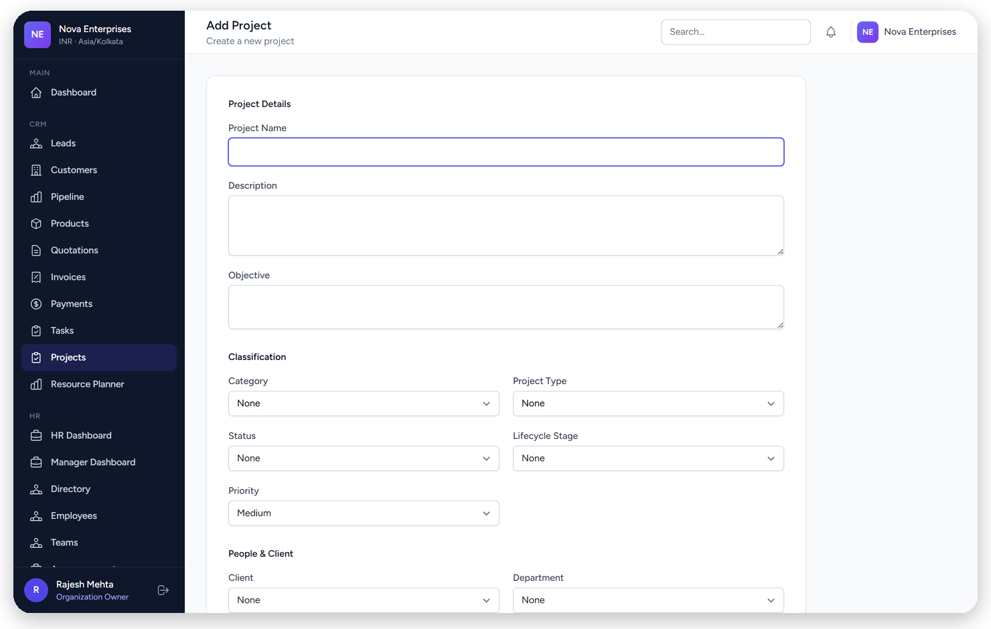
Project Management
Delivery control with milestones and health
Highlights
• Project portfolio
• Milestones
• Members
• Budget tracking
• Progress %
• Timeline & Gantt

Slide 13
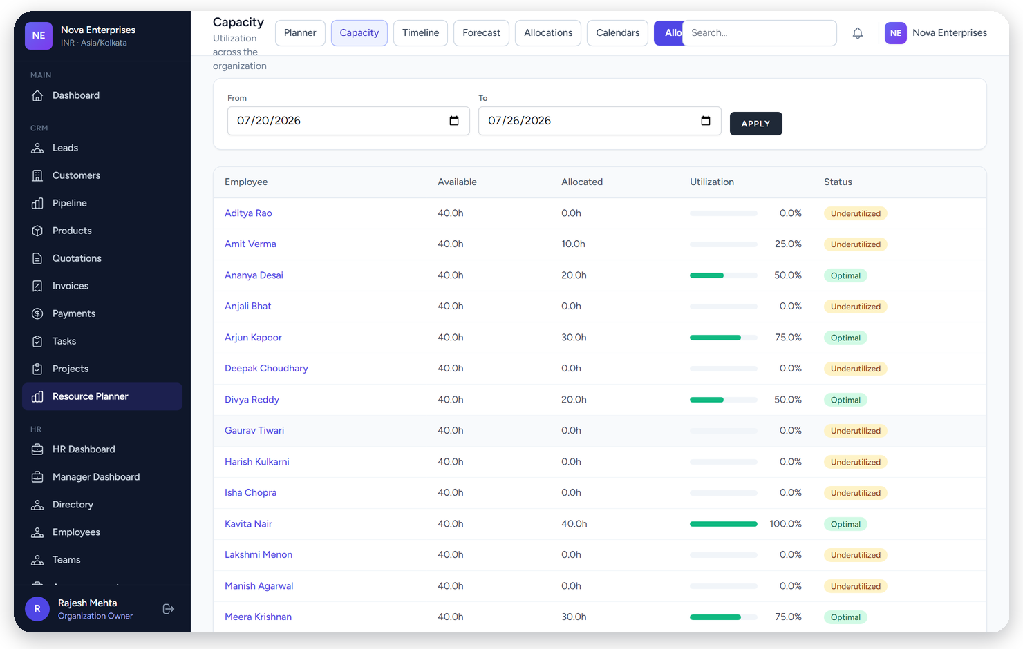
Resource Planning
Capacity, allocation, and utilization
Highlights
• Team capacity
• Utilization bars
• Allocations
• Workload views
• Planner timeline
• Forecasting

Slide 14
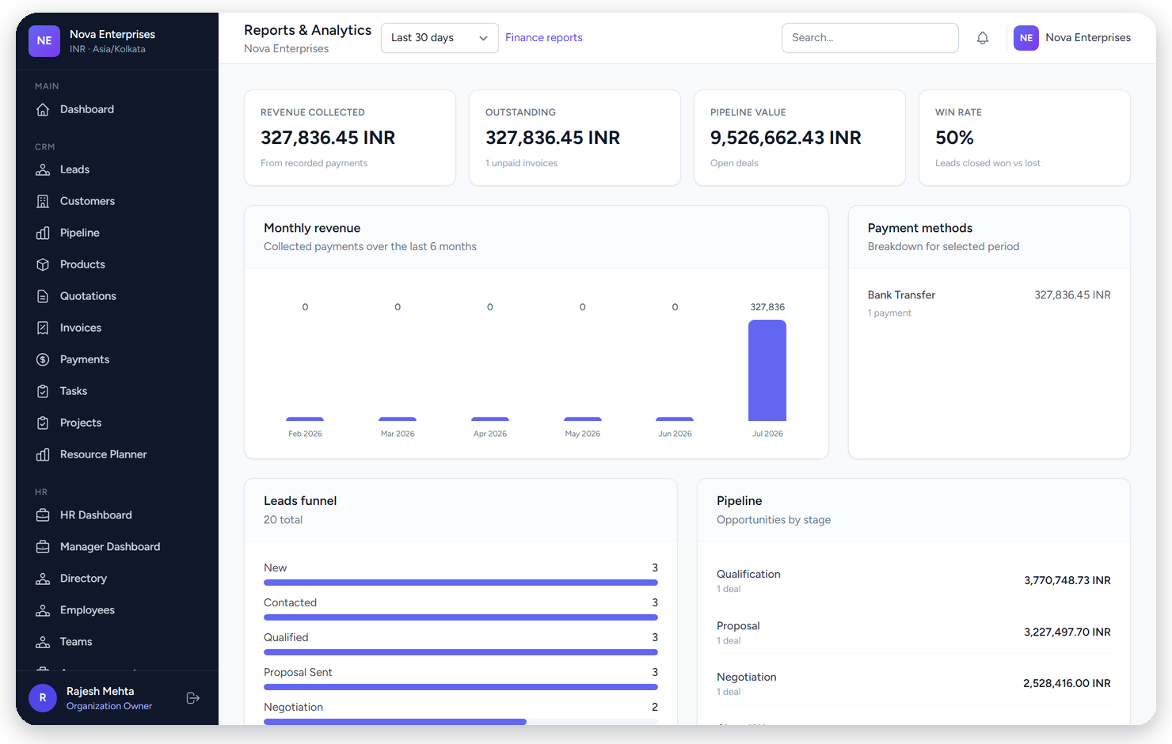
Analytics
Executive reporting across CRM and operations
Highlights
• Revenue trends
• Pipeline value
• Win rate
• Lead conversion
• Outstanding invoices
• Finance reports

Slide 15
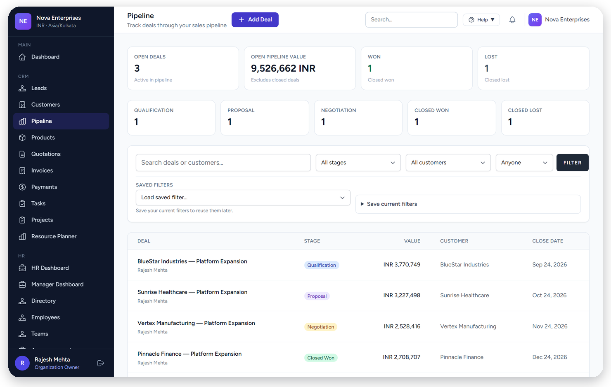
CRM Module
Optional sales suite — fully integrated
Highlights
• Lead list
• Sales pipeline
• Customers
• Quotations
• Invoices & payments
• Available as optional module

Slide 16
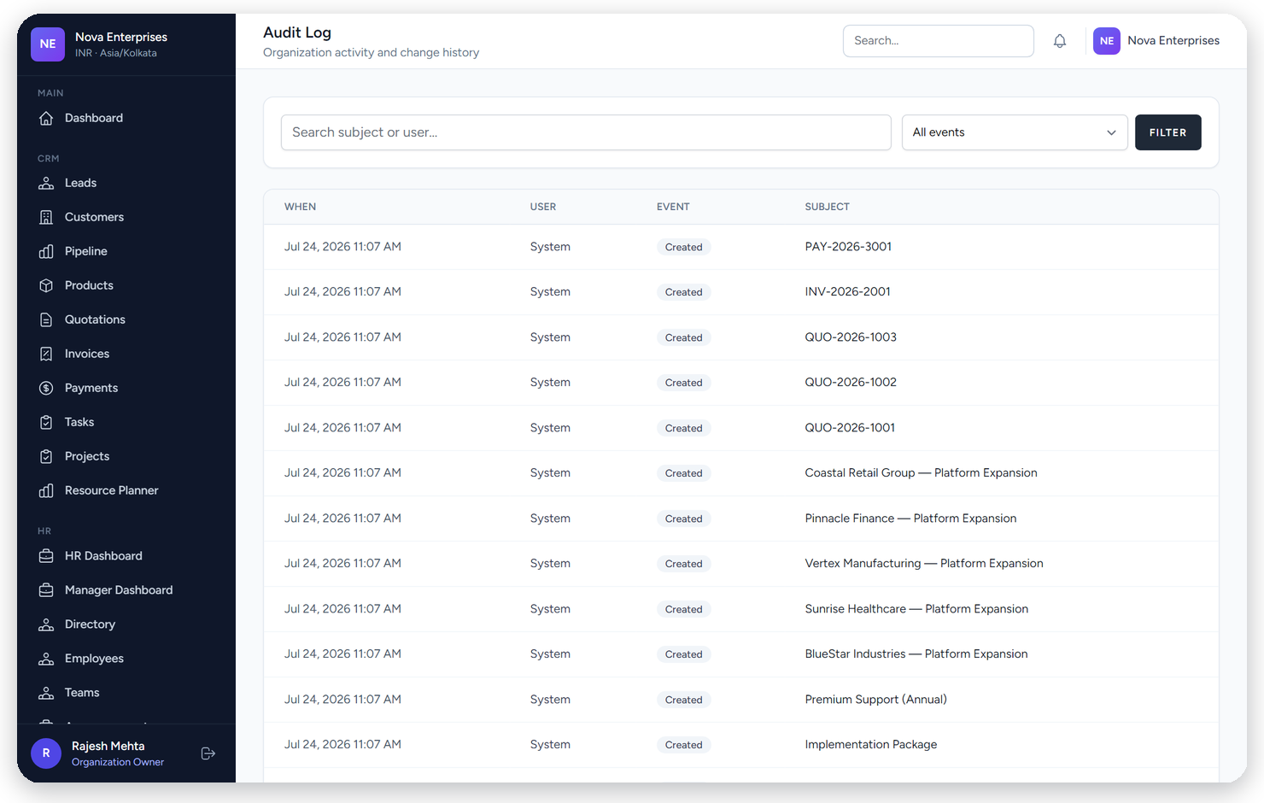
Enterprise Security
Designed for controlled access and auditability
Role Based Access
Audit Logs
Encryption Ready
Backups Ready
Granular Permissions
Activity Logs

Slide 17
Industry Solutions
Configurable for sector-specific operating models
Healthcare
Construction
Education
IT / Software
Retail
Manufacturing
Consulting
Real Estate

Slide 18
Implementation Process
A structured path from discovery to adoption
1
2
3
4
5
6
7
Requirements
Customization
Development
Testing
Deployment
Training
Support
Dedicated onboarding, data migration support, role-based training, and ongoing success management ensure NovaCRM becomes operational quickly without disrupting day-to-day business.

Slide 19
Future Roadmap
Continuously expanding the platform surface
Current
Upcoming
● HRMS
○ Inventory
● Projects & Tasks
○ Finance Deepening
● CRM Suite
○ Procurement
● Resource Planning
○ Helpdesk
● Recruitment
○ AI Assistants
● Analytics
○ Advanced Analytics

Slide 20
Why Choose NovaCRM
Traditional stacks vs a unified platform
Traditional Software
NovaCRM
✕ Multiple Systems
✓ Single Platform
✕ Multiple Logins
✓ Unified Login
✕ Higher Cost
✓ Integrated Modules
✕ Data Duplication
✓ Scalable Architecture
✕ Fragmented Reporting
✓ Modern UI

Slide 21
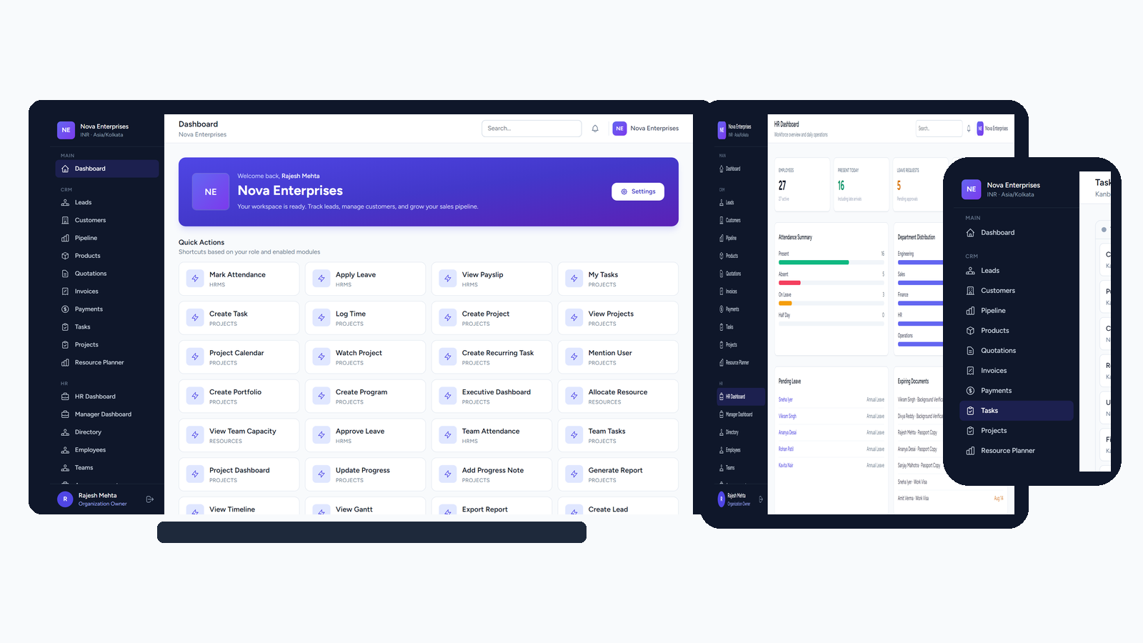
Mobile Experience
Responsive web experience across phone, tablet, and laptop

Slide 22



Client Benefits
Measurable impact for operators and executives
Lower Costs
Higher Productivity
Centralized Operations
Automation
Better Reporting
Scalability

Slide 23
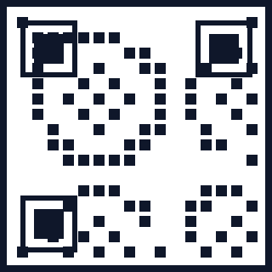
Thank You
NovaCRM — One Platform. Complete Business Control.
www.novacrm.com
hello@novacrm.com
+91 98765 43210
Schedule a live enterprise demo

