Slide 1


SMART INDIA HACKATHON 2026
Problem Statement ID –SIH26045
Problem Statement Title- IP-SAKTI Sahayak a multilingual, RAG-based (source-cited) AI assistant
Theme- MedTech / BioTech / HealthTech
PS Category- Software
Team ID- SIH26-A0H-T263
Team Name -Byte Busters

Slide 2

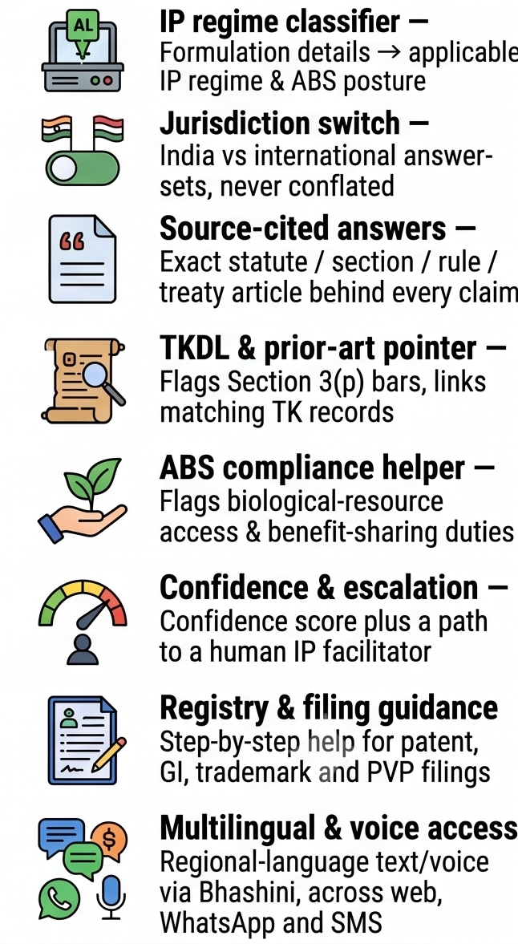
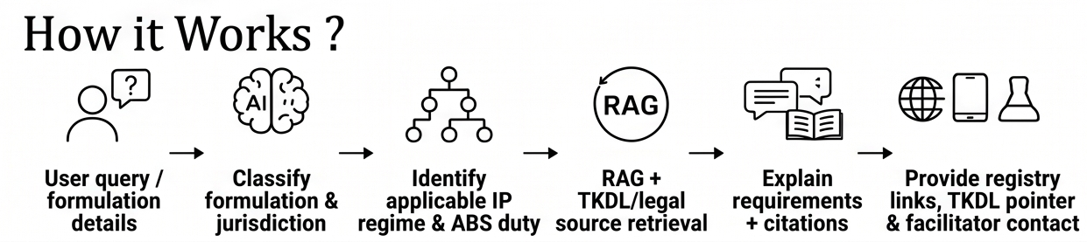
IDEA TITLE
Major Problems
Our Solution & Working
Key Features
Fragmented IP landscape — Ayurvedic IP spans patents, GI, trademarks, copyright, designs, trade secrets and plant-variety rights, with no single place to make sense of them.
A multilingual, source-grounded AI assistant that turns India's fragmented Ayurveda IP, ABS and drug-regulatory rules into one trusted, jurisdiction-aware conversation.
Unclear formulation classification — Practitioners and startups can't easily tell if a product is classical, proprietary, a new drug, each with a completely different IP and ABS posture.
What it does:
• Classifies the formulation (classical / proprietary / new drug / phytopharmaceutical / nutraceutical / cosmetic) before answering, since each carries a different IP and ABS posture
• Answers IP questions across patents, GI, trademarks, copyright, designs and plant-variety rights, keeping India and international answers visibly separate via an explicit jurisdiction toggle
TK misappropriation risk — India's traditional knowledge stays exposed to misappropriation abroad due to poor access to TKDL records, prior-art tools, and ABS compliance guidance.
• Points to TKDL and prior-art records and flags the Section 3(p) patentability bar for classical formulations
Jurisdictional confusion — National regimes (Patents Act, BDA, GI Act) and international ones (TRIPS, CBD/Nagoya, WIPO GRATK, PCT, Madrid, Budapest) are routinely conflated, leading to costly filing errors.
• Attaches the exact statute, rule or treaty-article citation, a confidence score, and an "information, not legal advice" disclaimer to every answer
• Escalates low-confidence or out-of-scope queries to a human IP facilitator
Fast-changing rules, no plain guidance — The 2024 patent and biodiversity rules and the new WIPO GRATK Treaty make authoritative, current guidance essential, but none exists for the AYUSH community. z

Slide 3
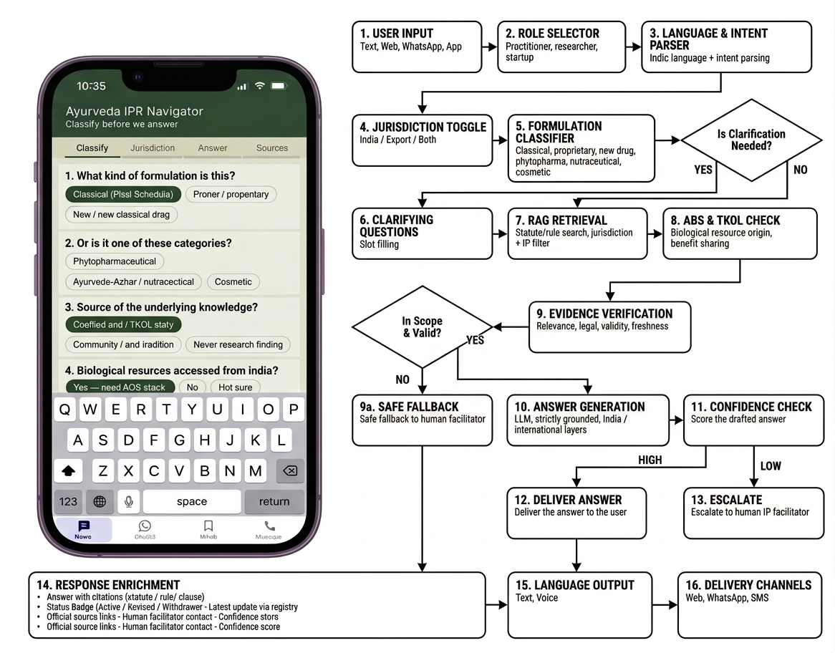
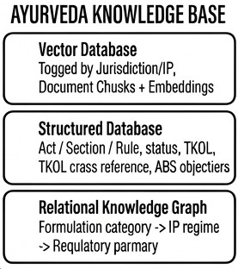
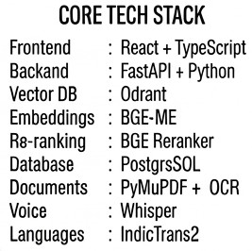
TECHNICAL APPROACH
Clarifying context:

Slide 4
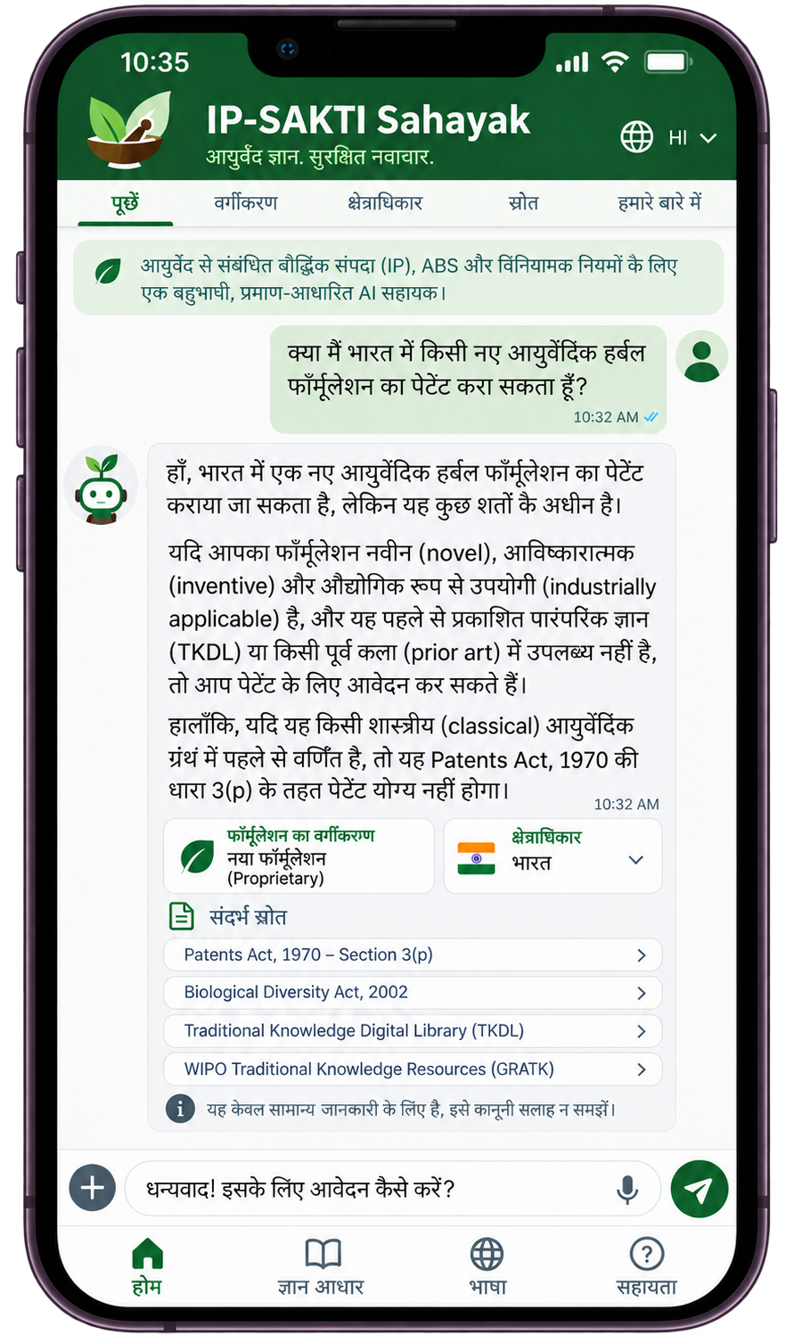
FEASIBILITY AND VIABILITY
FEASIBILITY & VIABILITY PILLARS
App Interface
</>
DB
$
↻
⚘
⚖
1. TECHNICAL
FEASIBILITY
2. LEGAL CORPUS
FEASIBILITY
3. ECONOMIC
VIABILITY
4. OPERATIONAL
VIABILITY
5. SOCIAL &
ACCESSIBILITY
6. LEGAL &
TRUST
RAG pipeline built on FastAPI + Qdrant, with IndicTrans2 and Whisper for multilingual text and voice.
Version-tracked corpus of statutes, rules, treaties, TKDL and registry records, tagged by jurisdiction.
Open-source stack keeps costs low; spend goes into corpus curation, not infrastructure.
Staged rollout: MVP retrieval, then knowledge graph, then paid connectors, then full voice.
Multilingual text/voice via Bhashini and IndicTrans2, over Web, WhatsApp and SMS — no new app.
Every answer includes a source citation, status badge, and confidence score.
POTENTIAL CHALLENGES AND RISKS
STRATEGIES FOR OVERCOMING
THESE CHALLENGES
EVOLVING LEGAL CORPUS
AI HALLUCINATION
VERSION-TRACKED CORPUS
GROUNDED, CITED RAG
Statutes, rules and treaties (2024 Rules, WIPO GRATK) change — stale answers mislead users.
A confident-looking wrong legal answer carries real risk for filers.
Live status badges and periodic review keep statute and treaty text current.
Answers restricted to retrieved legal text, with citation and confidence score.
MISCLASSIFICATION RISK
MULTILINGUAL ACCURACY
CLARIFICATION + CONFIDENCE SCORING
DOMAIN-TUNED TRANSLATION
Incomplete formulation details can misclassify jurisdiction or IP regime.
Regional Ayurveda/AYUSH terms rarely map 1:1 in translation.
Clarifying-question flow before classification, with scored, gated answers.
IndicTrans2 tuned on domain terms, with human-facilitator fallback.

Slide 5


IMPACT AND BENEFITS
AYUSH Startup & MSME Enablement
Traditional Knowl
edge Protection
Practitioner & Researcher Access
Cultivator & Biodiversity Compliance
Multilingual
Reach
Turns fragmented statutes and treaties into one jurisdiction-clear conversation smaller innovators can act on.
TKDL/prior-art pointers help stop India's TK from being patented abroad without attribution.
Makes overlapping IP, ABS, and drug-regulatory frameworks navigable without a specialist consultant.
An ABS-compliance helper clarifies benefit-sharing duties tied to biological resource use.
Bhashini-based delivery brings regulatory guidance to non-English-first AYUSH communities.
Faster IP Decisions
Reduced Misappropriation Risk
Grounded, Cited Answers
Confidence-Scored Guidance
Cross-Regime Coverage
Staged, Scalable Build
Privacy & Standards-Aligned
Formulation classification + jurisdiction toggle replace weeks of statute cross-referencing with a guided chat.
Prior-art and TKDL checks catch conflicts before filing, not after a foreign patent is granted.
Every answer traces to a specific statute, rule, treaty article, or record — never fabricated.
Low-confidence or out-of-scope queries route to a human IP facilitator instead of guessing.
One assistant spans patents, GI, trademarks, copyright, designs, trade secrets, and ABS together.
MVP retrieval first, then knowledge graph + agentic reasoning, then connectors and full voice.
DPDP-aligned privacy, audit, and security are built in from the MVP, not bolted on later.
Jurisdiction Toggle
Formulation-Classification Flow
TKDL & Prior-Art Pointer
India vs. international answer-sets stay visibly separate — never conflated in one response.
Classifies a product (classical / proprietary / new drug / phytopharmaceutical / nutraceutical / cosmetic) before answering, since each carries a different IP and ABS posture.
Flags the Section 3(p) patenting bar and points to the Traditional Knowledge Digital Library before a user files.

Slide 6
RESEARCH AND REFERENCES
1
Retrieval-Augmented Generation (RAG)
SDG 9
Summary: Pairs a language model with a retriever over an external index, grounding answers in retrieved passages rather than model memory alone.
Target 9.1 — Access to Quality Infrastructure
Turns India’s scattered IP, ABS and drug-regulatory rules into one searchable, plain-language system.
Link: arxiv.org/abs/2005.11401
2
Traditional Knowledge Digital Library (TKDL)
Summary: CSIR – Ministry of AYUSH prior-art database of India’s classical Ayurveda, Unani, Siddha and Yoga formulations, used to block wrongful patents abroad.
Link: tkdl.res.in
Target 9.3 — MSME & Startup Access
Gives AYUSH startups and small manufacturers affordable, guided IP and compliance direction without a specialist consultant.
3
WIPO GRATK Treaty (2024)
Summary: New WIPO treaty requiring patent applicants to disclose the country of origin of genetic resources and associated traditional knowledge used in an invention.
Link: wipo.int/en/web/treaties/ip/gratk
4
National Biodiversity Authority – ABS Regulations
Summary: Statutory body administering India’s Biological Diversity Act; issues access & benefit-sharing approvals for use of biological resources and associated knowledge.
Target 9.5 — Enhance Scientific Research
Applies modern retrieval-augmented AI and a version-tracked legal corpus to India’s legal-tech research base.
Link: nbaindia.nic.in
5
IndicTrans2 (AI4Bharat)
Summary: Open-source translation system covering all 22 scheduled Indian languages, built by AI4Bharat (IIT Madras) — powers our multilingual layer.
Link: github.com/AI4Bharat/IndicTrans2
Target 9.b — Domestic Technology Capacity
Built on IndicTrans2 (AI4Bharat) and an Indian legal corpus instead of foreign NLP tools or generic AI.
6
Patents Act, 1970 – Section 3(p) (IP India)
Summary: Official text of India’s Patents Act, including Section 3(p), which bars patents that are, in effect, traditional knowledge.
Link: ipindia.gov.in/pages/patents/chapter

