Slide 1




SMART INDIA HACKATHON 2026
  Problem Statement ID – SIH26107
  Problem Statement Title- AI-powered Intelligent Assistant for Indian Standards and BIS Services for Industries and Consumers
  Theme- Smart Automation
  PS Category- Software
  Team ID- SIH26-A0H-T263
  Team Name- Byte Busters

Slide 2






IDEA TITLE
Major Problems
Our Solution & Working
Key Features
Fragmented Information
BIS standards, certification, licensing and testing info are spread across multiple portals.
A multilingual, source-grounded AI assistant that turns scattered BIS standards and certification rules into one trusted conversation.
  AI Standard Discovery
Product description →applicable BIS standards
  Image/Spec-Sheet Analysis
Upload product/specifications → identify relevant standards
  Source cited Answers
Exact IS number + clause +official BIS source
  Trust & Freshness Layer
Status of the data +confidence score+ last-updated information
  Certification Guidance
Step-by-Step guidance for ISI, CRS, FMCS, hallmarking & licensing
  Actionable Results:
Official BIS links + relevant testing labs +BIS
contacts
  Multilingual & voice access
Regional-language text/voice interaction through web and WhatsApp/MSMS
What it does:
Difficult Standard Discovery
Users struggle to identify the correct Indian Standard from a product description or spec
• Matches a description, voice query, or spec sheet to the correct Indian Standard
• Guides step-by-step certification (ISI / CRS / FMCS)
• Verifies BIS marks and live license status
• Attaches source link, last-updated date, and a real time contact to every answer
Complex Certification Process
Certification, testing and scheme requirements often need manual interpretation or outside help
• Escalates low-confidence answers to the BIS helpline
Methodology used:
• RAG over BIS's Know Your Standard, CRS, and licensing portals — every answer is source-grounded
Accessibility Gap
Technical BIS information isn't easily accessible in regional languages, voice, or conversational form
• Confidence scoring — triggers human escalation below a threshold
• Multilingual NLP (IndicTrans 2) for Indian-language text and voice
• Vision/OCR for spec-sheet and image uploads
How it Works ?
Trust & Freshness Issues
Users need assurance that answers reference current, applicable standards — not outdated ones
User Query/
Product
Understand
& Reconfirm
Identify
Applicable standards
RAG + BIS Sources
Explain Requirements
Provide Links/ Contact

Slide 3
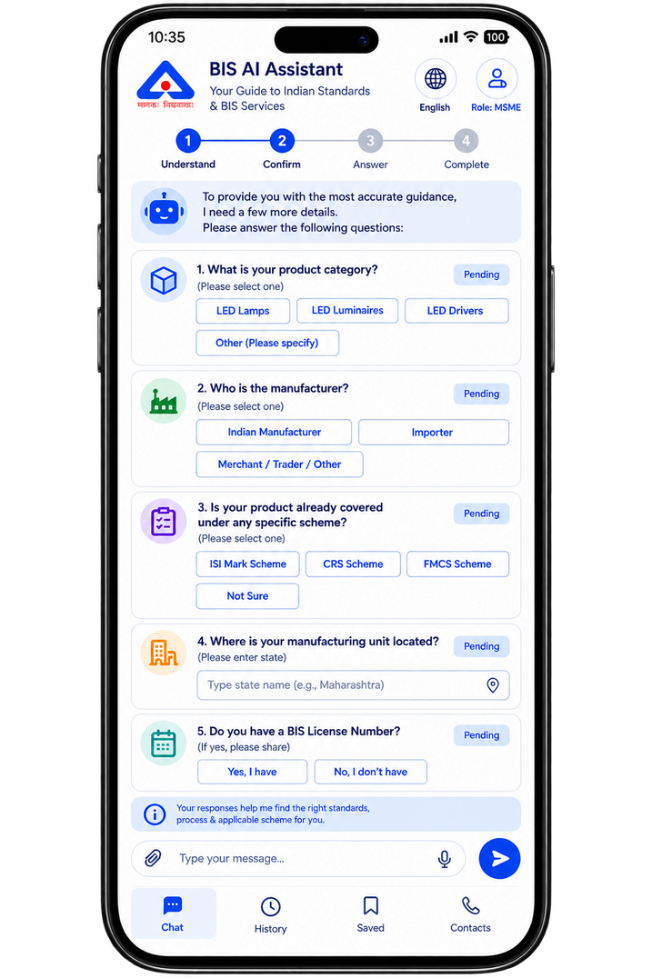
TECHNICAL APPROACH
Clarification Flow
1. USER INPUT
Text / Voice / Image
(Web / WhatsApp / SMS)
2. ROLE SELECTOR
(First-time only)
Consumer / MSME /
Student / Manufacturer
3. INPUT UNDERSTANDING
- Language Parser
- Audio Parser
- Image / OCR Parser
BIS KNOWLEDGE BASE
Conversational /
General Query?
Vector Database
(Document Chunks
+ Embeddings)
4. QUERY RECONFIRMATION
“Here’s what I understood can I confirm it ?”
6. RAG RETRIEVAL
  Standards / Clauses
  Status (Active / Revised / Withdrawn)
  License / BIS Mark Lookup
  Scheme / Certification Details
  Guidelines
Structured Database
confirm
  IS Number / Clause
  Status
  Revision
  Effective Date
  License Details
  Scheme
  Source Links
  SUFFICIENT CONTEXT
CLARIFYING QUESTIONS
(Slot Filling)
7. EVIDENCE VERIFICATION
(Relevance, Validity, Freshness)
SECURITY
JWT Auth + TLS Encryption
9a. FALLBACK ENGINE
(Retrieve relevant chunks
and generate a safe answer)
OUT OF SCOPE
Safe Fallback /
BIS Helpline
TECHNICAL STACK
Frontend : React + TypeScript
Backend : FastAPI + Python
RAG : Llamalndex
Vector DB : Qdrant
Embeddings : BGE-M3
Re-ranking : BGE Reranker
Database : PostgreSQL
Security: JWT Auth + TLS
Documents : PyMuPDF + OCR
Voice : Whisper
Languages : IndicTrans2
8. BIS SCOPE
& VALIDITY CHECK
9. ANSWER GENERATION (LLM)
10. CONFIDENCE CHECK
ESCALATE
to BIS Helpline
11.RESPONSE ENRICHMENT
  Web
  Whatsapp
  SMS
12. LANGUAGE OUTPUT
  Text
  Voice
13. DELIVERY CHANNELS
Answer with
Citations
(IS / Clause)
Status Badge
(Active / Revised /
Withdrawn)
Latest Update
(via License)
Official BIS
Links
BIS Score
Confidence score
Notes:
3

Slide 4






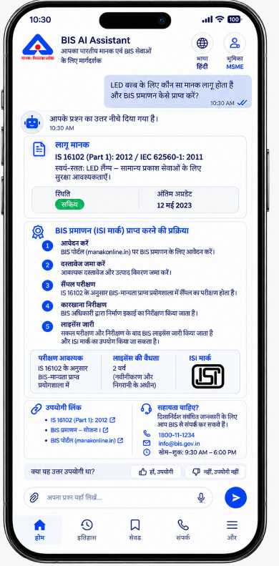
FEASIBILITY AND VIABILITY
FEASIBILITY & VIABILITY PILLARS
MULTILINGUAL SUPPORT
1. TECHNICAL FEASIBILITY
2. DATA & AI FEASIBILITY
3. ECONOMIC VIABILITY
4. OPERATIONAL VIABILITY
5. SOCIAL & ACCESSIBILITY
SECURITY, LEGAL & TRUST
RAG pipeline with OCR/vision parsing on FastAPI + Postgresql
Knowledge base from official BIS sources, with status and revision tracking.
Open-source AI infrastructure reduces licensing costs; one backend supports multiple channels.
One backend supports Web, WhatsApp and SMS; clarification is requested only when required.
Multilingual text/voice via IndicTrans 2, over WhatsApp/SMS — no new app.
RBAC, encryption, API protection and secrets management safeguard user data, AI services and system access.
POTENTIAL CHALLENGES AND RISKS
STRATEGIES FOR OVERCOMING THESE CHALLENGES
BIS DATA CHANGES
AI HALLUCINATION
FRESHNESS & STATUS CHECK
GROUNDED, CITED RAG
Standards get revised or withdrawn — stale answers mislead users.
A confident-looking wrong answer carries real legal risk.
Answers restricted to retrieved BIS text, with citation and confidence score.
Live status badge and last-updated date, via license lookups.
LOW-BANDWIDTH ACCESS
MULTILINGUAL ACCURACY
LIGHTWEIGHT RESPONSE MODE
TRANSLATION VALIDATION
Rural/MSME users on weak connections may struggle to load rich responses over WhatsApp/SMS.
Hindi/Hinglish queries confuse translation; terms rarely map 1:1.
Text-first replies by default, with voice/image only sent when the user explicitly requests them
IndicTrans 2 preserves technical terms; reconfirmation confirms intent first.
Notes:
4

Slide 5
IMPACT AND BENEFITS
UNIQUE FEATURES
IMPACTS
License-Linked Freshness
Consumer Trust & Safety
MSME Compliance Speed
Digital Inclusion
Less Counterfeit Circulation
Institutional Visibility
Every answer shows the regulation / last-updated date tied to its license number.
Licence and mark checks help users identify potentially invalid certification information.
Reduces time spent searching across standards, schemes and certification requirements.
Voice and regional-language interaction makes BIS information easier to access.
Real-time status badges flag withdrawn standards and fake marks fast.
Query analytics reveal common compliance gaps and information bottlenecks.
Reachable Official Links
Direct links to the official BIS portal — not just bot-generated text.
Confidence-Scored Answers
Users see how certain the AI is before they act on it.
BENEFITS
Faster Certification Cycles
Reduced Compliance Errors
Lighter Helpline Load
One Backend, Every Channel
Scalable Operations
Role-Aware Personalization
Role Selector (Consumer / MSME / Student / Manufacturer) tailors each answer's depth and next steps.
Step-by-step guidance + instant standard-matching gets products to market sooner.
Clear standard identification helps avoid incorrect certification paths.
Routine questions are handled automatically; complex cases are escalated.
Web, WhatsApp, and SMS all run off the same engine — no rebuilds.
Supports large query volumes without proportional growth in manual support.
Guideline-Query Contacts
BIS contact details auto-attached whenever a guideline question is asked.
Notes:
5

Slide 6


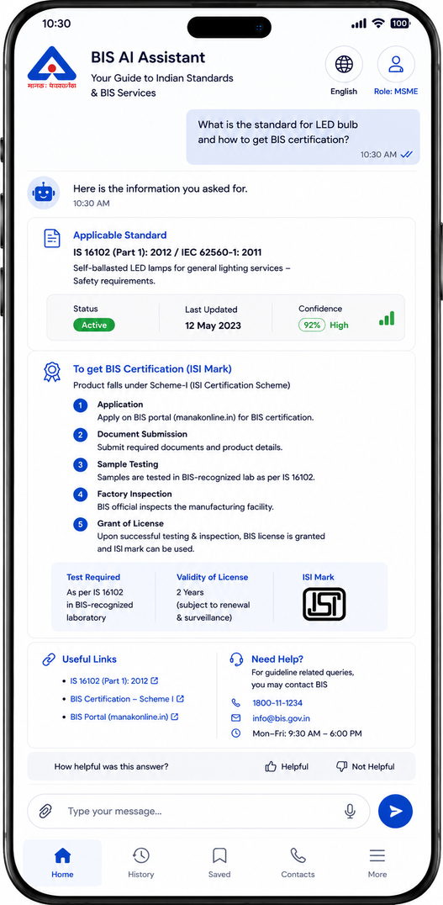





SDG 9
APP INTERFACE
Retrieval-Augmented Generation (RAG)
Summary: Pairs a language model with a retriever over an external index, grounding answers in retrieved passages rather than model memory alone.
Link: arxiv.org/abs/2005.11401
  Target 9.1 — Access to Quality Infrastructure: Makes BIS technical information searchable in plain language.
  Target 9.3 — MSME Market Access: Simplifies ISI/CRS certification guidance for small manufacturers.
  Target 9.b — Indigenous Tech Capacity: Uses IndicTrans 2 (AI4Bharat) for Indian-language AI support.
  Target 9.5 — Innovation in Public Infrastructure: Applies RAG-based AI to a government knowledge base.
Self-RAG (Self-Reflective Retrieval)
Summary: Trains a model to judge when retrieval is needed and critique its own drafts against retrieved text, cutting hallucinated claims.
Link: arxiv.org/abs/2310.11511
BIS ‘Know Your Standard’ Portal
Summary: BIS's official lookup for any IS number or product keyword, showing scope, status and related documents.
Link: bis.gov.in/know-your-standard
Why Our Product?
Quadrant Vector Database
Summary: Open source embedding database for LLM apps, storing text chunks with embeddings for similarity search.
Link: qdrant.tech/documentation
Product / Platform | Key Limitation (What it doesn't have) | What Our Solution Solves
BIS CARE (Official BIS App) | Separate modules for standards, licence verification, complaints, etc. Manual search and navigation required. | Single conversational interface for all BIS services. Provides step-by-step guidance with direct links and contacts.
Know Your Standard (BIS Portal) | Keyword / IS number based search only. No image/spec-sheet analysis. | Accepts text, voice and image/spec-sheet as input. Identifies the correct Indian Standard using AI.
General AI Assistants (e.g., ChatGPT, Gemini, Copilot) | Not connected to authoritative BIS sources. No real-time licence/status verification. | Answers are grounded only in official BIS sources (standards, CRS, licensing). Provides live licence/status verification.
BIS Compulsory Registration Scheme (CRS)
Summary: Official portal for BIS's CRS scheme on notified electronics/IT products, covering rules and license status.
Link: crsbis.in
IndicTrans2 (AI4Bharat)
Summary: Open-source translation system covering all 22 scheduled Indian languages, built by AI4Bharat (IIT Madras).
Link: github.com/AI4Bharat/IndicTrans2

