Slide 1


SMART INDIA HACKATHON 2026
Problem Statement ID – SIH26107
Problem Statement Title- AI-powered Intelligent Assistant for Indian Standards and BIS Services for Industries and Consumers
Theme- Smart Automation
PS Category- Software
Team ID- SIH26-A0H-T263
Team Name- Byte Busters

Slide 2

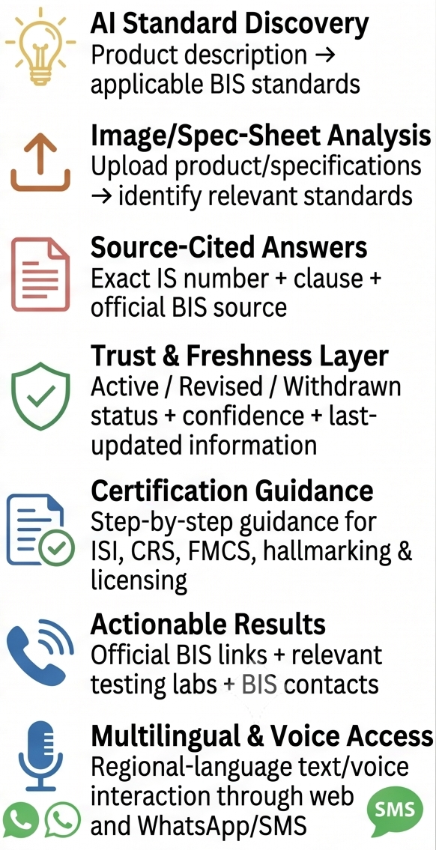
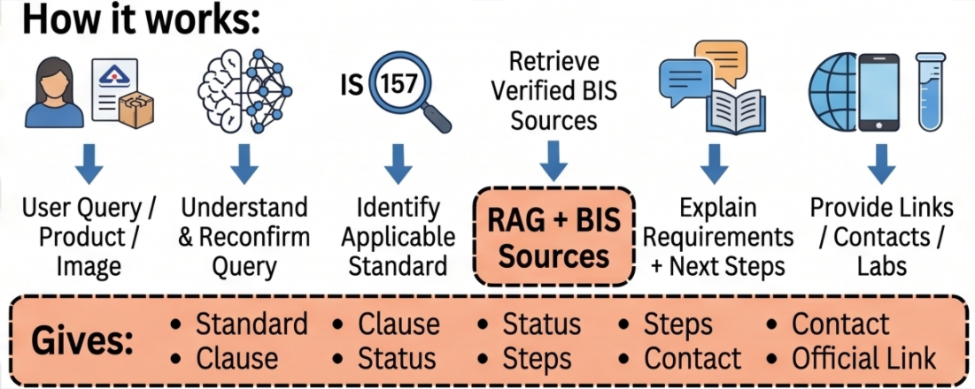
IDEA TITLE
Problem at Hand
Our Solution & Working
Key Features
Fragmented Information
BIS standards, certification, licensing and testing info are spread across multiple portals.
A multilingual, source-grounded AI assistant that turns scattered BIS standards and certification rules into one trusted conversation.
What it does:
Difficult Standard Discovery
Users struggle to identify the correct Indian Standard from a product description or spec
• Matches a description, voice query, or spec sheet to the correct Indian Standard
• Guides step-by-step certification (ISI / CRS / FMCS)
• Verifies BIS marks and live license status
• Attaches source link, last-updated date, and a real time contact to every answer
Complex Certification Process
Certification, testing and scheme requirements often need manual interpretation or outside help
• Escalates low-confidence answers to the BIS helpline
Methodology used:
• RAG over BIS's Know Your Standard, CRS, and licensing portals — every answer is source-grounded
Accessibility Gap
Technical BIS information isn't easily accessible in regional languages, voice, or conversational form
• Confidence scoring — triggers human escalation below a threshold
• Multilingual NLP (IndicTrans 2) for Indian-language text and voice
• Vision/OCR for spec-sheet and image uploads
Trust & Freshness Issues
Users need assurance that answers reference current, applicable standards — not outdated ones

Slide 3
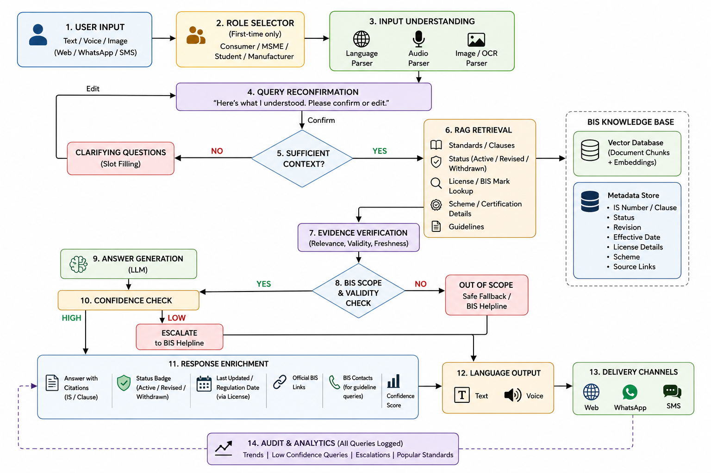
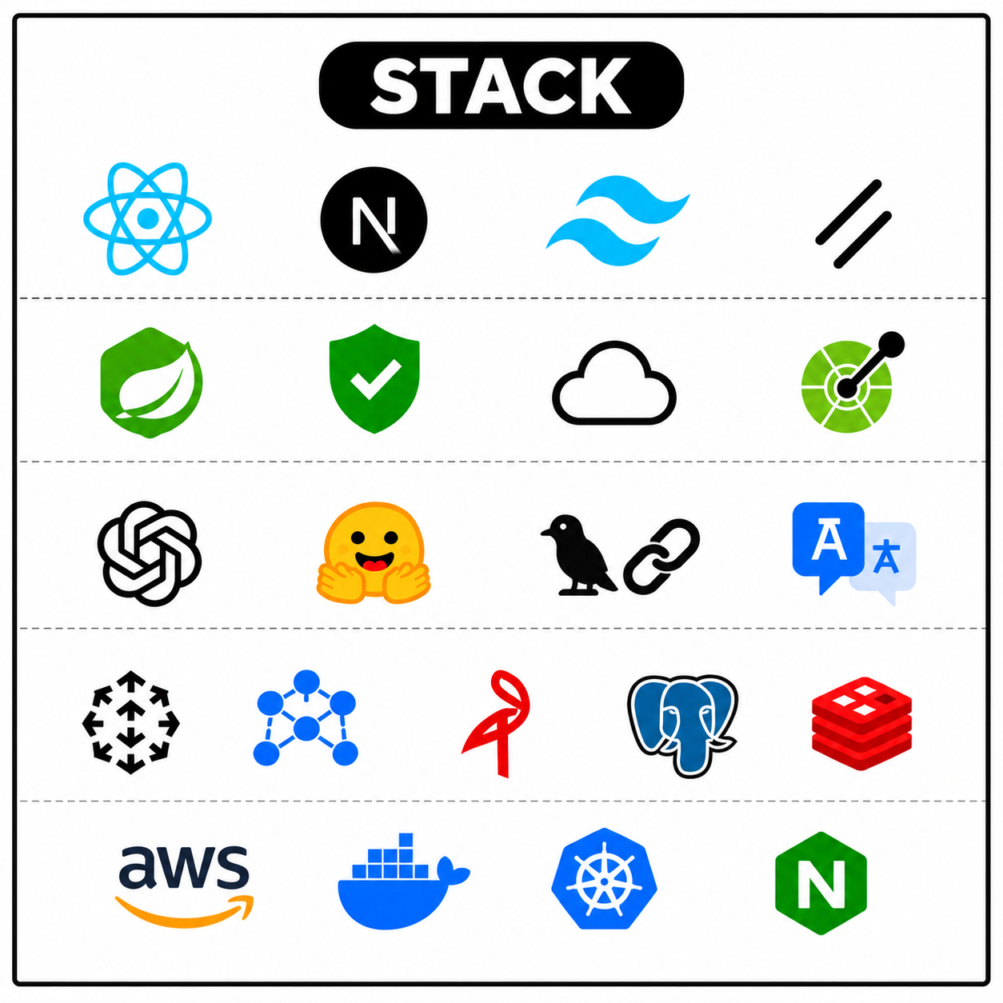
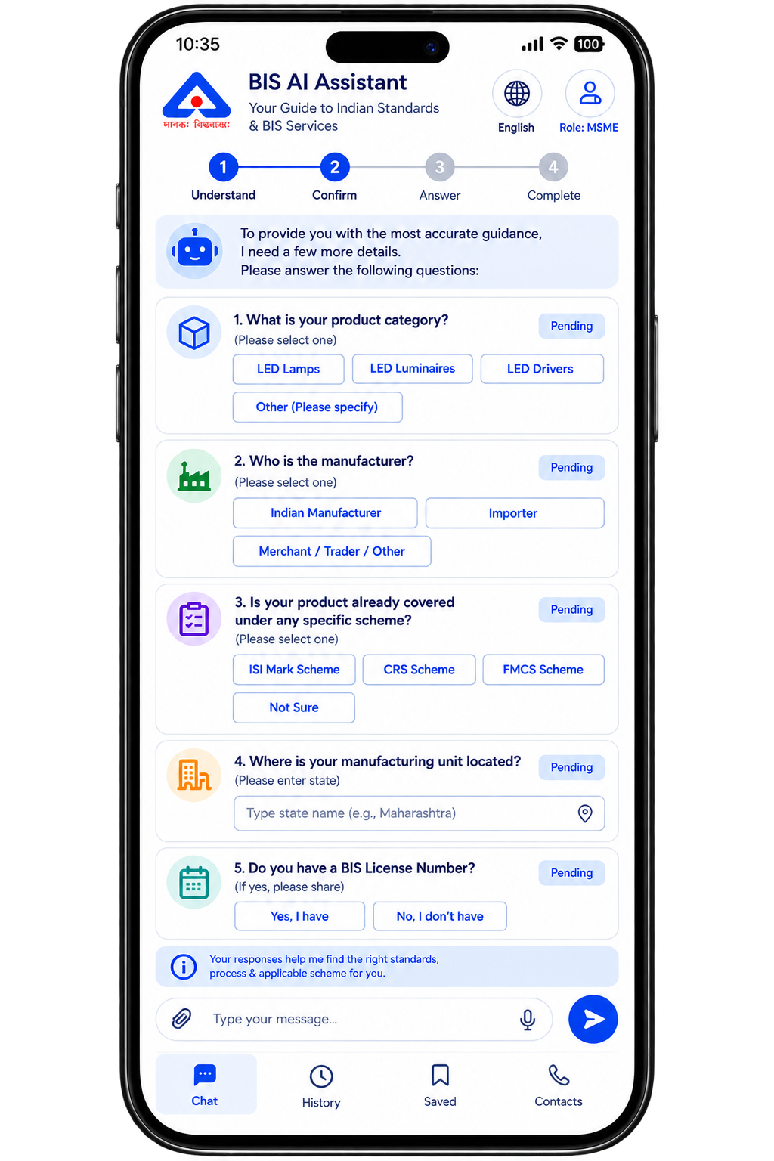
TECHNICAL APPROACH
Clarification Flow

Slide 4






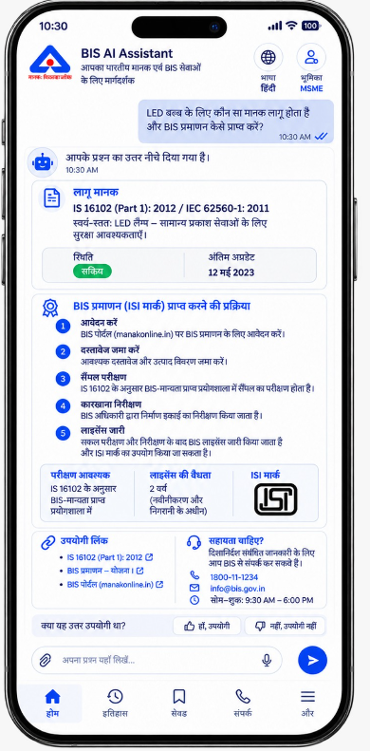










FEASIBILITY AND VIABILITY
FEASIBILITY & VIABILITY PILLARS
MULTILINGUAL SUPPORT
1. TECHNICAL FEASIBILITY
2. DATA & AI FEASIBILITY
3. ECONOMIC VIABILITY
4. OPERATIONAL VIABILITY
5. SOCIAL & ACCESSIBILITY
6. LEGAL & TRUST
Knowledge base built from official BIS sources, with metadata tracking status and revision.
Open-source vector DB and translation model minimize licensing costs, with built-in analytics for BIS
A unified backend supports web, WhatsApp, and SMS, asking clarifying questions only when necessary.
Multilingual text and voice via IndicTrans 2, reachable through WhatsApp/SMS with no new app.
Every answer carries an IS clause citation, status badge, and confidence score.
RAG pipeline with OCR/vision parsing on a Flask + MariaDB backend.
POTENTIAL CHALLENGES AND RISKS
STRATEGIES FOR OVERCOMING THESE CHALLENGES
BIS DATA CHANGES
AI HALLUCINATION
FRESHNESS & STATUS CHECK
GROUNDED, CITED RAG
Standards get revised or withdrawn over time — stale answers risk misleading MSMEs and consumers.
A wrong compliance answer can look confident but carries real legal and certification consequences.
LiveActive/Revised/Withdrawn badge and last-updated date, kept current via license lookups
Answers restricted to retrieved BIS text only, with mandatory clause citation and visible confidence score.
COPYRIGHTED STANDARD TEXT
MULTILINGUAL ACCURACY
SCOPED, LICENSED INGESTION
TRANSLATION VALIDATION
Hindi/regional and Hinglish queries confuse generic translation; BIS terms rarely map 1:1 across languages
Prototype scoped to compulsory-certification categories, sourced via BIS's free-download facility
IndicTrans 2 preserves Indian-language technical terms; reconfirmation script lets users confirm intent before searching.
Full IS standard text is copyrighted and can't be freely scraped or stored at scale.

Slide 5










IMPACT AND BENEFITS
UNIQUE FEATURES
IMPACTS
License-Linked Freshness
Consumer Trust & Safety
MSME Compliance Speed
Digital Inclusion
Less Counterfeit Circulation
Institutional Visibility
Every answer shows the regulation / last-updated date tied to its license number.
Reachable Official Links
Direct links to the official BIS portal — not just bot-generated text.
Instant ISI/CRS/FMCS mark checks help users spot fakes before they buy.
Cuts certification research from days of PDF-hunting to a short chat.
Voice + regional language reach users literacy and English never could.
Real-time status badges flag withdrawn standards and fake marks fast.
Query analytics show BIS exactly where citizens get stuck.
Confidence-Scored Answers
Users see how certain the AI is before they act on it.
BENEFITS
Faster Certification Cycles
Lighter Helpline Load
Data-Driven Policy
One Backend, Every Channel
Long-Term Cost Value
Role-Aware Personalization
Role Selector (Consumer / MSME / Student / Manufacturer) tailors each answer's depth and next steps.
Guideline-Query Contacts
Step-by-step guidance + instant standard-matching gets products to market sooner.
Routine queries handled by AI; agents freed for complex escalations.
Logged query gaps show BIS where standards or outreach need attention.
Web, WhatsApp, and SMS all run off the same engine — no rebuilds.
Higher build cost upfront, but scales to lakhs of queries without matching staff growth.
BIS contact details auto-attached whenever a guideline question is asked.

Slide 6


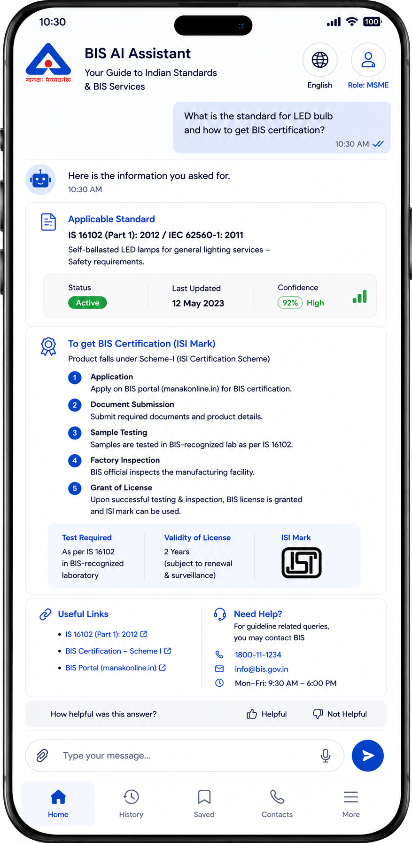





SDG 9
APP INTERFACE
Retrieval-Augmented Generation (RAG)
Summary: Pairs a language model with a retriever over an external index, grounding answers in retrieved passages rather than model memory alone.
Link: arxiv.org/abs/2005.11401
Target 9.1 — Access to Quality Infrastructure
Makes BIS's technical corpus searchable in plain language
Self-RAG (Self-Reflective Retrieval)
Summary: Trains a model to judge when retrieval is needed and critique its own drafts against retrieved text, cutting hallucinated claims.
Link: arxiv.org/abs/2310.11511
Target 9.3 — MSME Market Access
Simplifies ISI / CRS certification guidance for small manufacturers
BIS ‘Know Your Standard’ Portal
Summary: BIS's official lookup for any IS number or product keyword, showing scope, status and related documents.
Link: bis.gov.in/know-your-standard
IndicTrans2 (AI4Bharat)
Summary: Open-source translation system covering all 22 scheduled Indian languages, built by AI4Bharat (IIT Madras).
Link: github.com/AI4Bharat/IndicTrans2
Target 9.b — Indigenous Tech Capacity
Built on IndicTrans2 (AI4Bharat) instead of foreign NLP tools
Chroma Vector Database
Summary: Open-source embedding database for LLM apps, storing text chunks with embeddings for similarity search.
Link: docs.trychroma.com
Target 9.5 — Innovation in Public Infrastructure
Applies modern retrieval-augmented AI to a government knowledge base
BIS Compulsory Registration Scheme (CRS)
Summary: Official portal for BIS's CRS scheme on notified electronics/IT products, covering rules and license status.
Link: crsbis.in

