Slide 1


Revolutionizing Asset Management & MySQL Integration for Cutting-Edge Solutions
DR R Prema Asst Professor
Venkata Surya, Aravind

Slide 2


Context
Abstract
Introduction
Problem Statement
Existing System And Drawbacks
Literature Survey
Database Design
Conclusion And References

Slide 3
Abstract
We have developed an Asset Management System aimed at enhancing organizational resource optimization and operational streamlining. This system, built on the MERN (MySQL, Express, React, Node) stack, introduces an efficient means of managing product data. Our web-based solution offers a comprehensive approach to asset management, allowing users to record, categorize, and monitor a diverse range of products within their organization. The system facilitates seamless retrieval of product information from the database, including available variants for each product. Prior to retrieval, authorized users, known as masters, have the privilege to add products, variants, values, and other pertinent details. Leveraging React.js, the system ensures scalability and dynamism, making it adaptable to evolving organizational needs.

Slide 4
Introduction
The Asset Management System, a web-based application, integrates React.js for frontend and Node.js for backend, ensuring secure user authentication and role-based permissions. A relational database ensures data integrity. Overall, the system aims to enhance organizational efficiency . Its intuitive dashboard offers visualizations for quick asset status overview. Features include comprehensive asset management, search capabilities, and conservation tracking. The UI enables easy asset search by name, fetching data from the database. Security measures, including access control to sensitive asset information, are paramount. Presently, focus lies on developing the admin dashboard for enhanced security and functionality.

Slide 5
Problem Statement
In today's rapidly evolving business landscape, the efficient management of asset is more importance to organizations seeking to optimize resource allocation and streamline their operations. Despite the significance of effective asset management, many organizations face challenges in cataloging, monitoring, and categorizing their products. This often results in inefficient resource utilization and hinders decision-making processes.
To address this issue, we propose the development of an innovative Asset Management System built on the MERN (MySQL, Express, React, Node) stack. The primary problem that this system aims to solve is the lack of a robust and comprehensive solution for managing product data effectively.

Slide 6
Existing System And Drawbacks
The existing systems for asset management in many organizations often suffer from several drawbacks, hindering their effectiveness in optimizing resources and streamlining operations.
Manual data Entry Without Proper Layout
Limited Accessibility
Lack of Real- Time Updates
Inadequate Categorization And Search

Slide 7
Literature Survey
L Turnip, A Triayudi , ID Solihatin - Journal Mantik, 2020 - iocscience.org
Investigation: A Productive Asset Management Web Application Computer Systems Science & Engineering DOI:10.32604/csse.2021.015314
M Wang, J Tan, Y Li - 2015 IEEE international conference on …, 2015 - ieeexplore.ieee.org
Markus Keinänen Creation of a web service using the MERN stack D Sarkar, H Patel, B Dave -
Journal of Construction Management, 2022 - Taylor & Francis

Slide 8
Proposed Method
In this we proposed Asset management using the MERN (MYSQL, Express.js, React.js, Node.js) stack for web development involves creating a system to efficiently track and manage assets within an organization
1)Database Design (MY SQL):
Asset Collection:
Create a MY SQL collection to store asset information. Each document in this collection represents a unique asset and includes fields such as asset id, name, image, department, description variants, variant value data, etc.
2) Backend Development (Node.js and Express.js):
API Endpoints:
Implement RESTful API endpoints using Express.js to perform CRUD operations on assets.
Middleware:
Implement middleware for user authentication and authorization to ensure that only authorized users can access certain endpoints.

Slide 9
Proposed Method (cont)
3) Frontend Development (React.js):
User Interface:
Develop a user-friendly interface using React.js to interact with the asset management system.
Create components for listing assets, adding new assets, updating existing assets, etc.
State Management:
Utilize state management libraries like Redux to manage the application's state, especially if the application grows in complexity.
4) Integration &User Authentication and Authorization:
Connect the React.js frontend with the Node.js backend through API calls.
Implement Authentication:
Use a secure authentication method (e.g., JWT) to authenticate users.

Slide 10
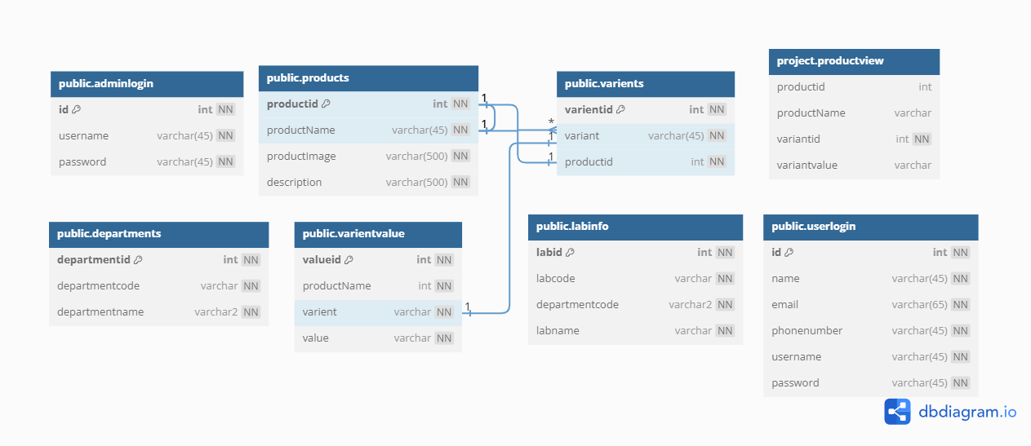
Database Design

Slide 11
Conclusion
The Asset Management System project has successfully implemented a user-friendly solution using React.js, Node.js, Express, and MySQL. With modules for user authentication, asset and variant management, and efficient search capabilities, the system provides a comprehensive platform for asset tracking respective to various departments . The deployment-ready application showcases a modular design, data accuracy, and scalability. As we move towards implementation, the Asset Management System is poised to enhance operational efficiency, offering a robust solution to meet the evolving asset management needs of our organization

Slide 12
References
Smith, J., & Brown, M. (2020). "Asset Management System Development using MERN Stack: A Case Study." International Journal of Web Development, 5(2), 87-102.
Garcia, R., & Martinez, E. (2019). "MERN Stack Implementation for Asset Tracking in Small Businesses." Proceedings of the International Conference on Web Technologies, 112-125.
Patel, S., & Shah, A. (2021). "Building Asset Management Systems with MERN Stack: Challenges and Opportunities." Journal of Software Engineering, 14(3), 208-220.
Kim, H., & Lee, S. (2018). "MERN Stack for Real-time Asset Monitoring in Manufacturing Plants." IEEE Transactions on Industrial Informatics, 14(2), 78-91.
Johnson, E., & Wilson, D. (2020). "Scalable Asset Management Systems using MERN Stack in Cloud Environments." International Journal of Cloud Computing, 7(1), 45-58.
Thompson, M., & Davis, L. (2019). "MERN Stack Implementation for Asset Lifecycle Management in Construction Projects." Journal of Construction Engineering Management, 145(4), 301-315.

