Slide 1
House Prices Prediction
Presented by
Arpit Chaukiyal
Komal Sasane
Surya Thummanapelly
Vidheesha kudipudi

Slide 2

Problem Statement
Ask a home buyer to describe their dream house, and they probably won't begin with the height of the basement ceiling or the proximity to an east-west railroad. But this dataset proves that much more influences price negotiations than the number of bedrooms or a white-picket fence.
With 79 explanatory variables describing (almost) every aspect of 1460 residential homes in Ames, Iowa, the goal is to predict the final price of other 1459 homes.

Slide 3
Data Description
Training Data: Contains 1460 unique labelled observations and 81 features including y variable “SalePrice”
Test Data: Contains 1459 unique and new unlabeled observations with 80 features
Each observation represents a house
The dataset has 53 numerical (Ratio and Ordinal) features, 26 categorical features and 1 identity feature.

Slide 4
Data Description
Numeric Features:
LotFrontage: Linear feet of street connected to property
LotArea: Lot size in square feet
GrLivArea: Above grade (ground) living area square feet.. Etc.
Ordinal Features:
OverallQual: Overall material and finish quality
GarageCond: Garage condition
PoolQC: Pool quality… Etc.
Categorical Features:
MSSubClass: The building class
Neighborhood: Physical locations within Ames city limits
Heating: Type of heating… Etc.

Slide 5
Exploratory Data Analysis

Slide 6
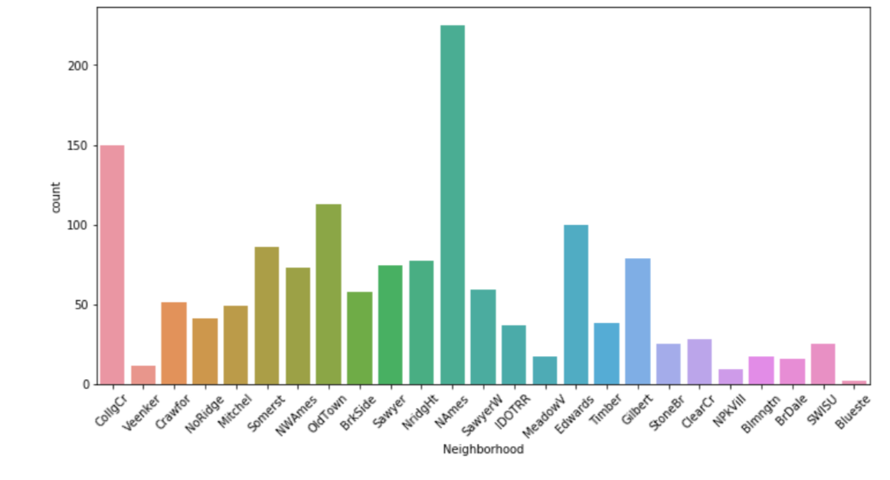
Histogram of Neighborhood

Slide 7
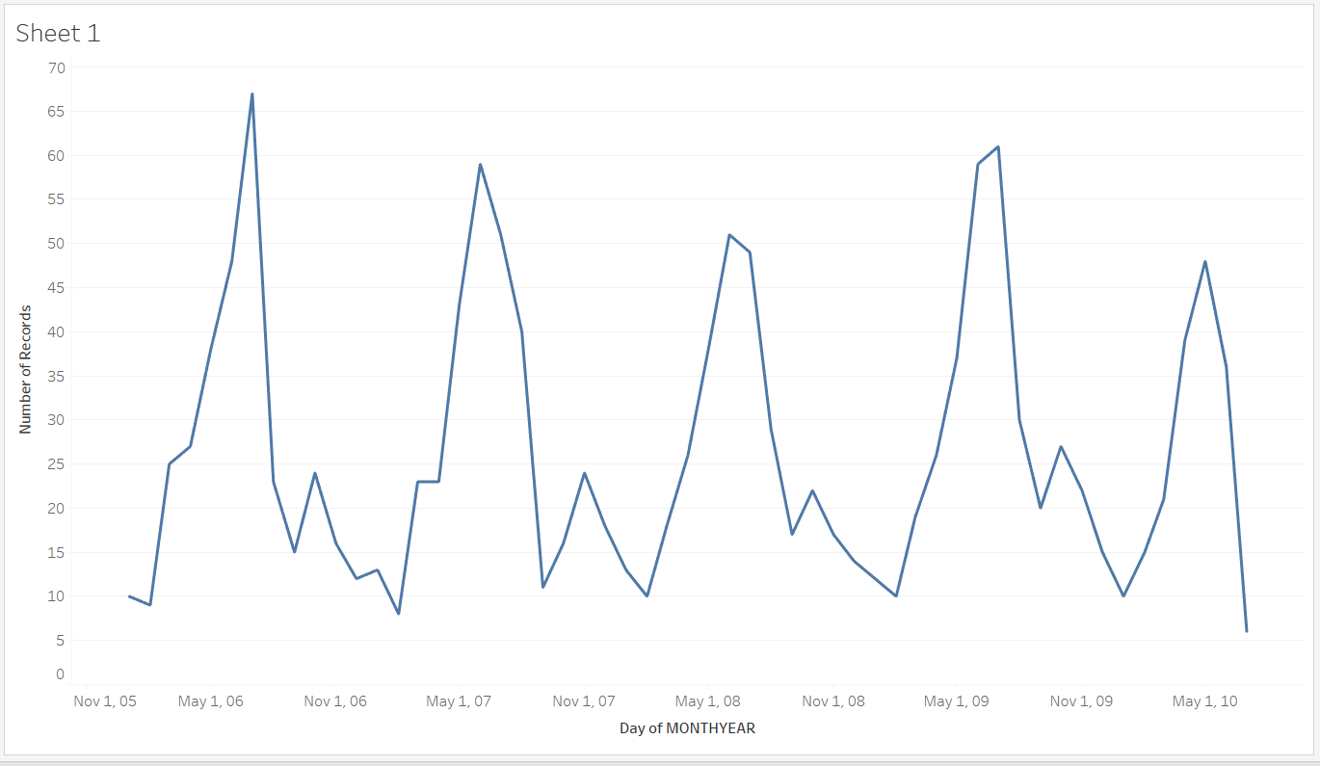
Seasonality of Houses sold

Slide 8
Seasonality of Houses sold
Graph describes the no. of houses sold in the months of every year.
The houses were predominantly sold during the summer i.e. in the months of May , June, July.

Slide 9
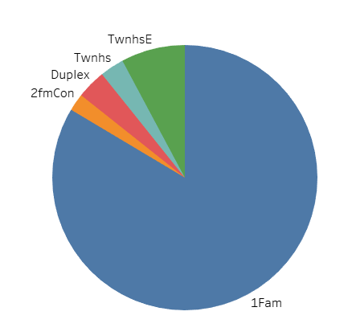
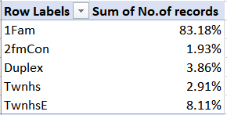
Type of house sold
1Fm –Single family detached
2FmCon – Two family conversion
Duplex
Twnhs – Townhouse End Unit
TwnhsE – Townhouse Inside Unit

Slide 10
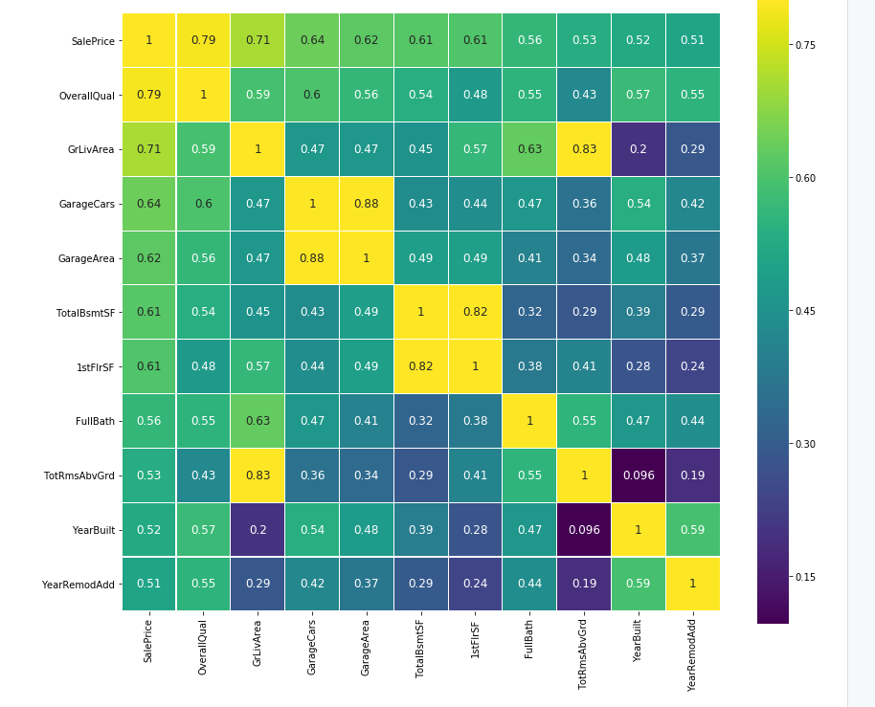
Correlation Matrix – Most Important Features

Slide 11
Data Transformation & Feature Engineering

Slide 12
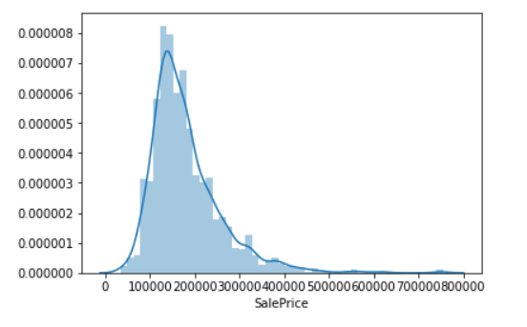
Checking skewness of SalesPrice variable
Skewness – 1.8828
So, it is highly positively skewed
We applied log(x+1) transformation to make it close to Normal Distribution

Slide 13
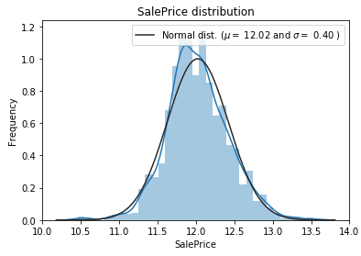
Checking skewness of SalesPrice variable
After log-transformation, the y variable is close to Normal Distribution
We also applied log (natural) transformation on highly positively skewed features to make them normal
There are no features with high negative skewness

Slide 14
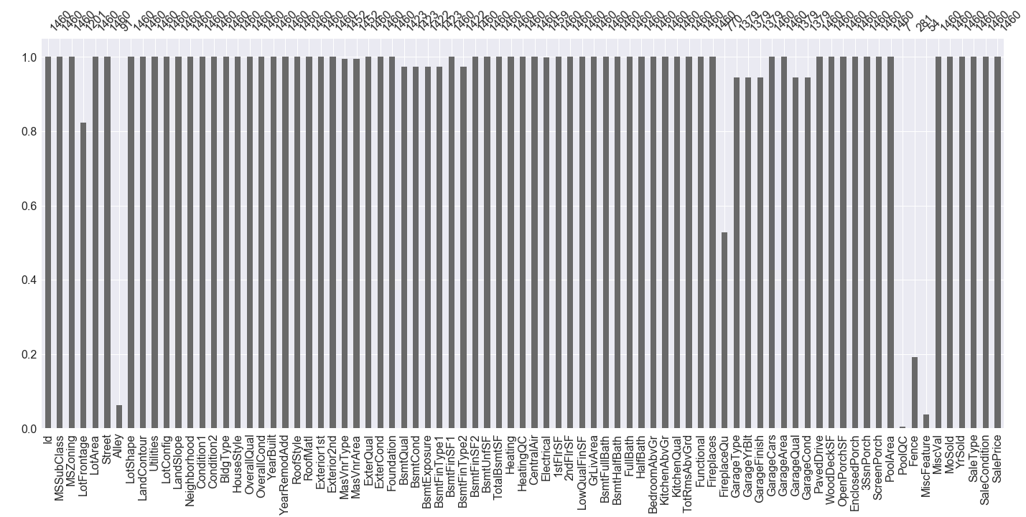
Missing Data Imputation
1.882876
1.882876

Slide 15
Missing Data Imputation
19 features with missing data in Training dataset
33 features with missing data in Test dataset
Upon further investigation we found that most of the features are not missing but inapplicable
We replaced most features with ‘None’ wherever applicable
We used Mode for imputing categorical variables, Mean for numeric variables wherever applicable

Slide 16
Data Transformation
Based on the given data description, we transformed some numeric features to categorical and some categorical features to ordinal using Label Encoding (Likert scale with 1-5 ratings)
We binned 1-5 scaled ordinal features into 3-scaled ratings for simplification
Created new “age” features from date fields using “YrSold” as reference, to make them continuous variables
Performed One-Hot-Encoding on all categorical features to create dummy variables and dropped first dummy variable as base

Slide 17
Data Transformation
We did split the training dataset into Test and Train datasets with 75:25 ratio by random sampling
Then we performed Standard Scaling on all numeric features (Excluding dummies) separately on Test and Train datasets to use in some algorithms
The resulting datasets have 235 features (Originally from 79)

Slide 18
Modeling

Slide 19
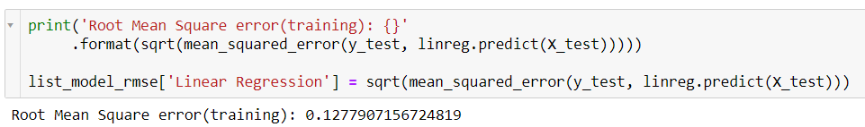
1. Linear Regression
We performed Linear Regression on unscaled data using Cross-Validation with 5 folds.
R-Squared Value – Training Data: 0.75
R-Squared Value – Test Data: 0.68
RMSE: 0.127

Slide 20
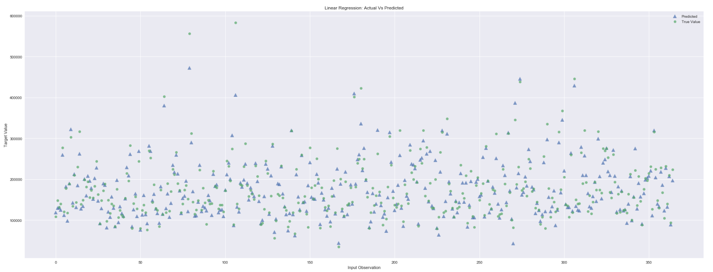
1. Linear Regression

Slide 21
2. KNN Regression
We performed Standard Scaling using sklearn on numerical features
We performed KNN Regression on the scaled data using Cross-Validation and GridSearch with 5 folds with following hyper-parameters:
'n_neighbors’ : [1,2,3,4,5,7,10,11,12,15]
GridSearch returned best hyper-parameter as n_neighbors = 15
R-Squared Value – Test Data: 0.80
RMSE: 0.168

Slide 22
3. Ridge Regression
We performed Ridge Regression on the scaled data using Cross-Validation and GridSearch with 5 folds with following hyper-parameters (learning rate):
'alpha': [0.001, 0.01, 0.1, 1, 10, 100]
GridSearch returned best hyper-parameter as alpha = 10
R-Squared Value – Test Data: 0.89
RMSE: 0.124

Slide 23
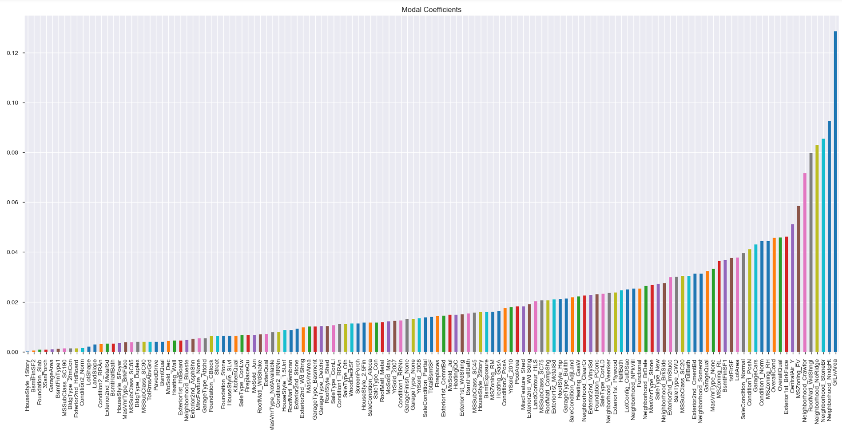
3. Ridge Regression – Regularized Parameters
Notes:
Selected penalized 122 features

Slide 24
4. Lasso Regression
We performed Standard Scaling using sklearn on numerical features
We performed Lasso Regression on the scaled data using Cross-Validation and GridSearch with 5 folds with following hyper-parameters:
'alpha':[0.0001, 0.0003, 0.0006, 0.001, 0.003, 0.006, 0.01, 0.03, 0.06, 0.1, 0.3, 0.6, 1],
'max_iter':[10000, 50000]
GridSearch returned best hyper-parameters as alpha = 0.001 & max_iter = 10K
R-Squared Value – Test Data: 0.88
RMSE: 0.128

Slide 25
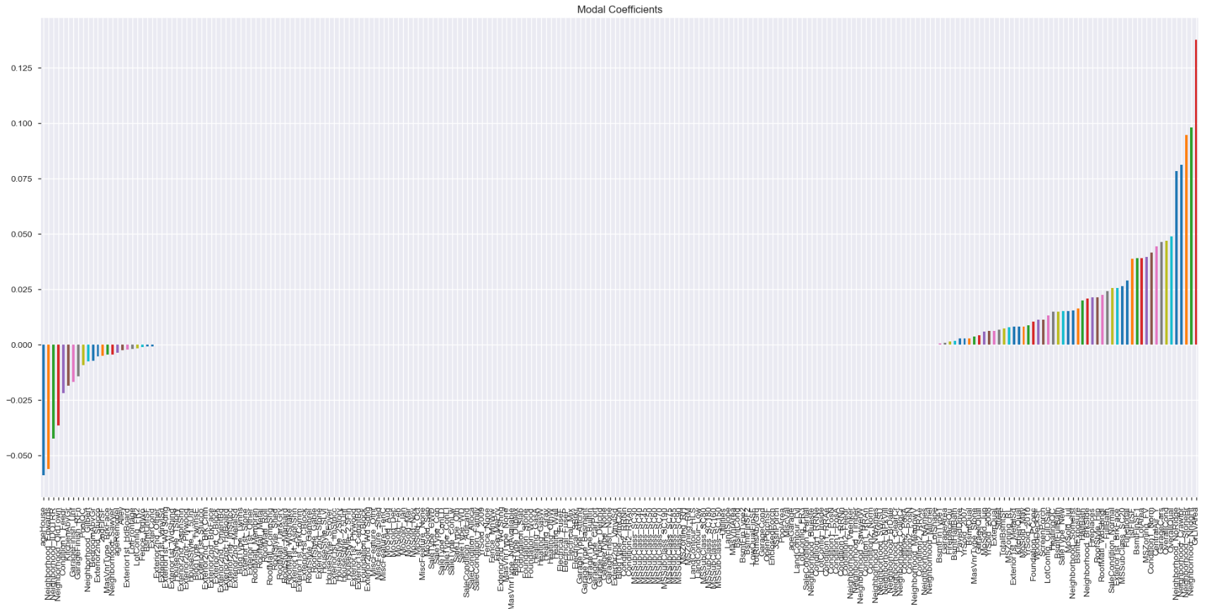
4. Lasso Regression – Selected Parameters
Notes:
Selected 54 features out of 235

Slide 26
5. Decision Tree Regression
We performed Decision Tree Regression on the scaled data using Cross-Validation and GridSearch with 5 folds with following hyper-parameters:
'max_depth': [1,2,3,4,5,6,7,8,9,10]
'min_samples_leaf': [1,2,3,4,5,6,7,8,9,10]
GridSearch returned best hyper-parameters as max_depth = 6 & min_samples_leaf = 8
R-Squared Value – Test Data: 0.736
RMSE: 0.196

Slide 27
6. Random Forests Regression
We performed Random Forest Regression on the scaled data using Cross-Validation and GridSearch with 5 folds with following hyper-parameters:
'n_estimators': [46,47,48,49,50,51,52],
'min_samples_split': [11,12,13],
'min_samples_leaf' : [4,5,6],
'max_depth' : [5,6,7,8,9,10]
GridSearch returned best hyper-parameters as max_depth = 10, min_samples_leaf = 4, min_samples_split = 11, n_estimators = 52
R-Squared Value – Test Data: 0.84
RMSE: 0.15

Slide 28
Model Selection

Slide 29
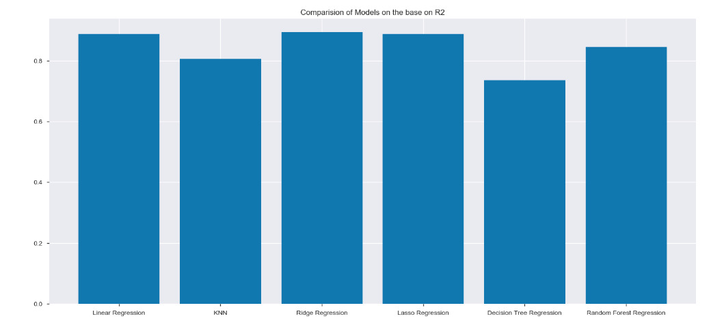
Model Selection

Slide 30
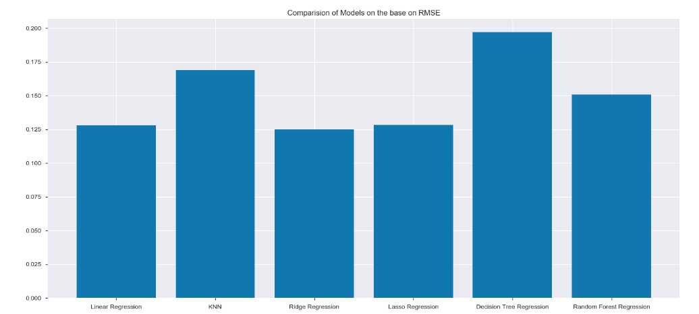
Model Selection

Slide 31
Conclusion
Based on the evaluation metric of “Root Mean Squared Error”, the best model seems “Ridge Regression”. Which has lowest RMSE on training data – 0.124
But Ridge regression used 133 features, whereas Lasso regression used only 54 features and achieved almost the same RMSE (0.128)
So, if processing and performance are not any concerns, Ridge regression turned out to be best.

