Slide 1
DATA VISUALISATION
PROFESSOR : DR. TAM NGUYEN
Team Members
Surya Venkatesh Vijjana
Shravya Reddy Akmy
Manasa Metta
Meghana Ayyalasomayajula
Anirudh Reddy Koppurapu

Slide 2
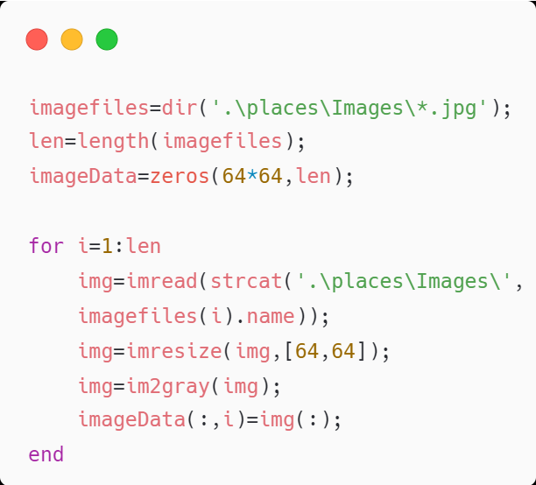
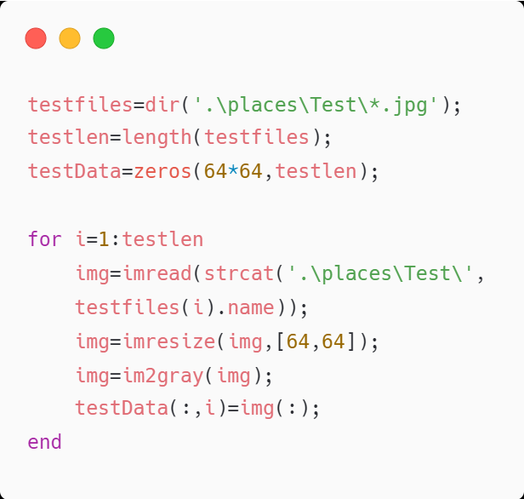
Problem (a)
Resize all images to 64*64 and convert them to grayscale images.

Slide 3
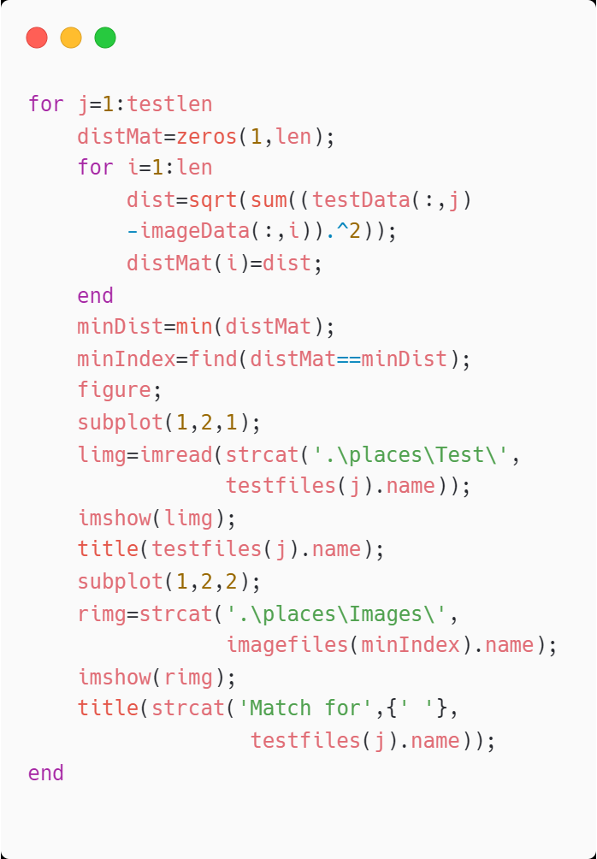
Problem (b)
Plotting Test Image with the most similar image from the Images directory using Distance Computation.

Slide 4
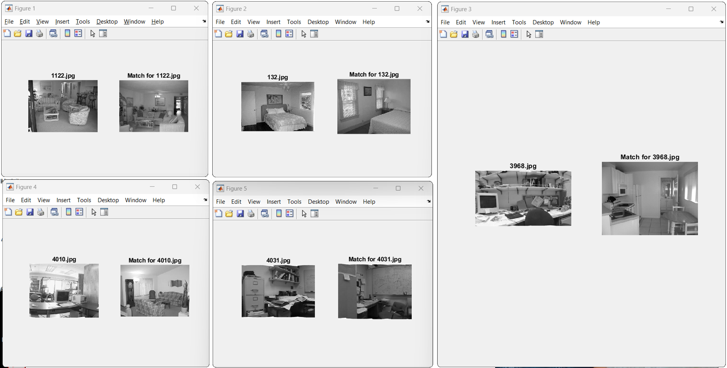
Output

Slide 5
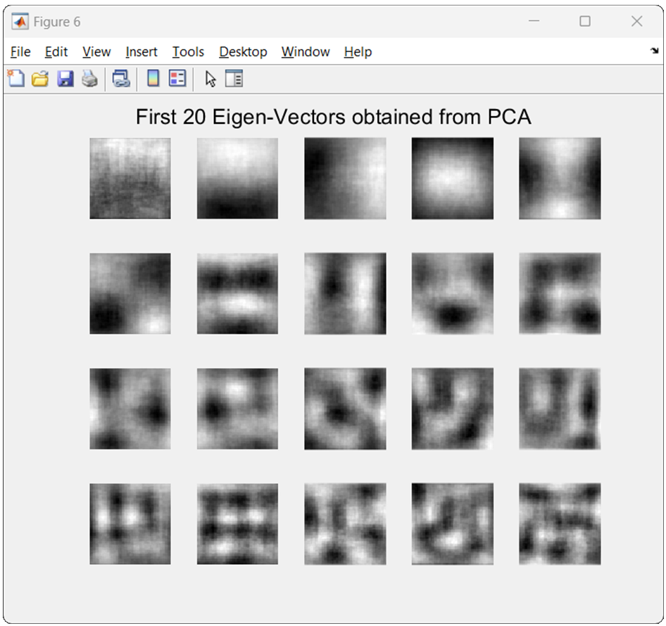
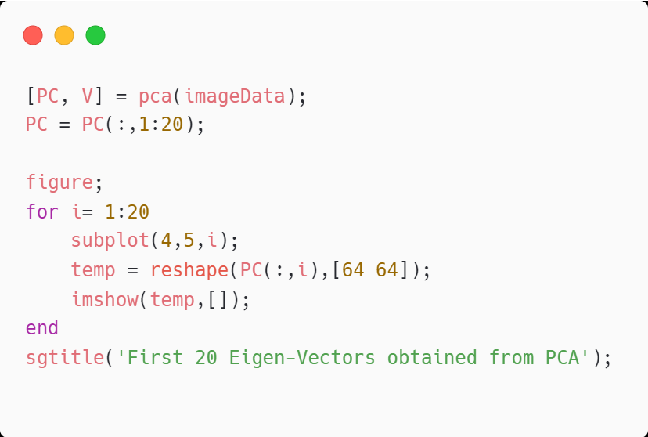
Problem (c)
Visualization of first 20 Eigen Vectors obtained from PCA.

Slide 6
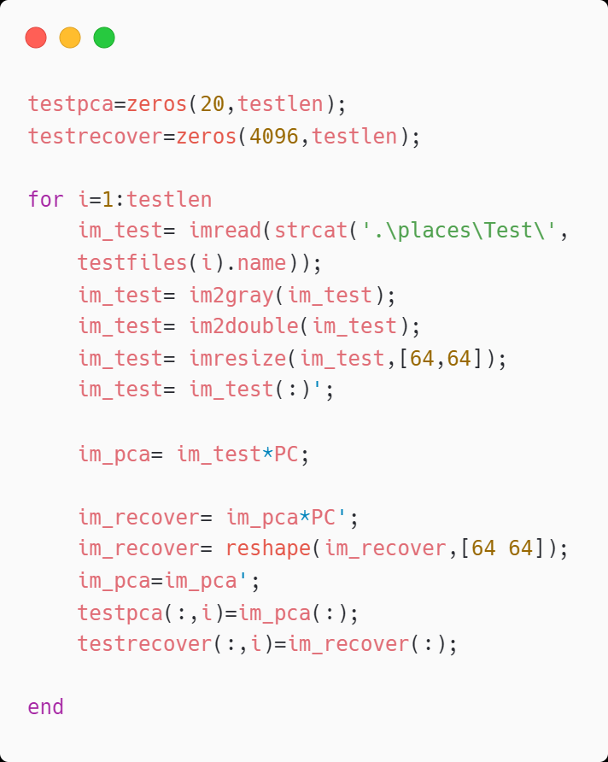
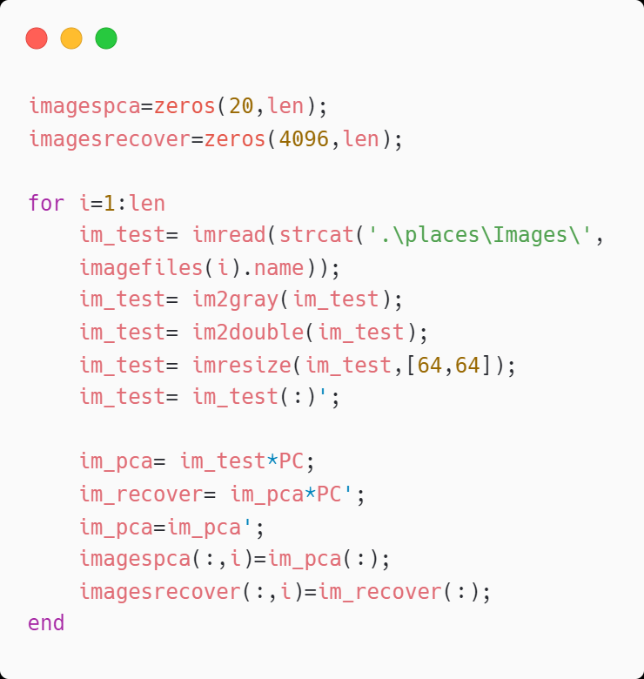
Problem (d)
Plotting each test image with the most similar image in the Images folder in 20 Dimension Space.

Slide 7
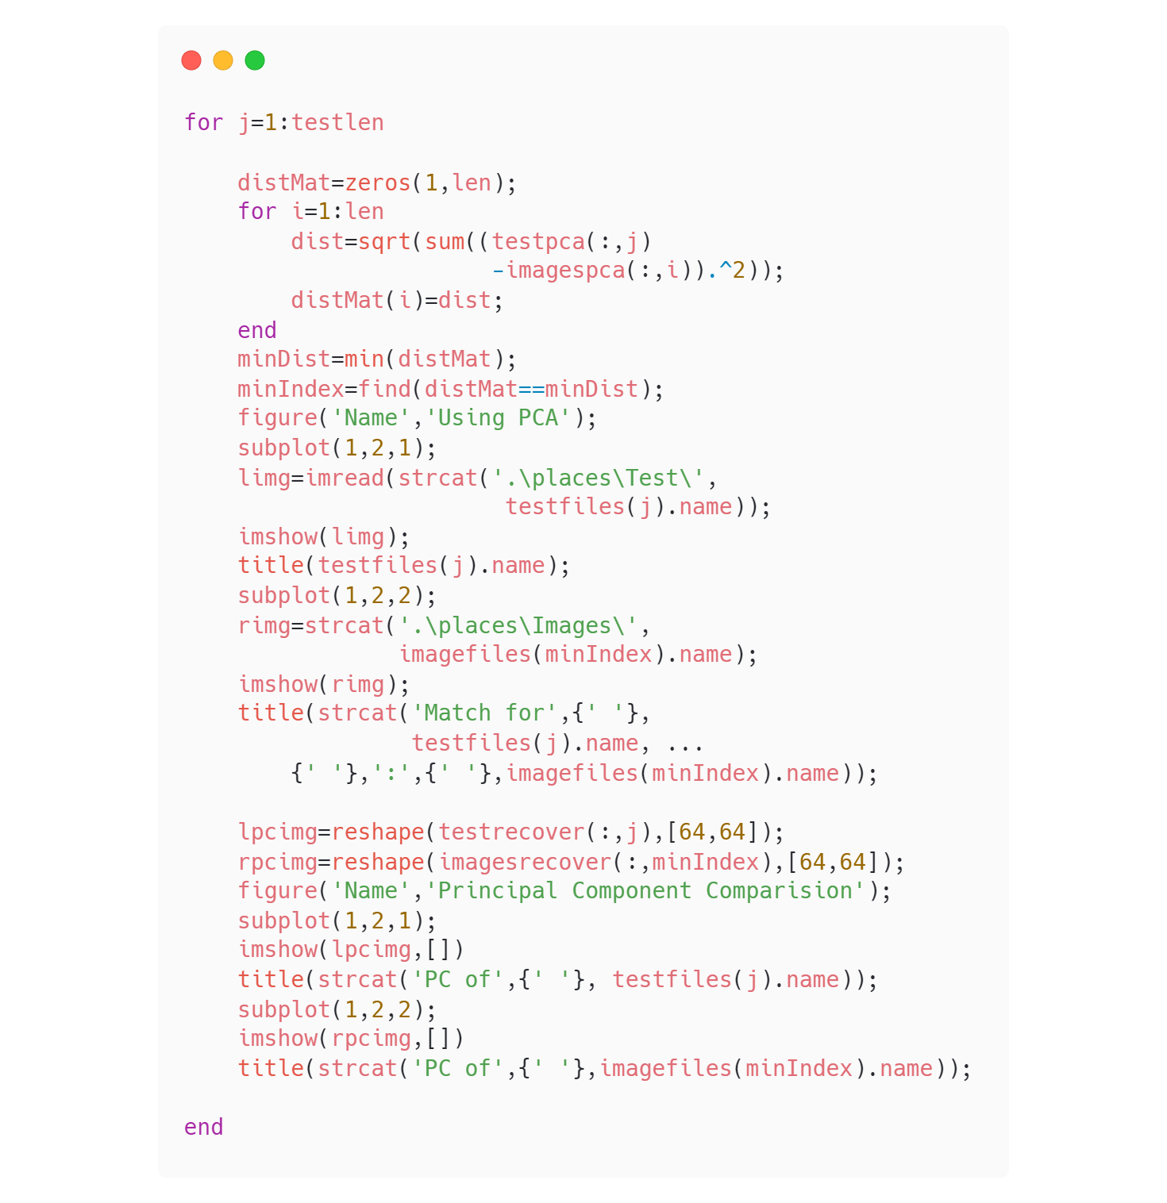

Slide 8
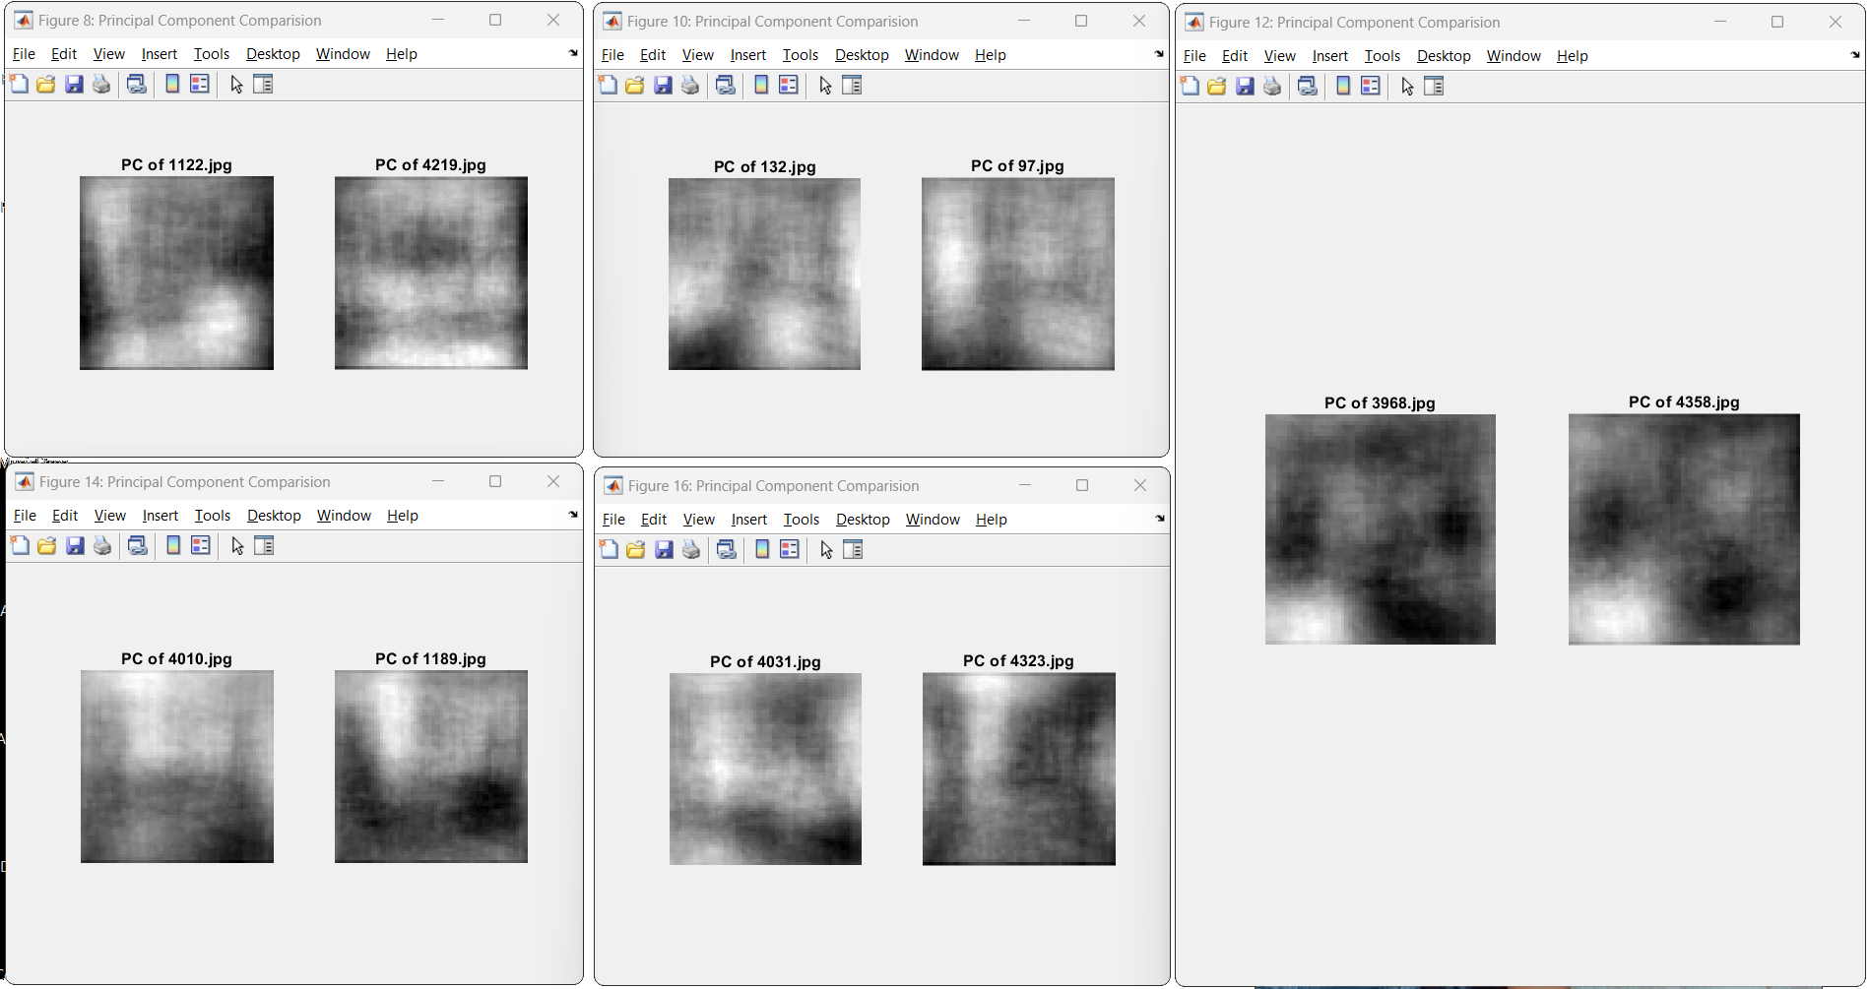
Output ( PC Comparison )

Slide 9
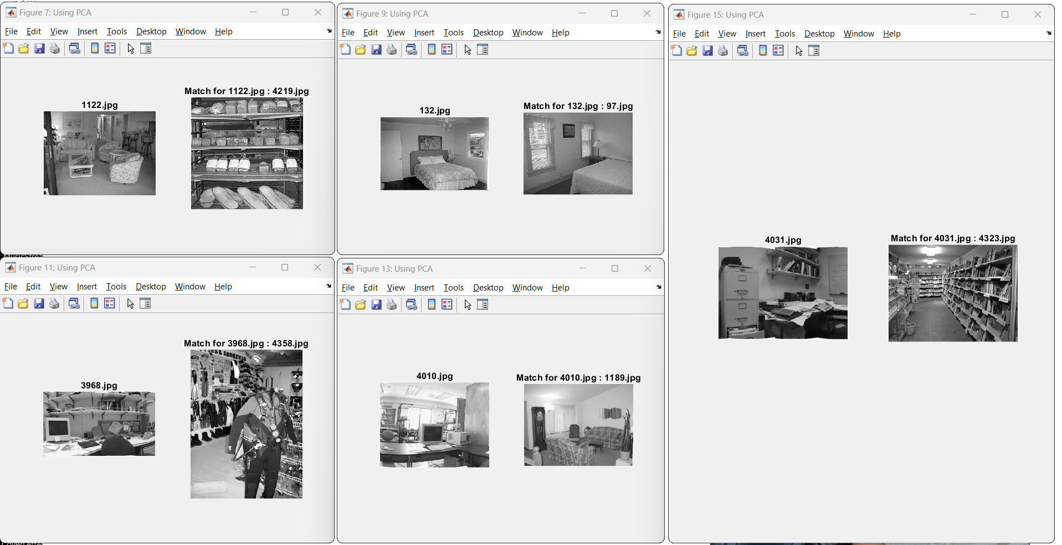
Output ( Image Comparison )

Slide 10
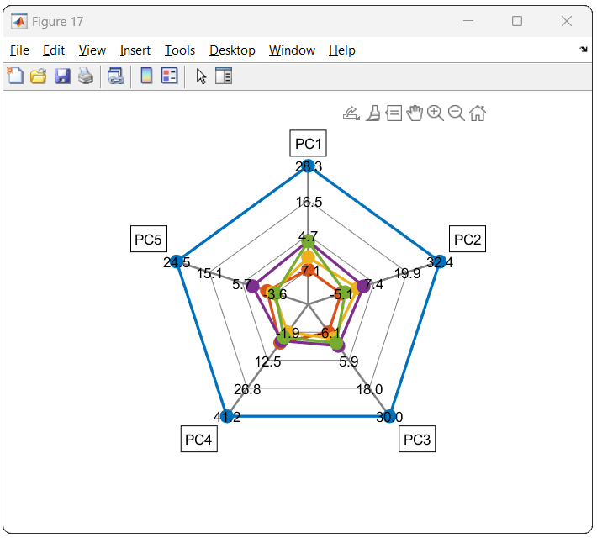
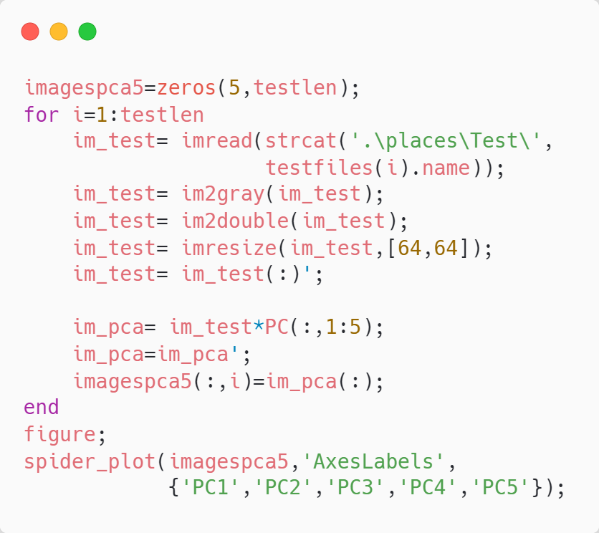
Problem (e)
Using spider_plot function, to visualize all images in the Test folder with the first 5 components.

Slide 11
Thank You

