Slide 1
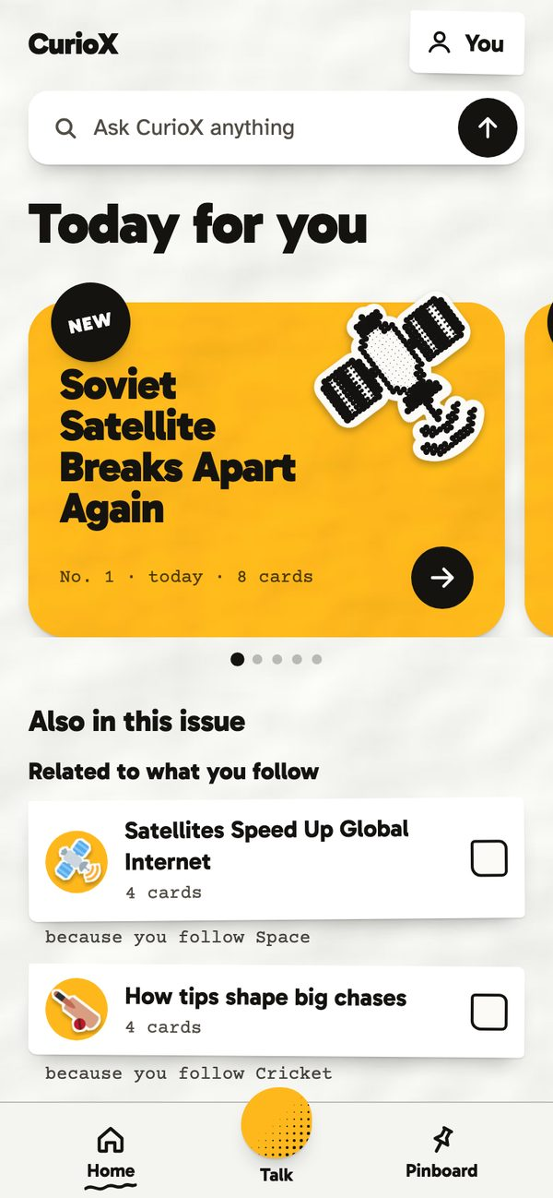
NEW
CurioX
A daily issue of what you care about, explained the way you learn.
Team cogniv8 · Apty Hackathon 2026
Tap anything yellow in the deck to jump around.
Start the tour
Notes:
Hello, we are Team cogniv8 and this is CurioX. One line: it is a learning companion that gets to know you, then every day explains what matters to you the way you learn best. Everything in this deck is clickable: yellow chips jump between sections.

Slide 2
Contents. Tap a card to jump there
3
The problem
4
What CurioX is
Feeds are endless, answers are flat, nothing sticks
Four parts, one companion
5
A reader's first minute
6
The daily issue
From notification to first issue, no sign-up
Nine cards per story, made for you
7
Make it stick
8
Talk and Ask
Quiz, teach it back, read the sources
Hands-free voice mode and cited answers
10
It learns you
11
Under the hood
Interest signals, pinboard, reader card
Expo, Express, MongoDB, Groq and Gemini
12
Why it is a business
13
Built and next
Use case, go-to-market, plan
What works today, where it goes
Notes:
This is the menu. In slideshow mode every card is a link, so we can take questions in any order. The numbers are slide numbers.

Slide 3
Today: endless feeds, flat answers, nothing sticks
1
Noise
2
Flat
3
Leaky
The news tells you what happened. It never tells you why it matters to you, so most of it is skipped.
Every explanation is written for an average reader who does not exist. Too simple for some, too hard for others.
Reading is passive. Nothing is checked, nothing is said back in your own words, so little of it stays.
The learner we build for: someone who follows a few topics, has ten minutes a day, and wants to actually understand, not just scroll.
Contents
Notes:
Three problems. Noise: news without personal relevance. Flat: one explanation for everyone. Leaky: passive reading with no recall. Our learner follows a few topics and has ten minutes a day.

Slide 4

CurioX: a learning companion that knows you
1
Reader card
Five chip questions on day one. What you follow, your level, why you learn, how you like things explained, the tone.
2
Daily issue
Every day it searches the news for your topics and writes a nine-card deck per story, plus short decks per interest.
3
Make it stick
Every deck ends with a quiz, a teach-it-back box that gets marked, the sources, and a summary podcast.
4
Talk and Ask
A hands-free voice mode that chats about today, and a text Ask with live, cited research and learn actions.
No login needed. A judge can pick it up and use it unaided.
Contents
Notes:
Four parts. The reader card is how it learns you. The daily issue is what you read. Make it stick is how we check understanding. Talk and Ask are how you go deeper, by voice or by text. No login is needed.

Slide 5
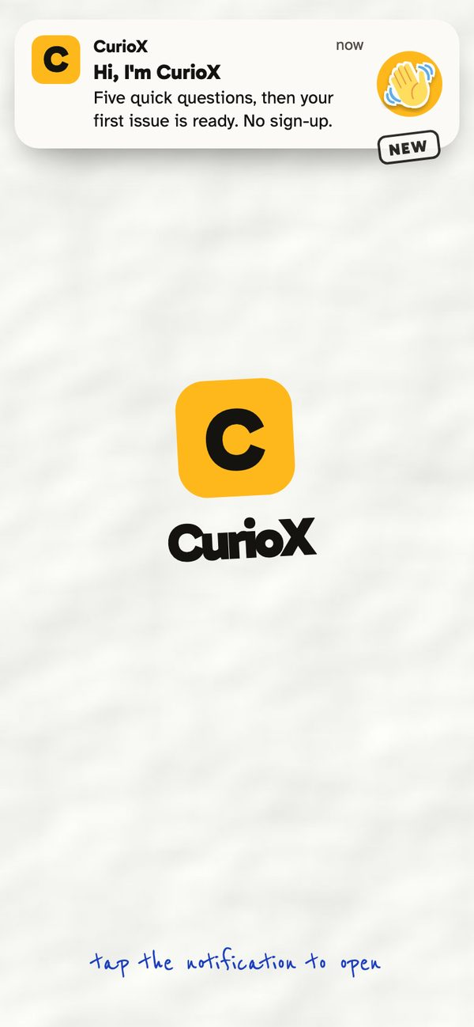
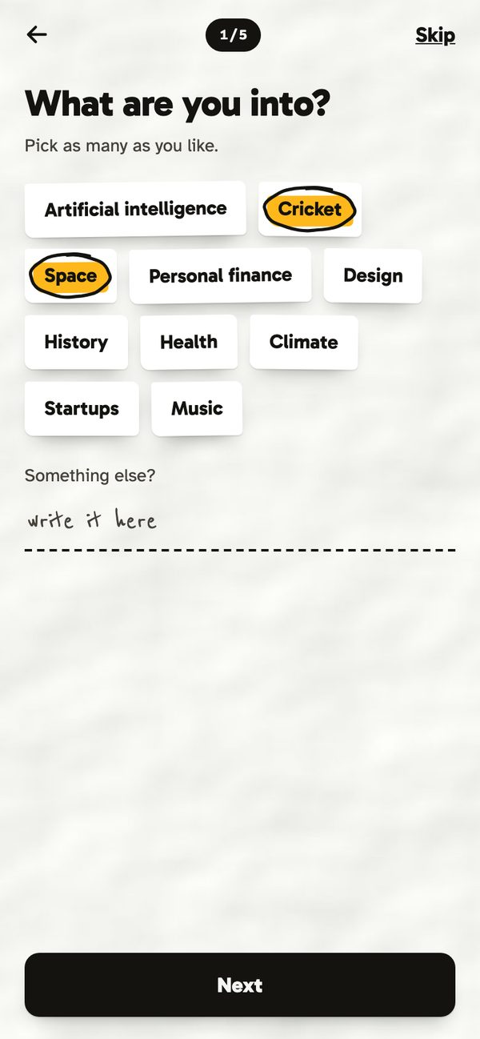
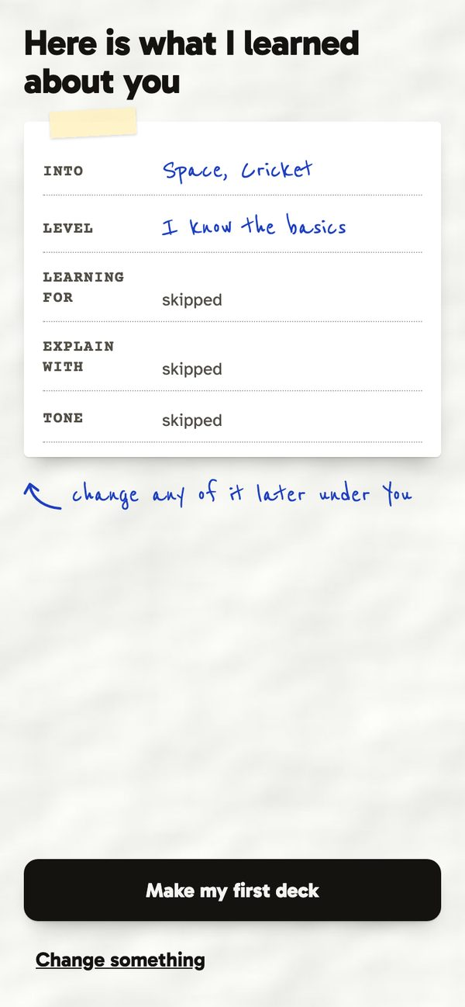
A reader's first minute: notification to first issue
1
2
3
4
A notification lands on paper. Tap it and the app opens.
Five chip questions. Questions two to five follow the topics picked in one.
The reader card: what CurioX learned, editable any time under You.
Today for you: the first issue, written while the questions were answered.
Contents
Notes:
Walk the judge journey. The opening is the notification itself. Five questions take under a minute. The reader card shows what was learned. By the time you reach Home the first issue is ready.

Slide 6
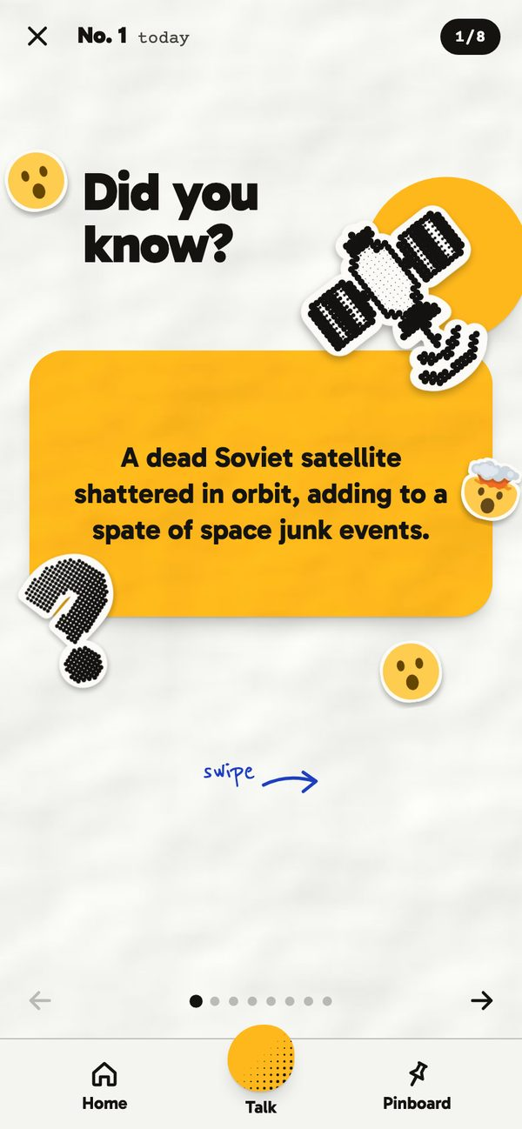
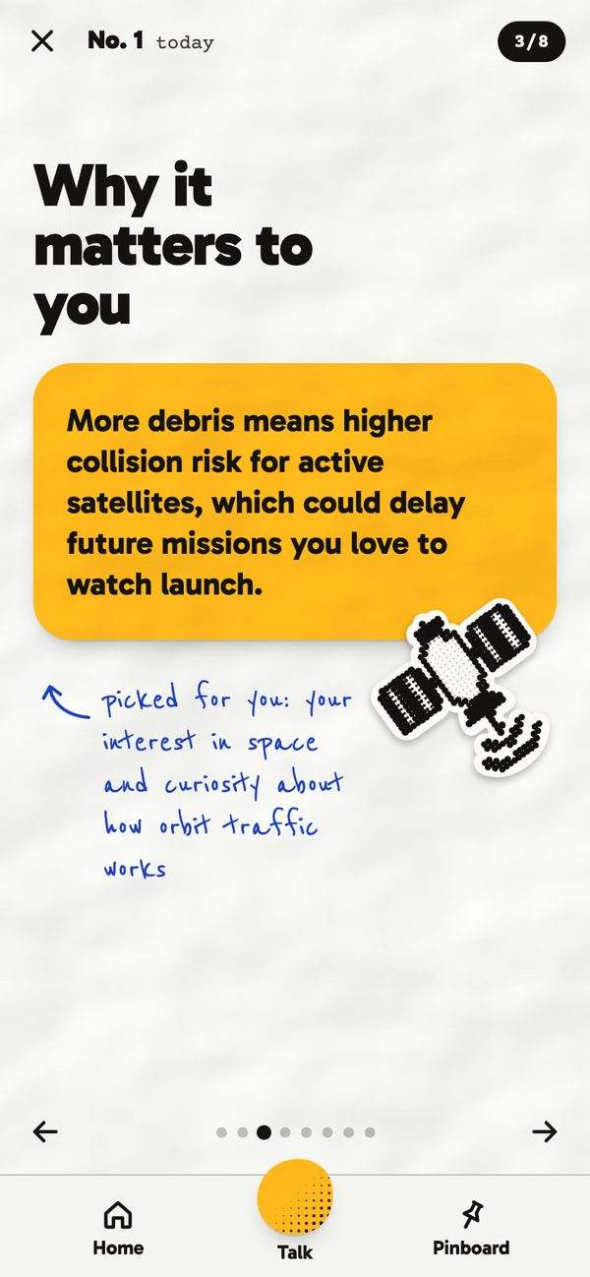
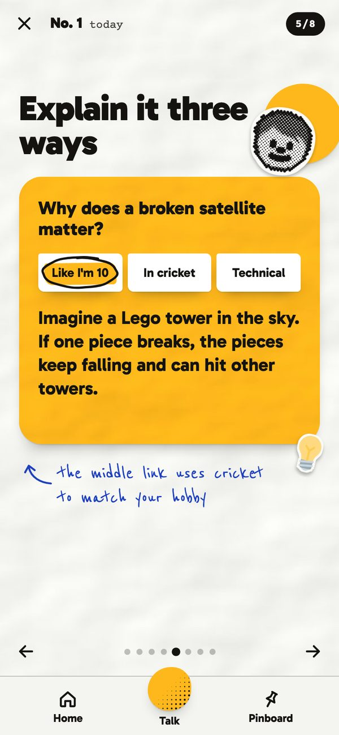
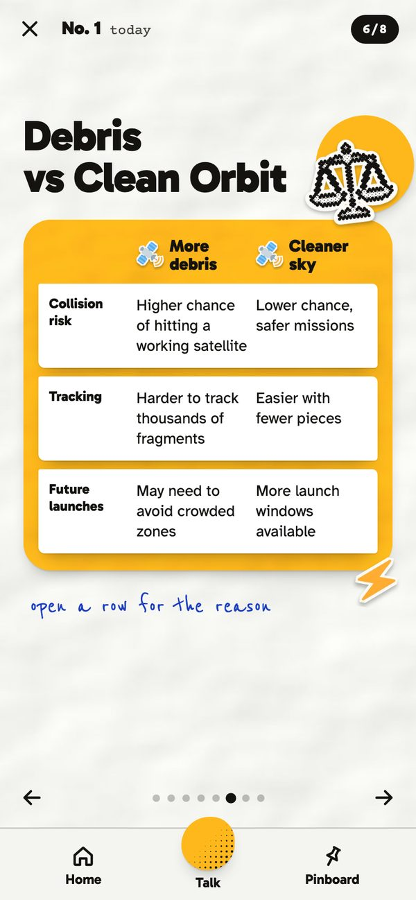
The daily issue: nine cards per story, written for you
Every lead story
1 Hook: did you know?
2 What happened
3 Why it matters to you
4 Myth or fact
5 Explain it three ways
6 This vs that
7 Guess the number
8 Watch it
9 Finale: make it stick
Plus a four-card deck per interest and related topics.
The hook
Why it matters to you
Explain it three ways
This vs that
Contents
Notes:
Each lead story becomes nine cards in a fixed rhythm: hook, what happened, why it matters to you, myth or fact, explain it three ways, this versus that, guess the number, watch it, finale. The three-ways card uses your own hobby as one of the explanations.

Slide 7
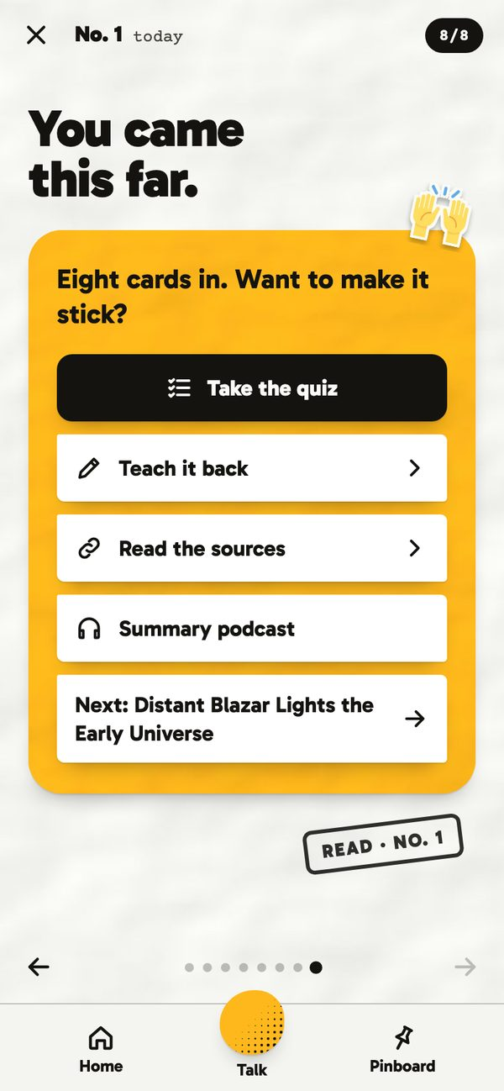
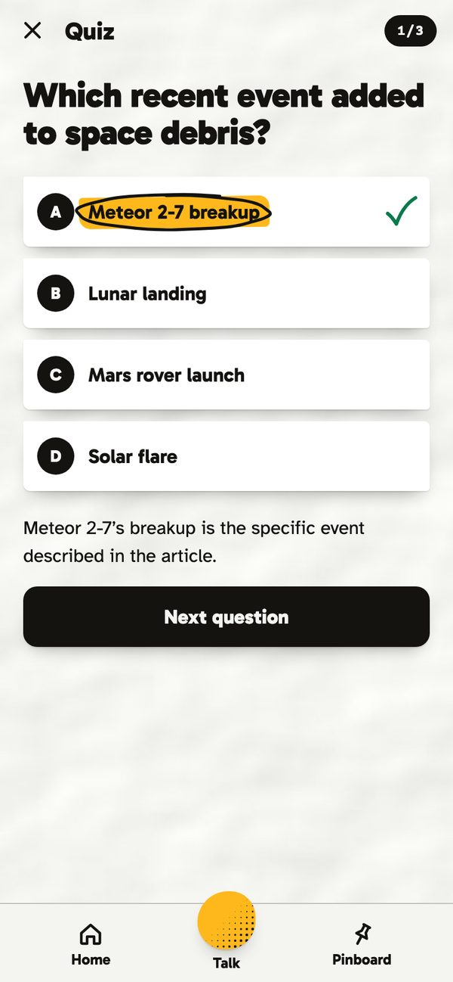
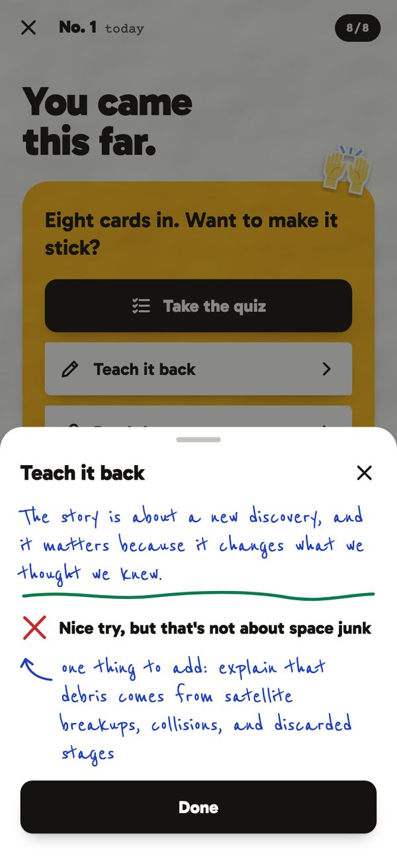
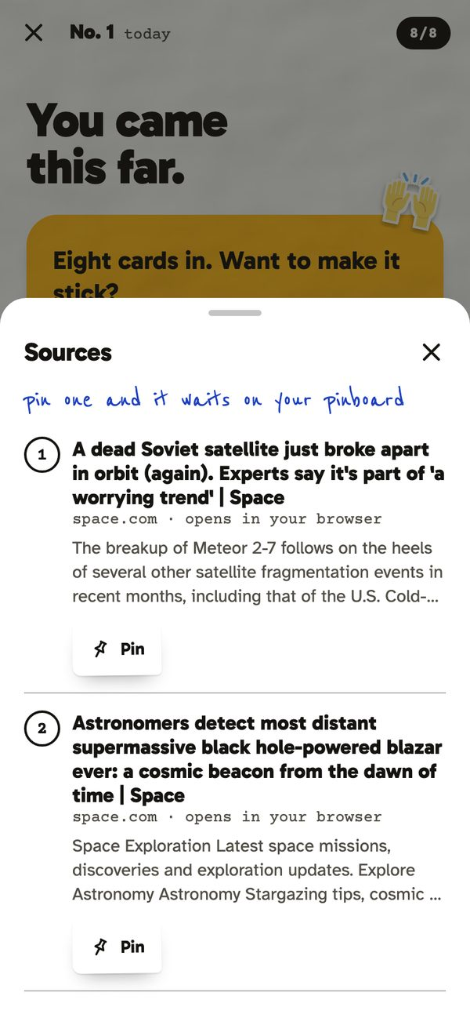
Make it stick: quiz, teach it back, read the sources
The finale offers four ways to lock it in
A three-question quiz on the story
Say it in your own words. CurioX marks it and adds one thing
Numbered sources, pin any of them
Contents
Notes:
Reading ends with a choice: quiz, teach it back, sources or a podcast summary. Teach it back is the one judges like: you type what you understood, it is marked honestly, and it adds the one thing you missed.

Slide 8
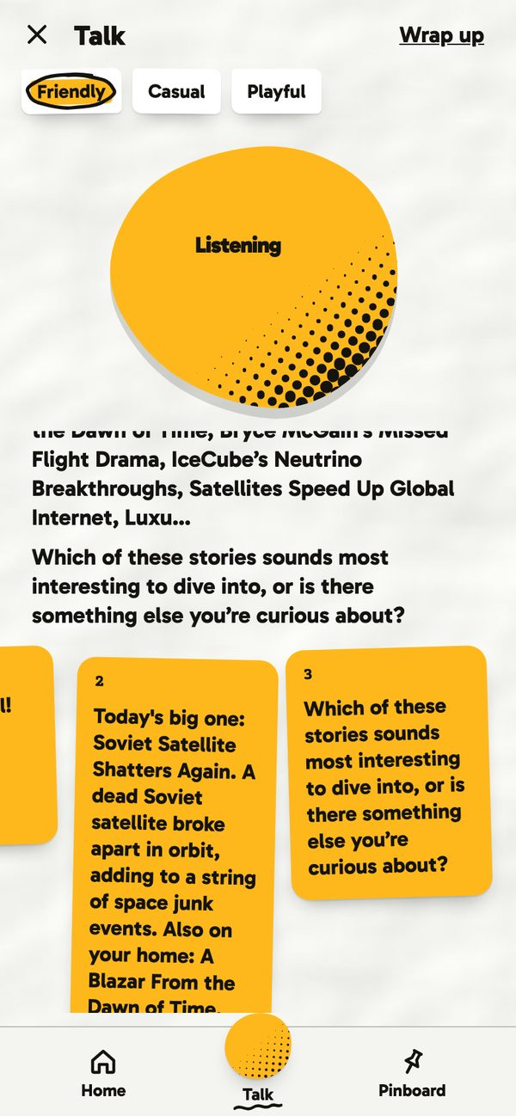
Talk: the hands-free way to learn
1
Says hello and tells you what is new today
What it leaves behind
2
Asks what you want to learn about
Scores how keen you were on each topic
A topic you cared about joins your interests
A fresh story shows up on Home when there is news on it
Speech to text falls back to Groq Whisper when the phone has none
3
Explains it, then asks your view
4
Explains the impact, asks what you make of it
5
Chats until you say "that is all"
6
Keeps the key points as a Back issue
The only place CurioX speaks and listens, so reading stays quiet.
Pick a voice: Friendly, Casual or Playful
Contents
Notes:
Talk is a guided, server-driven conversation: it opens with today, asks what you want, explains, asks your view, explains the impact, and chats until you wrap up. When you finish it keeps the key points and scores your interest, which feeds Home tomorrow.

Slide 9
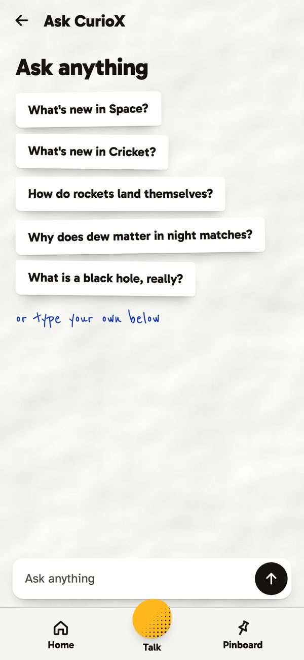
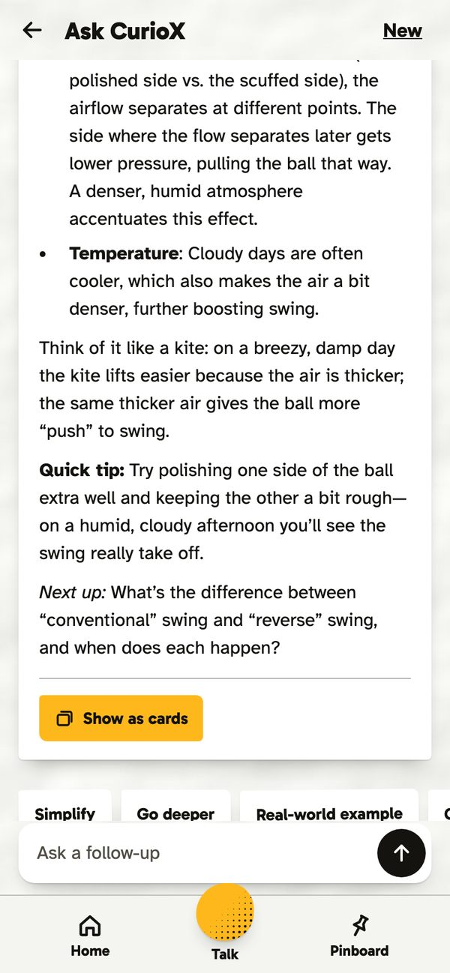
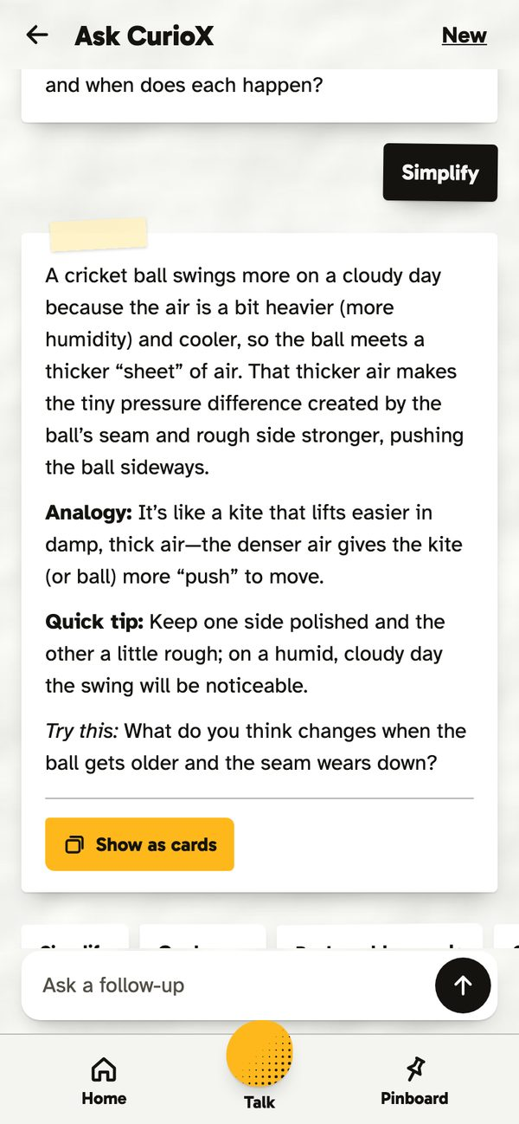
Ask: streamed answers with live, cited research
How an answer is made
A small model decides if the question needs current information
If so, one Tavily web search; results are cached for six hours
The answer streams token by token with numbered, tappable citations
Any answer can be turned into cards and pinned
If one provider is rate-limited the next one answers, and a labelled demo answer is the last resort
Suggested questions come from your reader card
Answers adapt to your profile and the conversation
One tap: Simplify, Go deeper, Example, Challenge me, Compare
Contents
Notes:
Ask is text. A router model decides whether to search; Tavily brings five results; the answer streams with citations. Learn actions are one tap. It always answers thanks to the provider chain.

Slide 10
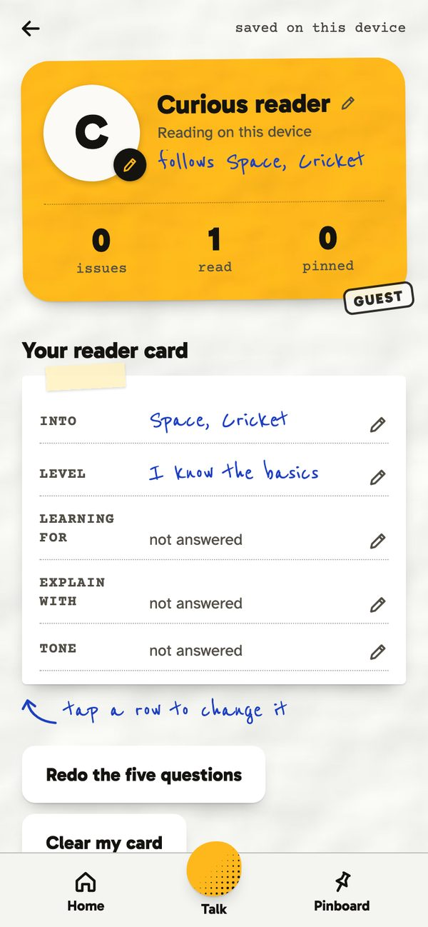
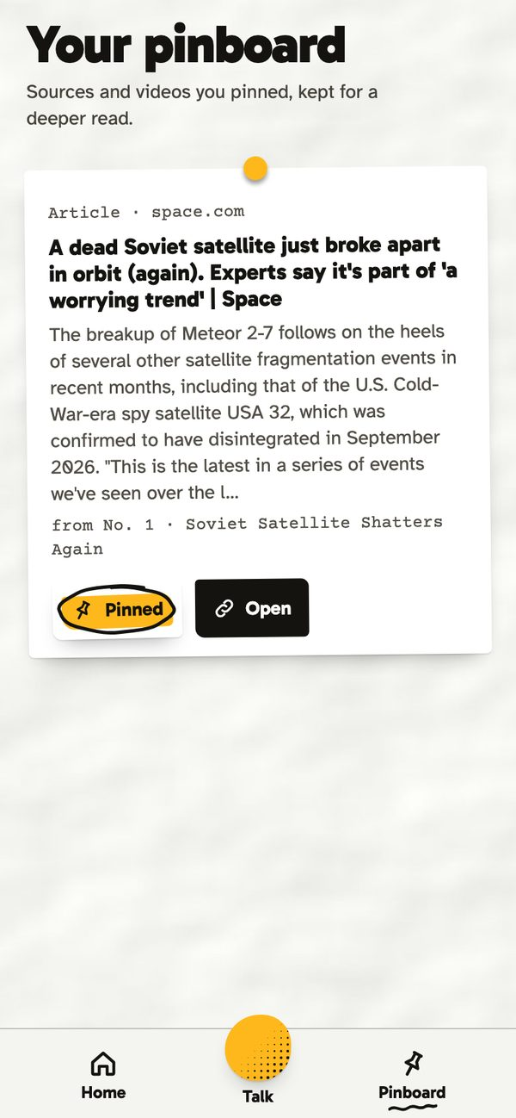
It learns you: every action is an interest signal
+1
+2
+3
Read a deck
Ask about it
Talk about it
At 4 points a topic is promoted to your interests, and the next issue carries a story on it.
Reader card: edit any answer under You, or redo the five questions
Accounts are optional: sign in to keep the card, issues and pins on every phone
Pinboard: sources and videos pinned from any deck, kept for a deeper read
Back issues: chats and talks are summarised into decks you can reopen
You: the reader card and reading stats
Pinboard
Contents
Notes:
Personalisation is explicit and visible. Reading, asking and talking score a topic; at four points it joins your interests. The reader card is always editable, so nothing is hidden from the user.

Slide 11
Under the hood: one API, every key stays on the server
Mobile app
API
Models, in order
Expo SDK 57, React Native, Expo Router, TypeScript. Android APK via EAS; iPhone via Expo Go. Zine look: paper, yellow panels, stickers.
Node 24, Express 5, TypeScript.
Routes: session, onboarding, issues, decks, chat (SSE), talk, learn, pins, auth.
MongoDB Atlas via Mongoose: users, issues, decks, messages, pins, search cache.
Hosted on Render from a blueprint.
Groq gpt-oss-120b first, Gemini 3.8 Flash and 3.5 Flash-Lite next, with key pools that rotate on a rate limit. Labelled demo answer last.
Search and voice
Shared package
Tavily for live web search, cached six hours. Groq Whisper for speech to text when the phone has none.
One request and response contract: types, zod schemas, art keys, voice parser.
Design choices that protect the demo: onboarding and Talk are server-driven so the model cannot wander; the quiz is one structured-output call; DEMO_MODE keeps the journey working with no keys at all.
Contents
Notes:
One Express API serves the Expo app. Keys never reach the client. Groq is first because it is fast on the free tier; Gemini is the fallback; a labelled demo answer is the last resort, so the app always answers. Tavily does the searching and Whisper does speech to text.

Slide 12
Why it is a business
Use case
Go-to-market
Business plan
Students and working professionals who follow a few topics and want to understand them, not scroll them
Ten minutes a day, on the phone, hands-free on a commute
Teams that need everyone current on a fast-moving field
Start with communities around a topic, such as cricket, space and AI, where a daily issue spreads by sharing
App stores plus a web link that works with no sign-up
Partner with newsletters and creators: their feed becomes an issue
Free: one daily issue and Ask
Plus: unlimited Talk, podcasts and back issues, as a monthly subscription
Teams: a shared issue for a company or classroom, priced per seat
Runs on free API tiers today; paid tiers of the same APIs scale with usage
Risks we watch: API rate limits (key pools and a provider chain), content accuracy (every claim links to its source), and privacy (the profile is a few hundred tokens, stored only for the reader).
Contents
Notes:
Who: people who follow a few topics. How we reach them: topic communities first, then creators whose feed becomes an issue. How it makes money: a free daily issue, a Plus subscription for Talk and podcasts, and a Teams tier. Costs are free tiers today and scale with usage.

Slide 13
Built in the hackathon, and what comes next
Working today
Next
Opening, five-question reader card, daily issue with a featured carousel of five
Nine-card lead decks, interest decks, related topics and a discover mode for new readers
Quiz, teach it back with marking, sources, summary podcast, YouTube watch cards
Talk mode with three voices, interest scoring and back issues
Ask with streamed, cited answers and five learn actions
Optional accounts, pins per account, profile photo and reading stats
Provider chain with key pools, demo mode, smoke tests, typecheck
Deployed: API on Render, Android APK via EAS, iPhone via Expo Go
30 days
Push notifications for the morning issue, offline reading, a shareable issue link
90 days
Spaced repetition from the quiz results, a weekly review deck, Plus subscription
Later
Teams tier, creator feeds, more languages, on-device speech
Contents
Notes:
Everything on the left is live and in the repo on main. On the right is where we take it: notifications and sharing first, then spaced repetition from the quiz data, then the paid tiers.

Slide 14
Try CurioX
Five questions, then your first issue is ready. No sign-up.
Code github.com/surya16495/hackathon-cogniv8-CurioX
Run it npm install, npm run dev:server, npm run dev:mobile, scan with Expo Go
Team cogniv8 · Apty Hackathon 2026 · Thank you
Back to contents
Notes:
Close. Invite the judges to try it on their own phone: five questions and the first issue is ready. Thank you.

