Slide 1
Restaurant Opening

Slide 2
Problems?
Opening a restaurant at a small place?
No idea if it will be really helpful?
Which place will be best suited for the new restaurant?

Slide 3
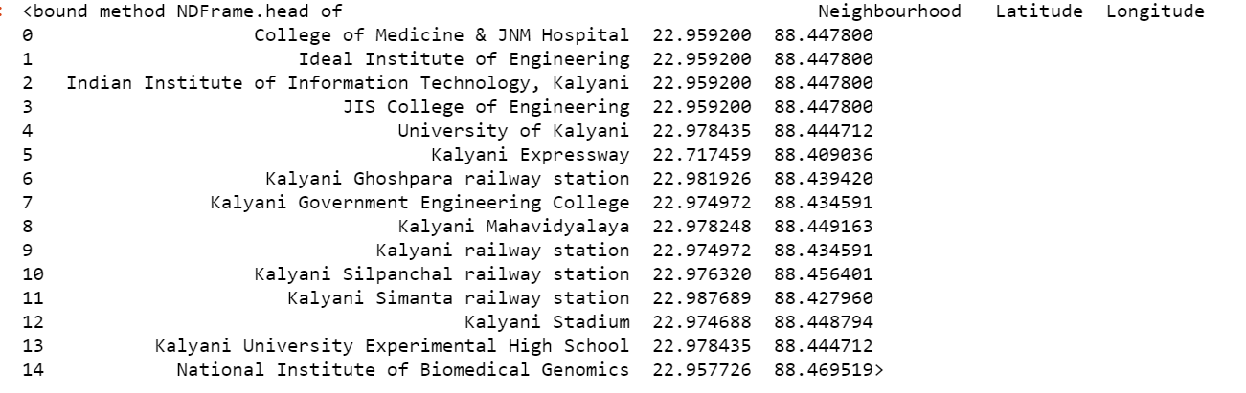
We have the solution
Lets capture the data first. The below are the prominent places in the town

Slide 4
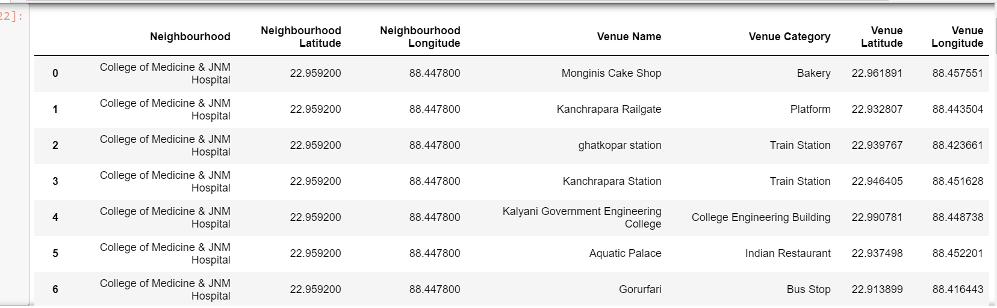
We have the solution
The below are the example of most popular places near the venues

Slide 5
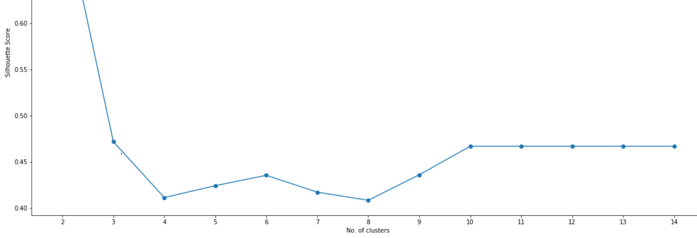
We have the solution
Here is the cluster of places

Slide 6
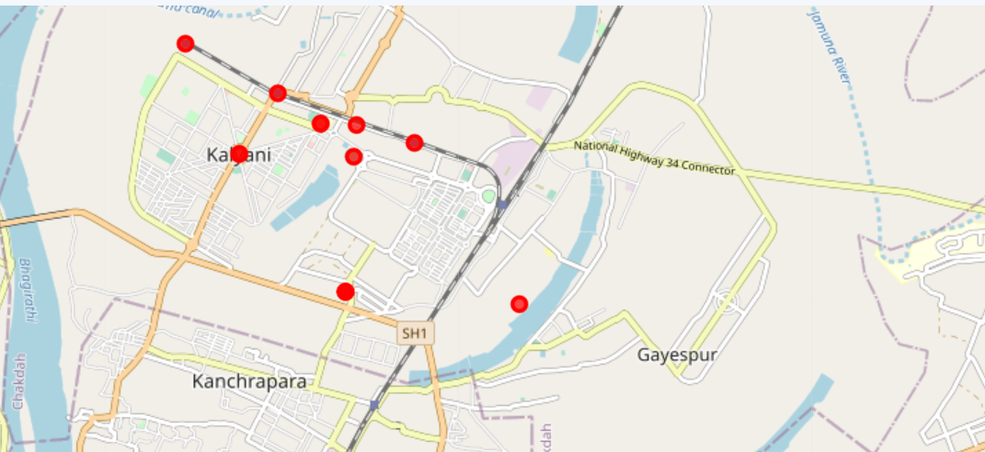
We have the solution
Using the data we found the below places which has the most number of footfall of people. Therefore we suggest to open your restaurant in any of this location.

Slide 7
Where the data from?
The list of Neighborhood is from Wikipedia
https://en.wikipedia.org/wiki/Category:Kalyani,_West_Bengal
The Location data is from
Foursquare API and Package geopy

Slide 8
Thank You
All the best for your venture

