Slide 1
Stroke prediction and analysis
Grp members:
Surya narayanan - CB.EN.U4CSE19056
Adhithya Varshan - CB.EN.U4CSE19001
Vigneshswaraj - CB.EN.U4CSE19060

Slide 2
Abstract
According to the World Health Organization (WHO) stroke is the 2nd leading cause of death globally, responsible for approximately 11% of total deaths.
This dataset is used to predict whether a patient is likely to get stroke based on the input parameters like gender, age, various diseases, and smoking status. Each row in the data provides relavant information about the patient.

Slide 3
Objective and motivation
One of the major challenges with attempting to predict any major disease like stroke is the high cost of false negatives. A false negative result is where the patient has the disease, but the test (or predictive tool) does not identify the patient as having the disease (or risk for the disease). Unlike false negatives in a business setting, false negatives in medicine can have deadly consequences. If someone gets a false negative and is told they are not at risk for a major disease, then they are not in a position to make informed lifestyle choice--putting their life in danger. Historically, false negative rates from traditional approaches exceeds 50%, but this has been reduced to less than 20% by applying machine learning tools

Slide 4
preproccessing
Data preprocessing involves transforming raw data to well-formed data sets so that data mining analytics can be applied. Raw data is often incomplete and has inconsistent formatting. The adequacy or inadequacy of data preparation has a direct correlation with the success of any project that involve data analytics.

Slide 5
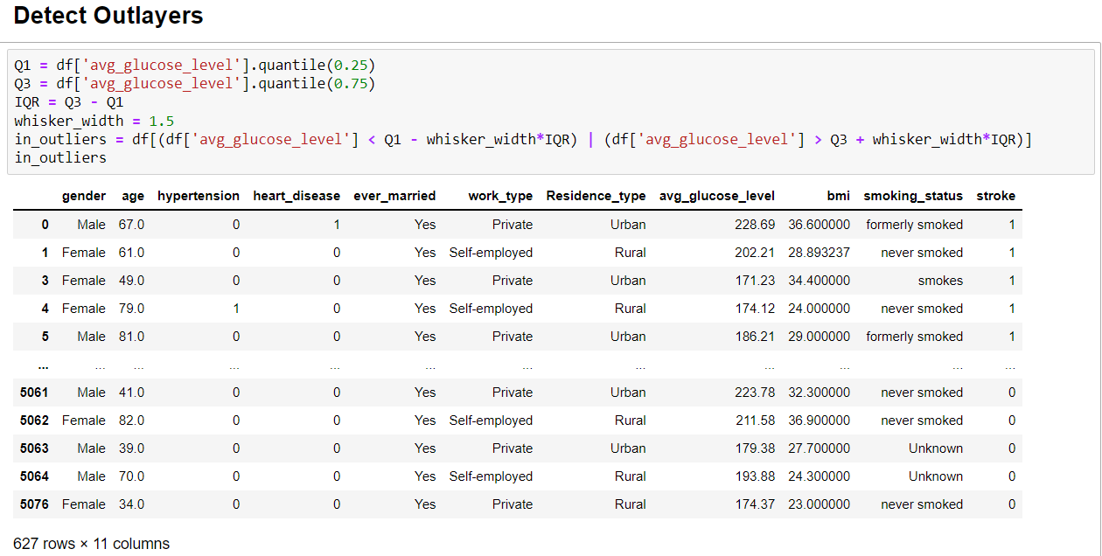
preproccesing

Slide 6
cont.
lower_whisker = Q1 -(whisker_width*IQR)
upper_whisker = Q3 + (whisker_width*IQR)
df['avg_glucose_level'] = np.where(df['avg_glucose_level']>upper_whisker,upper_whisker,np.where(df['avg_glucose_level']<lower_whisker,lower_whisker,df['avg_glucose_level']))
This step removes the outliers by replacing them

Slide 7
encoding
ct = ColumnTransformer(transformers= [('encoder', OneHotEncoder(), [5,9])], remainder= 'passthrough')
X = np.array(ct.fit_transform(X))
Used for transforming categorical values into numerical values

Slide 8
Train-test split
from sklearn.model_selection import train_test_split
X_train, X_test, y_train, y_test = train_test_split(X, y, test_size=0.2, random_state=42)
Used for splitting dataset into train and test

Slide 9
Feature scaling
Feature scaling is a method used to normalize the range of independent variables or features of data. In data processing, it is also known as data normalization and is generally performed during the data preprocessing step.
from sklearn.preprocessing import StandardScaler
scaler = StandardScaler()
X_train = scaler.fit_transform(X_train)
X_test = scaler.fit_transform(X_test)

Slide 10
PCA
Principal Component Analysis (PCA) is a statistical procedure that uses an orthogonal transformation that converts a set of correlated variables to a set of uncorrelated variables. PCA is the most widely used tool in exploratory data analysis and in machine learning for predictive models.
pca = PCA()
pca.fit_transform(X_train)
total = sum(pca.explained_variance_)

Slide 11
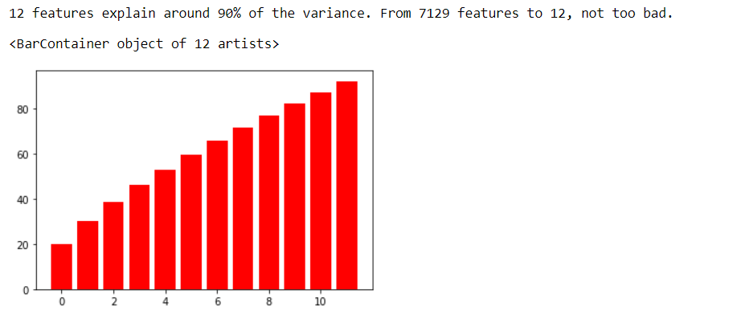
cont.

Slide 12
Imbalance checking
Imbalance checking
imbalance data distribution is an important part of machine learning workflow. An imbalanced dataset means instances of one of the two classes is higher than the other, in another way, the number of observations is not the same for all the classes in a classification dataset. This problem is faced not only in the binary class data but also in the multi-class data.

Slide 13
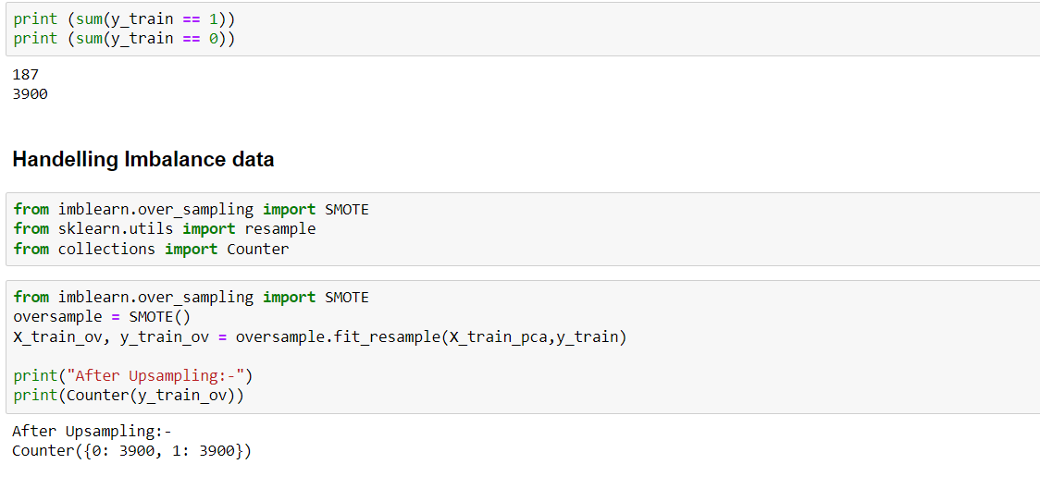
Imbalance checking

Slide 14
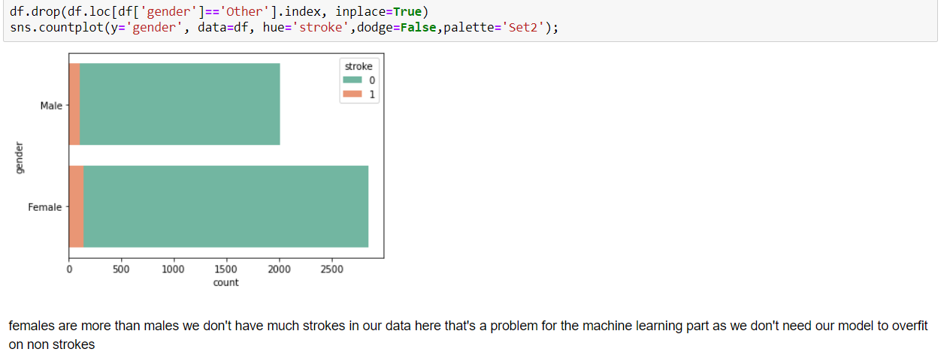
visualization

Slide 15
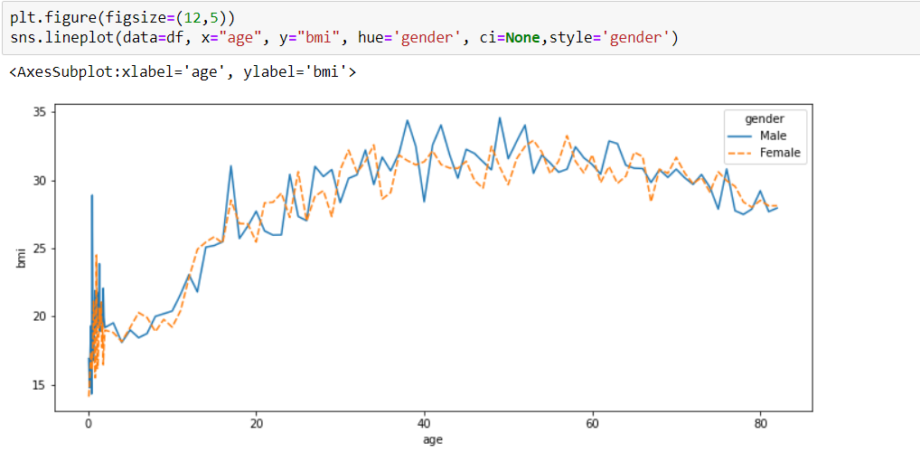

Slide 16
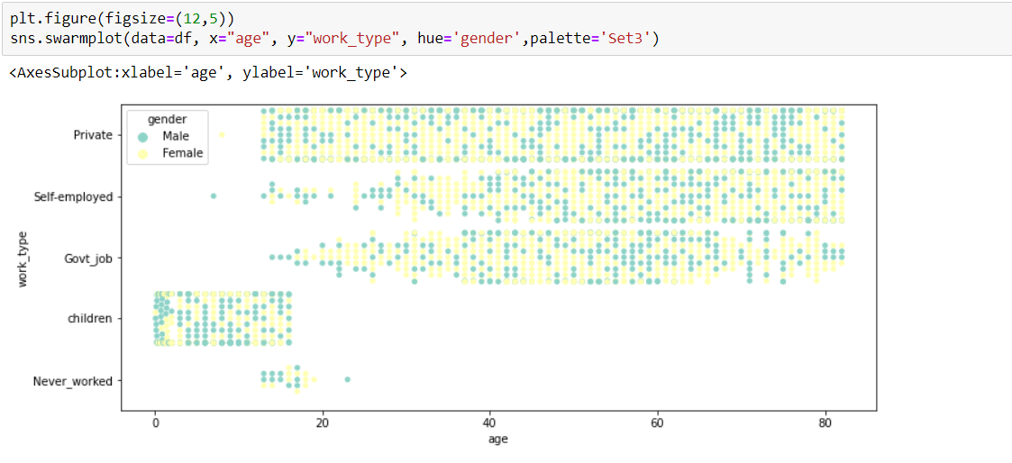

Slide 17
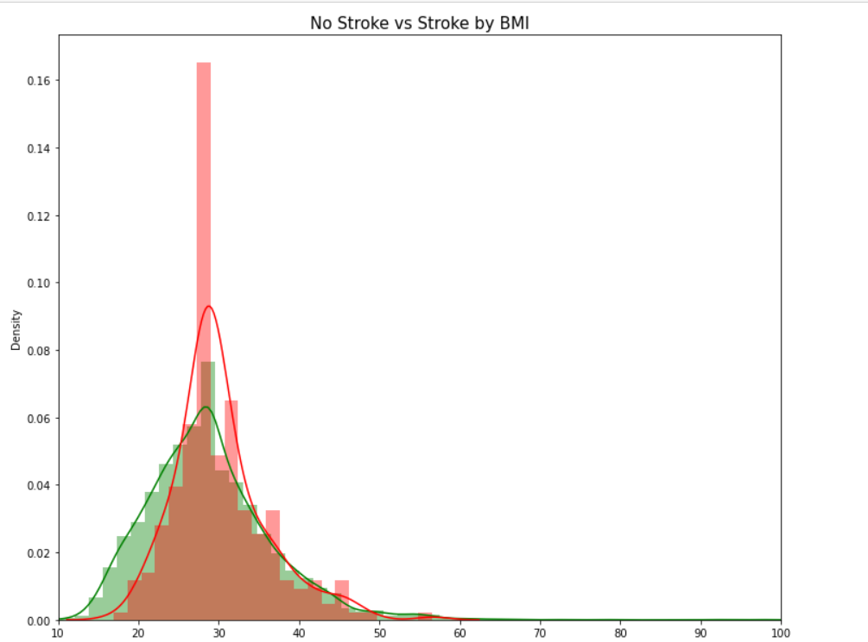

Slide 18
Training the model (log reg)
from sklearn.linear_model import LogisticRegression
lmodel = LogisticRegression()
lmodel.fit(X_train_ov,y_train_ov)
prediction=lmodel.predict(X_test_pca)

Slide 19
Performance metrics
score = cross_val_score(lmodel, X_train_ov, y_train_ov, cv = 6)
precision = precision_score(y_test, prediction)
roc = roc_auc_score(y_test, prediction)
recall = recall_score(y_test, prediction)
cm = confusion_matrix(y_test, prediction)
f1 = f1_score(y_test,prediction)
acc_ = accuracy_score(prediction,y_test)

Slide 20
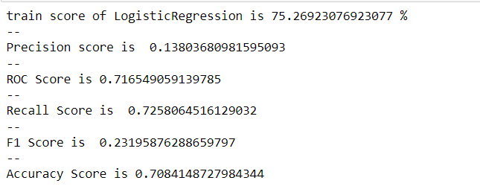

Slide 21
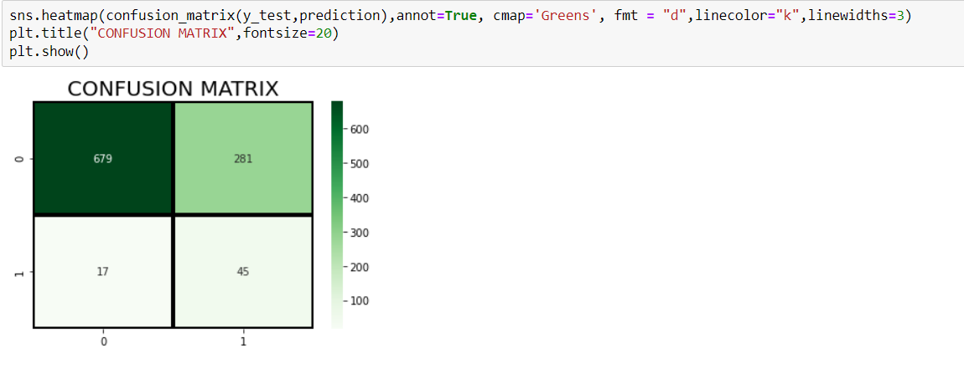

Slide 22
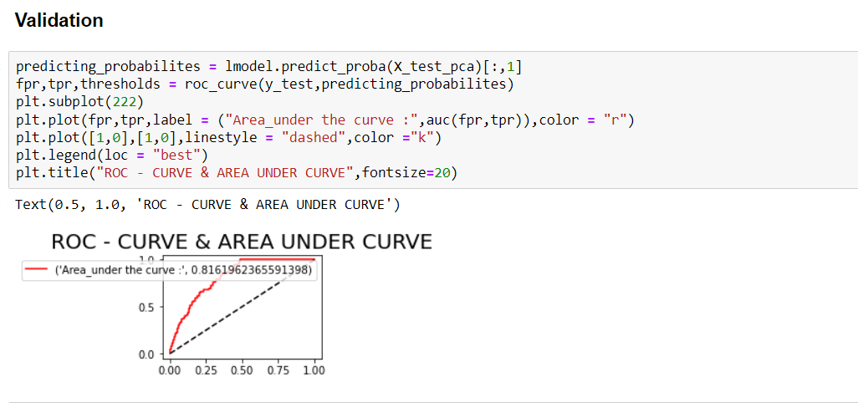

Slide 23
Training model (svm)
from sklearn.svm import SVC
smodel = SVC(probability=True)
smodel.fit(X_train_ov, y_train_ov)
y_pred = smodel.predict(X_test_pca)

Slide 24
Performance metrics (svm)
score = cross_val_score(smodel, X_train_ov, y_train_ov, cv = 6)
precision = precision_score(y_test, y_pred)
roc = roc_auc_score(y_test, y_pred)
recall = recall_score(y_test, y_pred)
cm = confusion_matrix(y_test, y_pred)
f1 = f1_score(y_test,y_pred)
acc_ = accuracy_score(y_pred,y_test)

Slide 25
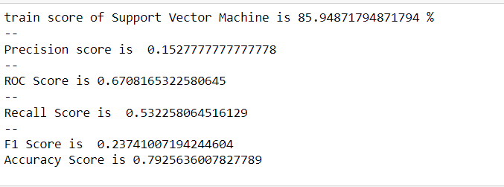

Slide 26
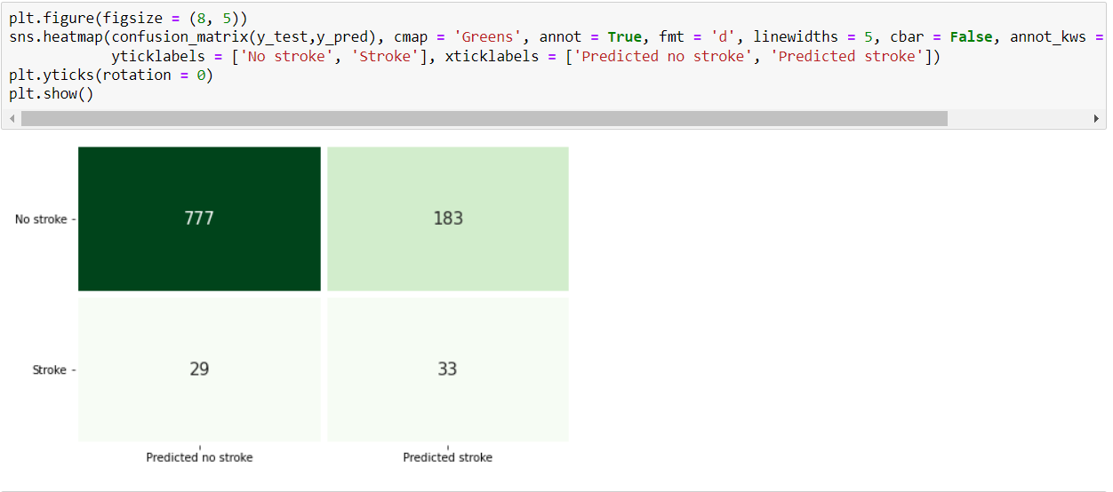

Slide 27
KNN
from sklearn.neighbors import KNeighborsClassifier
knmodel = KNeighborsClassifier()
knmodel.fit(X_train_ov, y_train_ov)
kny_pred = knmodel.predict(X_test_pca)

Slide 28
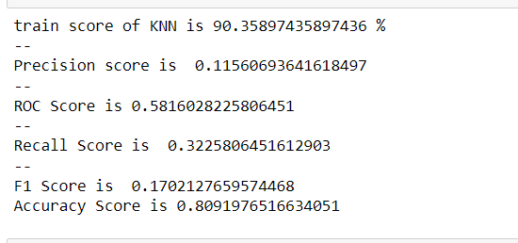

Slide 29
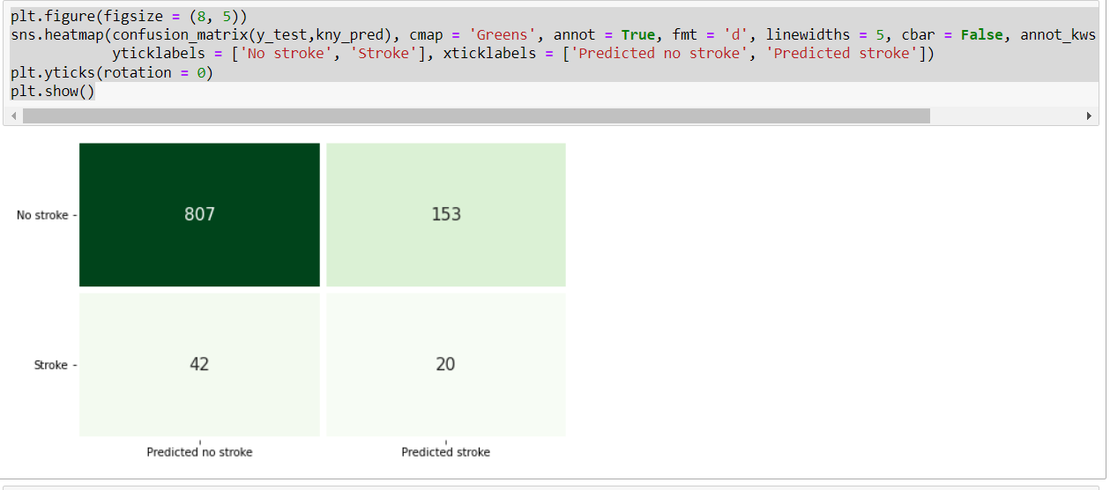

Slide 30
conclusion
So in this project, we saw some of the factors that might result in strokes. Where Age was highly correlated followed by hypertension, heart disease, avg glucose level, and ever married.
K-NN was a knight who performed well. There are outliers in some variable, reason behind why we kept it as it is because these things are either depends on other factors and there are possibilities of having such kind of records. For example, BMI can be high and still no stroke as a person is young or he does not have any heart disease.

