Slide 1


Password generator
NAME: D.SURYA
ORGANIZATION: MICRO IT
TOPIC: PASSWORD GENERATOR

Slide 2
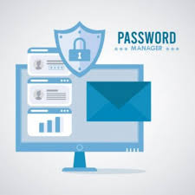
INTRODUCTION
A password is a secret string of characters, often letters, numbers, and symbols, used to verify a user's identity and grant access to a system, application.
It's designed to be known only to the authorized user and is typically used in conjunction with a username.

Slide 3

OBJECTIVES OF THE PROJECT
To understand the concept of password generator
To study about the password generator
Advantages of password generator
To gain knowledge about the password generator

Slide 4
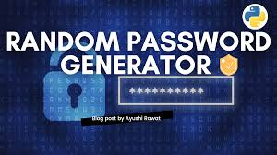
WHAT IS PASSWORD GENERATOR
A password generator is a tool, often software or part of a password manager, that automatically creates strong, random passwords for online accounts
. It helps users avoid weak or easily guessable passwords by generating complex combinations of characters, numbers, and symbols. This improves online security by making it harder for hackers to crack passwords and access accounts.

Slide 5
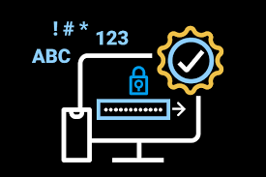
PASSWORD GENERATOR
Password generators are tools that create strong, random passwords, and they come in various types. Some generators focus on creating memorable passwords using phrases, while others prioritize highly secure, complex passwords using a mix of characters.

Slide 6


ADVANTAGES OF PASSWORD GENERATOR
Unpredictability and Complexity
Protection against Dictionary Attacks
Time-Saving:
Compliance with Security Policies

Slide 7
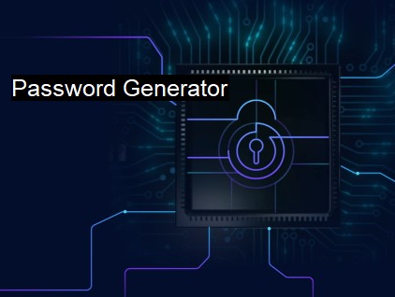
KEY LEARNINGS FROM INTERNSHIP
Pratical exposure to market analysis
Learned how to select the right mix of assets
Understood risk assessment and password generator
Gained confidence in using financial tools and performs

Slide 8

CONCLUSION
This internship helped bridge the gap between theory and pratical application
The project improved my analytical , decision making skills

