Slide 1

WEATHER UPDATE WEBSITE
NAME: D.Surya
ORGANIZATION: Micro IT
TOPIC: weather update website

Slide 2
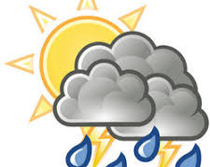
introduction
Weather describes the short-term atmospheric conditions, like temperature, humidity, and precipitation, at a specific location and time.
It's a constantly changing state influenced by various factors like sunlight, air pressure, and wind.

Slide 3

Objectives of the project
The primary goal of this project was to understand the software development life cycle by creating simple application, implement cire programming concepts like conditionals ,loops, functions ,and arrays .learning basic weather development and concepts. provide an interactive platform that allows two users to check the updates of weather

Slide 4
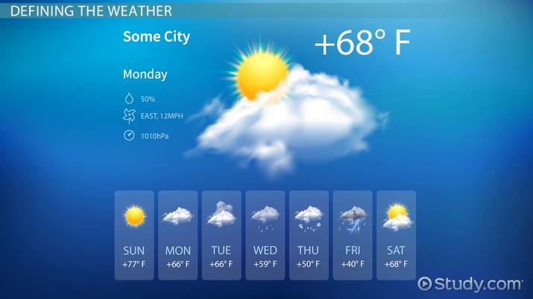
Importance of weather
Affects Daily Life:
Impacts Agriculture
Shapes the Earth
Impacts Human Health
Important for Predicting Weather Patterns

Slide 5

Key aspects about weather
Atmospheric Elements
Dynamic Nature
Impact on Daily Life
Severe Weathe
Importance of Forecasting

Slide 6
Learning outcomes
This internship project taught me:
How to structure and manage a small scale software project
The importance of clean code and programming
Basic of software testing
Effective use of version

Slide 7

conclusion
This weather update project helped me develop both technical and problem solving skills
Despite being a relatively simple game,the development process was rich in learning and practice
Frome design to backend logic and error handling to version control ,the project gave me a eal world feel of software

