Slide 1
Age Classification using Ocular Images acquired from Smart Phones
CS 891 Project

Slide 2
Introduction to Age Classification Problem
Age is an important demographic attribute.
Humans have an innate ability to reliably estimate age of their peers based on holistic facial features such as skin texture, wrinkles, skin quality, facial hair and chin line.
In the context of biometrics, age classification can be employed as a soft-biometric trait in fusion with primary biometric trait to improve the matching accuracy.
With integration of biometric technologies in mobile phones, biometrics-based access control has become convenient alternate to PINs and passwords.

Slide 3
BIAS in AI
It refers to situations where machine learning-based data analytics systems discriminate against particular groups of people.
The dataset used in AI can be biased. With respect to image data set , we can expect biasing as the images obtained from cell phones will contain higher weightage of middle-aged people than younger or older age groups.
Hence, there is a chance of Middle-Aged groups are likely to perform better than Younger and Older adults.

Slide 4
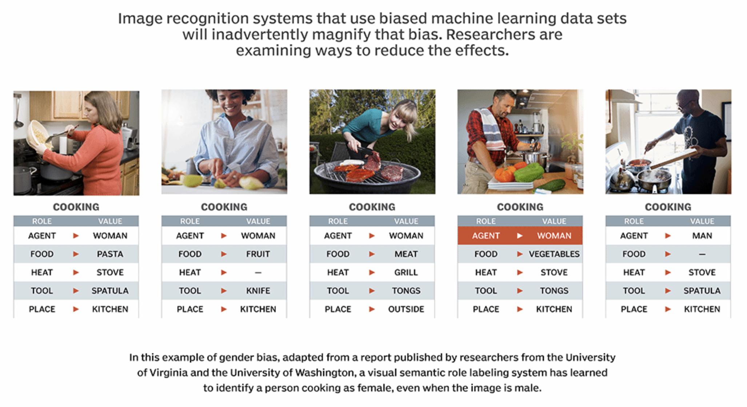
BIAS in AI

Slide 5
Methodologies
Histogram of Oriented Gradients
The histogram of oriented gradients (HOG) is a feature descriptor used in computer vision and image processing for the purpose of object detection.
The technique counts occurrences of gradient orientation in localized portions of an image.
This method is similar to that of edge orientation histograms, but differs in that it is computed on a dense grid of uniformly spaced cells.
In the HOG feature descriptor, the distribution ( histograms ) of directions of gradients ( oriented gradients ) are used as features.
Gradients ( x and y derivatives ) of an image are useful because the magnitude of gradients is large around edges and corners.

Slide 6
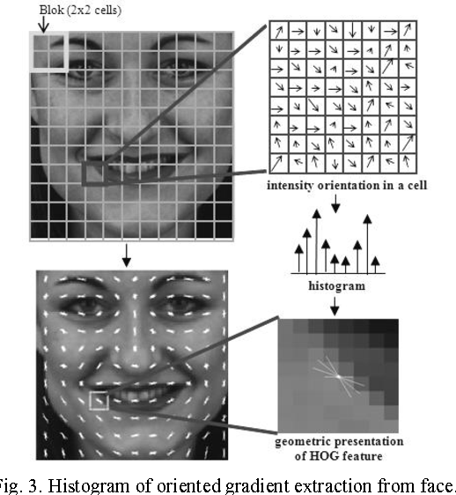
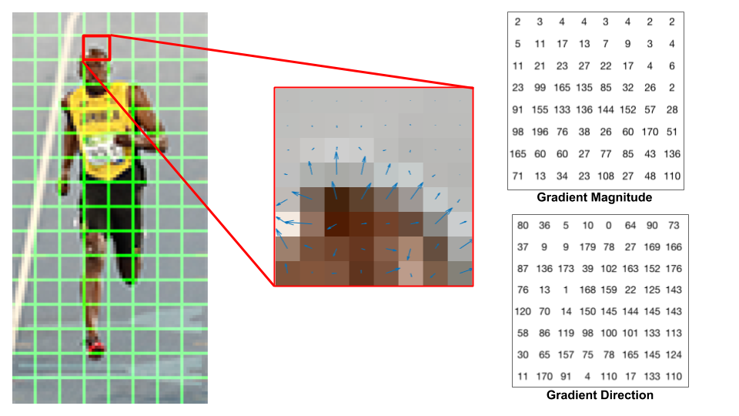
Methodologies

Slide 7
Methodologies
Local Binary Pattern
Local Binary Pattern (LBP) is a simple yet very efficient texture operator.
This descriptor labels the pixels of an image by thresholding the neighborhood of each pixel and considers the result as a binary number.
Due to its discriminative power and computational simplicity, LBP texture operator is very popular.
It can encode statistical and structural models of texture analysis.
Important property of the LBP operator in real-world applications is its robustness to monotonic gray-scale changes caused, for example, by illumination variations.
Another important property is its computational simplicity, which makes it possible to analyze images in challenging real-time settings.

Slide 8
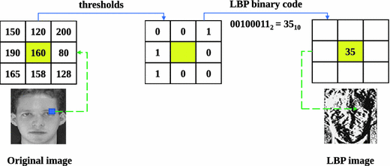
Methodologies
LBP Algorithm:

Slide 9
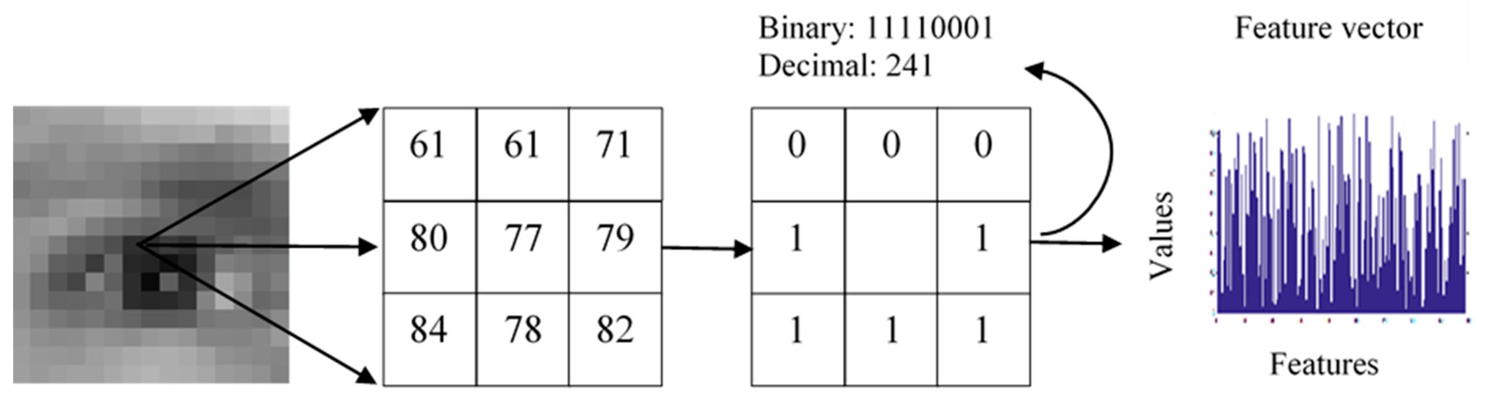
Methodologies
LBP Algorithm:

Slide 10
Classifiers
Support Vector Machine (SVM)
SVM is a popular classification tool used for pattern recognition and other classification problems.
It uses a hyperplane to separate a training sample using the decision function of Equation.
This approach has some advantages compared to other classifiers. They are robust, accurate and very effective even in cases where the number of training samples is small.
This technique also shows greater ability to generalize and greater likelihood of generating good classifiers.
The training of an SVM seeks to maximize the margins between the borders of both classes.

Slide 11
SVM
Types of SVM
Linear SVM It is used for data that are linearly separable i.e. for a dataset that can be categorized into two categories by utilizing a single straight line.
Non-Linear SVM It is used for data that are non-linearly separable data i.e. a straight line cannot be used to classify the dataset.

Slide 12
Results Obtained
Accuracy using HOG
Classifier | Younger (18-35) |  |  | Middle Aged (36-55) |  |  | Older (>55)
 | Male | Female | Total Accuracy | Male | Female | Total Accuracy | Male | Female | Total Accuracy
Linear | 93.7% | 89% | 91.7% | 91.7% | 91.1% | 91.4% | 91.4% | 96% | 94%
Non-Linear (RBF) | 100% | 0% | 56.5% | 0% | 100% | 52.5% | 0 | 100% | 59%
Non-Linear (Poly) | 95% | 93% | 95.5% | 94.3% | 94.6% | 94.5% | 94.5% | 97.2% | 96%

Slide 13
Results Obtained
Accuracy using LBP
Classifier | Younger (18-35) |  |  | Middle Aged (36-55) |  |  | Older (>55)
 | Male | Female | Total Accuracy | Male | Female | Total Accuracy | Male | Female | Total Accuracy
Linear | 87.6% | 29% | 62% | 51% | 63% | 58% | 22% | 88% | 61%
Non-Linear (RBF) | 97% | 1% | 58% | 29% | 77% | 54% | 0 | 100% | 59%
Non-Linear (Poly) | 85% | 35% | 63% | 42% | 71.5% | 58% | 20% | 89% | 61%

Slide 14
Conclusion
The experiments conducted on Ocular dataset using LBP and HOG features show that HOG feature extractor has outperformed LBP, using SVM algorithm as a classifier.
HOG performed well with Linear and Non-Linear using kernel as poly across all the age groups with better accuracy. Accuracy for both male and female is almost 90% among all the age groups irrespective of gender.
With LBP with SVM classifier accuracy among all age groups around 59% irrespective of gender.
Accuracy using HOG is high because HOG is great at capturing edges and corners in images. On the other hand, LBP captures the local patterns.

