Slide 1
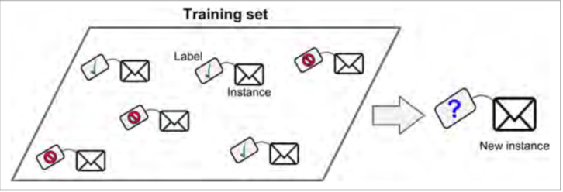
Supervised learning
In supervised learning, the training data you feed to the algorithm includes the desired solutions, called labels
Another typical task is to predict a target numeric value, such as the price of a car,given a set of features (mileage, age, brand, etc.) called predictors.

Slide 2
Examples

Slide 3
Unsupervised Learning
In unsupervised learning, as you might guess, the training data is unlabeled. The system tries to learn without a teacher.
Clustering
—k-Means
—Hierarchical Cluster Analysis (HCA)
—Expectation Maximization

Slide 4
Dimensionality Reduction/ Anomaly detection
A related task is dimensionality reduction, in which the goal is to simplify the data without losing too much information.

Slide 5
Semi-supervised Learning
Some algorithms can deal with partially labeled training data, usually a lot of unlabeled data and a little bit of labeled data. This is called semi-supervised learning.

Slide 6
Main Challenges of Machine Learning
Insufficient Quantity of Training Data

Slide 7
Nonrepresentative Training Data
In order to generalize well, it is crucial that your training data be representative of the new cases you want to generalize to. This is true whether you use instance-based learning or model-based learning.

Slide 8
Poor-Quality Data
Obviously, if your training data is full of errors, outliers, and noise (e.g., due to poor quality measurements), it will make it harder for the system to detect the underlying patterns, so your system is less likely to perform well.
If some instances are clearly outliers, it may help to simply discard them or try to fix the errors manually.
If some instances are missing a few features (e.g., 5% of your customers did not specify their age), you must decide whether you want to ignore this attribute altogether

Slide 9
Overfitting the Training Data
In Machine Learning this is called overfitting: it means that the model performs well on the training data, but it does not generalize well.

Slide 10
Avoiding Overfitting
Overfitting happens when the model is too complex relative to the amount and noisiness of the training data. The possible solutions are:
• To simplify the model by selecting one with fewer parameters (e.g., a linear model rather than a high-degree polynomial model), by reducing the number of attributes in the training data or by constraining the model
• To gather more training data
• To reduce the noise in the training data (e.g., fix data errors and remove outliers)
Constraining a model to make it simpler and reduce the risk of overfitting is called regularization.

Slide 11
No Free Lunch Theorem (Occam Razor)
The “No Free Lunch” theorem states that there is no one model that works best for every problem.
The assumptions of a great model for one problem may not hold for another problem, so it is common in machine learning to try multiple models and find one that works best for a particular problem.

