Slide 1
Hotel reservation system
-Group 3
Team Members
Shreyas Dharanesh(Y557W378)
Surya Devathi(N659A624)
Revanth Reddy(B645F423)
Sushma Bojja(H755A836)

Slide 2
Project Description
This application allows users to book hotel rooms. Using this system user can view and check for various rooms available and simultaneously book them by making online payment via credit card. The system also provides user with additional facilities like Jacuzzi, swimming, meals and additional bed addition along with their associated charges. The system calculates the total cost on booking the services. Once the user makes the payment, system will provide online receipt to the user.
Using this application user can select the room according to his preference. User just must select it and then proceed to payment option. Once user makes the payment system will generate receipt and it will be sent to respective users email id and it will be reported to the admin, when user visits the hotel, he must show the receipt for the accommodation.
Admin can view all the bookings made by the customers.

Slide 3
Requirements
User Registration and Login
Specify dates, search rooms and make Reservations
Add Additional Facilities (Jacuzzi, Swimming pool, Meals, Additional beds)
Make Payment
Generate and e-mail Receipt
Admin can view all bookings

Slide 4
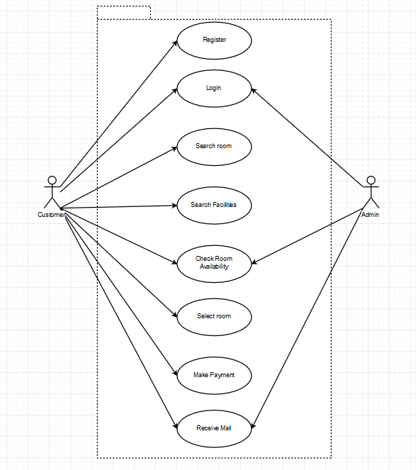
Use Case Diagram

Slide 5
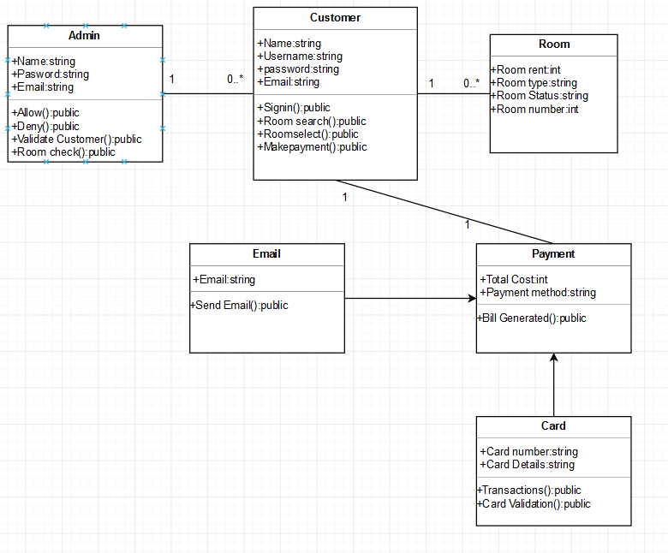
Design- Class Diagram

Slide 6
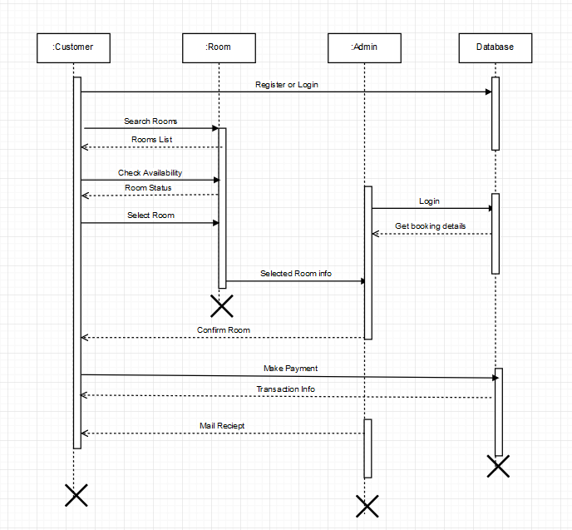
Design- Sequence Diagram

Slide 7
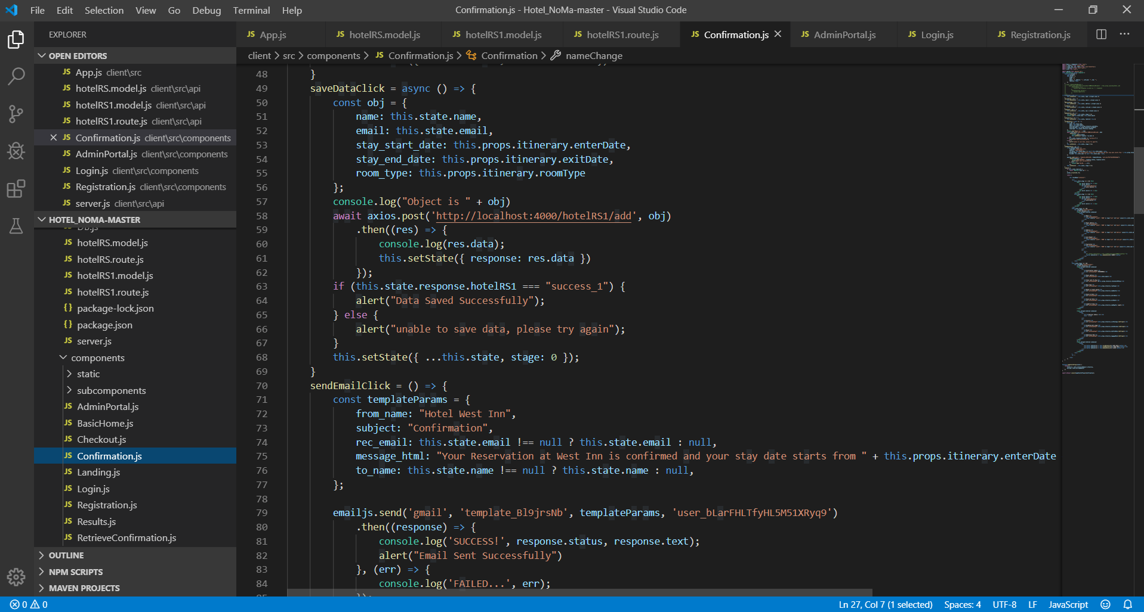
Implementation
IDE
Visual Studio Code
Frontend
ReactJS, HTML, CSS, JS
Database
MongoDB
Mailing SMTP
EmailJS

Slide 8
Testing
User tries to register
Success i.e. Registered Successfully
Failure i.e. Unable to register Please try again
User tries to Login
Success i.e. Goes to Landing Page
Failure i.e. Stays back in same page
User selects specific dates, number of people and particular room of his choice and can add additional facilities and amount reflects respectively
When submits payment
Success i.e. Data saved Successfully and Email Sent successfully
Failure i.e. Unable to save data Please try again

Slide 9
Thank You

