Slide 1
Advanced Software Engineering
CS 780
Electrical Engineering & Computer Science WSU

Slide 2
Instructor
Name: Zhiyong Shan (Tim)
Degree: Ph.D. in Computer Science
Email: zhiyong.shan@wichita.edu
Office: JB 237
Web Page: https://www.wichita.edu/academics/engineering/eecs/faculty/zshan/

Slide 3
How many of you have software development experiences in companies ??

Slide 4
CHAPTER 10
KEY MATERIAL
FROM
PART A

Slide 5
Overview
Software development: theory versus practice
Iteration and incrementation
The Unified Process
Workflow overview
Teams
Cost–benefit analysis
Metrics
CASE
Versions and configurations

Slide 6
Overview (contd)
Testing terminology
Execution-based and non-execution-based testing
Modularity
Reuse
Software project management plan

Slide 7
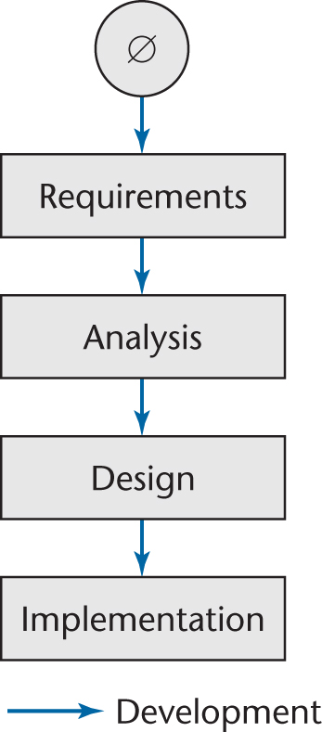
10.1 Software Development: Theory vs. Practice
Ideally, software is developed as described in Chapter 1
  Linear
  Starting from scratch
Figure 10.1

Slide 8
Software Development: Theory vs. Practice (contd)
In the real world, software development is totally different
  We make mistakes
  The client’s requirements change while the software product is being developed
    Moving target problem
Notes:
Moving target examples: warning dialog → sending email → sending text message → make a phone call
What is the difference between making a chair and a software: deterministic and nondeterministic

Slide 9
10.2 Iteration and Incrementation
In real life, we cannot speak about “the design phase”
  Instead, the operations of the design phase are spread out over the life cycle
  We keep returning to earlier workflows
The basic software development process is iterative
  Each successive version is closer to its target than its predecessor
Notes:
Draw cycles

Slide 10
Miller’s Law
At any one time, we can concentrate on only approximately seven chunks (units of information)
To handle larger amounts of information, use stepwise refinement
  Concentrate on the seven aspects that are currently the most important
  Postpone aspects that are currently less critical
  Every aspect is eventually handled, but in order of current importance
This is an incremental process
Notes:
20 modules 7 + 7 + 6, step 1 is for 7 modules, step2 is for 7 more modules, step 3 is for 6 modules. Draw modules and circles.

Slide 11
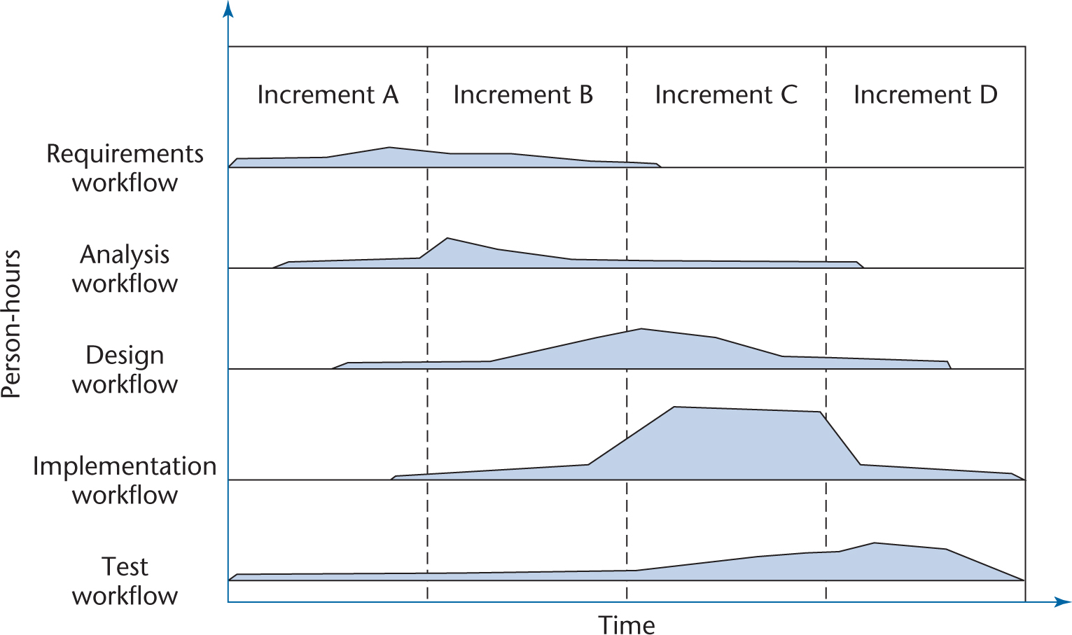
Incrementation
Figure 10.2

Slide 12
Incrementation (contd)
The number of increments will vary — it does not have to be four
Sequential phases do not exist in the real world
Instead, the five core workflows (activities) are performed over the entire life cycle
  Requirements workflow
  Analysis workflow
  Design workflow
  Implementation workflow
  Test workflow

Slide 13
Workflows
However, at most times one workflow predominates
Examples:
  At the beginning of the life cycle
    The requirements workflow predominates
  At the end of the life cycle
    The implementation and test workflows predominate
Planning and documentation activities are performed throughout the life cycle

Slide 14
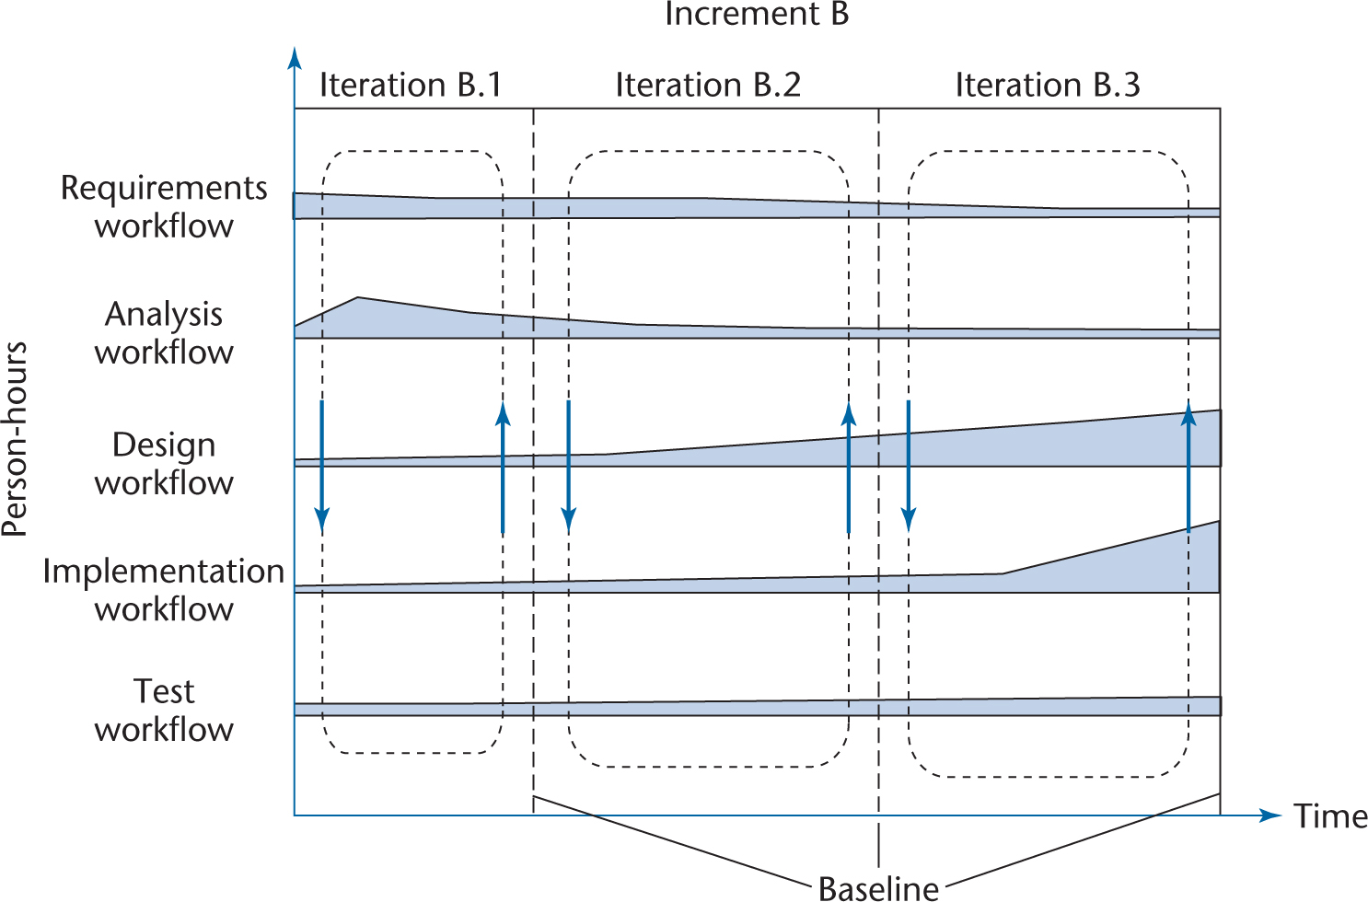
Iteration
Iteration is performed during each incrementation
Figure 10.3

Slide 15
Iteration (contd)
Again, the number of iterations will vary—it is not always three

Slide 16
10.3 The Unified Process
The software process is the way we produce software
It incorporates
  The methodology
    With its underlying software life-cycle model and techniques
  The tools we use
  The individuals building the software

Slide 17
The Unified Process (contd)
Despite its name, the Unified Process is not a process!
  It’s a methodology
The Unified Process is an adaptable methodology
  It has to be modified for the specific software product to be developed
Unified Process is an iterative and incremental software development process framework.
The Unified Process is not simply a process, but rather an extensible framework which should be customized for specific organizations or projects.

Slide 18
The Unified Process (contd)
The Unified Process uses a graphical language, the Unified Modeling Language (UML) to represent the software being developed
A model is a set of UML diagrams that represent various aspects of the software product we want to develop

Slide 19
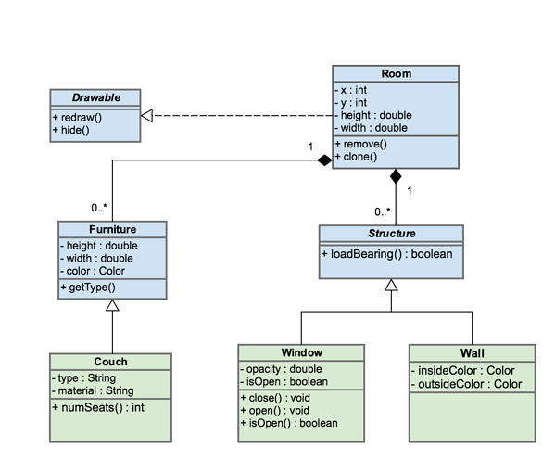
UML Diagram

Slide 20
The Unified Process (contd)
The Unified Process is iterative and incremental in nature
  Each workflow consists of a number of steps, and to carry that workflow, the steps of the workflow are repeatedly performed until the development team is satisfied that they have an accurate UML model of the software product they want to develop.

Slide 21
10.4 Workflow Overview
Requirements workflow
  Determine exactly what the client needs
Analysis workflow
  Analyze and refine the requirements
    To achieve the detailed understanding of the requirements essential for developing a software product correctly and maintaining it easily

Slide 22
Workflow Overview (contd)
Design workflow
  Refine the artifacts of the analysis workflow until the material is in a form that can be implemented by the programmers
Implementation workflow
  Implement the target software product in the chosen implementation language(s)

Slide 23
Workflow Overview (contd)
Test workflow
  Testing is carried out in parallel with the other workflows, from the beginning
  Every developer and maintainer is personally responsible for ensuring that his or her work is correct
  Once the software professional is convinced that an artifact is correct, it is handed over to the software quality assurance group for independent testing

Slide 24
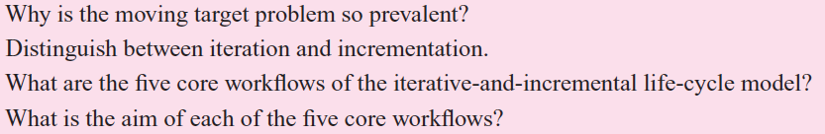
Discussion

Slide 25
10.5 Teams
Software products are usually too large (or too complex) to be built by one software engineering professional within the given time constraints
The work has to be shared among a group of professionals organized as a team

Slide 26
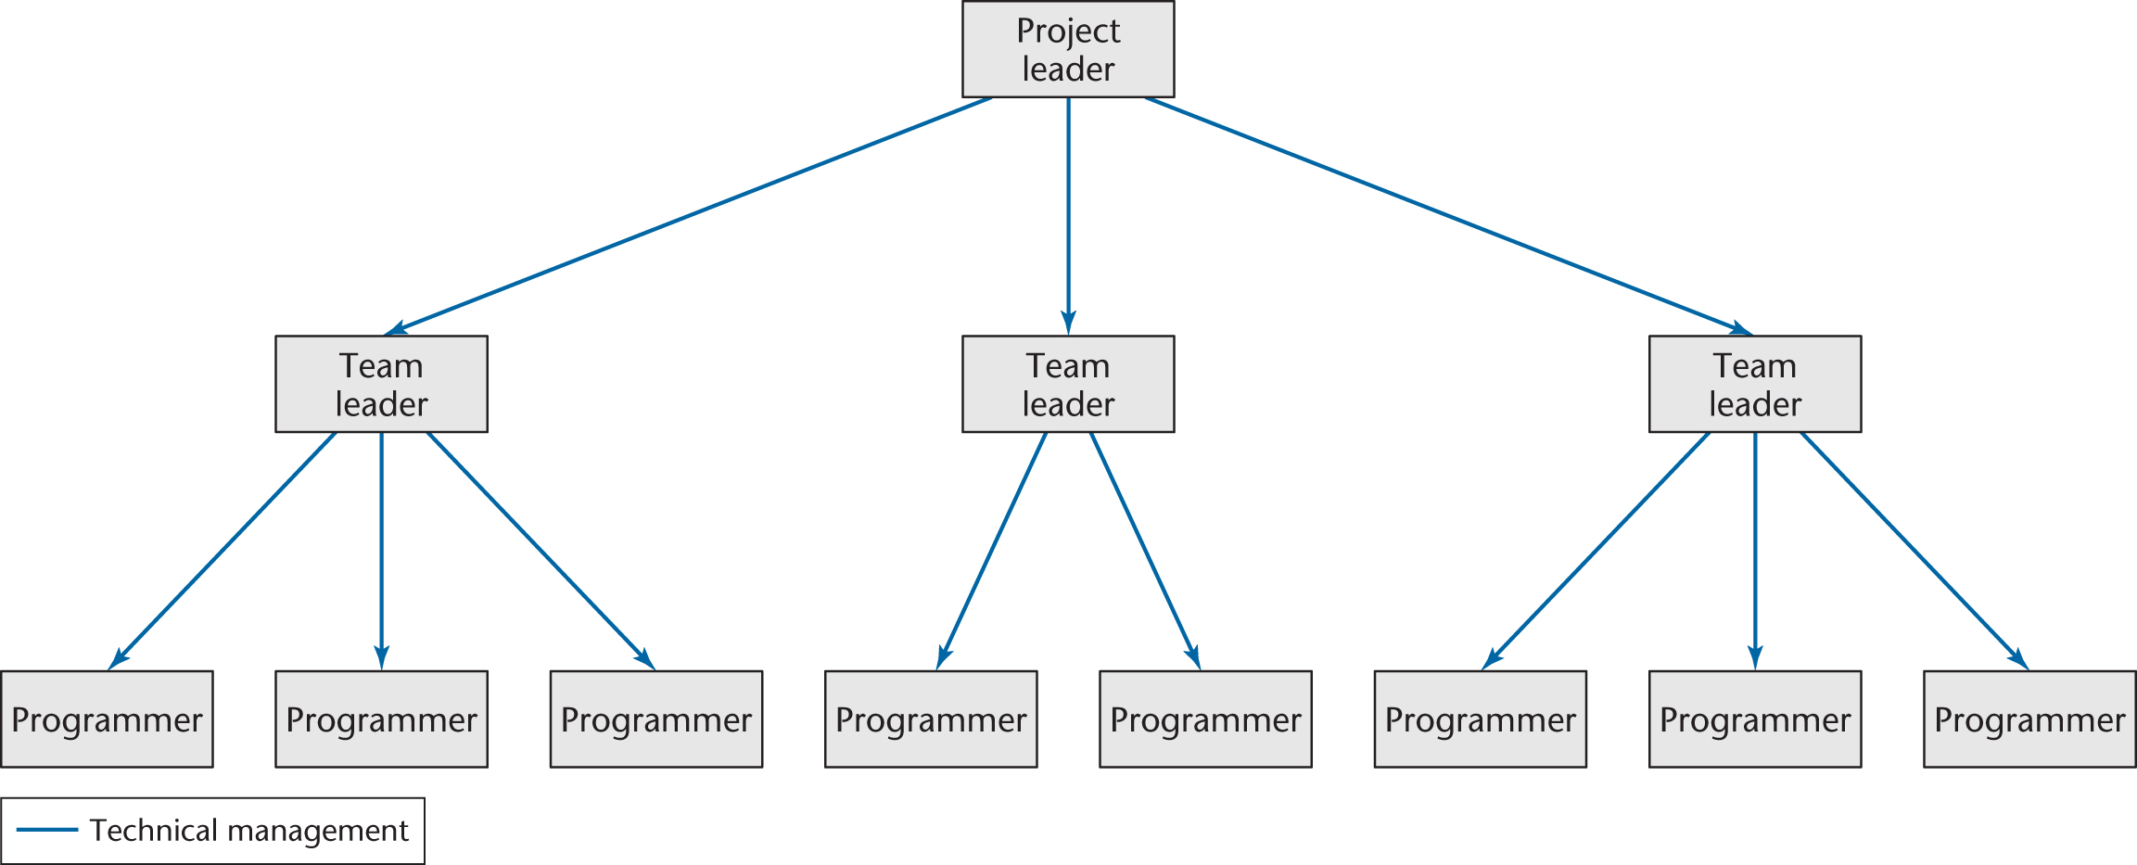
Team Organization
Notes:
Introduce your software development team ?

Slide 27
Teams (contd)
The team approach is used for each of the workflows
In larger organizations there are specialized teams for each workflow
What kind of members should a software development team have ??

Slide 28
10.6 Cost–Benefit Analysis
Cost–benefit analysis is a way of determining whether a possible course of action would be profitable
  Compare estimated future benefits against projected future costs
Cost–benefit analysis is a fundamental technique in deciding whether a client should computerize his or her business
  And if so, in what way
Notes:
Supermarket management system

Slide 29
10.7 Metrics
We need measurements (or metrics) to detect problems early in the software process
  Before they get out of hand

Slide 30
Metrics (contd)
There are five fundamental metrics
  Each must be measured and monitored for each workflow:
1. Size (in lines of code or, better, in a more meaningful metric)
2. Cost (in dollars)
3. Duration (in months)
4. Effort (in person-months)
5. Quality (number of faults detected)

Slide 31
Metrics (contd)
Metrics serve as an early warning system for potential problems
Management uses the fundamental metrics to identify problems
Notes:
Supermarket management system, hope to use it before Christmas, but the duration is 1 year.

Slide 32
10.8 CASE
CASE stands for Computer-Aided Software Engineering
  Software that assists with software development and maintenance
Three categories of CASE software:
  Tools support specific tasks in the software life-cycle.
  Workbenches combine two or more tools focused on a specific part of the software life-cycle.
  Environments combine two or more tools or workbenches and support the complete software life-cycle.

Slide 33
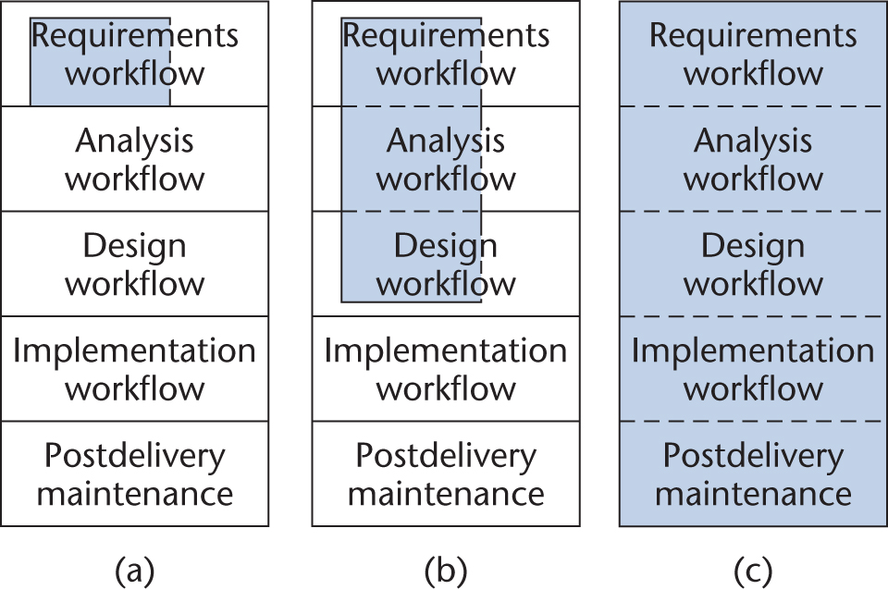
Taxonomy of CASE (contd)
Figure 5.9
(a) Tool versus (b) workbench versus (c) environment

Slide 34
CASE Taxonomy
A CASE tool assists in just one aspect of the production of software
  Examples:
    A tool that draws UML diagrams
    A report generator, which generates the code needed for producing a report

Slide 35
CASE Taxonomy (contd)
A CASE workbench is a collection of tools that together support one or two activities
  Examples:
    A requirements, analysis, and design workbench that incorporates a UML diagram tool and a consistency checker
    A project management workbench that is used in every workflow
A CASE environment supports the complete software process
Does anybody have experiences on the use of CASE ?

Slide 36
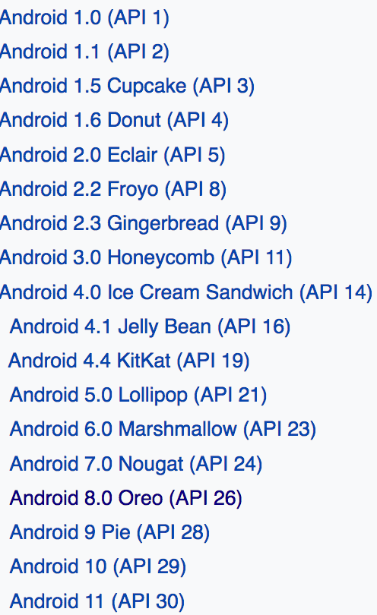
10.9 Versions and Configurations
During development and maintenance, there are at least two versions of the product
  The old version, and
  The new version
There will also be two or more versions of each of the component artifacts that have been changed

Slide 37
Versions and Configurations (contd)
The new version of an artifact may be less correct than the previous version
It is therefore essential to keep all versions of all artifacts
  A CASE tool that does this is called a version control tool
Version control is a tool that records changes to a file or set of files over time so that you can recall specific versions later.
Version control also can resolve conflicts caused by concurrent modifications on the same software.

Slide 38
Versions and Configurations (contd)
A configuration of a version of the product is
  A set of specific versions of each artifact from which that version of the complete product is built
  A configuration-control tool can handle problems caused by development and maintenance by teams
    In particular, when more than one person attempts to change the same artifact
A baseline is a configuration of all the artifacts in the product
  After each group of changes has been made to the artifacts, a new baseline is attained
Notes:
A baseline is a tested configuration

Slide 39
Versions and Configurations (contd)
If a software organization does not wish to purchase a complete configuration-control tool, then, at the very least,
  A version-control tool must be used in conjunction with
  A build tool, that is, a tool that assists in selecting the correct version of each compiled-code artifact to be linked to form a specific version of the product
    Build tools, such as make, have been incorporated into a wide variety of programming environments
Any other Version/Configuration tools you know ?
Notes:
SVN, Git

Slide 40
10.10 Testing Terminology
A fault is injected into a software product when a human makes a mistake
  “An incorrect step, process, or data definition in a computer program”
A failure is the observed incorrect behavior of the software product as a consequence of a fault
The error is the amount by which a result is incorrect
  “A difference…between a computed result and the correct result”
The word defect is a generic term for a fault, failure, or error

Slide 41
Testing Terminology (contd)
The quality of software is the extent to which the product satisfies its specifications
Within a software organization, the primary task of the software quality assurance (SQA) group is to test that the developers’ product is correct

Slide 42
10.11 Execution-Based and Non-Execution-Based Testing
There are two basic forms of testing:
  Execution-based testing (running test cases)
    Manual test
    Automatic test
  Non-execution-based testing
    carefully reading through an artifact
    Static program analysis
Notes:
Who has the experience to develop Android app ?

Slide 43
Non-Execution-Based Testing
In a review, a team of software professionals carefully checks through a document
  Examples:
    specification document
    design document
    code artifact
How does your team perform non-execution-based testing ?
Notes:
Review code with each other

Slide 44
Non-Execution-Based Testing (contd)
Non-execution-based testing has to be used when testing artifacts of the requirements, analysis, and design workflows
Execution-based testing can be applied to only the code of the implementation workflow
Non-execution-based testing of code (code review) has been shown to be as effective as execution-based testing (running test cases)

Slide 45

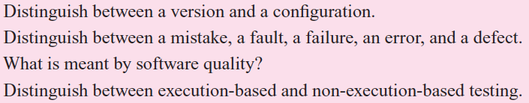

Slide 46
10.12 Modularity
A module is
  A lexically contiguous sequence of program statements,
  Bounded by boundary elements (that is, {…} pairs),
  Having an aggregate identifier
Examples:
  Procedures and functions of the classical paradigm
  Objects
  Methods within an object

Slide 47
Three Design Objectives
Ensure that the coupling (degree of interaction between two modules) is as low as possible
  An ideal product exhibits only data coupling
    Every argument is either a simple argument or a data structure for which all elements are used by the called module
Ensure that the cohesion (degree of interaction within a module) is as high as possible
Notes:
Coupling: sharing global variables
Cohesion: print data and send email. Generate graph and print graph

Slide 48
Modularity (contd)
Maximize information hiding
  Ensure that implementation details are not visible outside the module in which they are declared
    In the object-oriented paradigm, this can be achieved by careful use of the private and protected visibility modifiers

Slide 49
10.13 Reuse
Reuse refers to using components of one product to facilitate the development of a different product with a different functionality
  Examples of a reusable component:
    Module
    Class
    Code fragment
    Design
    Part of a manual
    Set of test data, a contract
    Duration and cost estimate
    Can you give a real example for reuse ??

Slide 50
Reuse (contd)
Reuse is most important because
  It takes time (= money) to
    specify,
    design,
    implement,
    test, and
    document
  a software component
If we reuse a component, we must retest the component in its new context

Slide 51
10.14 Software Project Management Plan
The components of a software project management plan:
  The resources with which to do it
  The work to be done
  The money to pay for it

Slide 52
Resources
Resources needed for software development:
  People
  Hardware
  Support software
Use of resources varies with time
  The entire software development plan must be a function of time

Slide 53
Three Work Categories
Project function
  Work carried on throughout the project
  Examples:
    Project management
    Quality control

Slide 54
Three Work Categories (contd)
Activity
  Work that relates to a specific phase
  A major unit of work
    With precise beginning and ending dates,
    That consumes resources, and
    Results in work products like the budget, design, schedules, source code, or users’ manual
Task
  An activity comprises a set of tasks (the smallest unit of work subject to management accountability)

Slide 55
Completion of Work Products
A milestone is the date on which the work product is to be completed
It must first pass reviews performed by
  Fellow team members
  Management
  The client
Once the work product has been reviewed and agreed upon, it becomes a baseline

Slide 56
Software Project Management Plan (contd)
A work package is
  A work product, plus
    Staffing requirements
    Duration
    Resources
    The name of the responsible individual
    Acceptance criteria for the work product
    The detailed budget as a function of time, allocated to
      Project functions
      Activities

Slide 57
Software Project Management Plan (contd)
Money is a vital component of the plan
  A detailed budget must be worked out
  The money must be allocated, as a function of time, to the project functions and activities
Key components of the plan include
  The cost estimate, and
  The duration estimate

Slide 58
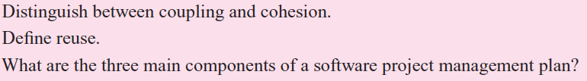
Discussion

