Slide 1
Object-Oriented and
Classical Software Engineering
Eighth Edition, WCB/McGraw-Hill, 2011
Stephen R. Schach

Slide 2
CHAPTER 15
IMPLEMENTATION

Slide 3
15.1 Choice of Programming Language
The language is usually specified in the contract
But what if the contract specifies that
  The product is to be implemented in the “most suitable” programming language
What language should be chosen?

Slide 4
Choice of Programming Language (contd)
Example
  QQQ Corporation has been writing COBOL programs for over 25 years
  Over 200 software staff, all with COBOL expertise
  What is “the most suitable” programming language?
Obviously COBOL

Slide 5
Choice of Programming Language (contd)
What happens when new language (C++, say) is introduced
  C++ professionals must be hired
  Existing COBOL professionals must be retrained
  Future products are written in C++
  Existing COBOL products must be maintained
  There are two classes of programmers
    COBOL maintainers (despised)
    C++ developers (paid more)
  100s of person-years of expertise with COBOL are wasted

Slide 6
Choice of Programming Language (contd)
The only possible conclusion
  COBOL is the “most suitable” programming language
And yet, the “most suitable” language for the latest project may be C++
  COBOL is suitable for only data processing applications
How to choose a programming language
  Cost–benefit analysis
  Compute costs and benefits of all relevant languages

Slide 7
Discussion
Can you tell us the advantages of C++, Java and Python respectively ?

Slide 8
15.3 Good Programming Practice
Use of consistent and meaningful variable names
  “Meaningful” to future maintenance programmers
  “Consistent” to aid future maintenance programmers

Slide 9
15.3.1 Use of Consistent and Meaningful Variable Names
A code artifact includes the variable names freqAverage, frequencyMaximum, minFr, frqncyTotl
A maintenance programmer has to know if freq, frequency, fr, frqncy all refer to the same thing
  If so, use the identical word, preferably frequency, perhaps freq or frqncy, but not fr
  If not, use a different word (e.g., rate) for a different quantity

Slide 10
Consistent and Meaningful Variable Names
We can use frequencyAverage, frequencyMaximum, frequencyMinimum, frequencyTotal
We can also use averageFrequency, maximumFrequency, minimumFrequency, totalFrequency
But all four names must come from the same set

Slide 11
15.3.2 The Issue of Self-Documenting Code
Self-documenting code is exceedingly rare
  The variable names are chosen so carefully and their code crafted so exquisitely that there is no need for comments.
The key issue: Can the code artifact be understood easily and unambiguously by
  The SQA team
  Maintenance programmers
  All others who have to read the code

Slide 12
Self-Documenting Code Example
Example:
  Code artifact contains the variable xCoordinateOfPositionOfRobotArm
  This is abbreviated to xCoord
  This is fine, because the entire module deals with the movement of the robot arm
  But does the maintenance programmer know this?
Solution:
  Explain every variable name at the beginning of the code artifact.

Slide 13
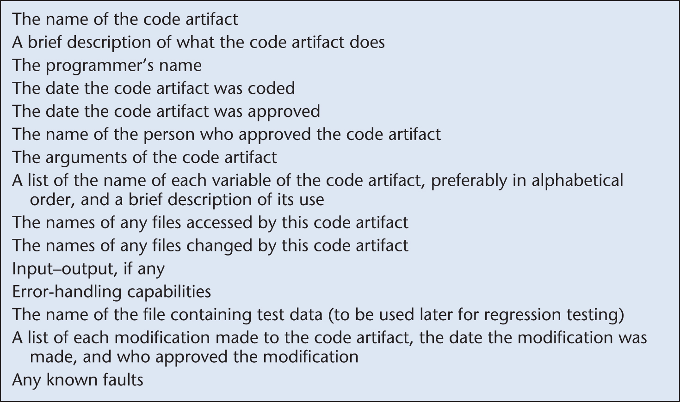
Prologue Comments
Minimal prologue comments for a code artifact
Figure 15.1

Slide 14
Other Comments
Suggestion
  Comments are essential whenever the code is written in a non-obvious way, or makes use of some subtle aspect of the language
Nonsense!
  Recode in a clearer way
  We must never promote/excuse poor programming
  However, comments can assist future maintenance programmers

Slide 15
15.3.3 Use of Parameters
There are almost no genuine constants. So don’t hard code.
  Sales tax rate
One solution:
  Use const statements (C++), or
  Use public static final statements (Java)
A better solution:
  Read the values of “constants” from a parameter file

Slide 16
Exercise
Please write a code example to resolve the issue of hard-coded file name.

Slide 17
15.3.4 Code Layout for Increased Readability
Use indentation
Use plenty of blank lines
  To break up big blocks of code

Slide 18
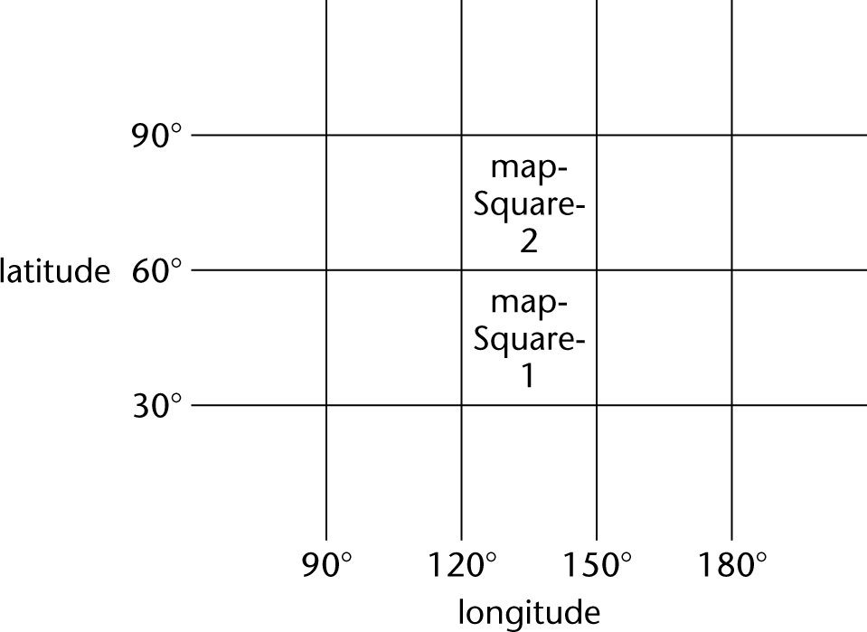
15.3.5 Nested if Statements
Example
  A map consists of two squares. Write code to determine whether a point on the Earth’s surface lies in mapSquare1 or mapSquare2, or is not on the map
Figure 15.2

Slide 19
Nested if Statements (contd)
Solution 1. Badly formatted
Figure 15.3

Slide 20
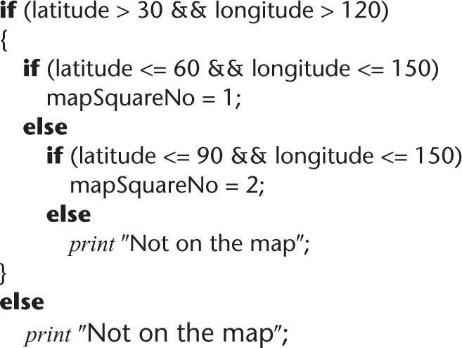
Nested if Statements (contd)
Solution 2. Well-formatted, badly constructed
Figure 15.4

Slide 21
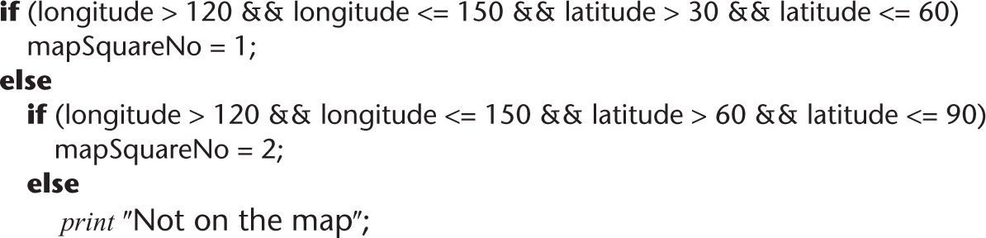
Nested if Statements (contd)
Solution 3. Acceptably nested
Figure 15.5

Slide 22
Nested if Statements (contd)
A combination of if-if and if-else-if statements is usually difficult to read
Simplify: The if-if combination
  if <condition1>
  if <condition2>
is frequently equivalent to the single condition
  if <condition1> && <condition2>

Slide 23
Nested if Statements (contd)
Rule of thumb
  if statements nested to a depth of greater than three should be avoided as poor programming practice

Slide 24
Discussion
  How to change if statements nested to a depth of greater than three ? Give an example.

Slide 25
15.4 Programming Standards
Standards can be both a blessing and a curse
Modules of coincidental cohesion arise from rules like
  “Every module will consist of between 35 and 50 executable statements”
Better
  “Programmers should consult their managers before constructing a module with fewer than 35 or more than 50 executable statements”

Slide 26
Examples of Good Programming Standards
“Nesting of if statements should not exceed a depth of 3, except with prior approval from the team leader”
“Modules should consist of between 35 and 50 statements, except with prior approval from the team leader”
“Use of gotos should be avoided. However, with prior approval from the team leader, a forward goto may be used for error handling”

Slide 27
Remarks on Programming Standards (contd)
The aim of standards is to make maintenance easier
  If they make development difficult, then they must be modified
  Overly restrictive standards are counterproductive

Slide 28
15.5 Code Reuse
Code reuse is the most common form of reuse
However, artifacts from all workflows can be reused

Slide 29
15.6 Integration
The approach up to now:
  Implementation followed by integration
This is a poor approach
Better:
  Combine implementation and integration methodically

Slide 30
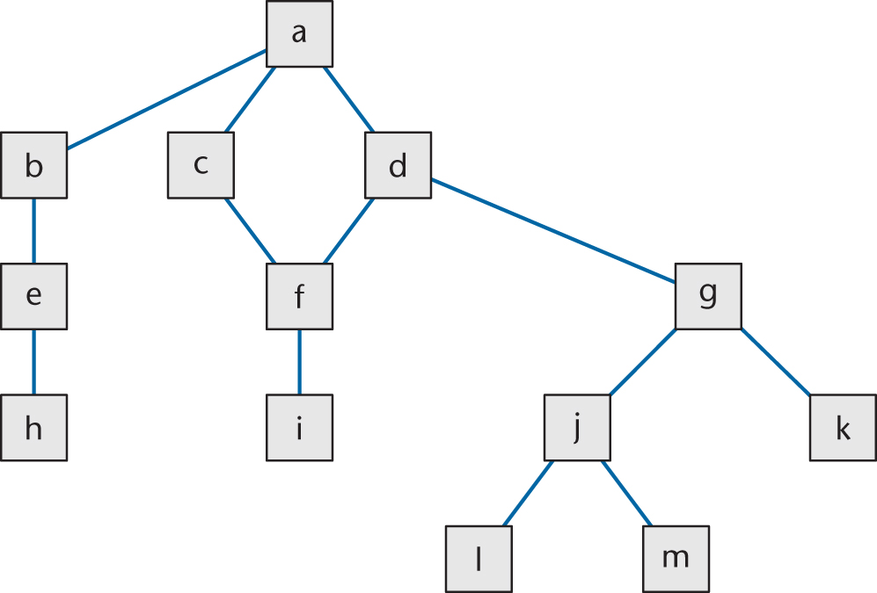
Product with 13 Modules
Figure 15.6

Slide 31
Implementation, Then Integration
Code and test each code artifact separately
Link all 13 artifacts together, test the product as a whole

Slide 32
Drivers and Stubs
To test artifact a, artifacts b, c, d must be stubs
  An empty artifact, or
  Prints a message ("Procedure radarCalc called"), or
  Returns precooked values from preplanned test cases
To test artifact h on its own requires a driver, which calls it
  Once, or
  Several times, or
  Many times, each time checking the value returned
Testing artifact d requires a driver and two stubs

Slide 33
Implementation, Then Integration (contd)
Problem 1
  Stubs and drivers must be written, then thrown away after unit testing is complete
Problem 2
  Lack of fault isolation (If the product as a whole is tested against a specific test case and the product fails, then)
  A fault could lie in any of the 13 artifacts or 13 interfaces
  In a large product with, say, 103 artifacts and 108 interfaces, there are 211 places where a fault might lie

Slide 34
Implementation, Then Integration (contd)
Solution to both problems
  Combine unit and integration testing

Slide 35
15.6.1 Top-down Integration
If code artifact mAbove sends a message to artifact mBelow, then mAbove is implemented and integrated before mBelow
One possible top-down ordering is
  a, b, c, d, e, f, g,
  h, i, j, k, l ,m
Figure 15.6 (again)

Slide 36
Top-down Integration (contd)
Another possible top-down ordering is
  a
  [a] b, e, h
  [a] c ,d, f, i
  [a, d] g, j, k, l, m
Figure 15.6 (again)

Slide 37
Top-down Integration (contd)
Advantage 1: Fault isolation
  A previously successful test case fails when mNew is added to what has been tested so far
    The fault must lie in mNew or the interface(s) between mNew and the rest of the product
Advantage 2: Stubs are not wasted
  Each stub is expanded into the corresponding complete artifact at the appropriate step

Slide 38
Top-down Integration (contd)
Advantage 3: Major design flaws show up early
  Logic artifacts include the decision-making flow of control
    In the example, artifacts a, b, c, d, g, j
  Operational artifacts perform the actual operations of the product
    In the example, artifacts e, f, h, i, k, l, m
  The logic artifacts are developed before the operational artifacts

Slide 39
Top-down Integration (contd)
Problem 1
  Reusable artifacts are not properly tested
  Lower level (operational) artifacts are not tested frequently
Defensive programming (fault shielding)
  Example:
  if (x >= 0)
    y = computeSquareRoot (x, errorFlag);
  computeSquareRoot is never tested with x < 0
  This has implications for reuse
  What is your solution for this ??

Slide 40
15.6.2 Bottom-up Integration
If code artifact mAbove calls code artifact mBelow, then mBelow is implemented and integrated before mAbove
One possible bottom-up ordering is
  l, m, h, i, j, k, e,
  f, g, b, c, d, a
Figure 15.6 (again)

Slide 41
15.6.2 Bottom-up Integration
Another possible bottom-up ordering is
h, e, b
i, f, c, d
l, m, j, k, g [d]
a [b, c, d]
Figure 15.6 (again)

Slide 42
Bottom-up Integration (contd)
Advantage 1
  Operational artifacts are thoroughly tested
Advantage 2
  Operational artifacts are tested with drivers, not by fault shielding, defensively programmed artifacts
Advantage 3
  Fault isolation

Slide 43
Bottom-up Integration (contd)
Difficulty 1
  Major design faults are detected late
Solution
  Combine top-down and bottom-up strategies making use of their strengths and minimizing their weaknesses

Slide 44
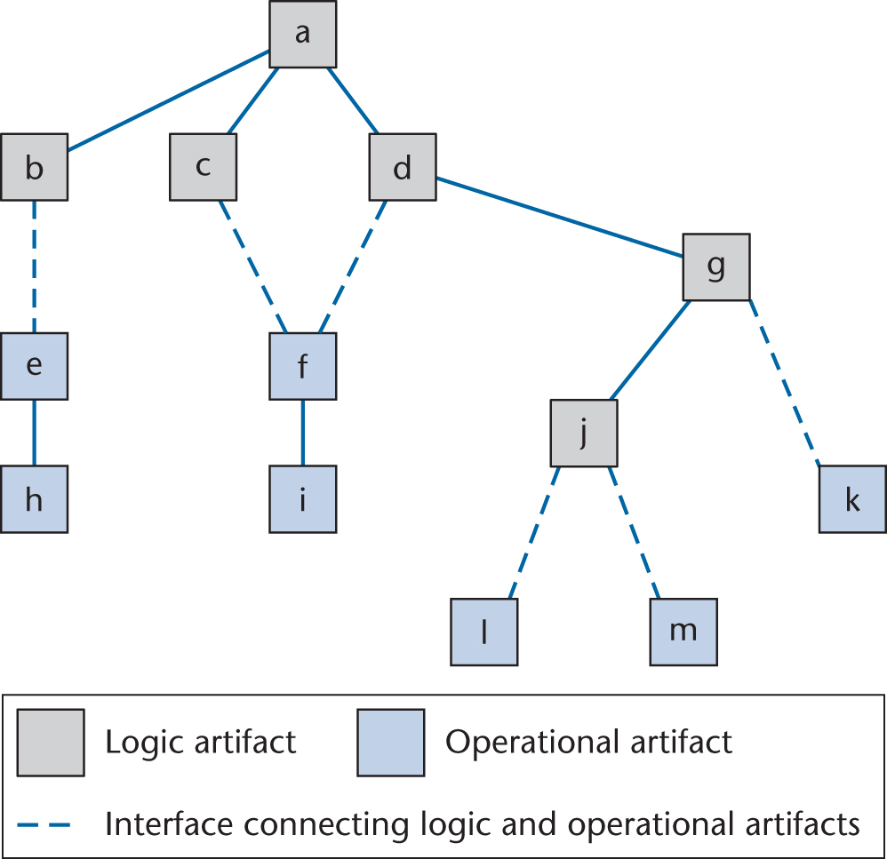
15.6.3 Sandwich Integration
Logic artifacts are integrated top-down
Operational artifacts are integrated bottom-up
Finally, the interfaces between the two groups are tested
Figure 15.7

Slide 45
Sandwich Integration (contd)
Advantage 1
  Major design faults are caught early
Advantage 2
  Operational artifacts are thoroughly tested
  They may be reused with confidence
Advantage 3
  There is fault isolation at all times

Slide 46
Discussion
Explain the difference between logic artifacts and operational artifacts.
What is fault isolation ?
What is defensive programming ?
What is top down integration, bottom up integration and sandwich integration ?
What are the advantages and disadvantages of the three integration methods ?

Slide 47
15.6.5 Management of Integration
Example:
  Design document used by programmer P₁ (who coded code object o1) shows o1 sends a message to o2 passing 4 arguments
  Design document used by programmer P₂ (who coded code artifact o2) states clearly that only 3 arguments are passed to o2
Solution:
  The integration process must be run by the SQA group
  They have the most to lose if something goes wrong

Slide 48
15.7 The Implementation Workflow
The aim of the implementation workflow is to implement the target software product
A large product is partitioned into subsystems
  Implemented in parallel by coding teams
Subsystems consist of components or code artifacts

Slide 49
The Implementation Workflow (contd)
Once the programmer has implemented an artifact, he or she unit tests it
Then the module is passed on to the SQA group for further testing
  This testing is part of the test workflow

Slide 50
15.9 The Test Workflow: Implementation
Unit testing
  Informal unit testing by the programmer
  Methodical unit testing by the SQA group
There are two types of methodical unit testing
  Non-execution-based testing
  Execution-based testing

Slide 51
15.10 Test Case Selection
Worst way — random testing
  There is no time to test all possible test cases, totaling perhaps 10¹⁰⁰ or more
We need a systematic way to construct test cases

Slide 52
15.10.1 Testing to Specifications versus Testing to Code
There are two extremes to testing
Test to specifications (also called black-box, data-driven, functional, or input/output driven testing)
  Ignore the code — use the specifications to select test cases
Test to code (also called glass-box, logic-driven, structured, or path-oriented testing)
  Ignore the specifications — use the code to select test cases

Slide 53
15.10.2 Feasibility of Testing to Specifications
Example:
  The specifications for a data processing product include 5 types of commission and 7 types of discount
  35 test cases

Slide 54
Feasibility of Testing to Specifications (contd)
Suppose the specifications include 20 factors, each taking on 4 values
  There are 4²⁰ or 1.1 × 10¹² test cases
  If each takes 30 seconds to run, running all test cases takes more than 1 million years
The combinatorial explosion makes testing to specifications impossible

Slide 55
15.10.3 Feasibility of Testing to Code
Each path through an artifact must be executed at least once
  Combinatorial explosion

Slide 56
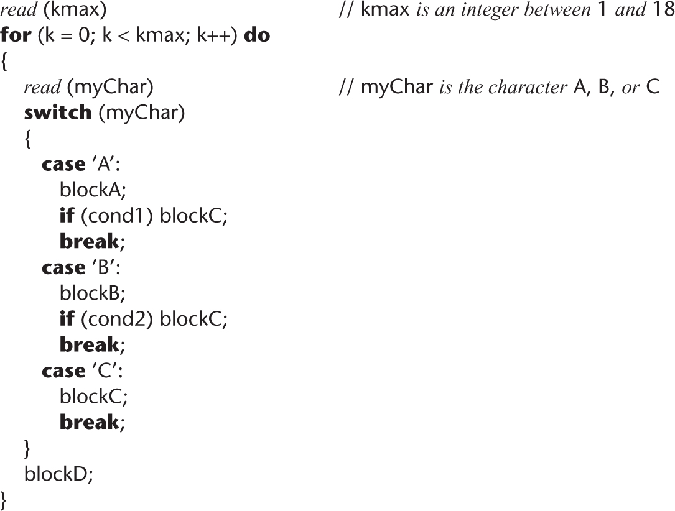
Feasibility of Testing to Code (contd)
Code example:
Figure 15.9

Slide 57
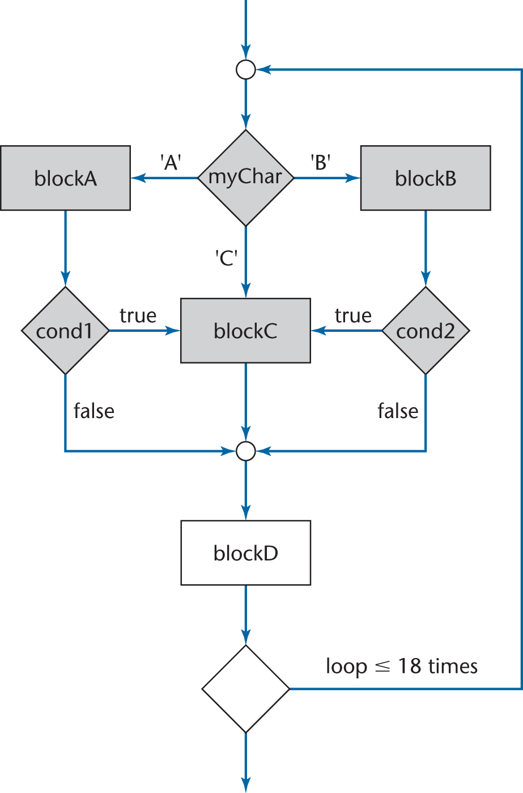
Feasibility of Testing to Code (contd)
The flowchart has over 10¹² different paths
Figure 15.10

Slide 58
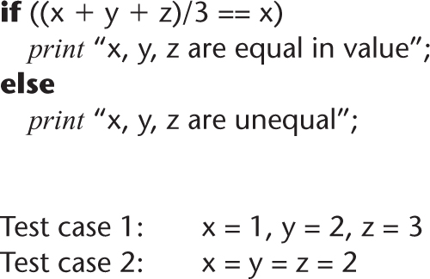
Feasibility of Testing to Code (contd)
Testing to code is not reliable
We can exercise every path without detecting every fault
Figure 15.11

Slide 59
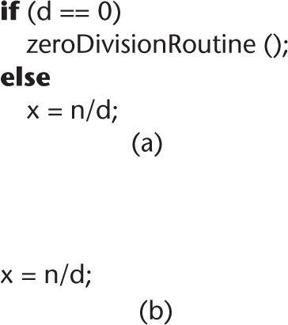
Feasibility of Testing to Code (contd)
A path can be tested only if it is present
A programmer who omits the test for d = 0 in the code probably is unaware of the possible danger
Figure 15.12

Slide 60
Feasibility of Testing to Code (contd)
Criterion “exercise all paths” is not reliable
  Products exist for which some data exercising a given path detect a fault, and other data exercising the same path do not

Slide 61
15.11 Black-Box Unit-testing Techniques
Neither exhaustive testing to specifications nor exhaustive testing to code is feasible
The art of testing:
  Select a small, manageable set of test cases to
  Maximize the chances of detecting a fault, while
  Minimizing the chances of wasting a test case
Every test case must detect a previously undetected fault

Slide 62
Black-Box Unit-testing Techniques (contd)
We need a method that will highlight as many faults as possible
  First black-box test cases (testing to specifications)
  Then glass-box methods (testing to code)

Slide 63
15.11.1 Equivalence Testing and Boundary Value Analysis
Example
  The specifications for a DBMS state that the product must handle any number of records between 1 and 16,383 (2¹⁴ – 1)
  If the system can handle 34 records and 14,870 records, then it probably will work fine for 8,252 records
If the system works for any one test case in the range (1..16,383), then it will probably work for any other test case in the range
  Range (1..16,383) constitutes an equivalence class

Slide 64
Equivalence Testing
Any one member of an equivalence class is as good a test case as any other member of the equivalence class
Range (1..16,383) defines three different equivalence classes:
  Equivalence Class 1: Fewer than 1 record
  Equivalence Class 2: Between 1 and 16,383 records
  Equivalence Class 3: More than 16,383 records

Slide 65
Boundary Value Analysis
Select test cases on or just to one side of the boundary of equivalence classes
  This greatly increases the probability of detecting a fault

Slide 66
Database Example (contd)
Test case 1: 0 records Member of equivalence class 1 and adjacent to boundary value
Test case 2: 1 record Boundary value
Test case 3: 2 records Adjacent to boundary value
Test case 4: 723 records Member of equivalence
class 2

Slide 67
Database Example (contd)
Test case 5: 16,382 records Adjacent to
boundary value
Test case 6: 16,383 records Boundary value
Test case 7: 16,384 records Member of equivalence class 3 and adjacent to boundary value

Slide 68
Equivalence Testing of Output Specifications
We also need to perform equivalence testing of the output specifications
Example:
  In 2008, the minimum Social Security (OASDI) deduction from any one paycheck was $0, and the maximum was $6,324
  Test cases must include input data that should result in deductions of exactly $0 and exactly $6,324
  Also, test data that might result in deductions of less than $0 or more than $6,324

Slide 69
Overall Strategy
Equivalence classes together with boundary value analysis to test both input specifications and output specifications
  This approach generates a small set of test data with the potential of uncovering a large number of faults

Slide 70
15.11.2 Functional Testing
An alternative form of black-box testing for classical software
  We base the test data on the functionality of the code artifacts
Each item of functionality or function is identified
Test data are devised to test each (lower-level) function separately
Then, higher-level functions composed of these lower-level functions are tested

Slide 71
Functional Testing (contd)
In practice, however
  Higher-level functions are not always neatly constructed out of lower-level functions using the constructs of structured programming
  Instead, the lower-level functions are often intertwined
Also, functionality boundaries do not always coincide with code artifact boundaries
  The distinction between unit testing and integration testing becomes blurred
  This problem also can arise in the object-oriented paradigm when messages are passed between objects

Slide 72
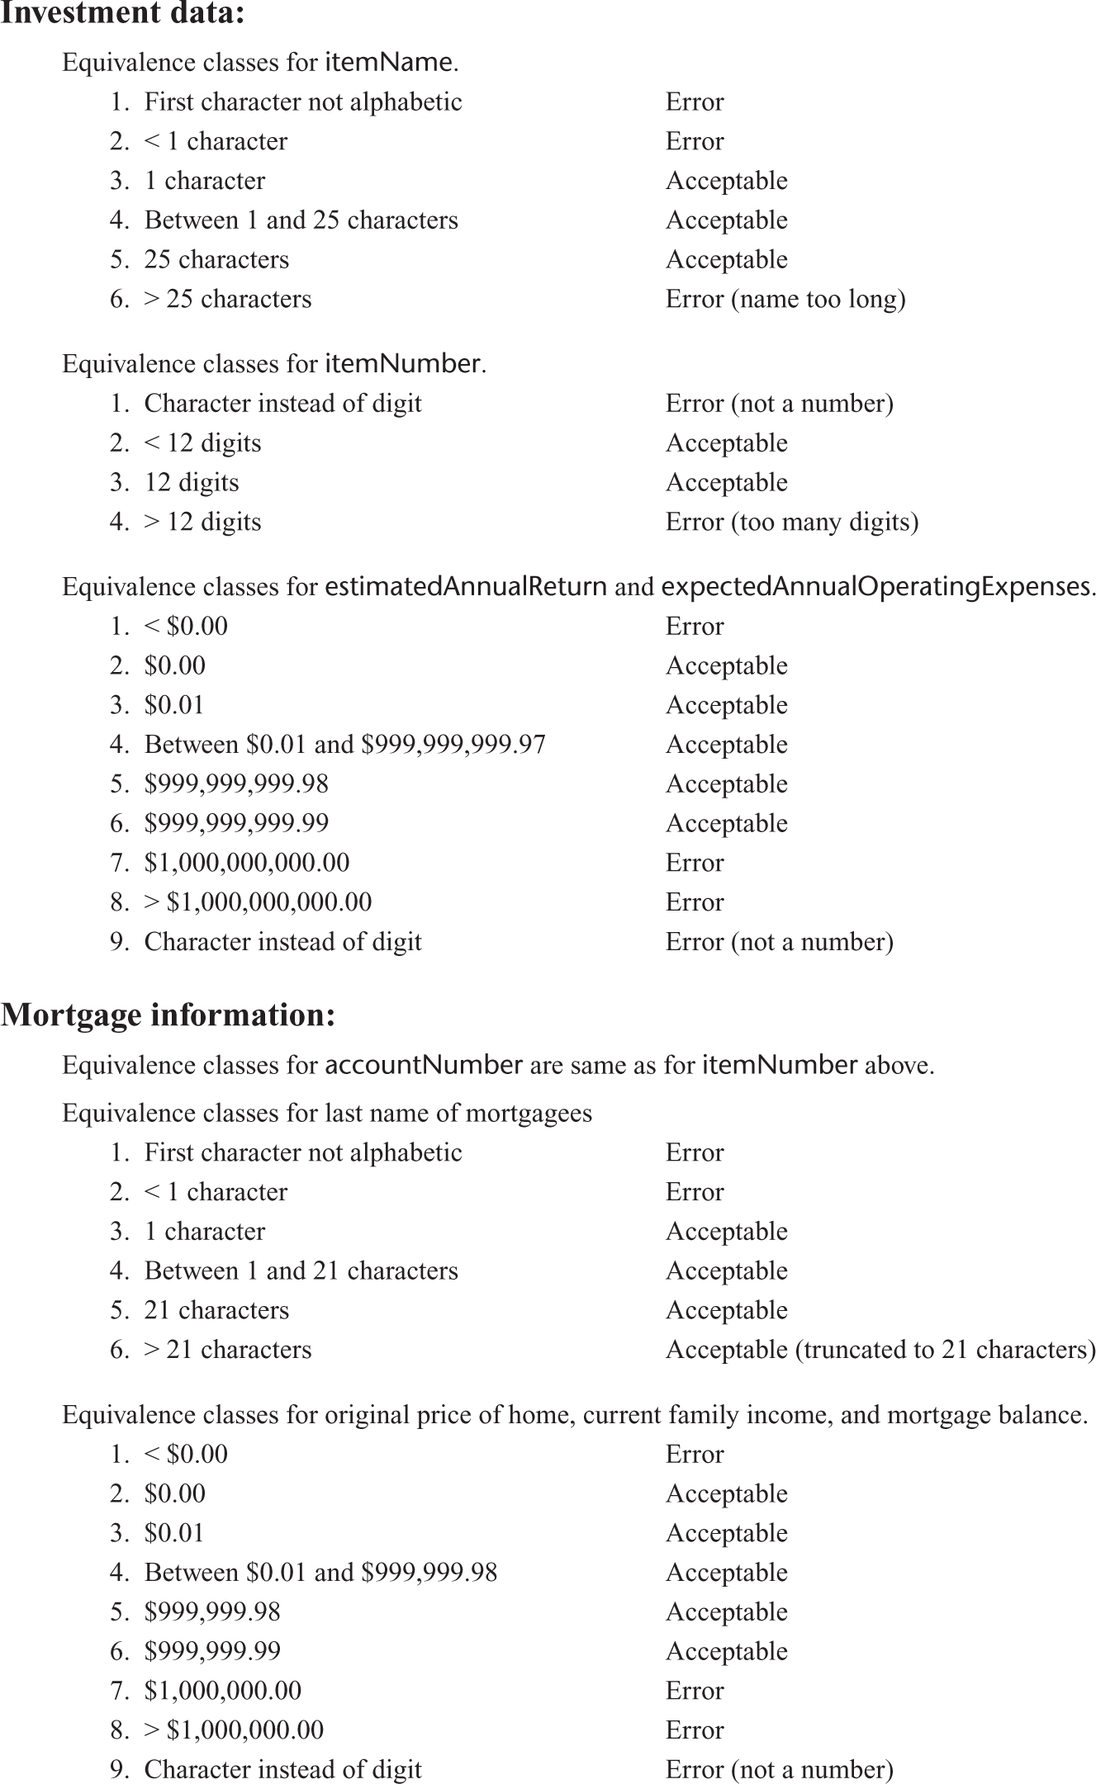
15.12 Black-Box Test Cases: The MSG Foundation Case Study
Test cases derived from equivalence classes and boundary value analysis
Figure 15.13a

Slide 73
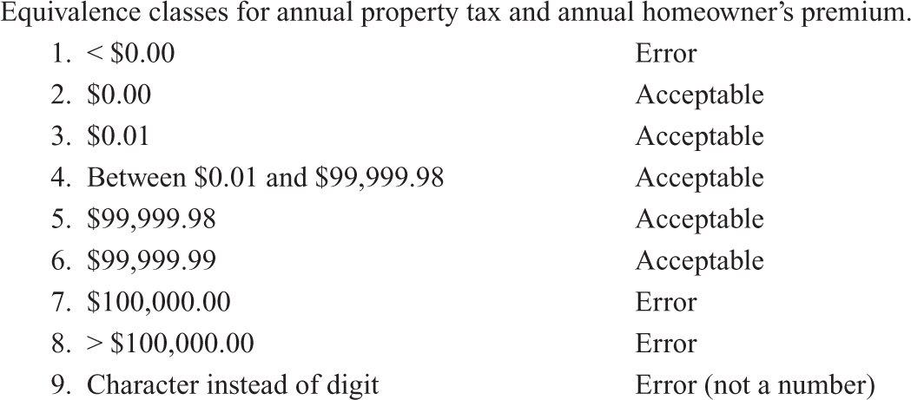
Black-Box Test Cases: MSG Foundation (contd)
Test cases derived from equivalence classes and boundary value analysis (contd)
Figure 15.13b

Slide 74
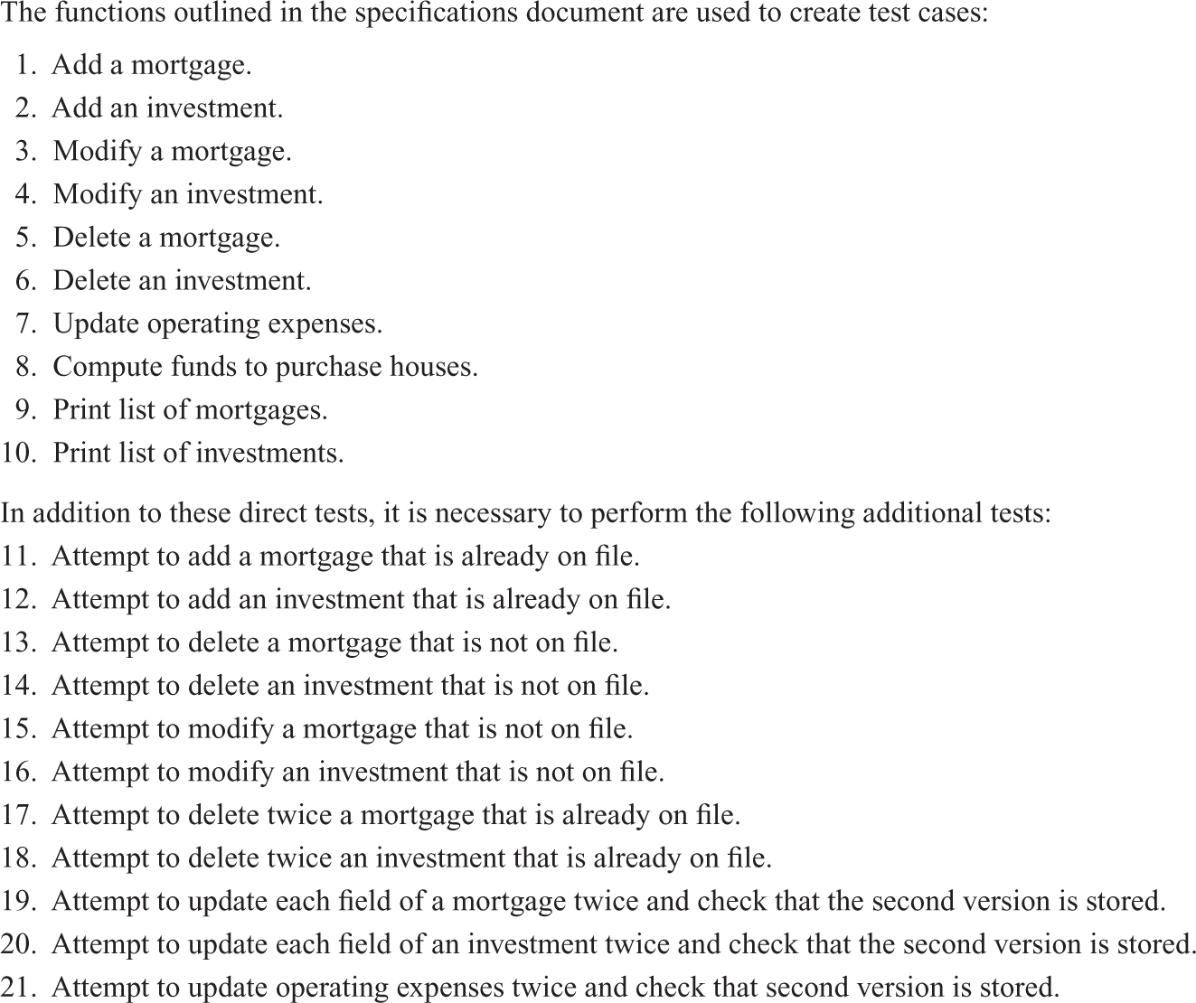
Black-Box Test Cases: MSG Foundation (contd)
Functional testing test cases
Figure 15.14

Slide 75
Exercise
What are two extremes to testing ?
What is the art of testing ?
What are the equivalence classes defined by range (10, 100) ? Please select test cases for this.

Slide 76
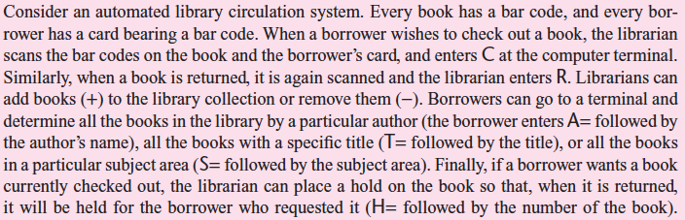
Exercise
For the following system, please select test cases for equivalence testing and functional testing :

Slide 77
15.13 Glass-Box Unit-Testing Techniques
We will examine
  Statement coverage
  Branch coverage
  Path coverage
  Linear code sequences
  All-definition-use path coverage

Slide 78
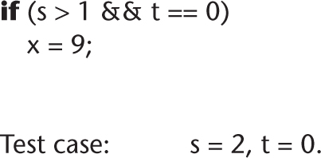
15.13.1 Structural Testing: Statement, Branch, and Path Coverage
Statement coverage:
  Running a set of test cases in which every statement is executed at least once
  A CASE tool needed to keep track
Weakness
  branch statements are not
  guaranteed to be properly tested.
Both statements can be executed without the fault showing up
Figure 15.15

Slide 79
Structural Testing: Branch Coverage
Running a set of test cases in which every branch is executed at least once (as well as all statements)
  This solves the problem on the previous slide
  It requires enough test cases such that each condition in a branch statement takes on all possible outcomes at least once.
  Again, a CASE tool is needed
  For the previous code example, how to select test cases to cover all branches ??

Slide 80
Structural Testing: Path Coverage
Running a set of test cases in which every path is executed at least once (as well as all statements)
Problem:
  The number of paths may be very large
We want a weaker condition than all paths but that shows up more faults than branch coverage

Slide 81
Linear Code Sequences
Identify the set of points L from which control flow may jump
  entry and exit points
  Branch statements, e.g., if, goto.
Restrict test cases to linear code sequences that begin and end with elements of L
This uncovers many faults without testing every path

Slide 82
Jumping Points
int main (void)
{
int count = 0, totals[MAXCOLUMNS], val = 0;
memset (totals, 0, MAXCOLUMNS * sizeof(int));
count = 0;
while ( count < ITERATIONS )
{
val = abs(rand()) % MAXCOLUMNS;
totals[val] += 1;
if ( totals[val] > MAXCOUNT )
{
totals[val] = MAXCOUNT;
}
count++;
}
return (0);
}

Slide 83
All-Definition-Use-Path Coverage
Each occurrence of variable, zz say, is labeled either as
  The definition of a variable
    zz = 1 or read (zz)
  or the use of variable
    y = zz + 3 or if (zz < 9) errorB ()
Identify all paths from the definition of a variable to the use of that definition
  This can be done by an automatic tool
A test case is set up for each such path

Slide 84
All-Definition-Use-Path Coverage (contd)
int gcd(int a, int b) {
int c = a;
int d = b;
if (c == 0)
return d;
while (d != 0) {
if (c > d)
c = c - d;
else
d = d - c;
}
return c;
}

Slide 85
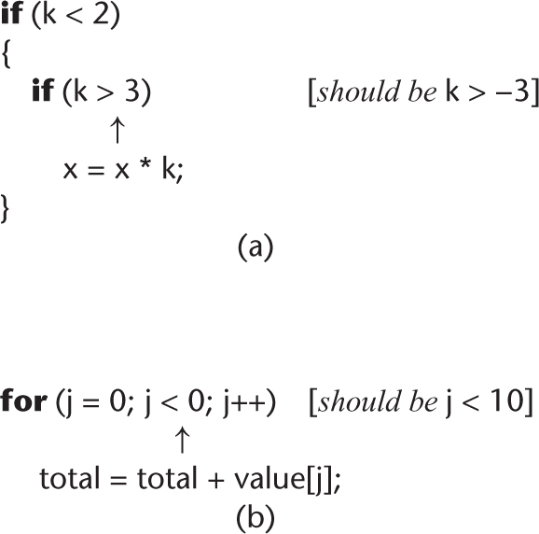
Infeasible Code
It may not be possible to test a specific statement
  We may have an infeasible path (“dead code”) in the artifact
Frequently this is evidence of a fault
Figure 15.16

Slide 86
Exercise
Please prepare test cases for statement coverage, branch coverage, all-definition-use-path coverage, path coverage and linear code sequences.
1. Public class ExampleClass {
2. public int returnInput (int x, boolean a, boolean b, boolean c) {
3. int y=0;
4. int z=0;
5. if (a)
6. y=x;
7. else
8. System.out.println("The condition a is false” );
9. x++;
10 if (b&&c)
11. y=x*10;
12. else
13. y= x+10;
14. z = x + y;
15. return x+y+z;
16. }
17. }

Slide 87
15.13.2 Complexity Metrics
A quality assurance approach to glass-box testing
Artifact m1 is more “complex” than artifact m2
  Intuitively, m1 is more likely to have faults than artifact m2
If the complexity is unreasonably high, redesign and then reimplement that code artifact
  This is cheaper and faster than trying to debug a fault-prone code artifact

Slide 88
Lines of Code
The simplest measure of complexity
  Underlying assumption: There is a constant probability p that a line of code contains a fault
Example
  The tester believes each line of code has a 2% chance of containing a fault.
  If the artifact under test is 100 lines long, then it is expected to contain 2 faults
The number of faults is indeed related to the size of the product as a whole

Slide 89
Code Walkthroughs and Inspections
Code reviews lead to rapid and thorough fault detection
  Up to 95% reduction in maintenance costs

Slide 90
15.15 Comparison of Unit-Testing Techniques
Experiments comparing
  Black-box testing
  Glass-box testing
  Reviews
[Myers, 1978] 59 highly experienced programmers
  All three methods were equally effective in finding faults
[Hwang, 1981]
  All three methods were equally effective

Slide 91
Comparison of Unit-Testing Techniques (contd)
[Basili and Selby, 1987] 42 advanced students in two groups, 32 professional programmers
Advanced students, group 1
  No significant difference between the three methods
Advanced students, group 2
  Code reading and black-box testing were equally good
  Both outperformed glass-box testing
Professional programmers
  Code reading detected more faults
  Code reading had a faster fault detection rate

Slide 92
Comparison of Unit-Testing Techniques (contd)
Conclusion
  Code inspection is at least as successful at detecting faults as glass-box and black-box testing

Slide 93
15.18 Management Aspects of Unit Testing
We need to know when to stop testing
A number of different techniques can be used
  Cost–benefit analysis
  Risk analysis
  Statistical techniques

Slide 94
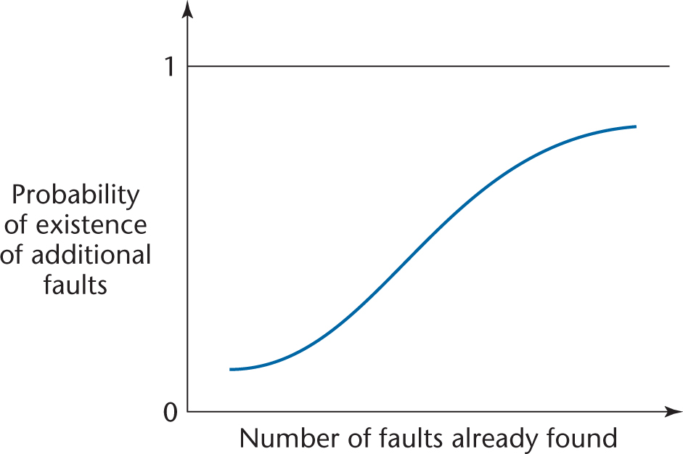
15.19 When to Rewrite Rather Than Debug
When a code artifact has too many faults
  It is cheaper to redesign, then recode
The risk and cost of further faults are too great
Figure 15.18

Slide 95
Fault Distribution in Modules Is Not Uniform
[Myers, 1979]
  47% of the faults in OS/370 were in only 4% of the modules
[Endres, 1975]
  512 faults in 202 modules of DOS/VS (Release 28)
  112 of the modules had only one fault
  There were modules with 14, 15, 19 and 28 faults, respectively
  The latter three were the largest modules in the product, with over 3000 lines of DOS macro assembler language
  The module with 14 faults was relatively small, and very unstable
  A prime candidate for discarding, redesigning, recoding

Slide 96
When to Rewrite Rather Than Debug (contd)
For every artifact, management must predetermine the maximum allowed number of faults during testing
If this number is reached
  Discard
  Redesign
  Recode

Slide 97
15.20 Integration Testing
The testing of each new code artifact when it is added to what has already been tested
Special issues can arise when testing graphical user interfaces — see next slide

Slide 98
Integration Testing of Graphical User Interfaces
GUI test cases include
  Mouse clicks, and
  Key presses
These types of test cases cannot be stored in the usual way
  We need special CASE tools
Examples:
  QAPartner
  XRunner

Slide 99
15.21 Product Testing
Product testing for COTS software
  Alpha, beta testing
Product testing for custom software
  The SQA group must ensure that the product passes the acceptance test
  Failing an acceptance test has bad consequences for the development organization

Slide 100
Product Testing for Custom Software
The SQA team must try to approximate the acceptance test
  Black box test cases for the product as a whole
  Robustness of product as a whole
    Stress testing (under peak load)
    Volume testing (e.g., can it handle large input files?)
  All constraints must be checked
  All documentation must be
    Checked for correctness
    Checked for conformity with standards
    Verified against the current version of the product

Slide 101
15. 22 Acceptance Testing
The client determines whether the product satisfies its specifications
Acceptance testing is performed by
  The client organization, or
  The SQA team in the presence of client representatives, or
  An independent SQA team hired by the client

Slide 102
Acceptance Testing (contd)
The four major components of acceptance testing are
  Correctness
  Robustness
  Performance
  Documentation
These are precisely what was tested by the developer during product testing

Slide 103
Acceptance Testing (contd)
The key difference between product testing and acceptance testing is
  Acceptance testing is performed on actual data
  Product testing is preformed on test data, which can never be real, by definition

Slide 104
15.24 CASE Tools for Implementation
CASE tools for implementation of code artifacts
CASE tools for integration include
  Version-control tools, configuration-control tools, and build tools
  Examples:
    rcs, sccs, PCVS, SourceSafe, Subversion

Slide 105
15.25 Metrics for the Implementation Workflow
The five basic metrics, plus
  Complexity metrics
Other metrics:
  Number of test cases
  Percentage of test cases that resulted in failure
  Total number of faults, by types

Slide 106
Discussion
How to measure complexity of a give code artifact ? Why ?
What is the most cost-efficient method to identify faults ?
What are the three kinds of unit-testing techniques ? Please compare them.
What are product testing and acceptance testing ? Please compare them.

Slide 107
Exercise
Please prepare test cases for statement coverage, branch coverage, all-definition-use-path coverage, path coverage and linear code sequences.
1. Public class FooClass {
2. public int foo (int count, int MAX, int MAXCOLUMNS, int MAXVAL) {
3. int ITERATIONS = 10;
int total = 0;
5. while ( count <= ITERATIONS )
6. {
7. val = abs(rand()) % MAXCOLUMNS;
8. count++;
9. if ( val > MAXVAL )
10. {
11. val = MAXVAL;
12. }
13. total += val;
14. }
15. if (total>MAX)
16. total = MAX*100;
17. else
18. total = total*100;
19. System.out.println("The total is d%”,total );
20. return total;
21. }
22. }

Slide 108
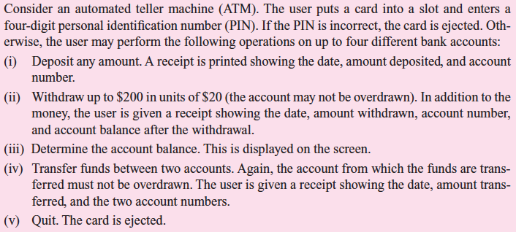
Exercise
For the following system, please select test cases for equivalence testing and functional testing :

