Slide 1
Object-Oriented and
Classical Software Engineering
Eighth Edition, WCB/McGraw-Hill, 2011
Stephen R. Schach

Slide 2
CHAPTER 16
POSTDELIVERY MAINTENANCE

Slide 3
Postdelivery Maintenance
Postdelivery maintenance
  Any change to any component of the product (including documentation) after it has passed the acceptance test

Slide 4
16.1 Why Postdelivery Maintenance Is Necessary
Corrective maintenance
  To correct residual faults
    Analysis, design, implementation, documentation, or any other type of faults

Slide 5
Why Postdelivery Maint. Is Necessary (contd)
Perfective maintenance
  Client requests changes to improve product effectiveness
    Add additional functionality
    Make product run faster
    Improve maintainability

Slide 6
Why Postdelivery Maint. Is Necessary (contd)
Adaptive maintenance
  Responses to changes in the environment in which the product operates
    The product is ported to a new compiler, operating system, and/or hardware
    A change to the tax code
    9-digit ZIP codes

Slide 7
16.2 What Is Required of Postdelivery Maintenance Programmers?
At least 67% of the total cost of a product accrues during postdelivery maintenance
Maintenance is a major income source
Nevertheless, even today many organizations assign maintenance to
  Unsupervised beginners, and
  Less competent programmers

Slide 8
What is Required of Postd. Maint. Prog. (contd)?
Postdelivery maintenance is one of the most difficult aspects of software production because
  Postdelivery maintenance incorporates aspects of all other workflows

Slide 9
Corrective Maintenance
A maintenance programmer must therefore have superb debugging skills
  The fault could lie anywhere within the product
  The original cause of the fault might lie in the by now non-existent specifications or design documents

Slide 10
Corrective Maintenance
Suppose that the maintenance programmer has located the fault
Problem:
  How to fix it without introducing a regression fault

Slide 11
Corrective Maintenance (contd)
How to minimize regression faults
  Consult the detailed documentation for the product as a whole
  Consult the detailed documentation for each individual module

Slide 12
The Programmer Now Must
Test that the modification works correctly
  Using specially constructed test cases
Check for regression faults
  Using stored test data
Add the specially constructed test cases to the stored test data for future regression testing
Document all changes

Slide 13
Corrective Maintenance (contd)
Major skills are required for corrective maintenance
  Superb diagnostic skills
  Superb testing skills
  Superb documentation skills

Slide 14
Adaptive and Perfective Maintenance
When programs are developed
  Specifications are produced by analysis experts
  Designs are produced by design experts
  Code is produced by programming experts
But a maintenance programmer must be expert in all three areas, and also in
  Testing, and
  Documentation

Slide 15
Conclusion
No form of maintenance
  Is a task for an unsupervised beginner, or
  Should be done by a less skilled computer professional
Managers must assign maintenance to their best programmers, and pay them accordingly

Slide 16
16.4 Management of Postdelivery Maintenance
Various issues regarding management of postdelivery maintenance are now considered

Slide 17
16.4 .1 Defect Reports
If the product appears to function incorrectly, the user files a defect report
  It must include enough information to enable the maintenance programmer to recreate the problem
Ideally, every defect should be fixed immediately
  In practice, an immediate preliminary investigation is the best we can do

Slide 18
Management of Postdelivery Mainten. (contd)
The maintenance programmer should first consult the defect report file
It contains
  All reported defects not yet fixed, and
  Suggestions for working around them

Slide 19
If the Defect Has Been Previously Reported
Give the information in the defect report file to the user

Slide 20
If it Is a New Defect
The maintenance programmer should try to find
  The cause,
  A way to fix it, and
  A way to work around the problem
The new defect is now filed in the defect report file, together with supporting documentation
  Listings
  Designs
  Manuals

Slide 21
16.4.2 Authorizing Changes to the Product
Corrective maintenance
  Assign a maintenance programmer to determine the fault and its cause, then repair it
  Test the fix, test the product as a whole (regression testing)
  Update the documentation to reflect the changes made
  Update the prologue comments to reflect
    What was changed,
    Why it was changed,
    By whom, and
    When

Slide 22
Authorizing Changes to the Product (contd)
Adaptive and perfective maintenance
  As with corrective maintenance, except there is no defect report
  There is a change in requirements instead

Slide 23
Authorizing Changes to the Product (contd)
What if the programmer has not tested the fix adequately?
  Before the product is distributed, it must be tested by the SQA group
Testing is difficult and time consuming
  Performed by the SQA group

Slide 24
Authorizing Changes to the Product (contd)
The programmer makes changes to private copies of code artifacts, tests them
The programmer freezes the previous version, and gives the modified version to SQA to test
SQA performs tests on the current baseline version of all code artifacts

Slide 25
16.4.3 Ensuring Maintainability
Maintenance is not a one-time effort
We must plan for maintenance over the entire life cycle
  Design workflow — use information-hiding techniques
  Implementation workflow — select variable names meaningful to future maintenance programmers
  Documentation must be complete and correct, and reflect the current version of every artifact

Slide 26
Ensuring Maintainability (contd)
During postdelivery maintenance, maintainability must not be compromised
  Always be conscious of the inevitable further maintenance

Slide 27
16.4.4 The Problem of Repeated Maintenance
The moving target problem is frustrating to the development team
Frequent changes have an adverse effect on the maintainability of the product

Slide 28
The Moving Target Problem
The problem is exacerbated during postdelivery maintenance
The more changes there are
  The more the product deviates from its original design
  The more difficult further changes become
  Documentation becomes even less reliable than usual
  Regression testing files are not up to date
  A total rewrite may be needed for further maintenance

Slide 29
The Moving Target Problem (contd)
Apparent solution
  Freeze the specifications once they have been signed off until delivery of the product
  After each request for perfective maintenance, freeze the specifications for (say) 3 months or 1 year

Slide 30
Discussion
What is postdelivery maintenance ?
What are corrective, adaptive and perfective maintenance ?
What is required of postdelivery maintenance programmers? Why ?

Slide 31
16.5 Maintenance of Object-Oriented Software
The object-oriented paradigm apparently promotes maintenance in four ways
  The product consists of independent units
  Encapsulation (conceptual independence)
  Information hiding (physical independence)
  Message-passing is the sole communication

Slide 32
Maintenance of Object-Oriented Software (contd)
Three obstacles
  The complete inheritance hierarchy can be large
  The consequences of polymorphism and dynamic binding
  The consequences of inheritance

Slide 33
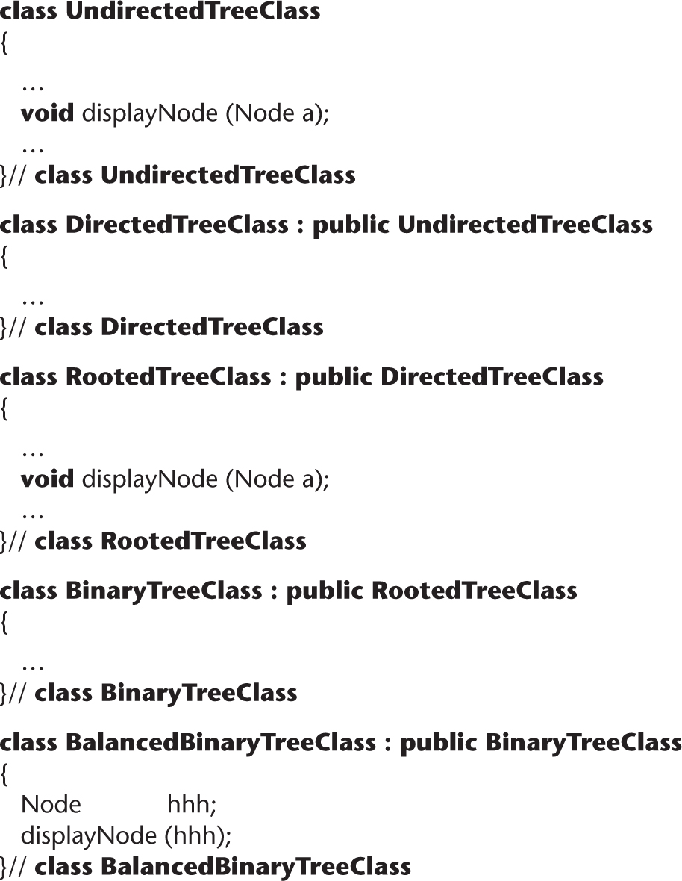
Size of the Inheritance Hierarchy
Figure 16.1

Slide 34
Size of Inheritance Hierarchy (contd)
To find out what displayNode does in BalancedBinaryTreeClass, we must scan the complete tree
  The inheritance tree may be spread over the entire product
  A far cry from “independent units”
Solution
  A CASE tool can flatten the inheritance tree

Slide 35
Polymorphism and Dynamic Binding
class Vehicle{
public void move(){
System.out.println(“Vehicles can move!!”);
}
}
class MotorBike extends Vehicle{
public void move(){
System.out.println(“MotorBike can move and accelerate too!!”);
}
}
class Test{
public static void main(String[] args){
Vehicle vh=new MotorBike();
vh.move(); // prints MotorBike can move and accelerate too!!
vh=new Vehicle();
vh.move(); // prints Vehicles can move!!
}
}

Slide 36
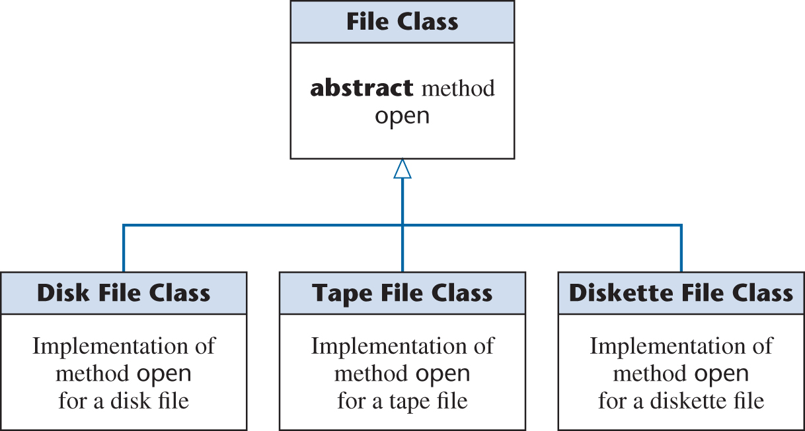
Polymorphism and Dynamic Binding
Figure 16.2
The product fails on the invocation myFile.open ()
Which version of open contains the fault?
  A CASE tool cannot help (static tool)
  We must trace

Slide 37
Polymorphism and Dynamic Binding (contd)
Polymorphism and dynamic binding can have
  A positive effect on development, but
  A negative effect on maintenance

Slide 38
Consequences of Inheritance
Create a new subclass via inheritance
The new subclass
  Does not affect any superclass, and
  Does not affect any other subclass
Modify this new subclass
  Again, no affect
Modify a superclass
  All descendent subclasses are affected
  “Fragile base class problem”

Slide 39
Consequences of Inheritance (contd)
Inheritance can have
  A positive effect on development, but
  A negative effect on maintenance

Slide 40
16.6 Postdelivery Maintenance versus Development Skills
The skills needed for maintenance include
  The ability to determine the cause of failure of a large product
    Also needed during integration and product testing
  The ability to function effectively without adequate documentation
    Documentation is rarely complete until delivery
  Skills in analysis, design, implementation, and testing
    All four activities are carried out during development

Slide 41
Postdelivery Maintenance vs. Development Skills (contd)
The skills needed for postdelivery maintenance are the same as those for the other workflows
Key Point
  Maintenance programmers must not merely be skilled in a broad variety of areas, they must be highly skilled in all those areas
  Specialization is impossible for the maintenance programmer
Postdelivery maintenance is the same as development, only more so

Slide 42
16.9 CASE Tools for Postdelivery Maintenance
Configuration-control tools are needed
  Commercial tool
    CCC
  Open-source tools
    cvs
    Subversion
Reengineering tools
  Commercial tools
    IBM Rational Rose, Together
  Open-source tool
    Doxygen

Slide 43
CASE Tools for Postdelivery Maintenance (contd)
Defect-tracking tools
  Commercial tool
    IBM Rational ClearQuest
  Open-source tool
    Bugzilla

Slide 44
Discussion
Why polymorphism and dynamic binding can have negative effects on maintenance ?
Why inheritance can have negative effects on maintenance ?

