Slide 1
Software Analysis Methods
Lecture 1 Zhiyong Shan

Slide 2
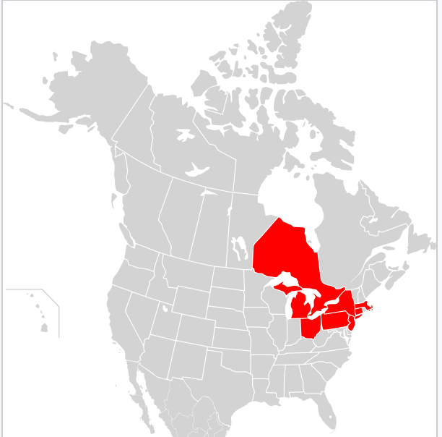
An Imperfect World
Software has bugs
The northeast blackout of 2003, affected 10 million people in Ontario and 45 million in eight U.S. states (caused by a race condition)
The blackout's primary cause was a programming error or "bug" in the alarm system at the control room of FirstEnergy Corporation, an Akron, Ohio-based company. The lack of an alarm left operators unaware of the need to re-distribute power after overloaded transmission lines hit unpruned foliage, triggering a "race condition" in the energy management system software, a bug affecting the order of operations in the system.

Slide 3

An Imperfect World
Software has bugs
The explosion of the Ariane 5 rocket launched by the European Space Agency, valued at $500 million, 45 seconds after its lift-off (due to an 16-bit integer overflow)
A board of inquiry investigated the causes of the explosion, which was a software error in the inertial reference system. Specifically a 64 bit floating point number relating to the horizontal velocity of the rocket with respect to the platform was converted to a 16 bit signed integer. The number was larger than 32,767, the largest integer storeable in a 16 bit signed integer, and thus the conversion failed.

Slide 4

An Imperfect World
Software is slow
the conversion of a single date field from a SOAP data source to a Java object can require as many as 268 method calls and the generation of 70 objects

Slide 5
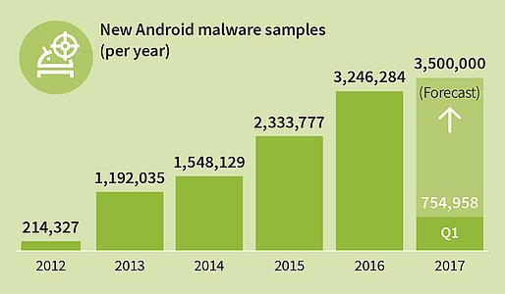
An Imperfect World
Malicious software
Each year, there are millions of new Android malware samples found. The number is still increasing year by year.

Slide 6
Program Analysis
Discovering facts about programs
A wide variety of applications
Finding bugs (e.g., model checking, testing, etc.)
Optimizing performance (e.g., compiler optimizations, bloat detection, etc.)
Detecting security vulnerabilities (e.g., detecting violations of security policies, etc.)
Improving software maintainability and understandability (e.g., reverse-engineering of UML diagrams, software visualization, etc.)

Slide 7
Static v.s. Dynamic Analysis
Static analysis
Attempt to understand certain program properties without running a program
Make over-conservative claims
Dynamic analysis
Need to run user instrumented code
Add overhead to running time and memory consumption

Slide 8
This Class
Focus on static program analysis in this class
We will discuss
Both principles and practices
Both classical program analysis algorithms and the state-of-the-art research
We will cover four major topics
Dataflow analysis
Abstract interpretation
Constraint-based analysis
Type and effect system

Slide 9
This Class
We will spend about 3~4 weeks on each topic
Discuss analysis principles in the first week (via lectures)
Discuss state-or-the-art research in the second and third weeks (via student presentations)
Projects
Two projects that implement program analysis algorithms in Java
Paper reading and presentation
Every student present one or two papers
Write short critiques for 12 papers

Slide 10
Projects
Three students form a group
Based on the soot program analysis framework (http://www.sable.mcgill.ca/soot/)
The first project
Implement a “hello-world” version of an intra- procedural analysis that prints out all heap load/store operations

Slide 11
Static Analysis Example
read(x); if(x>0) y = 1;
else {y = 2; S}; //S does not write y z = y;

Slide 12
Static Analysis Example
read(x); if(x>0) y = 1;
else {y = 2; S}; //S does not write z z = y;
Which of the following statements about z are valid from the perspective of a static analysis?

Slide 13
Static Analysis Example
read(x); if(x>0) y = 1;
else {y = 2; S}; //S does not write z z = y;
Which of the following statements about z are valid from the perspective of a static analysis?
– The value of z is 1

Slide 14
Static Analysis Example
read(x); if(x>0) y = 1;
else {y = 2; S}; //S does not write z z = y;
Which of the following statements about z are valid from the perspective of a static analysis?
– The value of z is 1

Slide 15
Static Analysis Example
read(x); if(x>0) y = 1;
else {y = 2; S}; //S does not write z z = y;
Which of the following statements about z are valid from the perspective of a static analysis?
The value of z is 1
The value of z is 2

Slide 16
Static Analysis Example
read(x); if(x>0) y = 1;
else {y = 2; S}; //S does not write z z = y;
Which of the following statements about z are valid from the perspective of a static analysis?
The value of z is 1
The value of z is 2

Slide 17
Static Analysis Example
read(x); if(x>0) y = 1;
else {y = 2; S}; //S does not write z z = y;
Which of the following statements about z are valid from the perspective of a static analysis?
The value of z is 1
The value of z is 2
The value of z is in the set {1, 2}

Slide 18


Static Analysis Example
read(x); if(x>0) y = 1;
else {y = 2; S}; //S does not write z z = y;
Which of the following statements about z are valid from the perspective of a static analysis?
The value of z is 1
The value of z is 2
The value of z is in the set {1, 2}

Slide 19
Static Analysis Example
read(x); if(x>0) y = 1;
else {y = 2; S}; //S does not write z z = y;
Which of the following statements about z are valid from the perspective of a static analysis?
The value of z is 1
The value of z is 2
The value of z is in the set {1, 2}
The value of z is in the set {1, 2, 34, 128}

Slide 20
Static Analysis Example
read(x); if(x>0) y = 1;
else {y = 2; S}; //S does not write z z = y;
Which of the following statements about z are valid from the perspective of a static analysis?
The value of z is 1
The value of z is 2
The value of z is in the set {1, 2}
The value of z is in the set {1, 2, 34, 128}

Slide 21


Static Analysis Example
read(x); if(x>0) y = 1;
else {y = 2; S}; //S does not write z z = y;
Which of the following statements about z are valid from the perspective of a static analysis?
The value of z is 1
The value of z is 2
The value of z is in the set {1, 2}
The value of z is in the set {1, 2, 34, 128}
The value of z depends on the value of x; when x > 0, z is 1; otherwise z is 2

Slide 22

Static Analysis Example
read(x); if(x>0) y = 1;
else {y = 2; S}; //S does not write z z = y;
Which of the following statements about z are valid from the perspective of a static analysis?
The value of z is 1
The value of z is 2
The value of z is in the set {1, 2}
The value of z is in the set {1, 2, 34, 128}
The value of z depends on the value of x; when x > 0, z is 1; otherwise z is 2

Slide 23
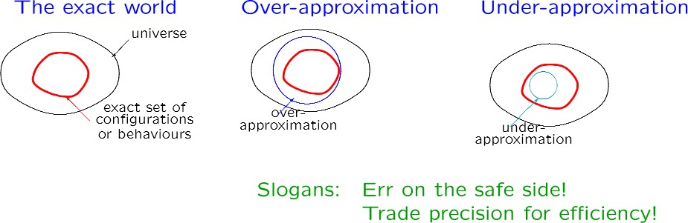
The Nature of Approximations

Slide 24
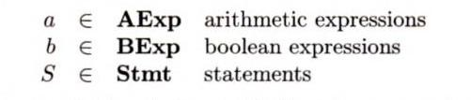
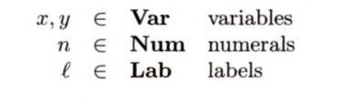

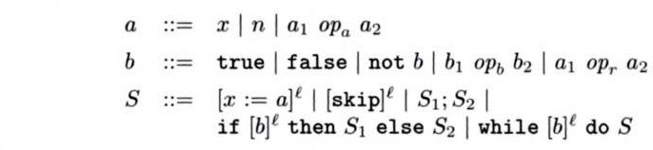
A while Language

Slide 25
An Example Program
[y:=x]¹;
[z:=1]²;
while [y>1]³ do ([z:=z*y]⁴; [y:=y-1]⁵;);
[y:=0]⁶
Computes the factorial of the number in x and leaves the result in z

Slide 26
Dataflow Analysis
Zhiyong Shan
CS 898AE
Spring 2019

Slide 27
Dataflow analysis
A class of static analyses that aim to understand how data flows in the program
Typical examples
Available expression analysis
Reaching definition analysis
Live variable analysis
Constant propagation

Slide 28
Analysis Scope
Intraprocedural analysis
Focusing on each individual function
Do not track dataflow across function boundary
Interprocedural analysis
Analyze the whole program
Way more expensive

Slide 29
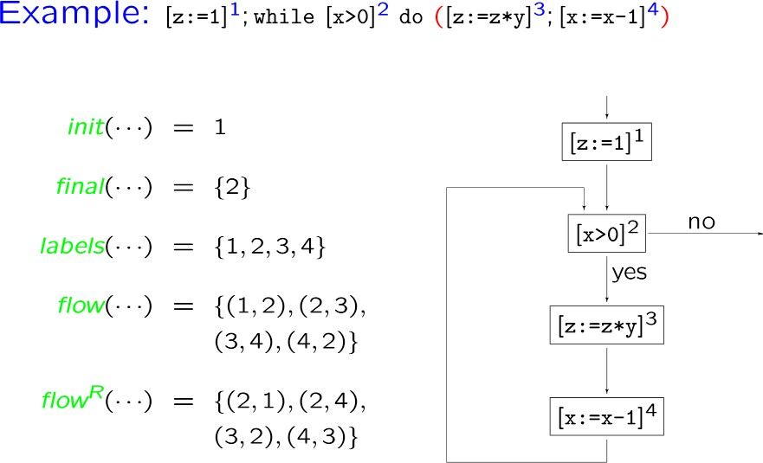
Control flow graph

Slide 30
Blocks in CFG
In the CFG, a block is a straight-line piece of code without any jumps or jump targets;
Jump targets start a block
Jumps end a block.
0: (A) t0 = read_num
1: (A) if t0 mod 2 == 0
2: (B) print t0 + " is even."
3: (B) goto 5
4: (C) print t0 + " is odd."

Slide 31
Motivation
Programs may contain code whose result is needed, but in which some computation is simply a redundant repetition of earlier computation within the same program.
The concept of expression availability is useful in dealing with this situation.

Slide 32
Expressions
Any given program contains a finite number of expressions (i.e. computations which potentially produce values),
so we may talk about the set of all expressions of a program.
int z = x * y; print s + t; int w = u / v;
⋯
program contains expressions { x*y, s+t, u/v, ... }

Slide 33
Availability
Availability is a data-flow property of expressions: “Has the value of this expression already been computed?”
?
?
?
⋯
int z = x * y;
}

Slide 34
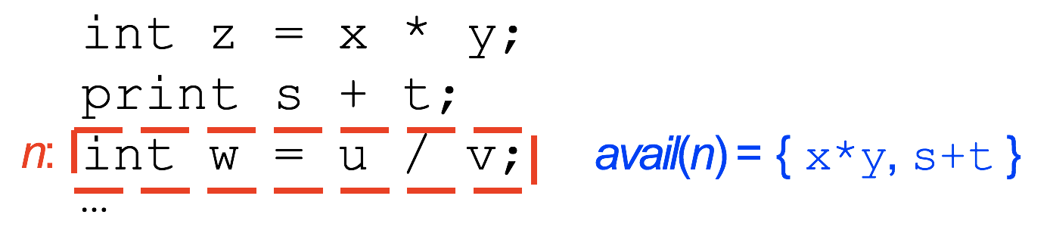
Availability
At each instruction, each expression in the program is either available or unavailable.
We therefore usually consider availability from an instruction’s perspective: each instruction (or node of the flowgraph) has an associated set of available expressions.

Slide 35
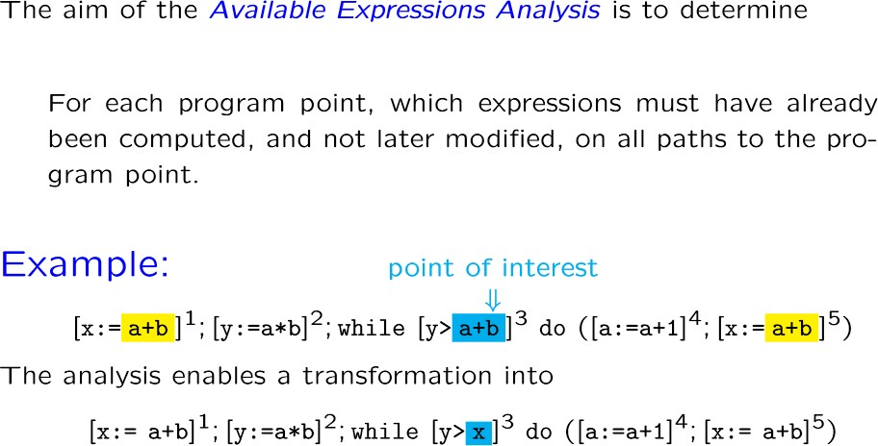
Available Expression Analysis

Slide 36
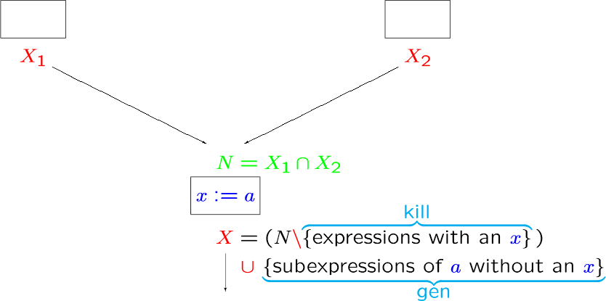
Basic Idea

Slide 37
Kill and Gen
An expression is killed in a block if any of the variables in the expression are modified.
An expression is generated in a block if none of the variables in the expression are later modified.

Slide 38
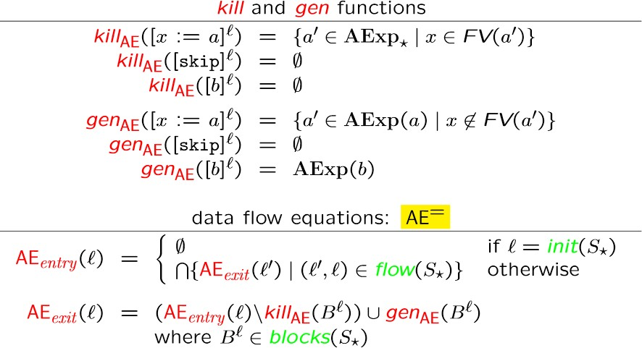
Analysis Algorithm

Slide 39
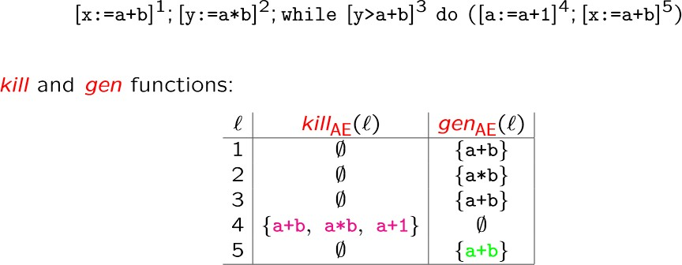
Analysis Example

Slide 40
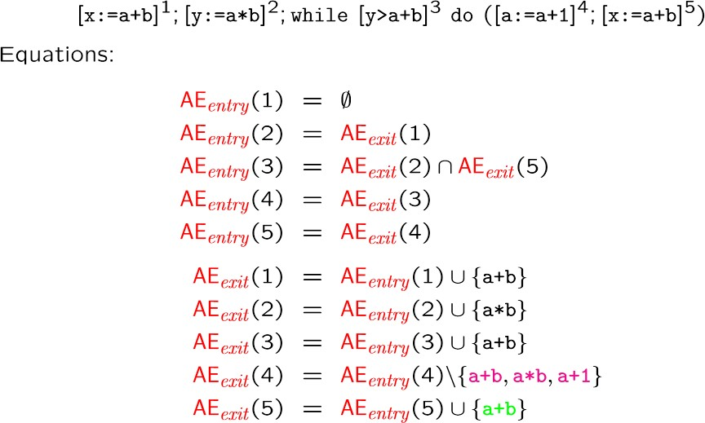
Example (Cond)

Slide 41
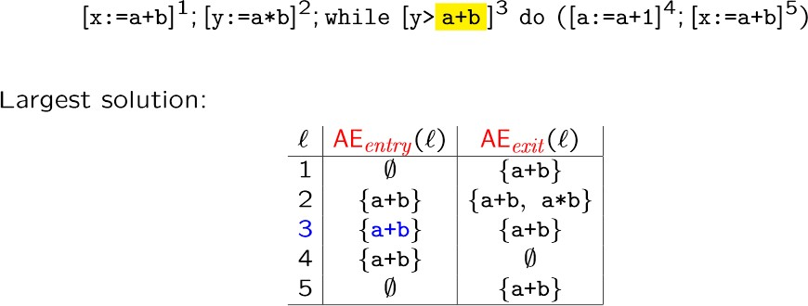
Example (Cond)

Slide 42
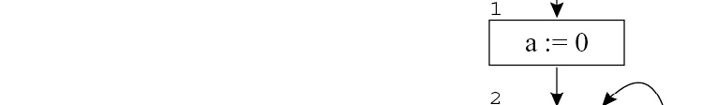
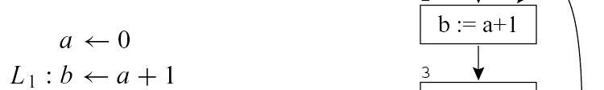
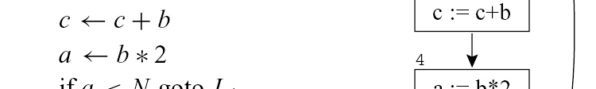
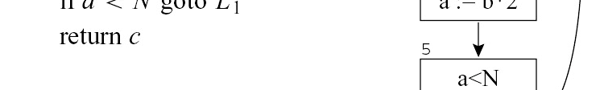

Exercise
Who are the available expressions for each instruction?

Slide 43
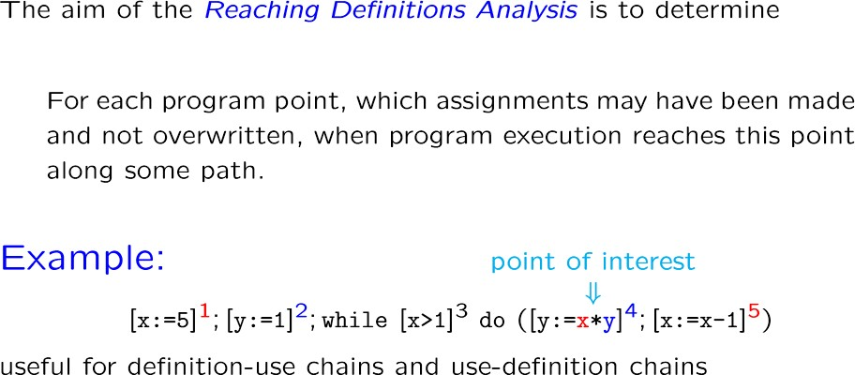
Reaching Definition Analysis

Slide 44
•
The most fundamental dataflow information concerns
the definition (or generation) and the use of values.
When an operation modifies a variable at program
•
point p, we say it defines the v
abl
s value at p.
point we say it defines the variable’ p
– So, the operation is also called a definition of the variable.
– We can number the definitions by d1, d2, … etc.
•
Similarly, when an operation makes a read reference
to a variable at program point p, we say it uses the variable’s value at p.
– The operation is also called a use of the variable.

Slide 45
•
If a value written by def1 is overwritten by def2, then
def1 is killed by def2.
If there exist an execution path from def1 to a
•
program point p such that def1 is not killed by any
defs, then we say def1 reaches p.
–
We also say that def1 belongs to the set of reaching
definitions of p.
Similarly, we can define the reaching definitions of a block B.
And, we can define the reaching definitions of a use
–
basic
–

Slide 46
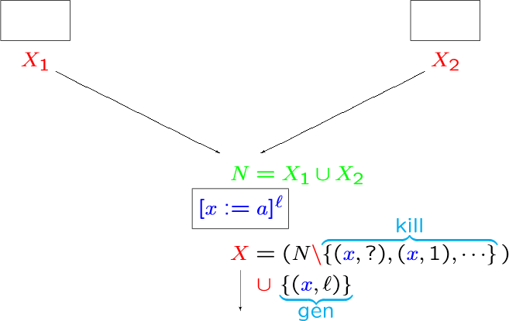
Basic Idea

Slide 47
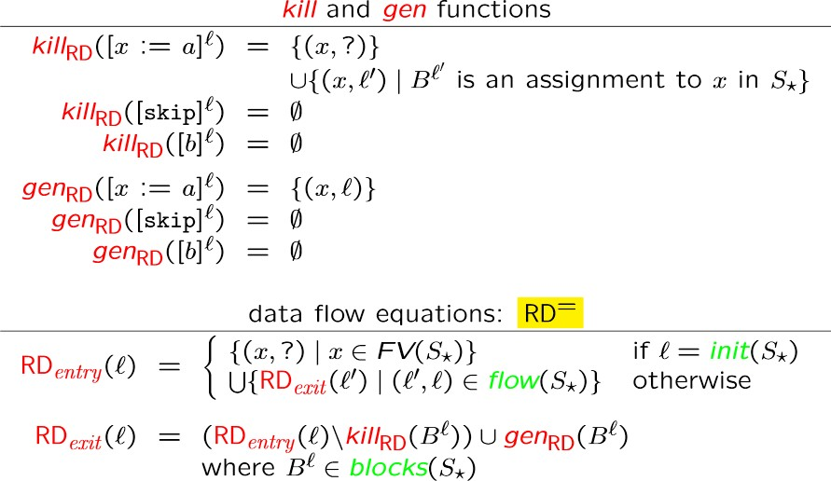
Analysis Algorithm

Slide 48
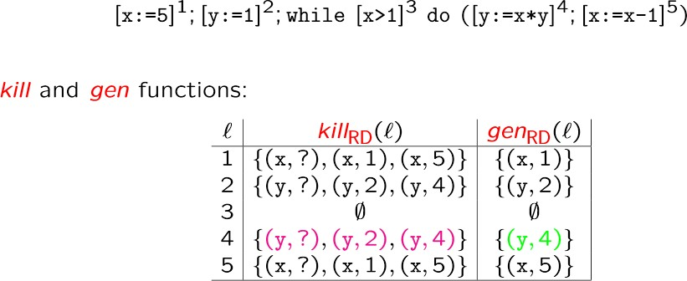
Analysis Example

Slide 49
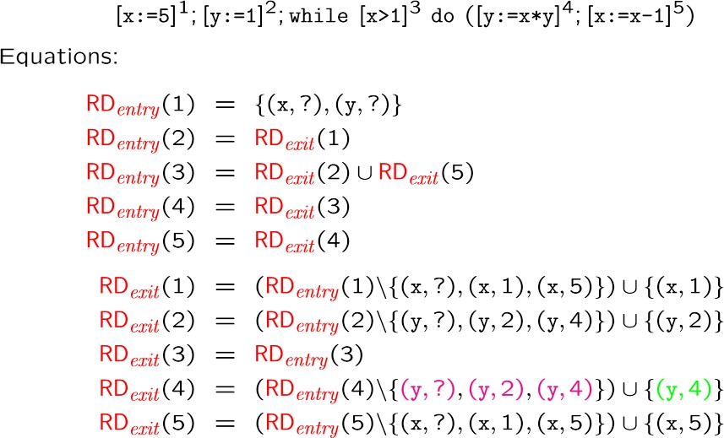
Example (Cond)

Slide 50
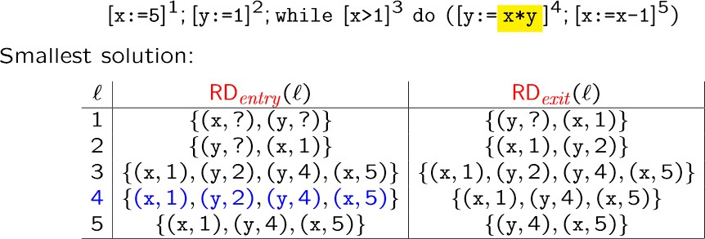
Example (Cond)

Slide 51
Exercise
Who are the reaching defs
for each instruction?

Slide 52
Live Variable Analysis
Definition
A variable is live at a particular point in the program if its value at that point will be used in the future (dead, otherwise).
∴ To compute liveness, we need to look into the future
Motivation: Register Allocation
A program contains an unbounded number of variables
Must execute on a machine with a bounded number of registers
Two variables can use the same register if they are never in use at the same time (i.e, never simultaneously live).
∴ Register allocation uses liveness information

Slide 53
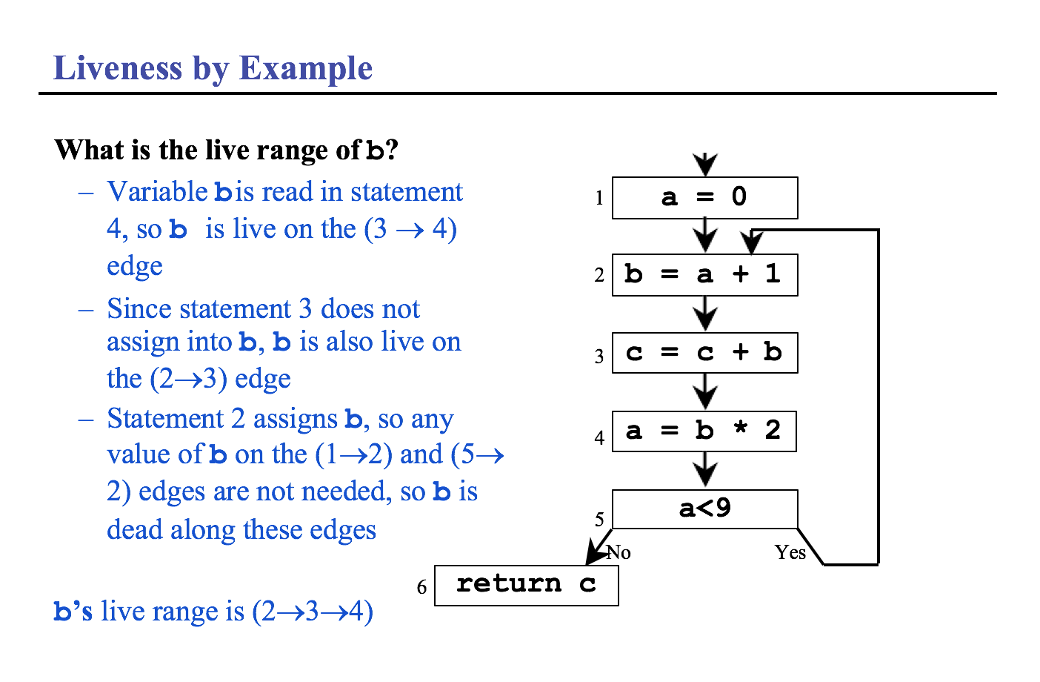

Slide 54
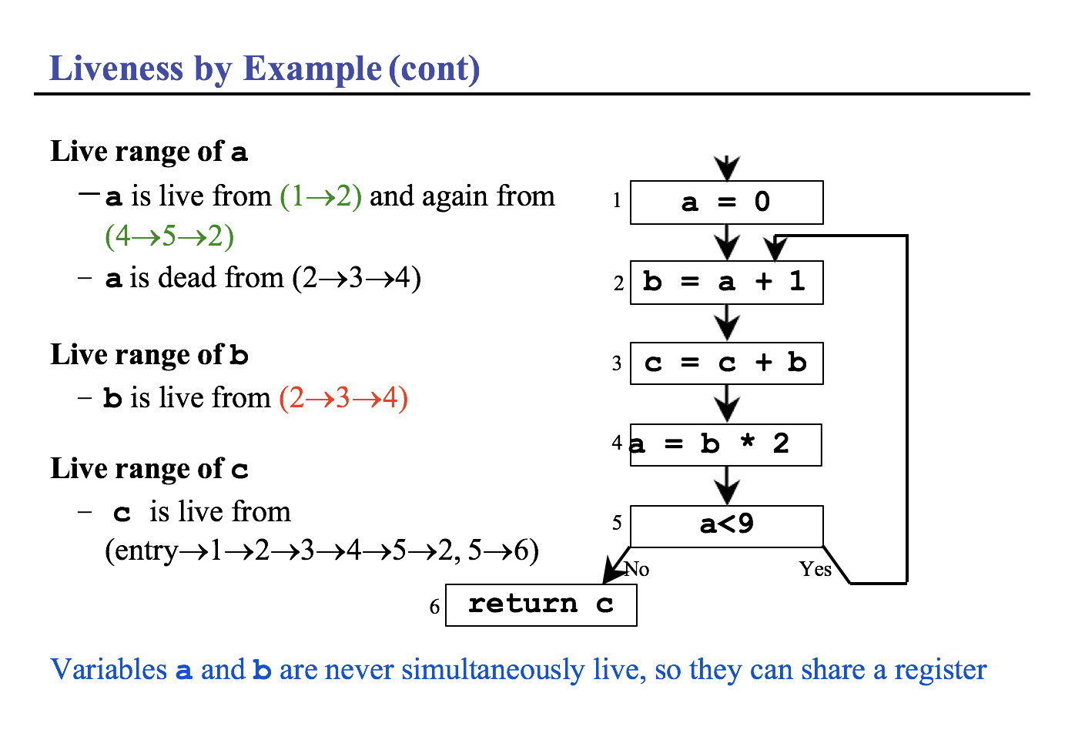

Slide 55
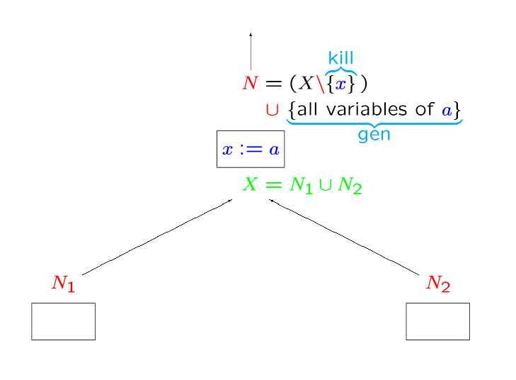
Basic Idea

Slide 56
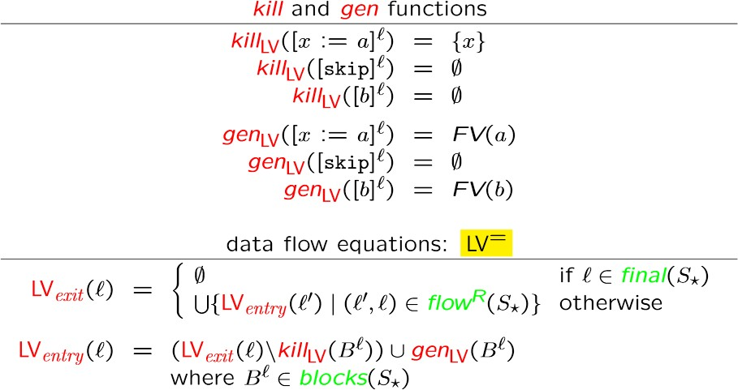
Analysis Algorithm

Slide 57
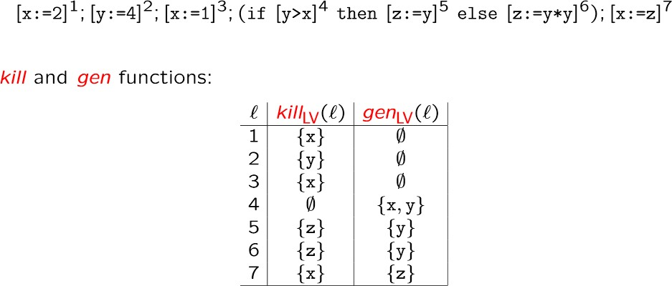
Example

Slide 58
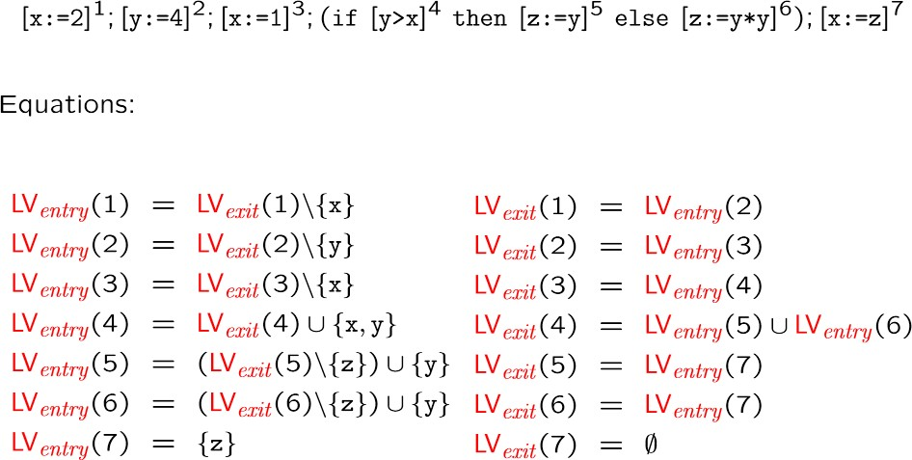
Example (Cond)

Slide 59
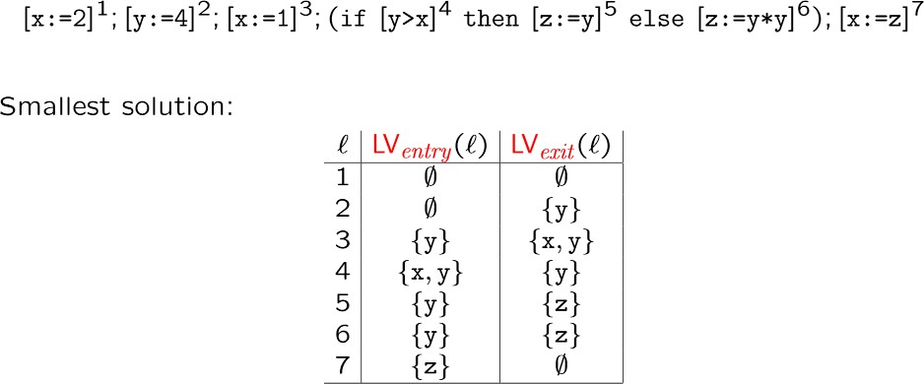
Example (Cond)

Slide 60
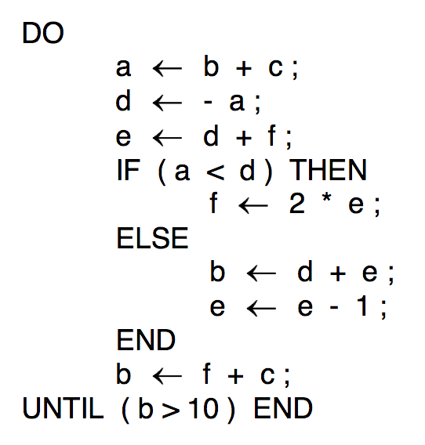
Exercise: live variable analysis

Slide 61
Project 1
Download the soot framework, get yourself familiar with various command-line options and phases, and implement an intra-procedural analysis that print out all heap load/store statements.
The project implements an intra-procedural transform that iterates over the set of all Jimple statements and print out those that read and write heap locations.

Slide 62
Each Java method in soot is represented by a SootMethod object. From this object, we retrieve the body of the method by calling getActiveBody(). This will give us a Body object, through which we have access to all information of the Java method, such as local variables and statements.
We can then use method getUnits() to get a chain of statements the method contains. Write a while loop that iterates over the statements in the chain. In Jimple, each statement is an object of interfact Stmt, which has many different implementing classes.

Slide 63
Among these Stmt classes, we are interested in JAssignStmt, which represents assignment statements (e.g., anything of the form a = b).
In order to identify statements that access the heap, we need to understand what the left-hand-side (LHS) and RHS operands are for each statement.
To do this, we can call methods getLeftOp() and getRightOp() on each statement object. These calls return objects of type Value, which is an interface representing all expressions, locals, constants, and references in a Java program.
We are particularly interested in InstanceFieldRef, StaticFieldRef, and ArrayRef, each of which represents a type of heap access.

Slide 64
If the LHS/RHS of an assignment is an InstanceFieldRef, the assignment is of the form:
a.f = b(heap write)
b = a.f (heap read);
If the LHS/RHS of an assignment is a StaticFieldRef, the assignment is of the form:
A.f = b (heap write)
b=A.f (heap read);
If the LHS/RHS of an assignment is an ArrayRef, the assignment is of the form:
a[i] = b (heap write)
b=a[i] (heap read);

Slide 65
The output of the analysis should have the following format:
Statement a.f = b, heap write;
Statement b = a[i], heap read;...

Slide 66
Deadline of the project: Feb 26
Please only submit an MS word document containing code and runtime snapshots.

Slide 67
Here is an article containing instructions to implement an intra-procedural analysis in soot http://www.bodden.de/2008/09/22/soot-intra/.
Ignore the dataflow analysis part—

