Slide 1
Diabetic Prediction using Random Forest Model
&
Evaluation metrics using IBM SPSS
Team members:
Amisha Patra
11715439
Surya Sai Raj Lakkoju 11610081 Bhavya Golla 11708064
Deepanvi Balusuguri 11708391
Vaishnavi Nomula 11618103

Slide 2
MOTIVATION:
The motivation behind this project is to contribute to the advancement of predictive healthcare analytics and ultimately improve the well-being of individuals at risk of diabetes.. Among various predictive factors, Body Mass Index (BMI) is a crucial indicator. Here we create a comprehensive solution for diabetes risk prediction. The ability to predict diabetes based on an individual's BMI allows for early interventions, such as lifestyle modifications and medical treatments.

Slide 3
OBJECTIVE:
The main objective of the proposed method is to develop a predictive model for forecasting diabetes risk in patients, prioritizing the BMI(Body Mass Index) and considering several factors such as age, gender, hypertension, heart disease, smoking history, blood glucose level, etc. To handle complex data and maintain the accuracy of the results, we are using the Random Forest model and various evaluation metrics such as F1 score and recall techniques.

Slide 4
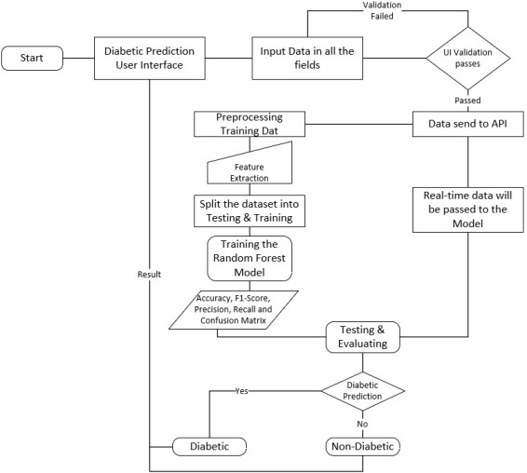
PROPOSED METHOD:
In this project we are trying to calculate the Evaluation Metrics such as Confusion matrix, Precision, Recall, F1-Score, and Accuracy, with that we are also going to use the T-Test Analysis for the dataset we choose on two different groups and find out what exactly the hypothesis will return.

Slide 5
TECHNOLOGIES USED:
Python
CSS
HTML

Slide 6
FEATURES IMPLEMENTED:
Machine Learning Model
Algorithm Selection.
Training Data
Evaluation Metrics
Model Performance Evaluation
Statistical Significance Analysis IBM SPSS
Tool Utilization
T-Test Analysis in SPSS

Slide 7
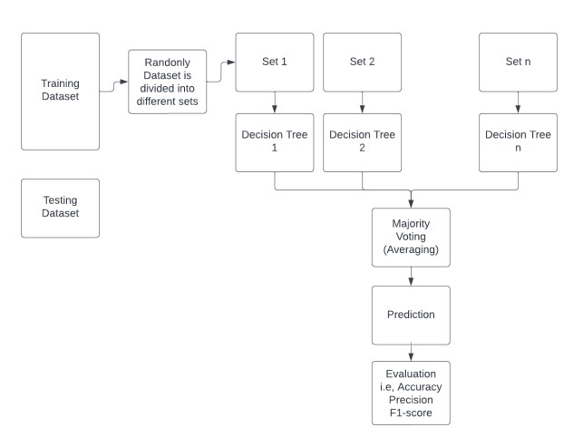
IMPLEMENTATION:
The development of GUI for users to interact with the application where they need to answer a few questions based on the model that will generate the results whether the patient is diabetic or not.

Slide 8
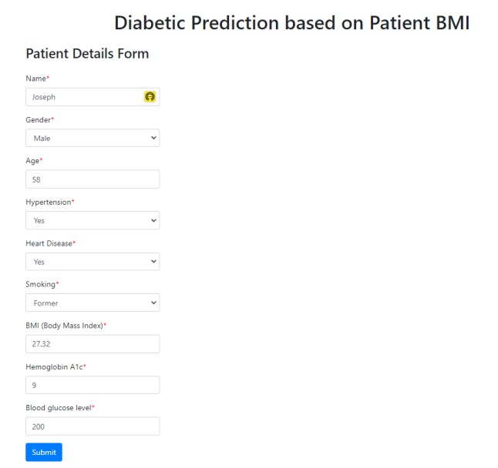
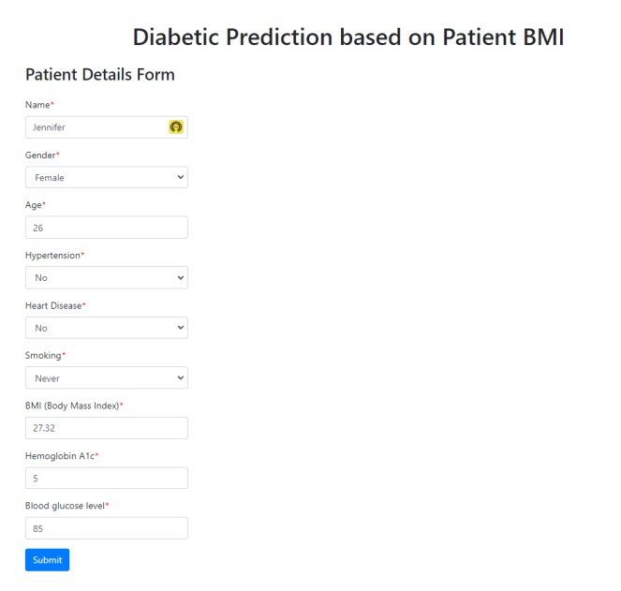
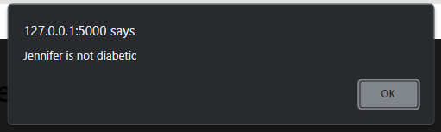
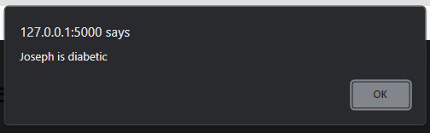
RESULTS:

Slide 9
Data Cleaning
We performed the data cleaning using following steps:
Duplicates: Duplicates can be classified into two types, that is exact and near duplicates. The exact duplicates are easier to identify as they are the same values. Near duplicates are the result of formatting, missing values, etc.
Null: The best way to remove the null values in the dataset is to either delete it or perform imputation.
NA records: The best way to deal with the NA records is similar to handling of null record, that is either we delete the missing data rows or impute a value in place of the NA value .
Empty records: The handling of empty records in a dataset is the same as we handle null records.

Slide 10
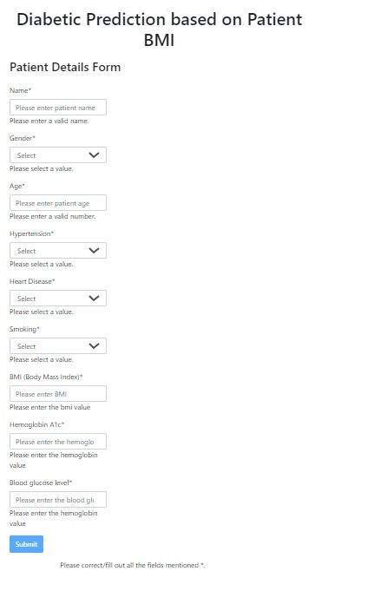
UI Validations:
UI Validation Form:
For field which are ‘text’ type is checked for the entered value is alphabetic or not using alphabetic.test(fieldValue). If not, an error is displayed. For field which are ‘number’ type is checked for the entered value is numeric or not using isNan(fieldValue). If not, an error is displayed. For field which are ‘select-one’ type is checked if a valid option is selected or not. If not, an error is displayed.
With this validation, the user input is checked if the input meets the criteria for each field. The error messages are displayed, which helps the user to know if the validation is failed.

Slide 11
Data Visualization
Data visualization is creating easy-to-understand graphic or visual representations of a large amount of complex quantitative and qualitative data and information with the help of static, dynamic or interactive visual items.
We here representing our diabetes data through common graphics. Here we used Histograms, heatmap and pie chart and Bar chart for representing data.

Slide 12
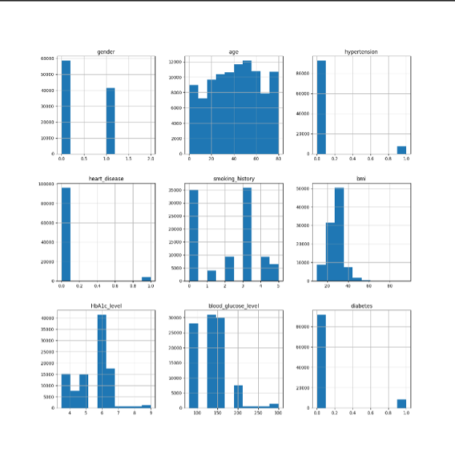
Bar-Plots

Slide 13
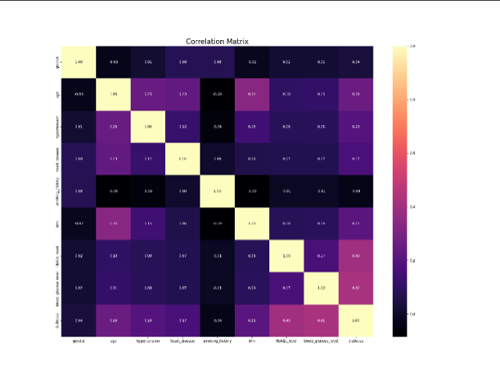
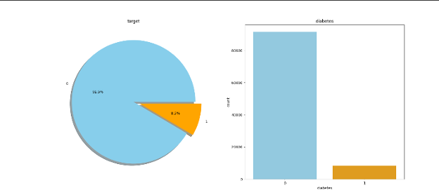
Heat Map and Pie chart

Slide 14
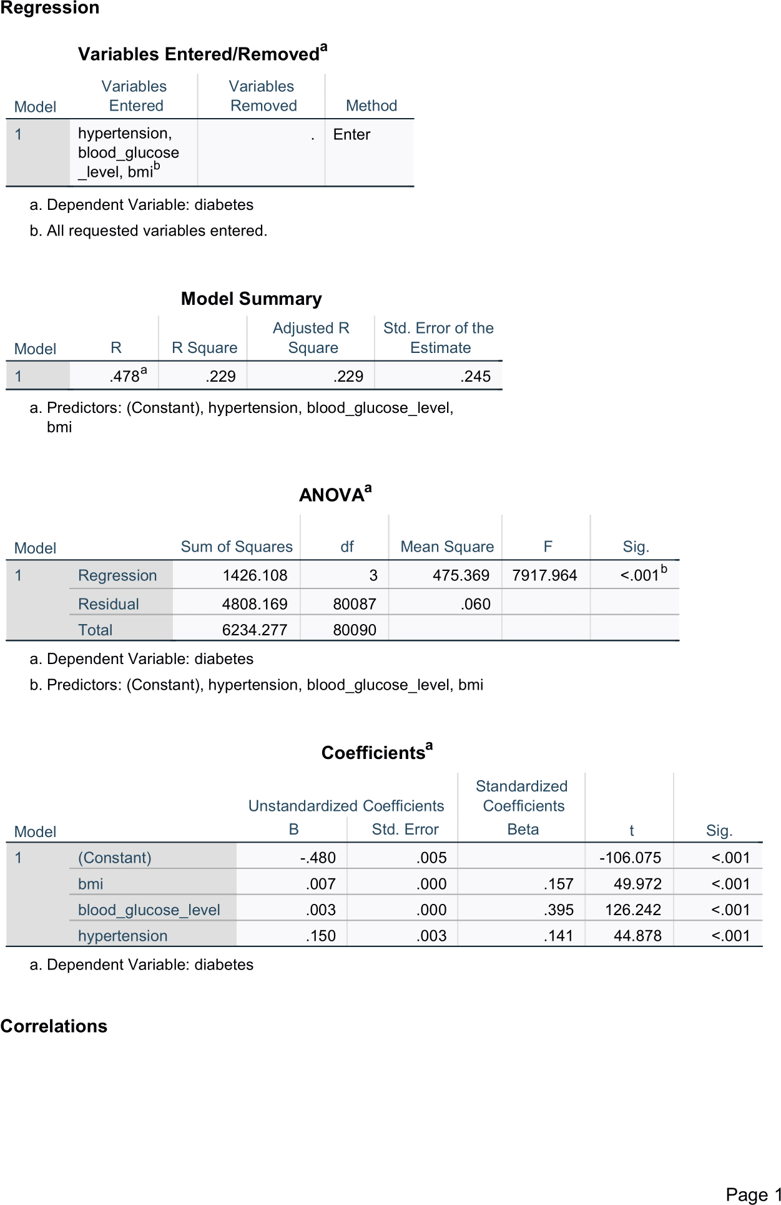
SPSS REGRESSION:
Output:
The spss for liner regression is done for the diabetes dataset.
Here the dependent variable is Diabetes and the independent variable is hypertension, blood_glucose_level, bmi^b.
The ANOVA Table will decide if the model is significant or not. Here the Sig value <0.05, then there is Linear Relationship between the independent and dependent variable, there is some random slope value.

Slide 15
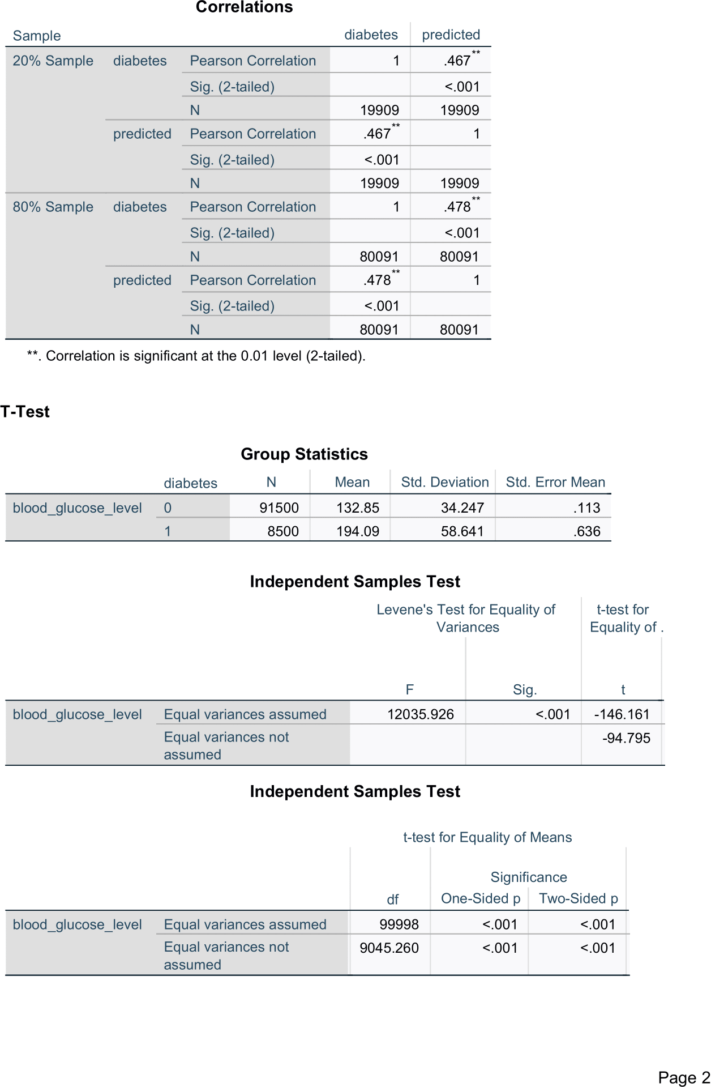
CO-RELATION
Output:
The Coefficient Box gives the linear equation. The Pearson Correlation value is 0.467 for 20% sample (Testing) and 0.478 for 80% of the Sample (Training). The values are nearly similar to each other.
Hence, we can conclude that our model is neither underfitting nor overfitting.

Slide 16
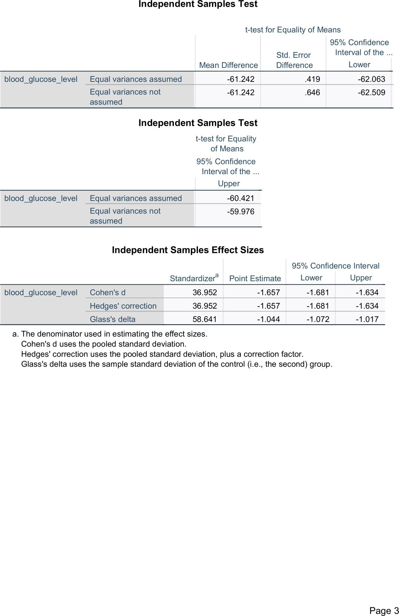
T-test
Output:
The record for blood_glucose_level is analyzed for diabetes the values are for the group as 0 and 1 which is classified as a person with diabetes or not.
In the Group statistics the values for mean, standard deviation and standard error mean and the number of patients for groups 0 and 1are taken.
From the independent samples test table we get 'p-value'. The value of p is <0.05 (alpha value) which depicts we can REJECT null-hypothesis.
From the t-test analysis we conclude that the groups 0 and 1 are unlike

Slide 17
THANK YOU.

