Slide 1
Diabetic Prediction using Random Forest Model & Evaluation metrics using IBM SPSS
Team members: Amisha Patra 11715439 Surya Sai Raj Lakkoju 11610081 Bhavya Golla 11708064 Deepanvi Balusuguri 11708391 Vaishnavi Nomula 11618103

Slide 2
MOTIVATION:
The motivation behind this project is to contribute to the advancement of predictive healthcare analytics and ultimately improve the well-being of individuals at risk of diabetes.. Among various predictive factors, Body Mass Index (BMI) is a crucial indicator. Here we create a comprehensive solution for diabetes risk prediction. The ability to predict diabetes based on an individual's BMI allows for early interventions, such as lifestyle modifications and medical treatments.

Slide 3
OBJECTIVE:
The main objective of the proposed method is to develop a predictive model for forecasting diabetes risk in patients, prioritizing the BMI(Body Mass Index) and considering several factors such as age, gender, hypertension, heart disease, smoking history, blood glucose level, etc. To handle complex data and maintain the accuracy of the results, we are using the Random Forest model and various evaluation metrics such as F1 score and recall techniques.

Slide 4
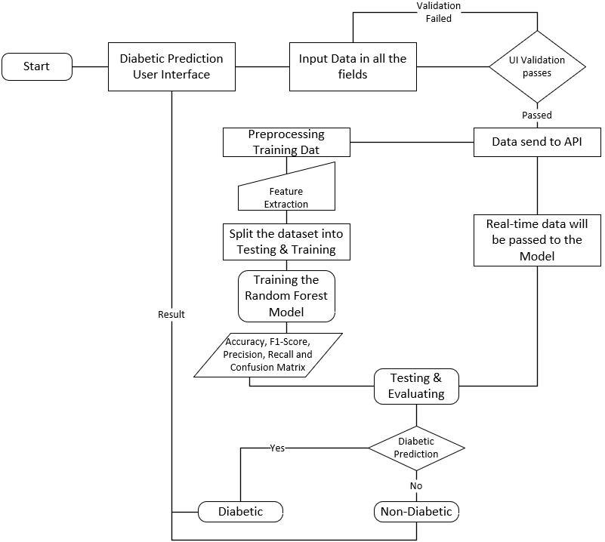
PROPOSED METHOD:
In this project we are trying to calculate the Evaluation Metrics such as Confusion matrix, Precision, Recall, F1-Score, and Accuracy, with that we are also going to use the T-Test Analysis for the dataset we choose on two different groups and find out what exactly the hypothesis will return.

Slide 5
TECHNOLOGIES USED
Python
CSS
HTML

Slide 6
FEATURES IMPLEMENTED:
Machine Learning Model
Algorithm Selection.
Training Data
Evaluation Metrics
Model Performance Evaluation

Slide 7
FEATURES TO BE IMPLEMENTED:
Evaluation Metrics
Statistical Significance Analysis
IBM SPSS
Tool Utilization
T-Test Analysis in SPSS

Slide 8
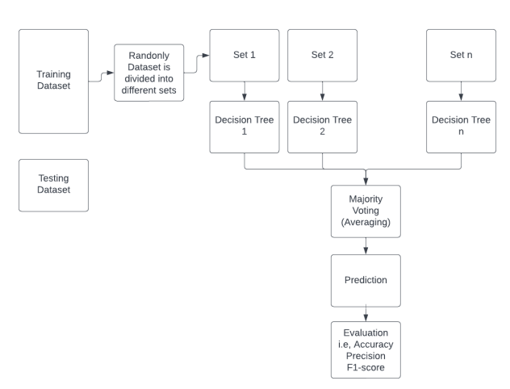
IMPLEMENTATION: The development of GUI for users to interact with the application where they need to answer a few questions based on the model that will generate the results whether the patient is diabetic or not.

Slide 9
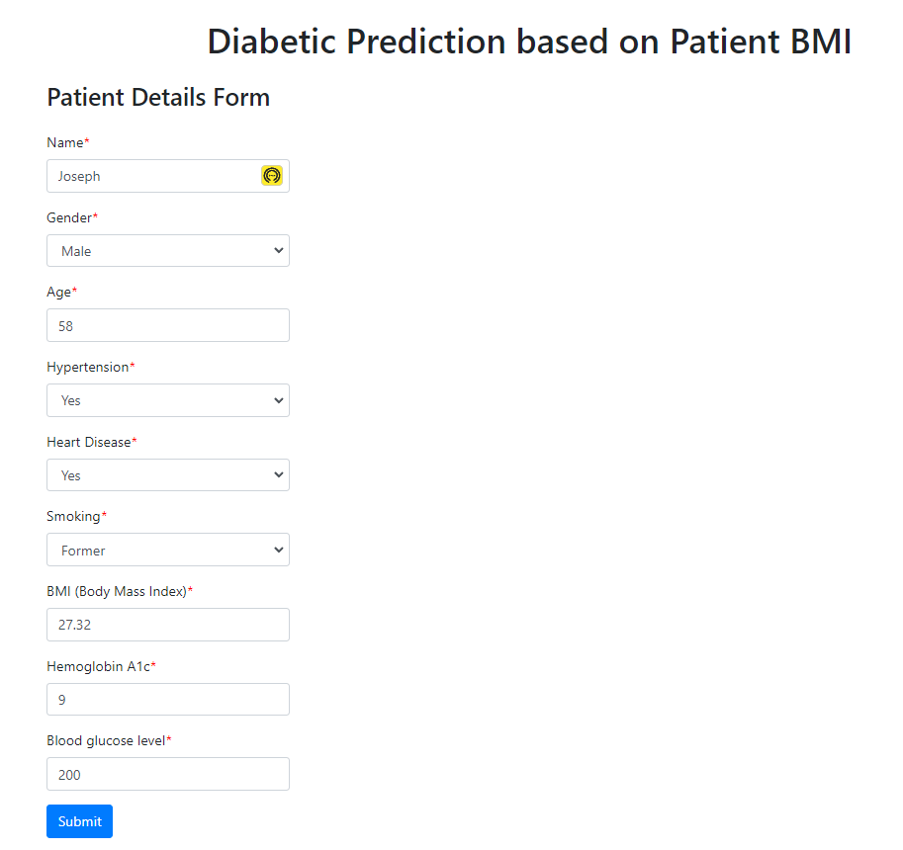
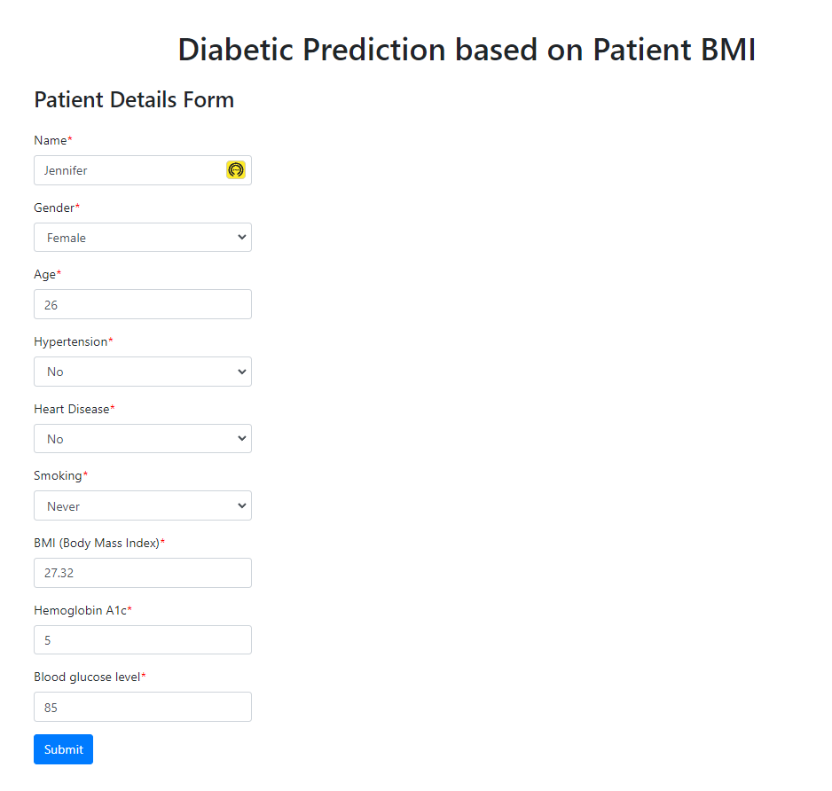
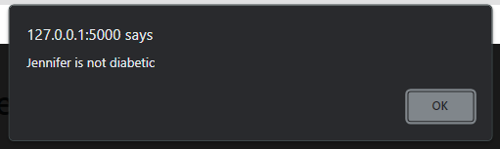
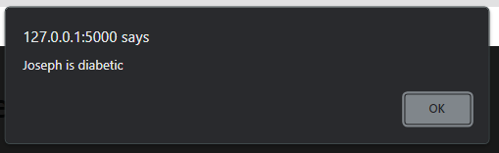
RESULTS:

Slide 10
THANK YOU.

