Slide 1
Presentation on Smart Farming
Presentation by
Surya Pratap 1905250100053
Krishna Gupta 1905250100026
Suraj Ku. Nigam 1905250100052
Sahil Panday 1905250100041
Under the Guidance of
Mr. Abhinandan Tripathi(Asst. Prof.)
Department of Computer Science & Engineering
Buddha Institute of Technology
Gorakhpur, India

Slide 2
OUTLINE OF THE PRESENTATION
Introduction
Objective
System Requirements
Advantages
Proposed Methodology for Smart Farming
Result
Conclusion
Future work
References

Slide 3
Introduction
Smart farming is a management concept focused on providing the agricultural industry with the infrastructure .
This project contains big data for farming that may be increase in yield.
We make a website in which user are satisfied and gain their all solution regarding.
In this project we provide every essential knowledge and details regarding farming, in which we include six state of India .

Slide 4
Objective
This project aims to improve the skills and competences of people in the agricultural sector by introducing this smart farming project.
This project is enhance country understanding of multilateral trade impact on agriculture by product.
Formulate climate smart agriculture investment proposals and identify possible financing sources.
Build capacity to plan, implement and finance climate smart agriculture on the basis of the results above

Slide 5

System Requirements
Visual Stdio Code editor ( for the Html, CSS, javascript and Php code ).
Google Chrome ( but it can run on any web browser ).
XAMPP web server for sql database.

Slide 6
Advantages
Optimize crop treatment such as accurate planting, watering, pesticide application and harvesting directly affects production rate.
Farmers can visualize production levels, soil moisture, sunlight intensity and more in real time and remotely to accelerate decision making process.
Analyzing production quality and results in correlation to treatment can teach farmers to adjust processes to increase.

Slide 7
Proposed Methodology
In this “SMART FARMING” we use predefined Html tags and classes we create responsive sliders at each and every page.
We create Html pages with the help of predefined Html tags and classes.
We create CSS Pages for the website styling and designing.
We use media query for the responsiveness of web pages at the different type of screen size.
We use JavaScript for the translation of website.
We create PHP pages for database connectivity .
We also use XAMPP local server for table creation.

Slide 8
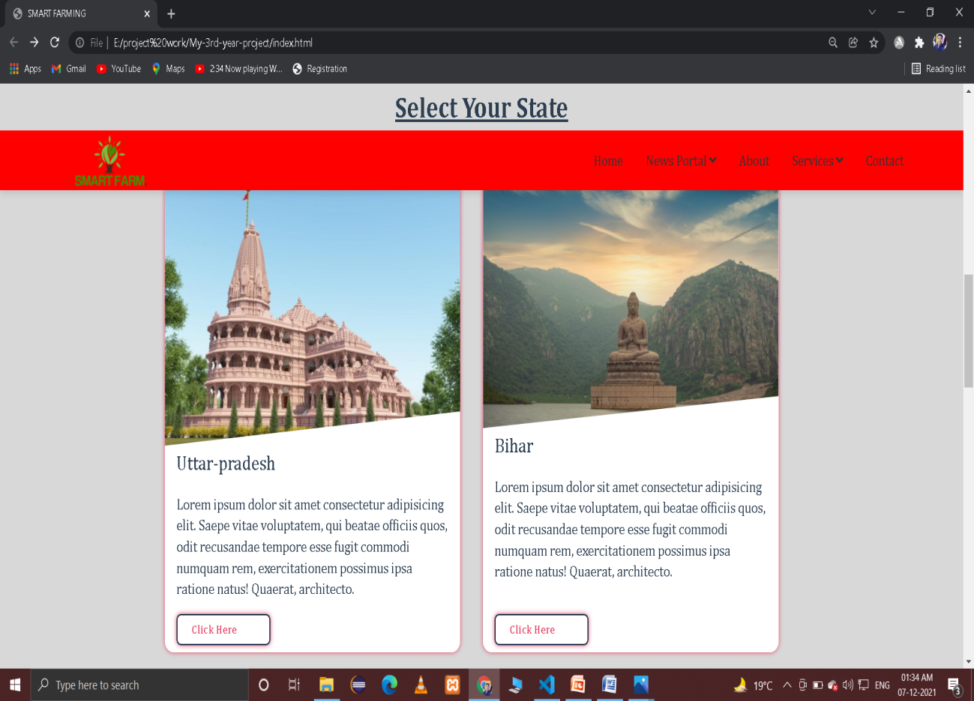
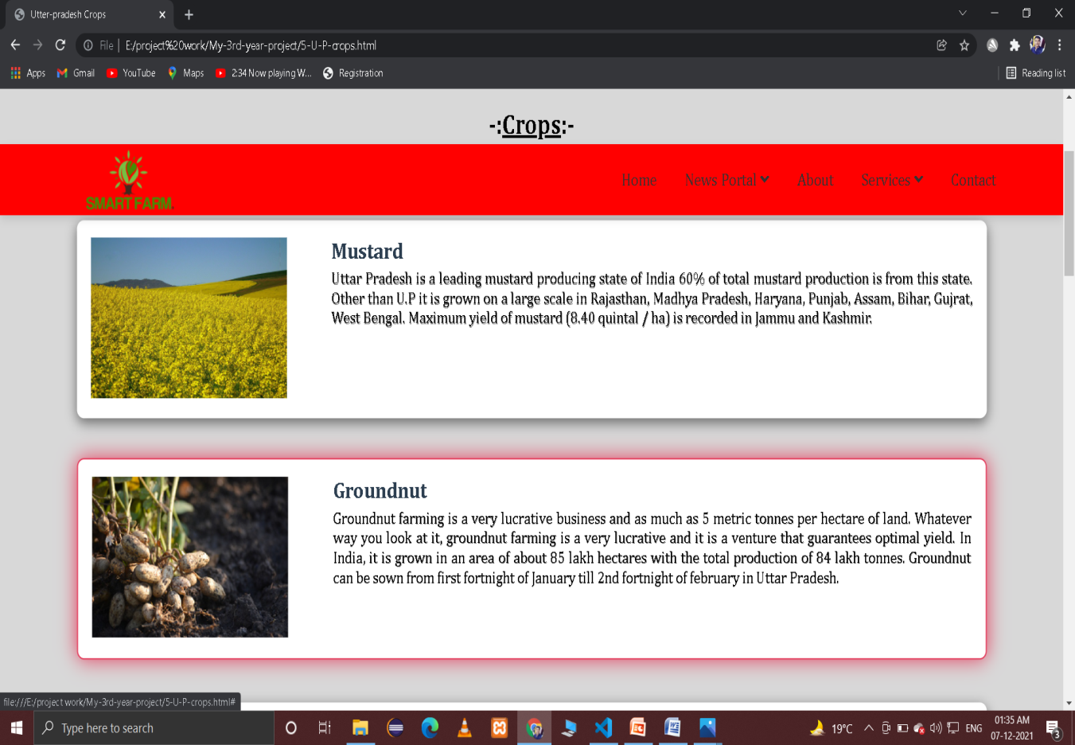
Result

Slide 9
Conclusion
If farmers have less awareness and knowledge regarding farming then the development of our country will be halted.
So, for the above problem we make a website in which user are satisfied and gain their all solution regarding farming of six states is our website, we provide every essential things as well as details regarding farming.

Slide 10
Future Work
We made this project for all states in India.
We can add more blogs regarding farming.

Slide 11
References
कृषि ज्ञान मंजूषा ( Book ) by up government.
https://upagriculture.com
https://mpkrishi.mp.gov.in
https://wb.gov.in
https://agri.panjab.gov.in
https://keralaagriculture.gov.in
https://state.bihar.gov.in

Slide 12

Any Query?

