Slide 1

Department of Information Technology Major Project review 2
FORGERY DATA DETECTION FOR NATIONAL SECURITY USING BLOCKCHAIN
Guided by
JAYANTHI. K
B.TECH(IT).,M.TECH(IT)
ASSISTANT PROFESSOR
Presented by
Yugandhar Surya
VTU12278

Slide 2

Meeting with Guide summary
S.No | Date | Time | Discussion | Remarks
1 | 12/02/22 | 10:00am | Confirmation about topic | Asked to explain in detail
2 | 22/03/22 | 12:00pm | Verified PPT for 1st review | Recommended some changes in diagrams.
3 | 04/06/22 | 3:00pm | Verified all the documents

Slide 3
Objective
Aim of the project :-
To take action against news and online curated content on the internet which could be inimical to the sovereignty of any nation, the proposed solution being implemented by smart contracts may have the capacity to identify and flag such content on websites and social media.The solution may identify such content with reasonable accuracy, which may then be reviewed by the Ministry for taking appropriate action under the Rules.
The current system analysis of forgery data is always questionable because there is no transparency and security provided. The Blockchain proposed system will have the transparency by which one can fetch details of the user who made any forging in data, after which the officials can assess it and take appropriate action under the Rules.

Slide 4
Objective
Scope of the project :-
Scope of our project is to prevent forgery of data that can spread someone’s personal ideologies and can harm the sovereignty of any nation using smart contract.

Slide 5


Introduction
Forgery in any kind of data or information becomes quite simple, nowadays technology like GANs(Generative Adversarial Networks) is being used to generate deep fakes and fake images. The bitter truth is to be captured here is, these thing is being used in creating child sexual abuse material, bullying, financial fraud, revenge porn, fake news, etc.
The main reason behind these forgery data is the invisibility of the creator, mutable data, and insecurity on web2.0. At a saturated level machine or deep learning fails to identify the deepfakes and also to achieve high accuracy, these algorithms need data in bulk to train with, and to store big data high computational database is needed which will cost higher. Using blockchain the data will be transparent, secured, immutable and so the authenticity of data increases.

Slide 6
Problem statement
High increase in deepfakes and fake images.
More density of fake news is being transferred to the public.
Misuse of sensitive data
Invisibility of data provider

Slide 7
Literature review
S.No | Authour | year | Proposed technique | Pros and cons
1 | Rajesha , Rohini Krishna Mohite, et. al. | 2021 | Blockchain | Using IPFS
2 | Sunghyun Cho, Chiyoung Jeong, et. al. | 2019 | Blockchain | Easily traceable and manageable
3 | Liqun Liu, Weihan Zhang, et. al. | 2021 | Blockchain | decentralization, security, and tamper-proof
4 | Paula Fraga-Lamas, Tiago M. Fernández-Caramés, et. al. | 2021 | Blockchain | DLTs guarantee provenance and traceability

Slide 8
Title explanation
S.no | Item | Description
1 | Base paper title | Fake News, Disinformation, and Deepfakes: Leveraging Distributed Ledger Technologies and Blockchain to Combat Digital Deception and Counterfeit Reality
2 | Proposed project title | Identification of forgery data that could be inimical to the sovereignty of any nation using the smart contract.
3 | Improvement from existing system | Transparency, secured, immutable, authenticity, less storage consumption and economical

Slide 9
Existing system
Using Machine or deep learning we can do these work.
Cons:
Centralised access to the data
One can manipulate the data
Higher dataset

Slide 10
Proposed system
Our proposed idea will be eliminating the consequences of machine or deep learning and will make the proposed system lightweight and economical. Moreover, the data on the blockchain distribution will be verified by the real-time peers and then it will be put out to the public domain.

Slide 11
Feasibility of project
Scheduling feasibility
Economic feasibility
Technical feasibility
Social feasibility

Slide 12
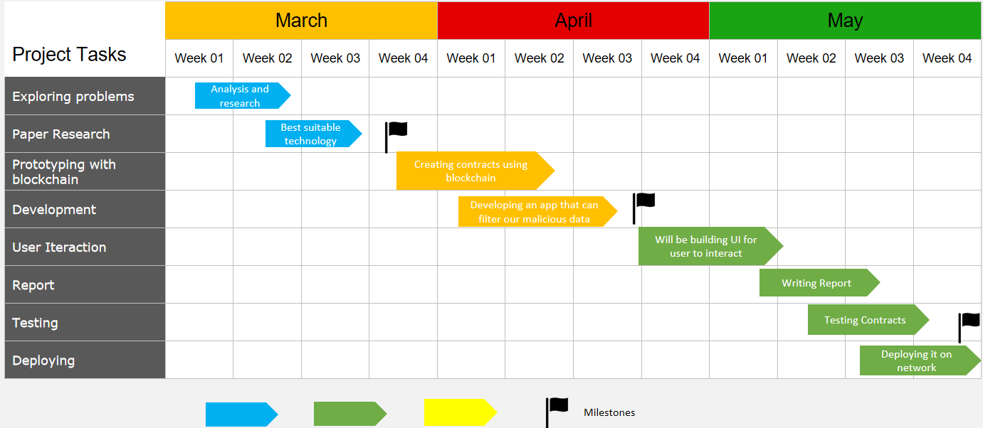
Scheduling feasibility

Slide 13
Feasibility of project
2. Technical feasibility:-
VScode
Github
Ethereum IDE
Metamask
JavaScript
Solidity
ReactJs
3. Economical feasibility:-
It’s very economical as it doesn’t need more infrastructure.
There is some cost for every transaction a user makes which will make it more effecient and effective.

Slide 14
0th review query and response
Detailed explanation about blockchain and where and how it can be implemented and used.

Slide 15
DESIGN AND METHODOLOGIES
MODULE 1: Initializing the project and connect with Rinkbey test networks.
MODULE 2: Planned and created the smart contract using the Solidity.
MODULE 3: Deployment of code on Ethereum.
MODULE 4: Integration of backend and frontend.

Slide 16
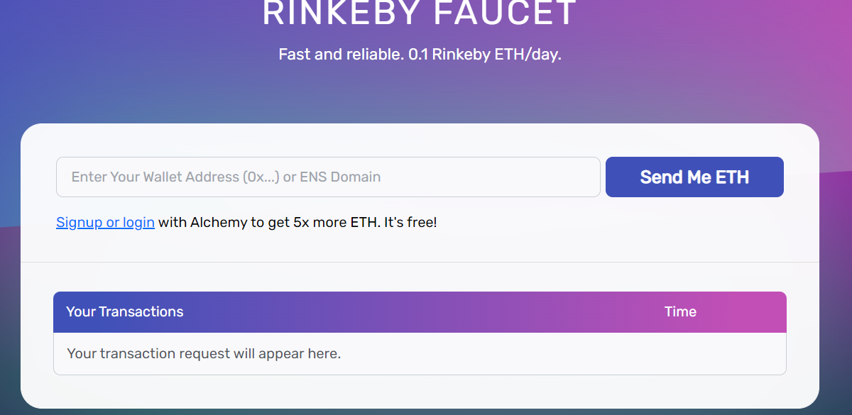
MODULE 1 :-
Initializing the project and connect with Rinkbey test networks.
Install a ReactJs project then to connect with any blockchain network.
I have installed contracts using hardhat(i.e. a compiler to compile smart contracts).
IPFS file system for that I have used sanity.io.

Slide 17
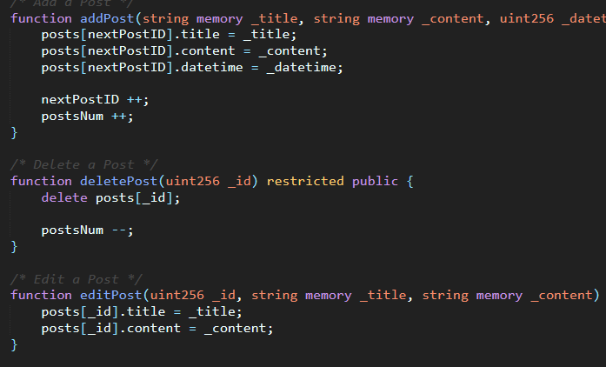
MODULE 2 :-
Planned and creating the smart contract using the Solidity.
Plan on developing an efficient system design with better results.
Designed an architecture on how our proposal can work more effectively and scalable.

Slide 18
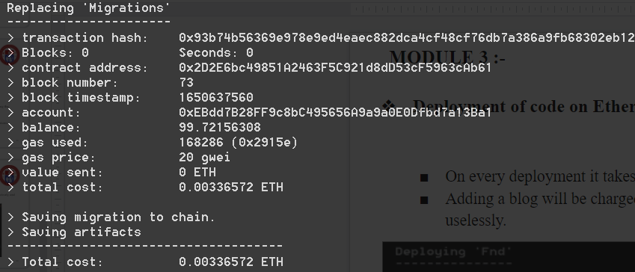
MODULE 3 :-
Deployment of code on Ethereum
On every deployment it takes real money on ethereum.
Adding any article will cost handsome amount, therefore many will avoid sharing fake data uselessly.

Slide 19
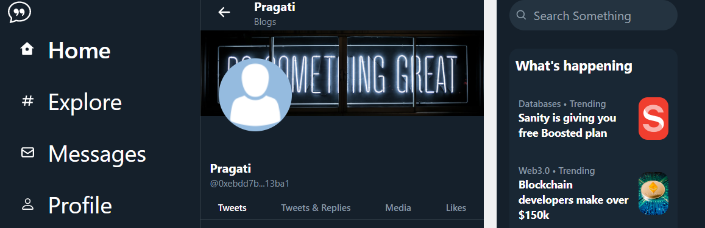
MODULE 4 :-
Integration of back-end and front-end.
Connect to metamask through any specified network. Fetch all the data from the IPFS file system i.e Sanity database.
Display those dynamic data on the front- end.
Addition of data from front-end which will then pushed to the IPFS file system.

Slide 20
IMPLEMENTATION
ARCHITECTURE DIAGRAM
DATA FLOW DIAGRAM
USE CASE DIAGRAM

Slide 21
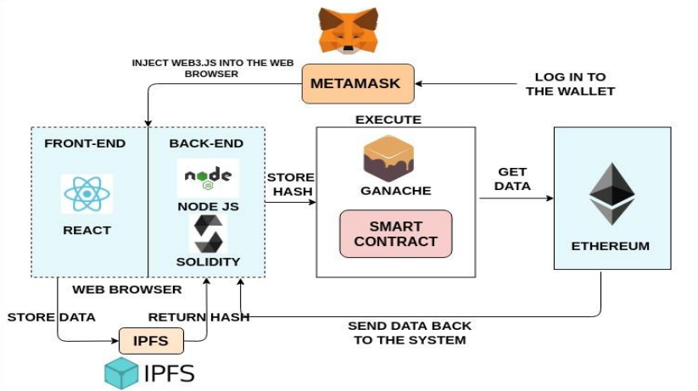
SYSTEM ARCHITECTURE

Slide 22
DATA FLOW DIAGRAM
INSTALL REQUIRED SOFTWARES
DEVELOP AN APPLICATION USING BLOCKCHAIN
SMART CONTRACT TO BE SIGNED BY CONTENT CREATORS
UPLOAD CONTENTS TO BE PUBLISHED
VERIFICATION OF CONTENT BY OFFICIALS
FILTER CONTENTS WITH 50% VOTE OR MORE
PUBLISH FILTERED CONTENT ON THE PLATFORM

Slide 23
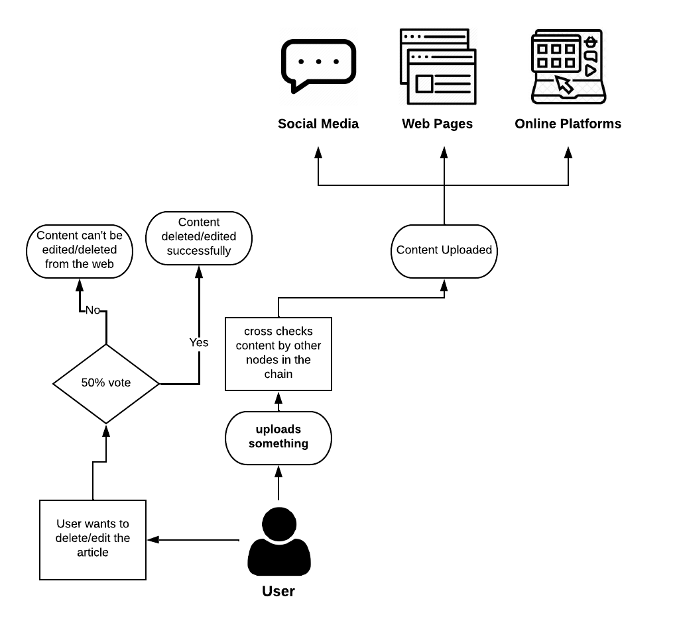
USE CASE DIAGRAM

Slide 24
TESTING
UNIT TESTING
FUNCTIONAL TESTING
WHITE BOX TESTING
BLACK BOX TESTING

Slide 25
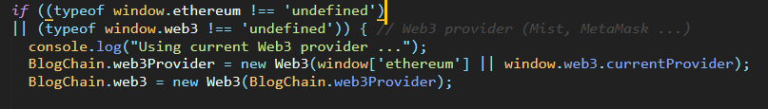
UNIT TESTING
Individual units or components of this project are tested successfully.
Successfully validated that each unit of the project performs as designed.

Slide 26
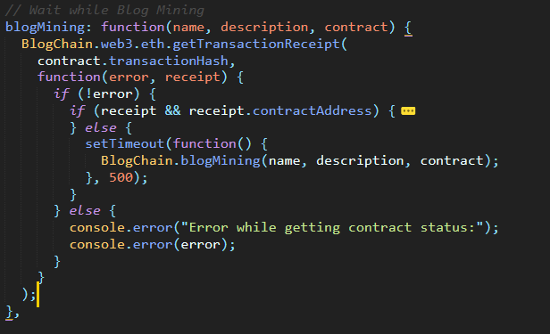
FUNCTIONAL TESTING
When a user tries to find a blog using their address, our function is checking if the address is matched with any existing address or not.
Verified that all the functionality of this project works as expected.

Slide 27
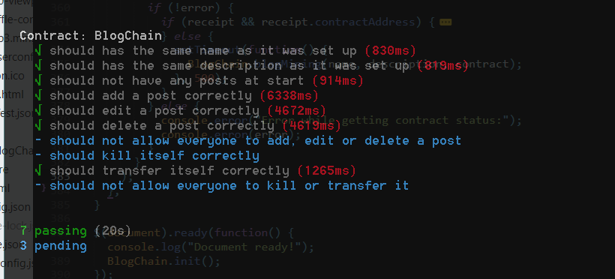
WHITE BOX TESTING
Created the test cases for our project and passes all the tests. Hence, we are taking into consideration that its internal functions work perfectly.

Slide 28
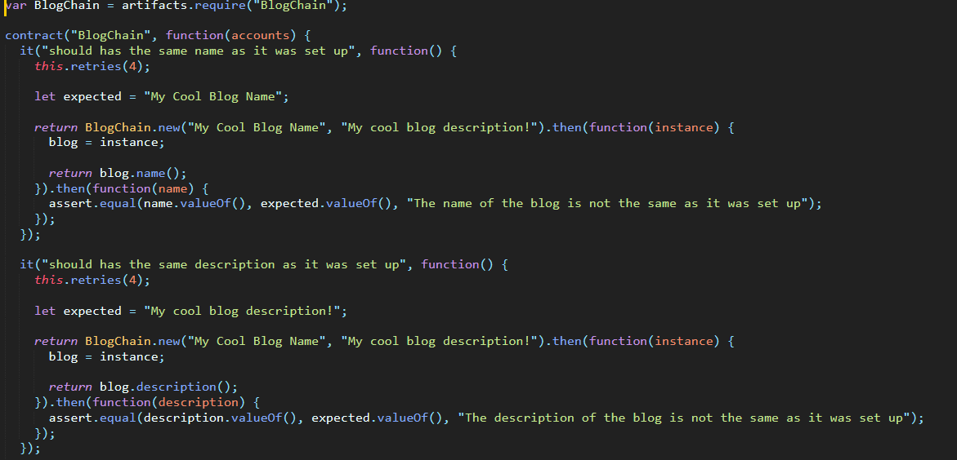
BLACK BOX TESTING
Created the test cases for our project and passes all the tests. Hence, we are taking into consideration that its external functions work perfectly.

Slide 29
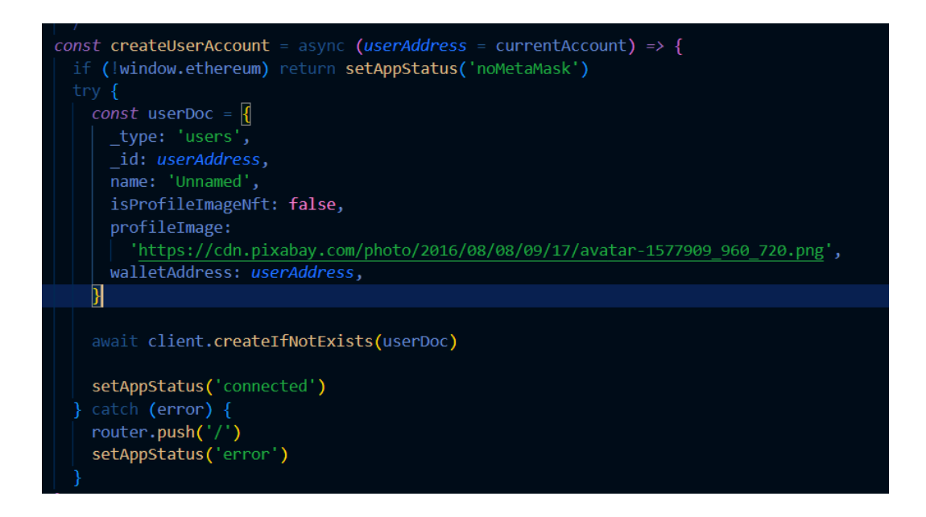
INPUT SCREENSHOT

Slide 30
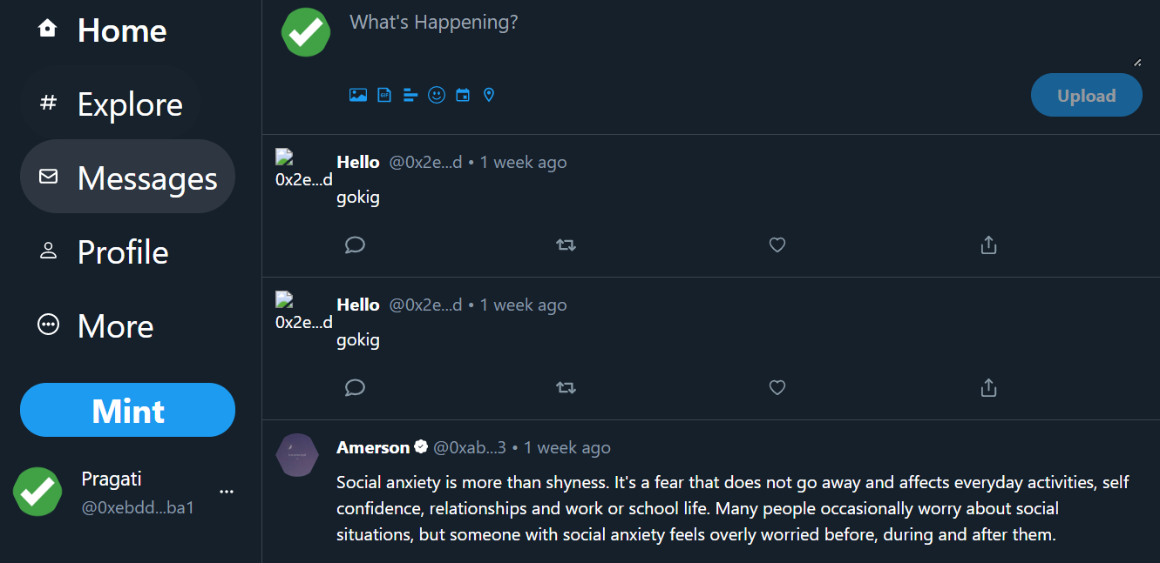
OUTPUT SCREENSHOT

Slide 31
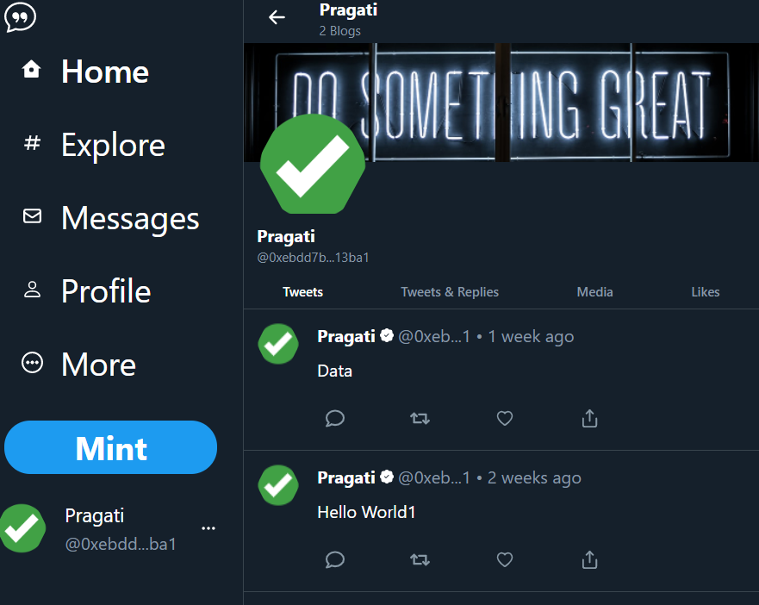
OUTPUT SCREENSHOT

Slide 32
CONCLUSION
A new system is proposed to detect and avoid further spreading of fake news and validate the information from origin. The proposed systems make use of block-chain technology for verifying the source and content of the news. Using blockchain makes it secure and efficient as it identifies the user's malicious intent and hence prevents it from spreading fake news. RTAP (Real Time Alert Panel) keeps track of the live news and constantly updates news status. Fake dataset helps to identify fake nature of the news.

Slide 33
REFERENCES
Liquin Liu,Weihan Zhang,Cunqi Han, “A survey for the application of blockchain technology in the media”,Peer-to-Peer Netw. Appl. 14, 3143–3165, May 2021.
P. Fraga-Lamas and T. M. Fernández-Caramés, "Fake News, Disinformation, and Deepfakes: Leveraging Distributed Ledger Technologies and Blockchain to Combat Digital Deception and Counterfeit Reality," in IT Professional, vol. 22, no. 2, pp. 53-59, 1 March-April 2020.
S. Cho and C. Jeong, "A blockchain for media: Survey," 2019 International Conference on Electronics, Information, and Communication (ICEIC), 2019.

Slide 34
REFERENCES
Shilpashree B N , Rohini Krishna Mohite , Sahana S , Rajesha, Rakesh K R, 2021, “Counterfeit Detection of Documents using Blockchain”, International Journal of Engineering Research & Technology,Volume 10, Issue 07 ,July 2021.
S. E. Haddouti and M. D. Ech-Cherif El Kettani, "Analysis of Identity Management Systems Using Blockchain Technology," 2019 International Conference on Advanced Communication Technologies and Networking (CommNet), 2019.

Slide 35
Thank You
Any Queries?

