Slide 1
Coffee Shop Sales Dashboard Summary
Power BI Dashboard Overview
Presented by: [Suraj Sahane]
Date: 12th April 2025

Slide 2
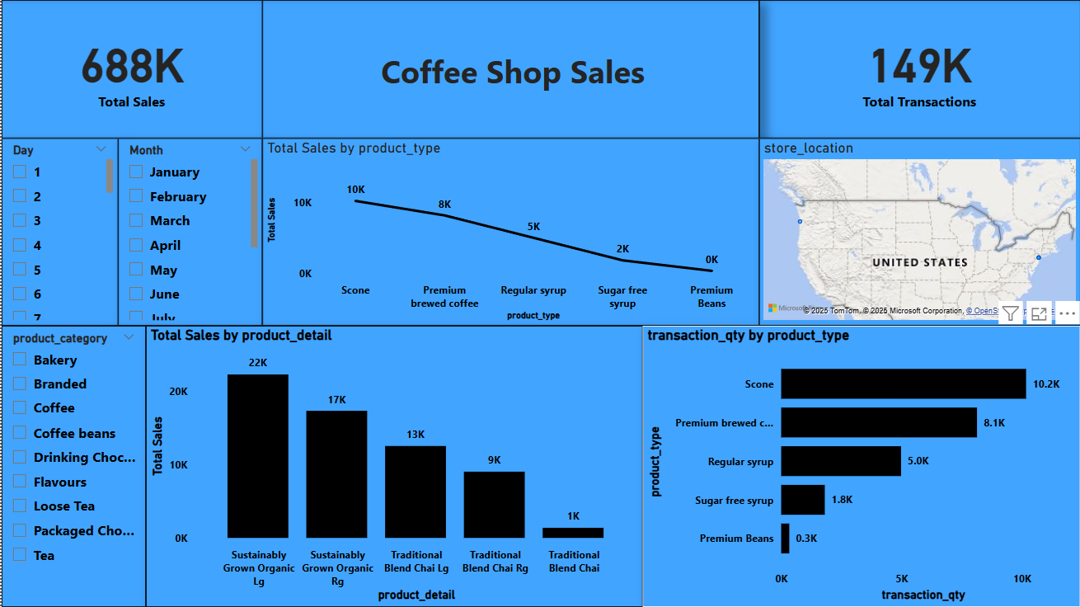
Screenshot Of Dashboard

Slide 3
Executive Summary
Total Sales: 688K
Total Transactions: 149K
Dashboard provides an overview of sales and transactions for various coffee shop products across U.S. store locations.
Visual filters include: Day, Month, Product Category.

Slide 4
Sales Overview by Product Type
Top-selling product type: Scone (10K sales)
Followed by:
Premium brewed coffee – 8K
Regular syrup – 5K
Sugar free syrup – 2K
Premium Beans – 0K
Chart Used: Line chart showing decreasing trend in total sales by product type.

Slide 5
Transaction Quantity by Product Type
Highest transaction quantity:
Scone – 10.2K
Premium brewed coffee – 8.1K
Regular syrup – 5.0K
Lowest: Premium Beans – 0.3K
Chart Used: Horizontal bar chart comparing transaction quantity.

Slide 6
Detailed Sales by Product
Top 3 performing product details:
Sustainably Grown Organic Lg – 22K
Sustainably Grown Organic Rg – 17K
Traditional Blend Chai Lg – 13K
Least performing: Traditional Blend Chai – 1K
Chart Used: Vertical bar chart showing sales by product detail.

Slide 7
Geographic Insights
Map visualization displaying store locations across the United States.
Useful for identifying regional performance.

Slide 8
Interactive Filters
Available filters include:
Day of the month
Month
Product Category
Enables stakeholders to drill down into specific timeframes or product segments.

Slide 9
Key Takeaways
Scone and Premium brewed coffee are the most popular products both in sales and transactions.
Organic and sustainably grown products are top performers in detailed sales.
Low performance observed in Premium Beans category.
The dashboard enables dynamic exploration of time, category, and geography.

