Slide 1
SIGN LANGUAGE DETECTION
Name: Aryan Dahiya

Slide 2
1. Introduction 2. Problem Statement 3. Possible Approaches 4. Methodology 5. Result And Discussion 6. Conclusion And Future Work
Table of contents

Slide 3
Introduction!

Slide 4
PROBLEM STATEMENT
The ability to communicate effectively is fundamental to social interaction, education, and participation in society. However, significant challenges exist for Deaf and hard-of-hearing (DHH) individuals who rely on Sign Language for communication. These challenges stem from a lack of readily available resources. The scarcity of qualified sign language interpreters creates communication barriers in crucial settings like healthcare, legal proceedings, and educational institutions. This can lead to misunderstandings, delays, and limited access to vital services and information. The effect of these limitations creates a communication gap that restricts the full participation of DHH individuals in society.

Slide 5
INTRODUCTION
The limitations faced by Deaf and hard-of-hearing (DHH) individuals in accessing qualified sign language interpreters and learning resources create a significant communication barrier. This project proposes a groundbreaking solution to bridge this gap: a real-time sign language gesture recognition system powered by machine learning. This system leverages the power of Convolutional Neural Networks (CNNs), a type of artificial intelligence adept at image recognition. By analyzing video frames, the CNNs can accurately identify sign language gestures. This innovative technology has the potential to revolutionize communication accessibility for sign language users. Imagine a world where seamless communication becomes a reality across diverse social and professional settings. Doctors consultations, educational lectures, legal proceedings – all these interactions could be facilitated by this system, empowering DHH individuals to participate fully in society.

Slide 6
Possible approaches

Slide 7
Three Approaches Explored for Sign Language Gesture Recognition System:
MEDIAPIPE: Goal: Utilize MediaPipe, an open-source framework by Google, to identify and track hand landmarks in video frames. Problem: Camera quality significantly impacted the accuracy of hand landmark detection and storage. Poor resolution or lighting conditions hindered reliable tracking.
2. OBJECT DETECTION: Goal: Implement object detection algorithms to identify hands within video frames and potentially classify them based on their position and shape. Problem: This approach might be overly complex for the specific task. Object detection algorithms are designed for a wider range of objects, and customizing them for hand
gestures only might introduce unnecessary processing overhead.
3. CONVOLUTIONAL NEURAL NETWORK (CNN) ARCHITECTURE: Goal: Develop and implement a CNN model specifically designed for sign language gesture recognition. CNNs excel at extracting features from images and videos, making them
well-suited for this task. Implementation: Built a model with CNN layers to extract features from frames
containing hand gestures. This involved convolutional layers followed by pooling
layers to reduce data size and activation functions to introduce non-linearity.

Slide 8
METHODOLOGY

Slide 9
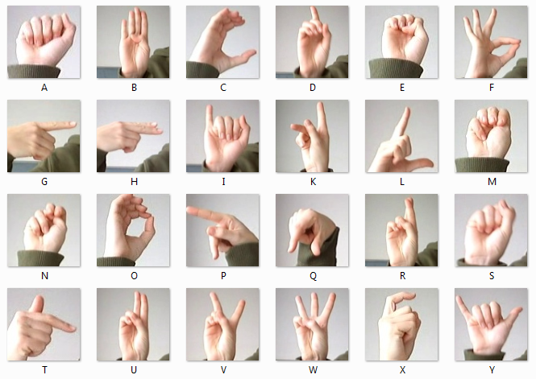
Data Acquisition AND Preprocessing
The research focused on developing a CNN model to classify American Sign Language (ASL) gestures using a dataset from Kaggle. The dataset, stored in CSV format was used for training and testing images of American Sign Language (ASL) gestures, with each image labeled from 0 to 25 representing letters A-Z (excluding J and Z). The training dataset included 27,455 images, while the test dataset comprised 7,172 images. Each image was represented by 784 pixels (28x28) in grayscale. The preprocessing involved resizing images to 64x64 pixels, converting them to float type, and normalizing pixel values between 0 and 1, with data augmentation to improve model robustness.

Slide 10
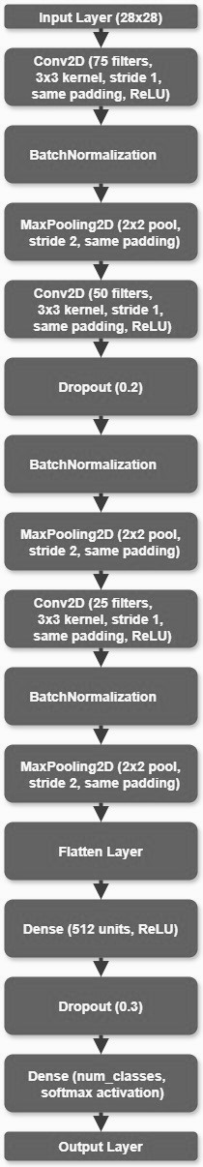
CNN model architecture
The CNN model for ASL gesture classification was designed with multiple layers optimized for image recognition, including convolutional layers for feature extraction, batch normalization layers for improved training stability, max-pooling layers for spatial down-sampling, dropout layers to prevent overfitting, and dense layers for the final classification. The output layer uses the softmax activation function to produce probability distributions over the 24 gesture classes. The model was compiled with the Adam optimizer to adjust the learning rate dynamically, and categorical cross-entropy was used as the loss function for this multi-class classification problem.

Slide 11
EVALUATION
Performance evaluation included accuracy, precision, recall, F1-score, and confusion matrices, alongside training and validation accuracy/loss curves to assess learning dynamics. The trained model was saved in HDF5 format for easy deployment. A function was defined to predict random images, where the input image is processed, and the predicted alphabet is printed.

Slide 12
RESULT AND DISCUSSION

Slide 13
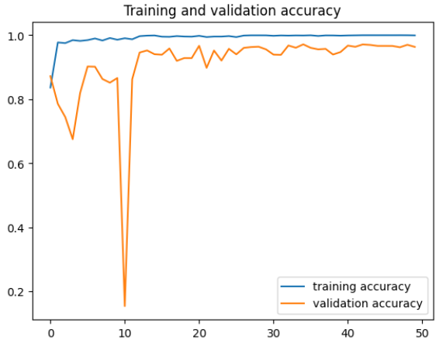
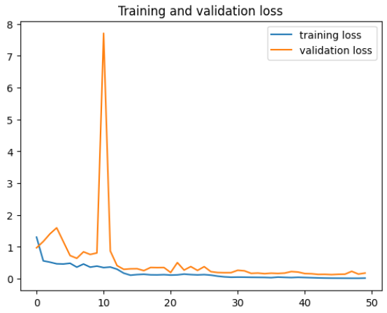
RESULT
Accuracy: The model achieved a high accuracy of 96.35% on the test set, demonstrating its effectiveness in recognizing ASL gestures.
Training and Validation Curves: The learning curves showed consistent performance without significant overfitting. This consistency indicates that the model generalized well to unseen data, maintaining a balance between fitting the training data and preserving the ability to perform well on new, unseen data.

Slide 14
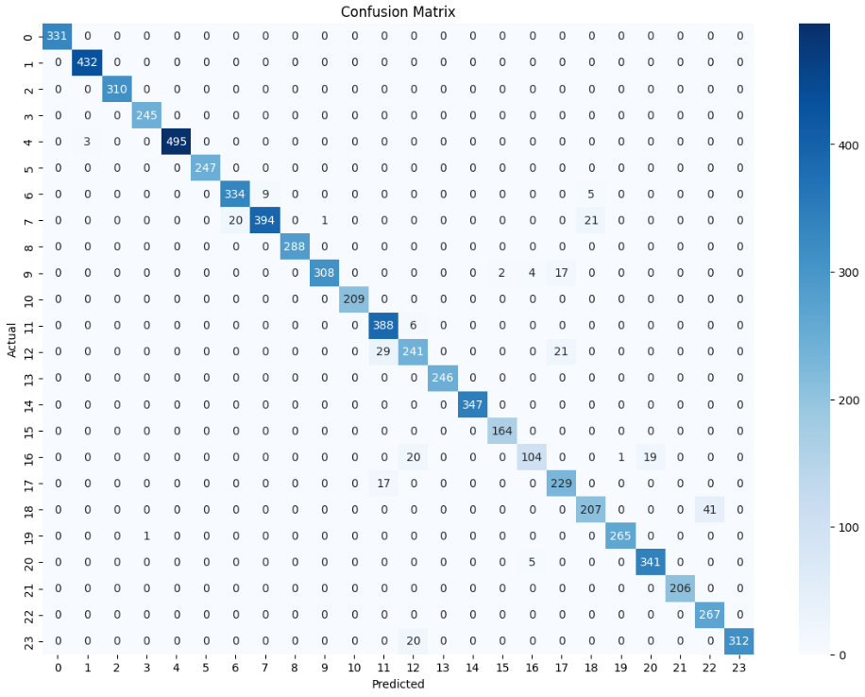
Confusion Matrix: The confusion matrix confirmed robust performance across all classes. Most gestures were accurately recognized, highlighting the model's capability to differentiate between various ASL gestures effectively. This detailed evaluation ensures that the model's high overall accuracy is reflected in its performance on individual gesture classes.

Slide 15
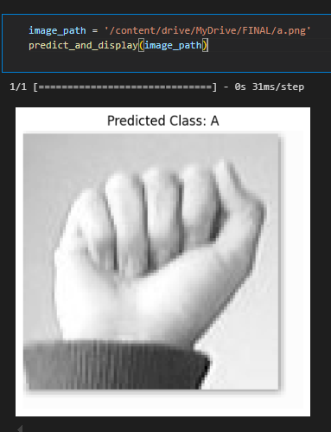
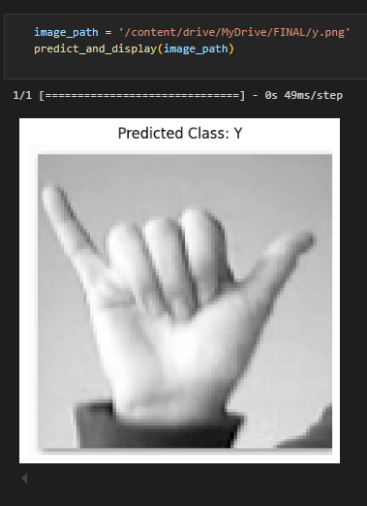
Gesture Recognition Function
The function designed for predicting ASL gesture images preprocesses the input by resizing it to fit the model's input dimensions. It utilizes a trained CNN model to classify the gesture and returns the predicted ASL alphabet corresponding to the input image, enabling real-time application of the gesture recognition system. The predicted alphabets demonstrate high accuracy, validating the model's effectiveness.

Slide 16
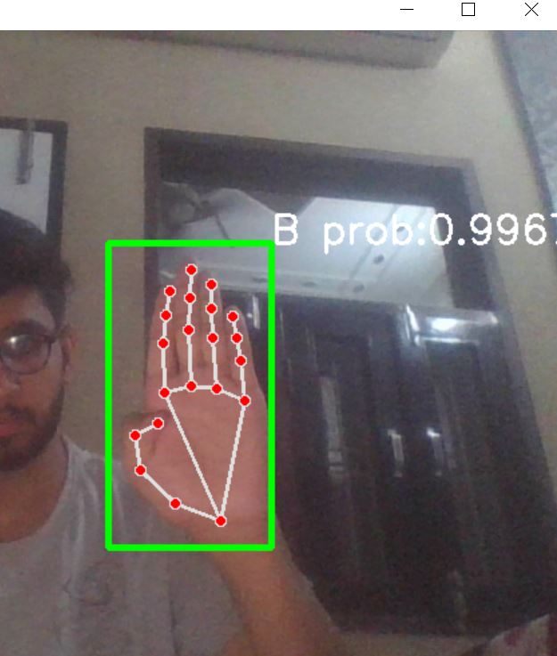
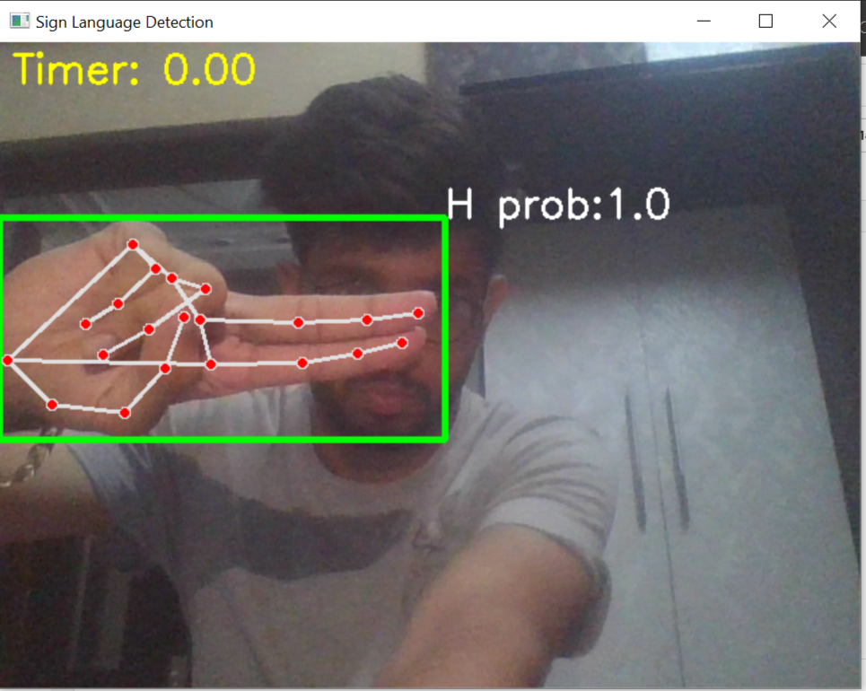
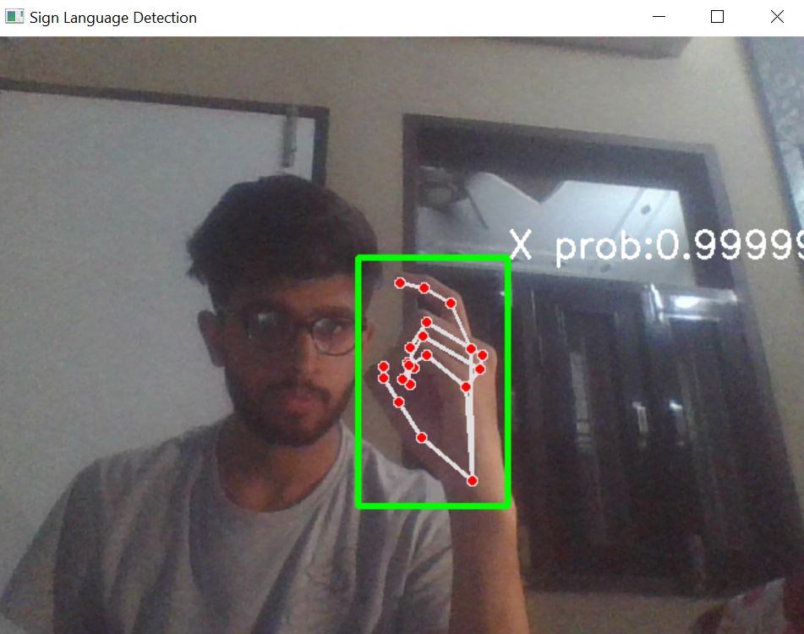
REAL TIME PREDICTION

Slide 17
DISCUSSION
Model Efficacy: The high accuracy and balanced precision, recall, and F1-scores indicated the model effectively learned to recognize ASL gestures.
Regularization Techniques: Dropout and batch normalization layers played a crucial role in preventing overfitting, contributing to stable and robust training.
Optimization Strategies: Early stopping and learning rate reduction helped in optimizing the training process, preventing overfitting and ensuring the model converged to a good solution.
Practical Application: The trained model was saved in HDF5 format for easy deployment. A prediction function was defined to demonstrate the model's practical application by accurately predicting gestures from new images.

Slide 18
CONCLUSION

Slide 19
In conclusion, the CNN model developed for American Sign Language (ASL) gesture recognition has demonstrated exceptional performance with a test set accuracy of 96.35%. The methodology, comprising meticulous data acquisition, preprocessing, and the design of optimized convolutional layers, yielded robust results validated by comprehensive evaluation metrics including precision, recall, F1-score, and the confusion matrix. The model's stable learning dynamics, as evidenced by training and validation curves, underscore its ability to generalize effectively to unseen ASL gestures. For future work, enhancing the dataset with diverse gestures and exploring advanced CNN architectures or transfer learning methods could further elevate accuracy and extend the model's application in real-time gesture recognition systems and assistive technologies. Continued refinement will be pivotal in maximizing the model's performance and utility in practical ASL communication contexts.

Slide 20
Thank YOU

