Slide 1

RydeResolve
Every ride dispute, heard fairly: AI advocates for both sides, an AI judge that cites the evidence, and people for anything unsafe or uncertain.
Architecture · Tencent Cloud Hackathon · Digital Native Track
Notes:
RydeResolve resolves rider and driver disputes on a ride-hailing platform: route deviation, no-show charges and cleaning fees. Safety reports always go to a person. The deck shows the hearing, how a case flows, what each agent may see, how evidence is enforced, when a person decides, the platform, and the measured results.

Slide 2
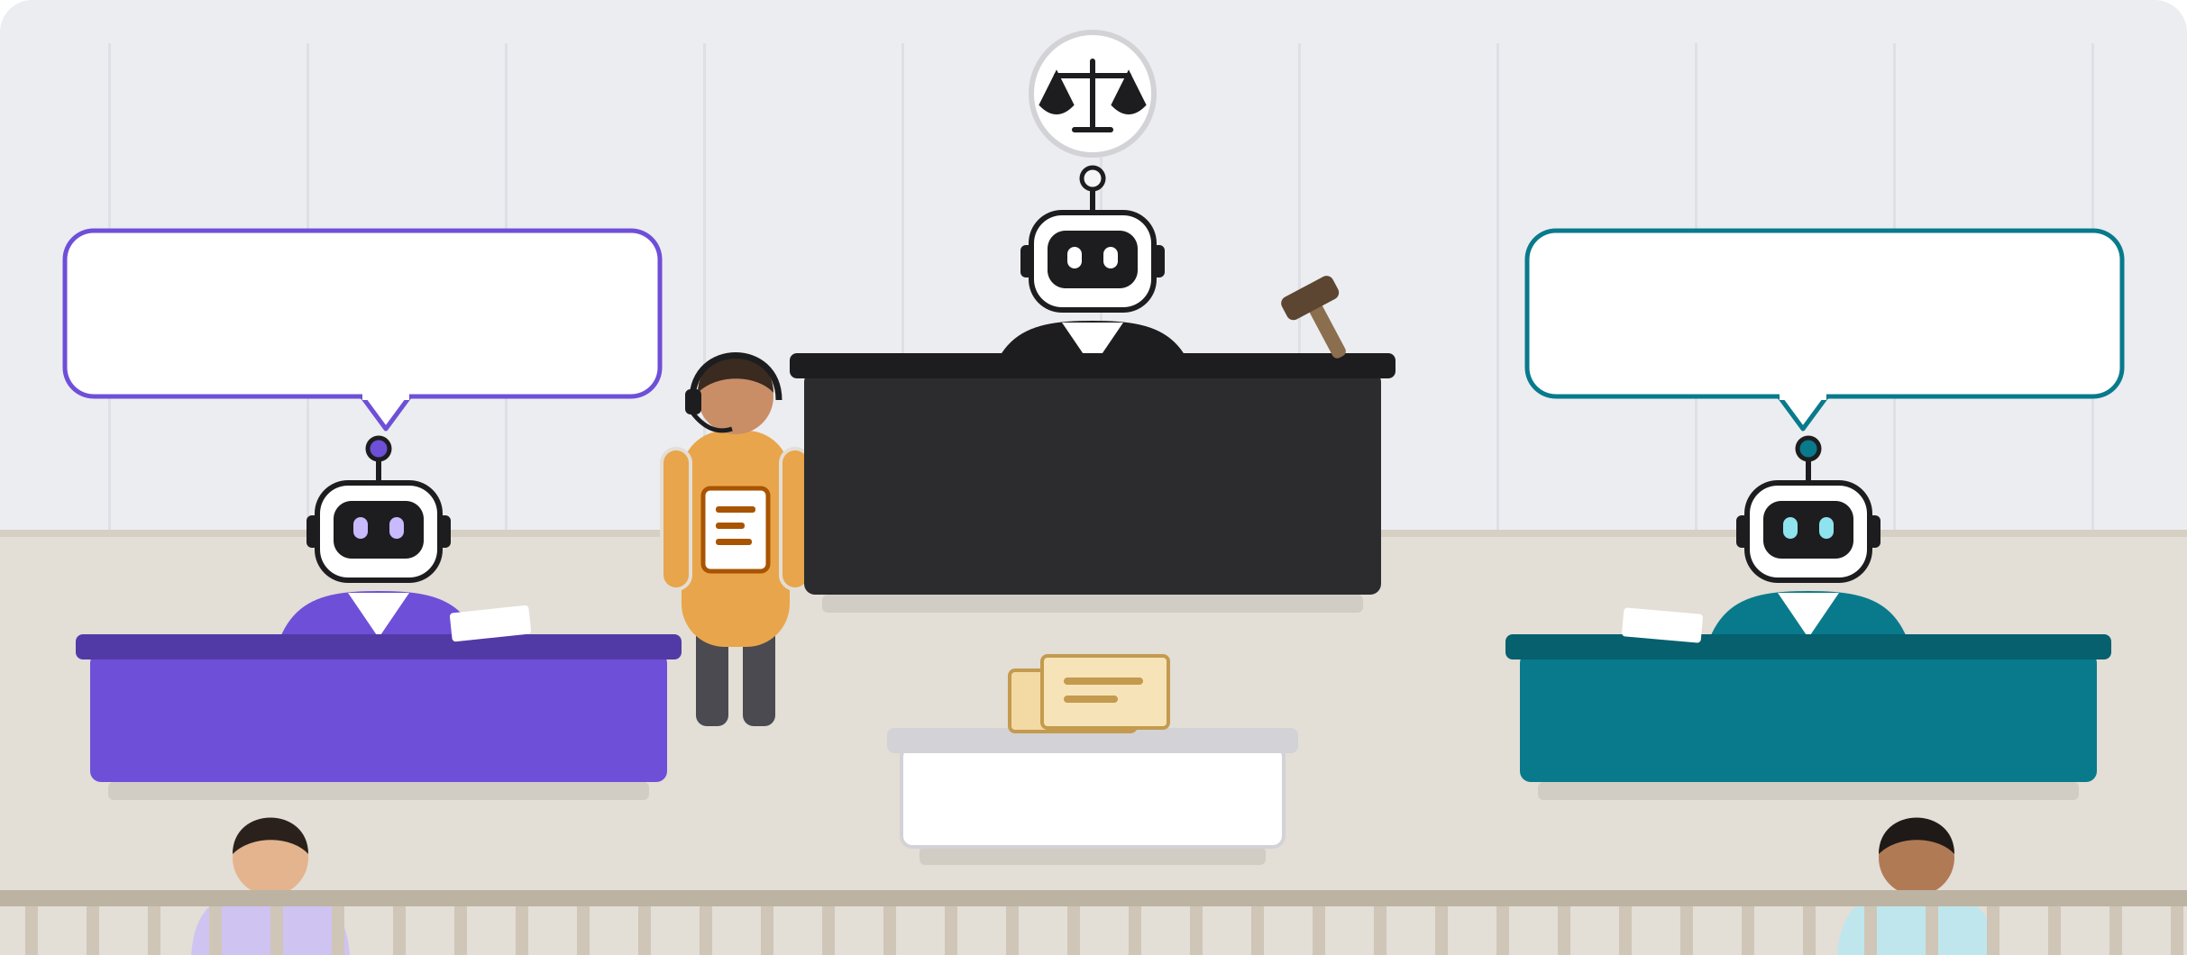
A dispute, heard like a court
Two AI advocates argue from the same case file, and an AI judge rules. People handle anything unsafe or uncertain.
“Driven 41% longer than the fastest route.”
cites ROUTE-COMPARISON
“There was a road closure.”
cites MSG-0132
Judge
AI agent · never reads the complaint
Claim upheld · $3.68 refund
Rider's advocate
AI agent
Driver's advocate
AI agent
Human judge
L2 support
Case file
shared by both sides
Rider
Driver
Notes:
The whole system in one picture. Each side gets its own AI advocate, and both argue from the identical case file, citing evidence by ID: here the rider's advocate cites the route comparison and the driver's advocate the driver's own chat message. The AI judge rules from the case file and both arguments, never from the original complaint. The example is a real case: the driven route was 41% longer than the fastest one, no road closure was on record, and the claim was upheld with a $3.68 refund. A human judge, the L2 support team, steps in for safety reports and for any ruling the plain-code checks flag.

Slide 3












One dispute, end to end
Plain code connects the steps. Agents never call each other.
Report filed
Triage
Eligibility
Evidence
Photo check
From the trip, in a chat
Kind of dispute, safety flag
Six rules, no AI
Builds one case file
Code sets the fee tier
Safety
Declined
to a person
can refile
the same case file to both sides
Rider's advocate
Judge
Final checks
Compliance
Decided
Rules from both arguments and the case file
Confidence and risk, no AI
Can veto a ruling, never writes one
Driver's advocate
A person
AI step (model call)
Plain code, no AI
A person decides
Rider's side
Driver's side
Notes:
Top row is intake. An agent triages the report, then six plain-code rules run: a safety flag hands the case to a person, and missing evidence declines it (the claimant can refile). Evidence Collection, the only agent allowed to read raw records, builds one case file; cleaning-fee photos get a vision check whose finding code maps to the fee tier. Bottom row is the hearing: two advocates argue in parallel from the identical case file, the Judge rules, and plain-code checks plus a compliance veto decide whether the ruling stands or goes to a person.

Slide 4

Each agent sees only what it needs
The limits are enforced in code, not requested in a prompt.
Triage
Evidence Collection
Rider's advocate
Driver's advocate
Judge
Sees
The report, in the person's words
Sees
The trip records. The only agent that can
Sees
The case file and both sides' words
Sees
The case file and both sides' words
Sees
The case file and both arguments
Never sees
Any trip records
Never sees
The complaint text
Never sees
The raw database
Never sees
The raw database
Never sees
The complaint text, the raw database
Photos: a vision model says what it sees; code picks the fee ($40 / $120 / $200).
Notes:
Only Evidence Collection touches the database. Both advocates see the shared case file plus both parties' words, and can only look up items in that case file. The Judge sees the case file and both arguments but never the complaint text, so the tone of a complaint cannot sway it. The vision model only describes a photo; code applies the fee table.

Slide 5



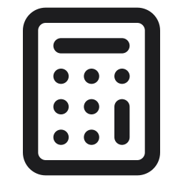
Every finding cites evidence
A claim that points at nothing in the case file is struck before anyone acts on it.
Trip records
Case file
Arguments
Citation check
On screen
GPS, routes, fare, messages, photos
Every item gets an ID, like MSG-0132
Every claim names the IDs it rests on
An unknown ID: claim struck, case flagged
Click any citation to open the evidence
Computed in code, never by a model
How much longer the route was, how close the driver got to the pickup, whether traffic was on the route, and every amount.
Notes:
Evidence Collection turns raw records into one case file in which every item has an ID. Advocates and the Judge must cite those IDs for every factual claim; a validator in code strikes any claim whose citation does not exist and flags the case. On screen, every citation opens the exact evidence. The facts a ruling turns on, and every amount, are computed in code so a model can never invent them.

Slide 6




When a person decides
These checks run on every case, whatever the Judge says. Any one sends it to a person.
Safety report
No agent hears it at all
A person decides
Safety reports come first
The evidence is shown before the AI's recommendation, so it can't anchor them
They approve or change the outcome, with a reason
Low confidence
The Judge is under 0.60
High risk
Repeat filer, or a fee of $120+
OR
The Judge asks
A request, never a substitute
None fire: the ruling stands
Both parties see the same facts and rule
Compliance veto
The remedy breaks a policy rule
Notes:
Escalation is plain code and runs on every case regardless of the Judge. A safety report never reaches an agent. Low confidence, a risk bucket (repeat filers, fees of $120 or more) or a compliance veto each independently sends the case to a person; the Judge can also ask, but its request never replaces the checks. The reviewer sees the evidence before the AI recommendation and records a reason for any change.

Slide 7
Technical architecture
A React app, one FastAPI service and Neon. Every step streams live to the screen.
Frontend
Vercel
Rider and driver apps
report, reply, outcome
Support console
the person's queue
AI trace
every case as a hearing
Live updates
server-sent events
Backend
FastAPI on Render
Orchestrator
wires every step
5 AI agents
pydantic-ai, typed output
Rules
checks with no AI
Tools
evidence, policy, photos
Data
Neon
Postgres + pgvector
cases, evidence, trace
Object storage
evidence photos
Services
external
DeepInfra
Qwen3-235B, Gemma 4
Logfire
traces every agent run
OneMap
real Singapore routes
Notes:
Four layers. The frontend is a static React app on Vercel: the rider and driver apps, the support console and the AI trace; it sends actions over REST and receives every live update over server-sent events. The backend is one FastAPI service on Render: the orchestrator wires every step, five pydantic-ai agents with typed outputs and citation validators, rules with no AI, and narrow tools. Neon holds Postgres with pgvector and the evidence photos. DeepInfra serves the models, Logfire traces every agent run, and OneMap provides real Singapore road routes.

Slide 8
Results
22 labelled test cases, each run through the full pipeline with real model calls.
13 of 22
100%
22/22
decided with no person
the other 9 went to a person, as the rules require
safety reports to a person
no AI ever decides one
verdicts correct
Outcome, remedy and exact amount all match the label, across every category.
$0.012
3.4 min
model cost per case
about 124K input and 2.3K output tokens
report to outcome
median per case
Notes:
From the latest golden run with Qwen3-235B on DeepInfra: all 22 labelled cases matched their labels down to the exact amount; the fallback model, Qwen3.6-27B, also scored 22 of 22. Thirteen cases were decided with no person, and the other nine went to a person because the checks required it: safety reports, fees of $120 or more, and repeat filers. Model cost was about 1.2 US cents per fully argued case, and the median time from report to outcome was 202 seconds. The project also has 216 automated tests.

