Slide 1
Introduction

Slide 2
What is Enterprise?
A business Organization
In computer industry, term is often describe as the large organization that utilized computers
E.g. Intranet example of an enterprise computing system
Enterprise Application:
A business Application
Business application are complex, scalable ,distributed, component based and mission critical.

Slide 3
Trend(better tools, greater impact, powerful option)
Growth of User Experience (UX)
Explosion of Development Tools
Decline of Native Development
Growing business focus on user experience
Growing need for integration and web service
Others…….?????

Slide 4
Enterprise Application Integration
Enterprise application integration (EAI) is the use of technologies and services across an enterprise to enable the integration of software applications and hardware systems. Many proprietary and open projects provide EAI solution support.EAI is related to middleware technologies. Other developing EAI technologies involve Web service integration, service-oriented architecture, content integration and business processes. Intercommunication between enterprise applications (EA), such as customer relations management (CRM), supply chain management (SCM) and business intelligence is not automated. Thus, EAs do not share common data or business rules. EAI links EA applications to simplify and automate business processes without applying excessive application or data structure changes. However, EAI is challenged by different operating systems, database architectures and/or computer languages, as well as other situations where legacy systems are no longer supported by the original manufacturers.
Keyword Web services and business integration

Slide 5
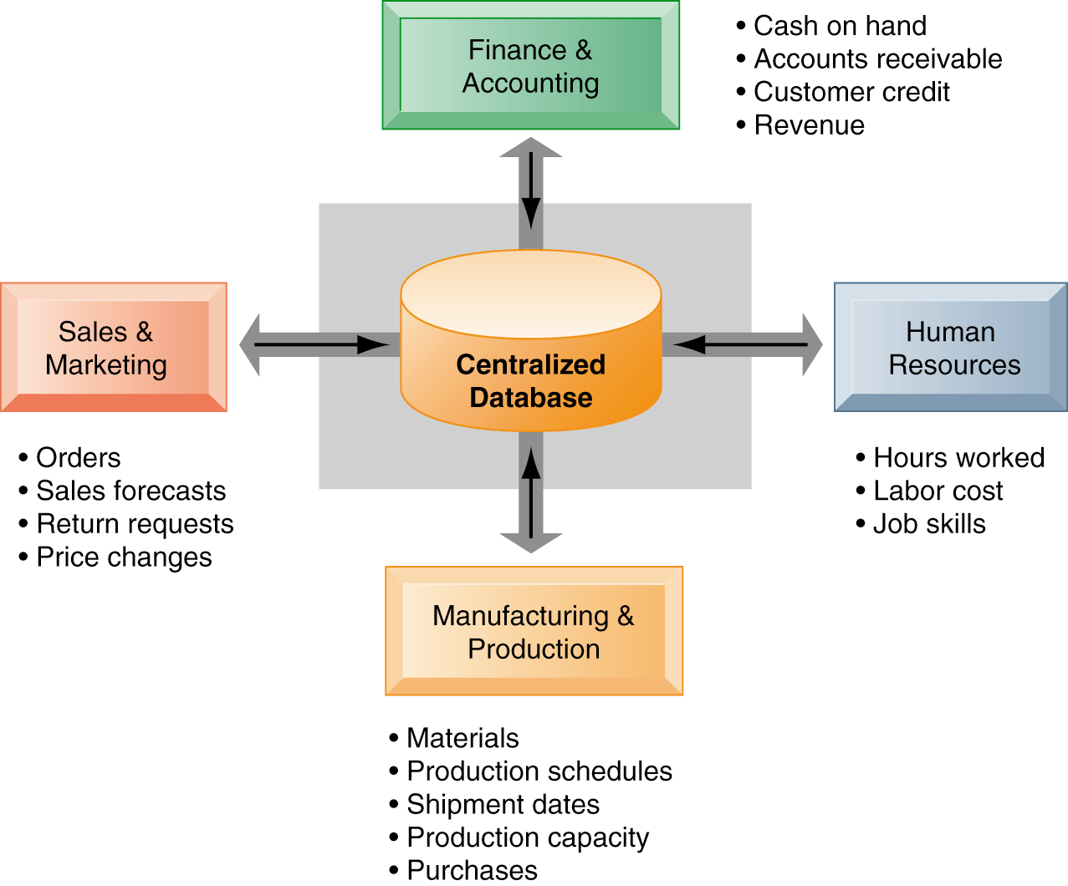
How enterprise System Works?
Enterprise systems feature a set of integrated software modules and a central database that enables data to be shared by many different business processes and functional areas throughout the enterprise.

Slide 6
What is EAI?
an application coupling mechanism, to integrate individual applications into enterprise
provides a unified interface to legacy systems
defined as the uses of software and computer systems architectural principles to integrate a set of enterprise computer applications
The real beauty of Enterprise Application Integration is making various separate applications work together to produce a unified set of functionality

Slide 7
Why EAI?
System development over the last 20 years has tended to emphasize core functionality as opposed to integration
Many systems are difficult to integrate with other similar systems
Ultimately, it comes down to a cost issue. Building a system with integration in mind reduces the amount of money spent on further system development
30% of the IT budget is spent on linking/merging of databases and sources

Slide 8
Why EAI?
It would be great if everyone used the same servers with the same operating system with the same clients, etc
Reality is very diverse. We can expect a mix of mainframes, Windows, UNIX, Linux, VMS, as well as many other systems
Getting them to work/share data together is the issue!
The market is stocked with legacy systems designed to support single users without thought to integrating them into a larger whole.
Many of these systems still provide value to the organization.
Packaged applications often create their own set of issues and problems

Slide 9
Why EAI?
EAI is defined as “the unrestricted sharing of data and business processes among any connected applications and data sources in the enterprise.”
Using EAI effectively will allow us to integrate without have to make major changes to our current infrastructure

Slide 10
Applying Technology
The traditional solution to integration issues has been the introduction of ‘middle-ware’.
Middle-ware acts as a transport mechanism to perform integration typically on client/server based systems.
Many flavors/standards of middle-ware exist:
Remote Procedure Calls (RPC)
Sockets
Common Object Reuse Broker Architecture (CORBA)
Distributed Computing Environment (DCE)
Java’s Remote Method Invocation (RMI)

Slide 11
Applying Technology
While middle-ware can be a solution, problems exist:
Changes are typically required to existing systems to incorporate middle-ware
No centralized management typically exists, so complex systems rapidly grow unmanageable
Technological advances tend to make middle-ware based systems look like an ill-planned highway system composed of small integration projects instead of a single over-reaching standard

Slide 12
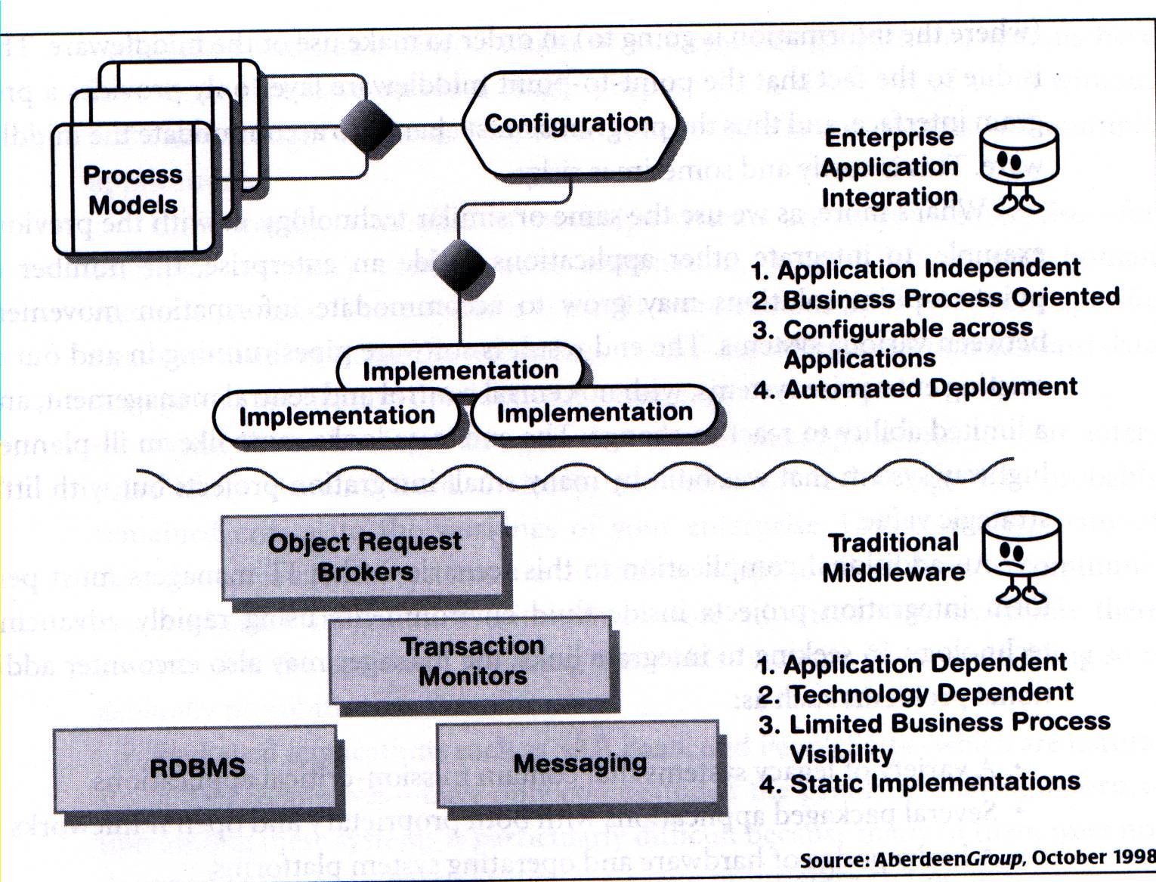
Defining EAI
Applying Technology
EAI focuses on the integration of both processes AND data while middle-ware is data oriented

Slide 13
Problem in EAI
Most organizations lacked architectural foresight.
As they upgraded from legacy systems, they moved to newer ‘open’ systems without consideration to how well these new systems would fit into their current structure and integrate with existing legacy systems.

Slide 14
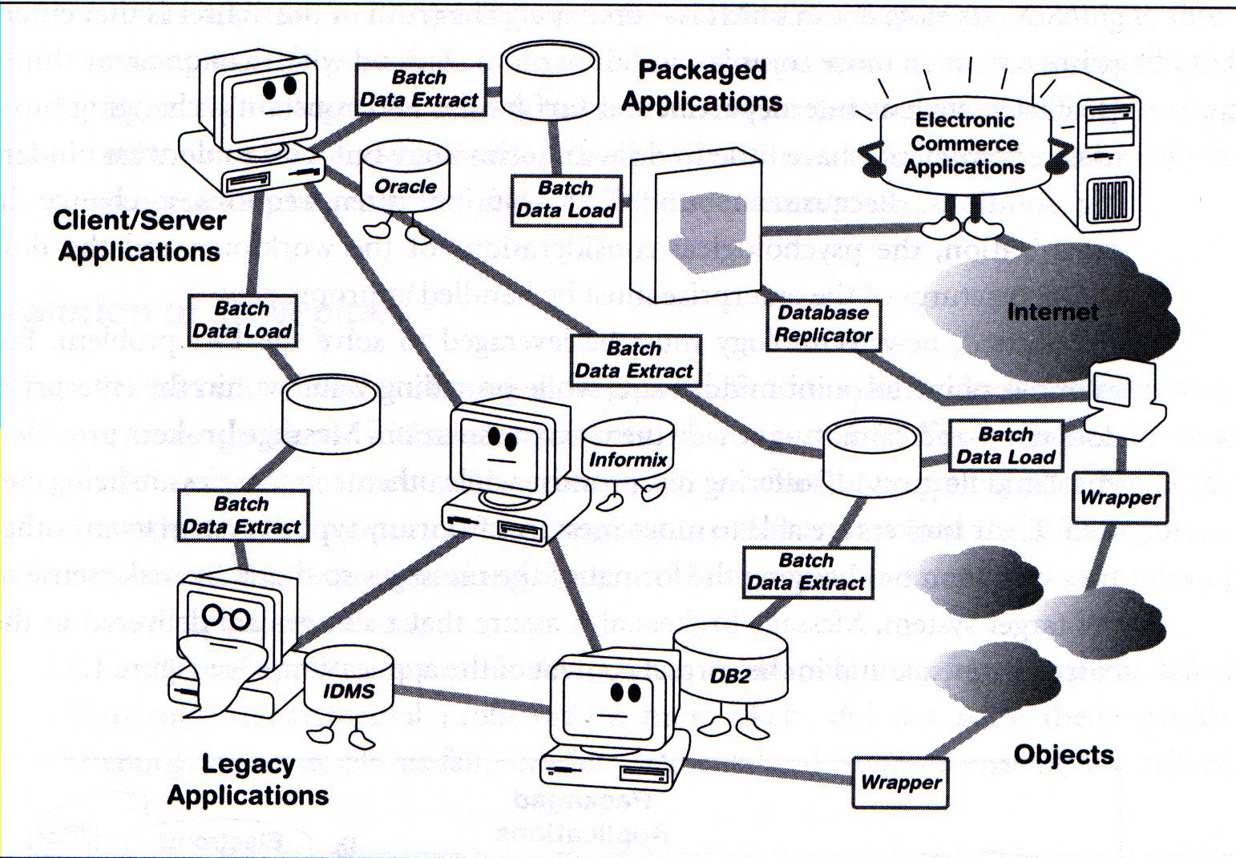
Defining EAI
Enterprise Chaos!

Slide 15
How is EAI different?
EAI focuses on the integration of both business-level processes and data whereas the traditional middleware approach is data oriented.
EAI includes the notion of reuse as well as distribution of business processes and data.
EAI allows users who understand very little about the details of the applications to integrate them

Slide 16
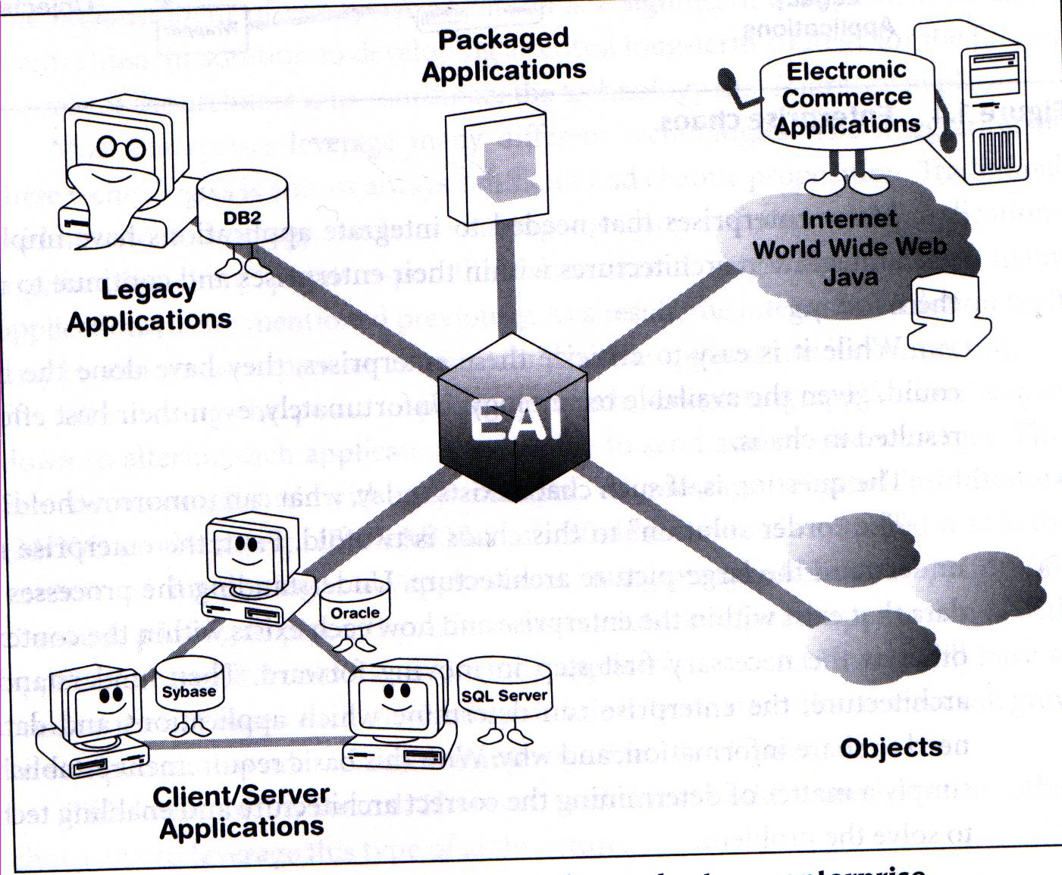
EAI Brings Order to the Enterprise

Slide 17
Purpose of EAI
Data (information) integration: Ensuring that information in multiple systems is kept consistent. This is also known as EII (Enterprise Information Integration).
Process integration: linking business processes across applications.
Vendor independence: Extracting business policies or rules from applications and implementing them in the EAI system, so that even if one of the business applications is replaced with a different vendor's application, the business rules do not have to be re-implemented.
Common facade: An EAI system could front-end a cluster of applications, providing a single consistent access interface to these applications and shielding users from having to learn to interact with different applications.

Slide 18
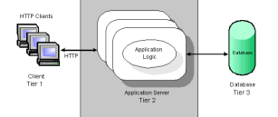
Multitier Architecture

Slide 19
Multitier architecture :
In software engineering, multi-tier architecture (often referred to as n-tier architecture) is a client–server architecture in which presentation, application processing, and data management functions are logically separated. For example, an application that uses middleware to service data requests between a user and a database employs multi-tier architecture. The most widespread use of multi-tier architecture is the three-tier architecture.
N-tier application architecture provides a model by which developers can create flexible and reusable applications. By segregating an application into tiers, developers acquire the option of modifying or adding a specific layer, instead of reworking the entire application. Three-tier architectures typically comprise a presentation tier, a business or data access [logic] tier, and a data tier.
(Wikipedia : Multitier Architecture)

Slide 20
3-tier architecture (application view)

Slide 21
Advantages of the 3-tier architecture approach :
the ability to separate logical components of an application ensures that applications are easy to manage and understand.
i.e. experts can be employed that specialise in one of the layers e.g. user interface design
because communication can be controlled between each logical tier of an application, changes in one tier, for example, the database access tier, do not have to affect the client component
i.e. a change from one DBMS to another would only require a change to the component in the data access layer with little or no effect on the business/logic (middle) or UI layer.
specific tools and technologies suited to each layer can be deployed (and may evolve at a different pace) .

Slide 22
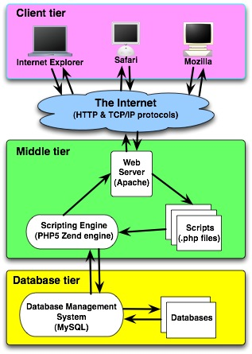
Typical web-oriented 3-tier architecture

Slide 23
Web-oriented 3-tier architecture: tools & technologies
Presentation tier – Browser / custom client, Client Side Scripting (JavaScript, ActionScript, VBScript etc.), Applets.
Logical Tier – Web Server (Apache, IIS, Websphere etc.); Scripting Languages (PHP, Perl etc.), Programming Languages (Java, C, C# etc), Application Frameworks (Ruby on Rails etc.)
Data Tier – Database Management System (DBMS) (Oracle, MySQL, SQL Server, DB2 etc.), XMLDB

Slide 24
N-Tier Architecture - Advantages
Scalable:
this is due to its capability of multiple tier deployment and the tier decoupling it brought.
For example,
the data tier can be scaled up by database clustering without other tiers involving.
The web client side can be scaled up by load-balancer easily without affecting other tiers.
Windows server can be clustered easily for load balancing and failover.
In addition, business tier server can also be clustered to scale up the application, such as Weblogic cluster in J2EE.
Better and finer security control to the whole system:
we can enforce the security differently for each tier if the security requirement is different for each tier.
For example,
business tier and data tier usually need higher security level than presentation tier does, then we can put these two high security tiers behind firewall for protection.
1 or 2 tiers architecture cannot fully achieve this purpose because of a limited number of tiers.
Also, for N-Tier architecture, users cannot access business layer and data layer directly, all requests from users are routed by client presenter layer to business layer, then to data layer. Therefore, client presenter layer also serves as a proxy-like layer for business layer, and business layer serves as a proxy-like layer for data layer. These proxy-like layers provides further protection for their layers below.
Better fault tolerance ability:
for example,
the databases in data layer can be clustered for failover or load balance purpose without affecting other layers.

Slide 25
Independent tier upgrading and changing without affecting other tiers:
in object-oriented world, Interface-dependency implementation can decouples all layers very well so that each layer can change individually without affecting other layers too much.
Interface-dependency means a layer depends on another layer by interfaces only, not concrete classes.
Also, the dependency of a layer only on its directly-below layer also minimizes the side effect of a layer’s change on the whole system.
For example,
if keep the interfaces unchanged, we can update or replace the implementation of any layer independently without affecting the whole system.
Due to the changing of business requirement and technology, changing the implementation of a layer to another totally different one does happen often.
Friendly and efficient for development:
the decoupled layers
are logic software component groups mainly by functionality,
are very software development friendly and efficient.
Each layer
can be assigned individually to a team who specializes in the specific functional area; a specialized team can handle the relevant task better and more efficiently.

Slide 26
Friendly for maintenance:
N-Tier architecture groups different things together mainly by functionality and then makes things clear, easily understandable and manageable.
Friendly for new feature addition:
due to the logical grouped components and the decoupling brought by N-Tier architecture, new features can be added easily without affecting too much on the whole system.
Better reusability:
due to the logically grouped components and the loose couplings among layers.
Loosely-coupled component groups are usually implemented in more general ways, so they can be reused by more other applications.

Slide 27
The Disadvantages of the N-Tier Deployment
The performance of the whole application
may be slow if the hardware and network bandwidth aren’t good enough because more networks, computers and processes are involved.
More cost for hardware, network, maintenance and deployment
because more hardware and better network bandwidth are needed.

Slide 28

Tier and Layer
Tier
the physical deployment computer.
Usually an individual running server is one tier.
Several servers may also be counted as multiple tier, such as server failover clustering.
Layer
logic software component group mainly by functionality;
is used for software development purpose.
Tier and Layer
Layer software implementation has many advantages and is a good way to achieve N-Tier architecture.
Layer and tier may or may not exactly match each other.
Each layer may run in an individual tier.
Multiple layers may also be able to run in one tier.
A layer may also be able to run in multiple tiers.
For example, in Diagram 2 below, the persistence layer in .NET can include two parts: persistence Lib and WCF data service, the persistence lib in the persistence layer always runs in the same process as business layer to adapt the business layer to the WCF data service. However, the WCF data service in persistence layer can run in a separate individual tier.
Here is another example: we may extract the data validation in business layer into a separate library (but still kept in business layer), which can be called by client presenter layer directly for a better client-side interactive performance. If this occurs, then data validation part of the business layer runs in the same process of the client presenter layer, the rest of business layer runs in a separate tier.

Slide 29
Model View Controller (MVC)

Slide 30
Smalltalk-80™
In the MVC paradigm, the user input, the modeling of the external world, and the visual feedback to the user are explicitly separated and handled by three types of objects, each specialized for its task.
The view manages the graphical and/or textual output to the portion of the bitmapped display that is allocated to its application.
The controller interprets the mouse and keyboard inputs from the user, commanding the model and/or the view to change as appropriate.
The model manages the behavior and data of the application domain, responds to requests for information about its state (usually from the view), and responds to instructions to change state (usually from the controller).

Slide 31
Smalltalk-80™ continued
The formal separation of these three tasks is an important notion that is particularly suited to Smalltalk-80 where the basic behavior can be embodied in abstract objects: View, Controller, Model and Object.

Slide 32
Sun says
Model-View-Controller ("MVC") is the recommended architectural design pattern for interactive applications
MVC organizes an interactive application into three separate modules:
one for the application model with its data representation and business logic,
the second for views that provide data presentation and user input, and
the third for a controller to dispatch requests and control flow.

Slide 33
Sun continued
Most Web-tier application frameworks use some variation of the MVC design pattern
The MVC (architectual) design pattern provides a host of design benefits

Slide 34
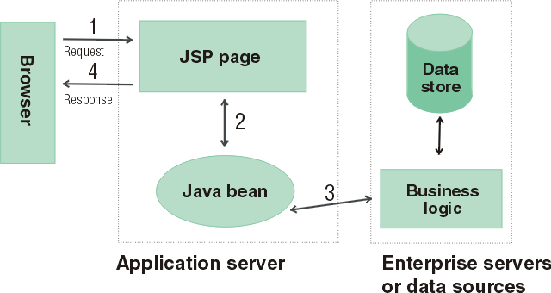
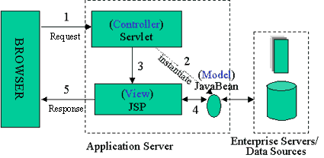
Java Server Pages
Model 2 Architecture to serve dynamic content
Model: Enterprise Beans with data in the DBMS
JavaBean: a class that encapsulates objects and can be displayed graphically
Controller: Servlets create beans, decide which JSP to return, do the bulk of the processing
View: The JSPs generated in the presentation layer (the browser)

Slide 35
OO-tips Says
The MVC paradigm is a way of breaking an application, or even just a piece of an application's interface, into three parts: the model, the view, and the controller.
MVC was originally developed to map the traditional input, processing, output roles into the GUI realm:
Input --> Processing --> Output
Controller --> Model --> View

Slide 36
Wikipedia says
Model-View-Controller (MVC) is a software architecture that separates an application's data model, user interface, and control logic into three distinct components so that modifications to one component can be made with minimal impact to the others.
MVC is often thought of as a software design pattern. However, MVC encompasses more of the architecture of an application than is typical for a design pattern. Hence the term architectural pattern may be useful (Buschmann, et al 1996), or perhaps an aggregate design pattern.

Slide 37
MVC Benefits
Clarity of design
easier to implement and maintain
Modularity
changes to one don't affect the others
can develop in parallel once you have the interfaces
Multiple views
games, spreadsheets, powerpoint, Eclipse, UML reverse engineering, ….

Slide 38
Summary (MVC)
The intent of MVC is to keep neatly separate objects into one of tree categories
Model
The data, the business logic, rules, strategies, and so on
View
Displays the model and usually has components that allows user to edit change the model
Controller
Allows data to flow between the view and the model
The controller mediates between the view and model

Slide 39
Model
The Model's responsibilities
Provide access to the state of the system
Provide access to the system's functionality
Can notify the view(s) that its state has changed

Slide 40
View
The view's responsibilities
Display the state of the model to the user
At some point, the model (a.k.a. the observable) must registers the views (a.k.a. observers) so the model can notify the observers that its state has changed

Slide 41
Controller
The controller's responsibilities
Accept user input
Button clicks, key presses, mouse movements, slider bar changes
Send messages to the model, which may in turn notify it observers
Send appropriate messages to the view
In Java, listeners are controllers

Slide 42
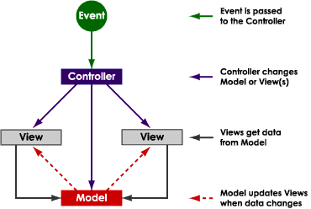
from http://www.enode.com/x/markup/tutorial/mvc.html)

Slide 43
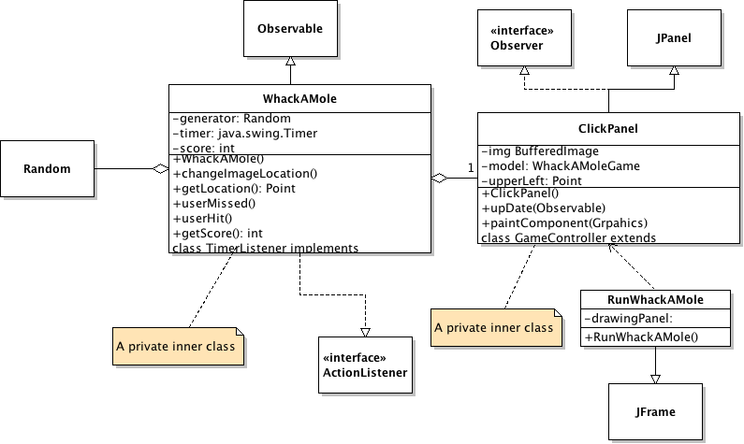
Quiz?
Model? ________ View? _________ Controller? ________
43

