Slide 1
Web Technology Concept

Slide 2
Internet is a global system of interconnected computer networks that connect various Domain Name System (DNS) servers, web hosting servers, home and business users, etc. Internet is a network of networks.
Computers are connected together via a network or transmission line
The objective of the ARPAnet project was to investigate the development of a decentralized computer network, The network then became known as the Internet
It has since adopted a suite of protocols called the Internet Protocol Suite or as more commonly known as TCP/IP
Now, the Internet has grown to encompass a huge number of autonomous networks

Slide 3
Protocols
Protocols exist at several levels in a telecommunication connection. For example, there are protocols for the data interchange at the hardware device level and protocols for data interchange at the application program level.
Some of the important protocols of internet are:
TCP (Transmission Control Protocol),
IP (Internet Protocol),
UDP (User Datagram Protocol),
HTTP (Hypertext Transfer Protocol),
FTP (File Transfer Protocol) and
SMTP (Simple Mail Transfer Protocol).

Slide 4
Transmission Control Protocol (TCP) is a connection-oriented protocol that provides reliable, ordered, error-checked delivery of packets.
Internet Protocol (IP) has the task of delivering packets from the source host to the destination host solely based on the IP addresses in the packet headers.
UDP is a connection-less protocol that does not provide reliability, order or error-checking. UDP messages are referred to as datagrams and a datagram is defined as a basic transfer unit associated with a packet-switched network in which the delivery, arrival time, and order of arrival are not guaranteed by the network.
HTTP is the protocol to exchange or transfer hypertext. Hypertext is structured text that uses logical links (hyperlinks) between nodes containing text.
The World Wide Web (abbreviated as WWW or W3) or the web is a system of interlinked hypertext documents accessed via the Internet. With a web browser, one can view web pages and navigate between them via hyperlinks.
FTP is a standard network protocol used to transfer files from one host to another host over a TCP-based network.
SMTP is an Internet standard for electronic mail (e-mail) transmission across Internet Protocol (IP) networks.

Slide 5
Service Oriented Architecture
SOA is an architectural pattern in software design.
SOA application components provide services to other components via a communications protocol, typically over a network.
The principles of service-orientation are independent of any vendor, product or technology.

Slide 6
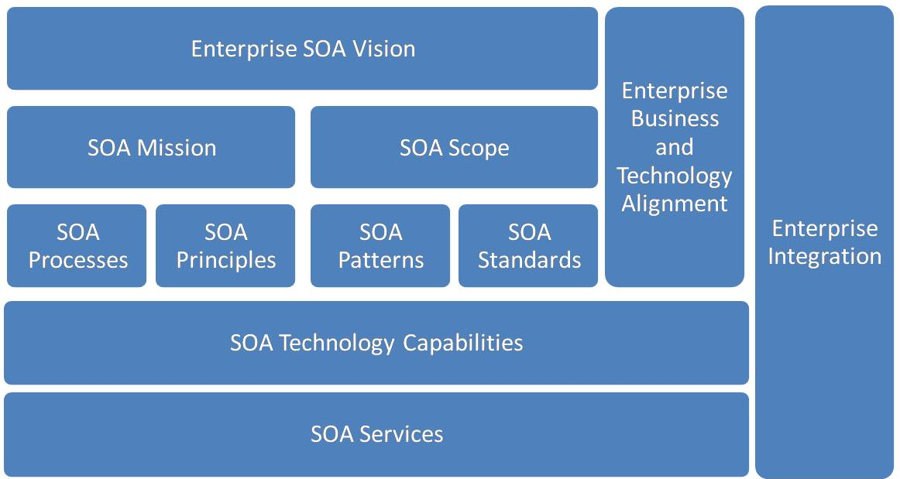

Slide 7
SOA Concepts and Principles
Design Concept
SOA is based on the concept of a service.
Depending on the service design approach taken,
Each SOA service is designed to perform one or more activities by implementing one or more service operations.
SOA defines how to integrate widely disparate applications for a Web-based environment and uses multiple implementation platforms. Rather than defining an API, SOA defines the interface in terms of protocols and functionality.

Slide 8
Types of SOA services
There are several types of services used in SOA systems.
• Business services
• Entity services
• Functional services
• Utility services

Slide 9
SOA benefits
Ability to build business applications faster and more easily
Easier maintenance / update
Business agility and extensibility
Lower total cost of ownership

Slide 10
Architectures can operate independently of specific technologies and can therefore be implemented using a wide range of technologies, including:
Web services based on WSDL and SOAP
Messaging, e.g., with ActiveMQ, JMS, RabbitMQ
RESTful HTTP, with Representational state transfer (REST) constituting its own constraints-based architectural style
OPC-UA
WCF (Microsoft's implementation of Web services, forming a part of WCF)
Apache Thrift
SORCER

Slide 11
Data Exchange Format XML
The eXtensible Markup Language (XML),
Derived from the Standard Generalized Markup Language (SGML),
Was originally envisioned as a language for defining new document formats for the World Wide Web

Slide 12
XML Document
<?xml version="1.0" encoding="UTF-8" ?>
<order id="1234" date="05/06/2013">
<customer first_name="James" last_name="Rorrison">
<email>j.rorri@me.com</email>
<phoneNumber>+44 1234 1234</phoneNumber>
</customer>
<content>
<order_line item="H2G2" quantity="1">
<unit_price>23.5</unit_price>
</order_line>
<order_line item="Harry Potter" quantity="2">
<unit_price>34.99</unit_price>
</order_line>
</content>
<credit_card number="1357" expiry_date="10/13" control_number="234" type="Visa"/>
</order>
Notes:
An XML Document Representing a Purchase Order

Slide 13
XML Terminology
Terminology | Definition
Unicode character | An XML document is a string of characters represented by almost every legal Unicode character
Markup and content | The Unicode characters are divided into markup and content. Markups begin with the character < and end with a > (<email>) and what is not markup is considered to be content (such as j.rorri@me.com)
Tag | Tags come in three flavors of markups: start-tags (<email>), end-tags (</email>) and empty-element tags (<email/>)
Element | An element begins with a start-tag and ends with a matching end-tag (or consists only of an empty-element tag). It can also include other elements, which are called child elements. An example of an element is <email>j.rorri@me.com</email>
Attribute | An attribute consists of a name/value pair that exists within a start-tag or empty-element tag. In the following example item is the attribute of the order_line tag: <order_line item="H2G2">
XML Declaration | XML documents may begin by declaring some information about themselves, as in the following example: <?xml version="1.0" encoding="UTF-8" ?>

Slide 14
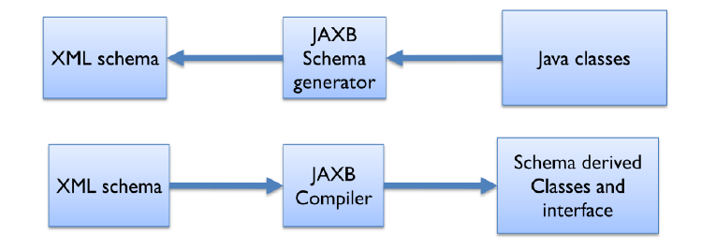
XML Binding in Java
JAXB: Java Architecture for XML Binding
Notes:
Java Architecture for XML Processing (JAXP) is an API that provides a common, implementation-independent interface for creating and using the SAX, DOM, and XSLT APIs in Java.
Prior to JAXP, there were different incompatible versions of XML parsers and transformers from different vendors. JAXP has provided an abstraction layer on top of these vendor-specific XML API implementations to parse
and transform XML resources.
Note that JAXP doesn’t use a different mechanism to parse and transform XML documents. Instead, applications can use it to access the underlying XML APIs indirectly in a common manner. Applications can then replace a
vendor’s implementation with another. Using JAXP, you can parse XML documents with SAX or DOM as the underlying strategy, or transform them to a new format using XSLT.

Slide 15
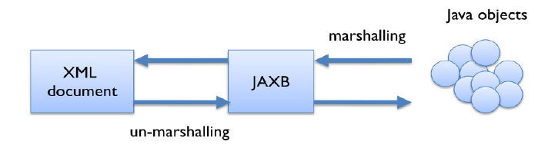
Marshalling and un-marshalling
Notes:
Java Architecture for XML Processing (JAXP) is an API that provides a common, implementation-independent interface for creating and using the SAX, DOM, and XSLT APIs in Java.
Prior to JAXP, there were different incompatible versions of XML parsers and transformers from different vendors. JAXP has provided an abstraction layer on top of these vendor-specific XML API implementations to parse
and transform XML resources.
Note that JAXP doesn’t use a different mechanism to parse and transform XML documents. Instead, applications can use it to access the underlying XML APIs indirectly in a common manner. Applications can then replace a
vendor’s implementation with another. Using JAXP, you can parse XML documents with SAX or DOM as the underlying strategy, or transform them to a new format using XSLT.

Slide 16
JSON
JSON: JavaScript Object Notation.
JSON is a syntax for storing and exchanging data.
JSON is text, written with JavaScript object notation.
Exchanging Data
When exchanging data between a browser and a server, the data can only be text.
JSON is text, and we can convert any JavaScript object into JSON, and send JSON to the server.
We can also convert any JSON received from the server into JavaScript objects.
This way we can work with the data as JavaScript objects, with no complicated parsing and translations.
Why Json?
Since the JSON format is text only, it can easily be sent to and from a server, and used as a data format by any programming language.
JavaScript has a built in function to convert a string, written in JSON format, into native JavaScript objects:
JSON.parse()
So, if you receive data from a server, in JSON format, you can use it like any other JavaScript object.

Slide 17
Sending Data
var myObj = { "name":"John", "age":31, "city":"New York" }; var myJSON = JSON.stringify(myObj); window.location = "demo_json.php?x=" + myJSON;
Receiving Data
var myJSON = '{ "name":"John", "age":31, "city":"New York" }'; var myObj = JSON.parse(myJSON); document.getElementById("demo").innerHTML = myObj.name;

Slide 18
RDF(Resource Description Framework)
RDF is a framework for describing resources on the web
RDF is designed to be read and understood by computers
RDF is not designed for being displayed to people
RDF is written in XML
Example of use
Describing properties for shopping items, such as price and availability
Describing time schedules for web events
Describing information about web pages (content, author, created and modified date)
Describing content and rating for web pictures
Describing content for search engines
Describing electronic libraries

Slide 19
RDF Resource, Property, and Property Value
A Resource is anything that can have a URI, such as "https://www.abc.com/rdf"
A Property is a Resource that has a name, such as "author" or "homepage"
A Property value is the value of a Property, such as "Jan Egil Refsnes" or https://www.abc.com
<?xml version="1.0"?> <RDF> <Description about="https://www.abc.com/rdf"> <author>Jan Egil Refsnes</author> <homepage>https://www.abc.com</homepage> </Description> </RDF>

Slide 20
How Do Web Services Work?
A Web service enables this communication by using a combination of open protocols and standards, chiefly XML, SOAP and WSDL.
A Web service uses XML to tag data, SOAP to transfer a message and finally WSDL to describe the availability of services.

Slide 21
Web Services Terminologies
Hypertext transfer protocol [HTTP]
Extensible Markup Language [XML]
Web Services Description Language [WSDL]
SOAP

Slide 22
Web Services
Web service is a realization of SOA.
It is important to note that the SOA is an architectural model that is independent of any technology platform and Web Services the most popular SOA implementation.
As the name implies, web services offers services over the web. This is not surprising as the choice of the Internet it already connects many different systems from all over the world.

Slide 23
SOAP (Simple Object Access protocol)
It is a protocol specification for exchanging structured information in the implementation of web services in computer networks.
It uses XML Information Set for its message format, and relies on other application layer protocols, most notably Hypertext Transfer Protocol (HTTP),
or Simple Mail Transfer Protocol (SMTP), for message negotiation and transmission.

Slide 24
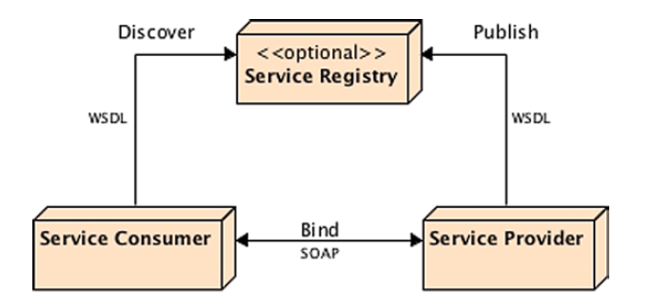
Notes:
SOAP web services depend on several technologies and protocols to transport and to transform data from a consumer to a service provider in a standard way. The ones that you will come across more often are the following:
Extensible Markup Language (XML) is the basic foundation on which SOAP web services are built and defined (SOAP, WSDL, and UDDI).
• Web Services Description Language (WSDL) defines the protocol, interface, message types, and interactions between the consumer and the provider.
• Simple Object Access Protocol (SOAP) is a message-encoding protocol based on XML technologies, defining an envelope for web services communication.
• Messages are exchanged using a transport protocol. Although Hypertext Transfer Protocol (HTTP) is the most widely adopted transport protocol, others such as SMTP or JMS can also be used.
• Universal Description Discovery, and Integration (UDDI) is an optional service registry and discovery mechanism, similar to the Yellow Pages; it can be used for storing and categorizing SOAP web services interfaces (WSDL).
With these standard technologies, SOAP web services provide almost unlimited potential. Clients can call a service, which can be mapped to any program and accommodate any data type and structure to exchange messages through XML.

Slide 25
SOAP Elements and Attributes
Element | Description
Envelope | Defines the message and the namespace used in the document. This is a required root element
Header | Contains any optional attributes of the message or application-specific infrastructure such as security information or network routing
Body | Contains the message being exchanged between applications
Fault | Provides information about errors that occur while the message is processed. This element is optional

Slide 26
SOAP Request
POST /InStock HTTP/1.1
Host: www.bookshop.org
Content-Type: application/soap+xml; charset=utf-8
Content-Length: nnn
<?xml version="1.0"?>
<soap:Envelope xmlns:soap="http://www.w3.org/2001/12/soap-envelope"
soap:encodingStyle="http://www.w3.org/2001/12/soap-encoding">
<soap:Body xmlns:m="http://www.bookshop.org/prices">
<m:GetBookPrice>
<m:BookName>The Fleamarket</m:BookName>
</m:GetBookPrice>
</soap:Body>
</soap:Envelope>

Slide 27
SOAP Response
POST /InStock HTTP/1.1
Host: www.bookshop.org
Content-Type: application/soap+xml; charset=utf-8
Content-Length: nnn
<?xml version="1.0"?>
<soap:Envelope xmlns:soap="http://www.w3.org/2001/12/soap-envelope" soap:encodingStyle="http://www.w3.org/2001/12/soap-encoding">
<soap:Body xmlns:m="http://www.bookshop.org/prices">
<m:GetBookPriceResponse>
<m: Price>10.95</m: Price>
</m:GetBookPriceResponse>
</soap:Body>
</soap:Envelope>

Slide 28
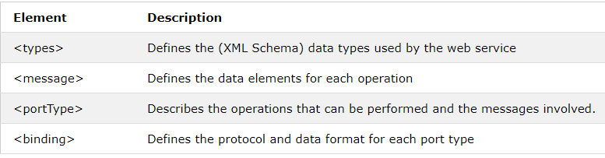
WSDL
WSDL stands for Web Services Description Language
WSDL is used to describe web services
WSDL is written in XML

Slide 29
<definitions> <types> data type definitions........ </types> <message> definition of the data being communicated.... </message> <portType> set of operations...... </portType> <binding> protocol and data format specification.... </binding> </definitions>

Slide 30
UDDI(Universal Description, Discovery, and Integration)
UDDI is an XML-based standard for describing, publishing, and finding web services.
UDDI uses Web Service Definition Language(WSDL) to describe interfaces to web services
UDDI is often compared to a telephone book's white(basic info), yellow(details about the company), and green pages(technical information). The project allows businesses to list themselves by name, product, location, or the Web services they offer.
UDDI can communicate via SOAP, CORBA, Java RMI Protocol.
UDDI uses Web Service Definition Language(WSDL) to describe interfaces to web services.
UDDI is seen with SOAP and WSDL as one of the three foundation standards of web services.
UDDI is an open industry initiative, enabling businesses to discover each other and define how they interact over the Internet.

Slide 31
ebXML(Electronic Business XML)
It is a modular suite of specifications that gives businesses of any size the ability to conduct business over the Internet.
The features of ebXML are as follows:
ebXML is an end-to-end B2B XML framework.
ebXML is a set of specifications that enable a modular framework.
ebXML relies on the Internet's existing standards such as HTTP, TCP/IP, MIME, SMTP, FTP, UML, and XML.
ebXML can be implemented and deployed on virtually any computing platform.
ebXML provides concrete specifications to enable dynamic B2B collaborations.

