Slide 1

Modern Systems Analysis
and Design
Fourth Edition
Jeffrey A. Hoffer
Joey F. George
Joseph S. Valacich
Chapter 1
The Systems Development Environment

Slide 2
Learning Objectives
Define information systems analysis and design.
Describe the different types of information systems.
Describe the information Systems Development Life Cycle (SDLC).
Explain Rapid Application Development (RAD), prototyping, Joint Application Development (JAD), and Computer Aided Software Engineering (CASE).
Describe agile methodologies and eXtreme programming.
Explain Object Oriented Analysis and Design and the Rational Unified Process (RUP).

Slide 3
Introduction
Information Systems Analysis and Design
  Complex organizational process whereby computer-based information systems are developed and maintained
Application Software
  Computer software designed to support organizational functions or processes
Systems Analyst
  Organizational role most responsible for analysis and design of information systems

Slide 4
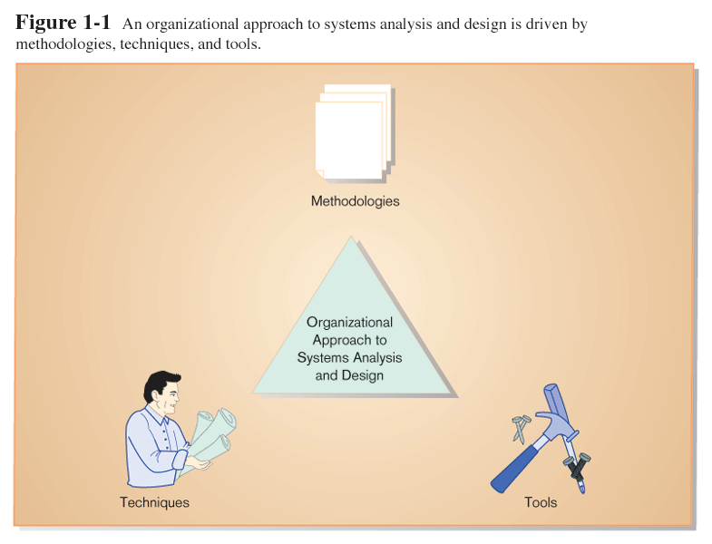
Introduction (cont.)

Slide 5
A Modern Approach to Systems Analysis and Design
1950s: focus on efficient automation of existing processes
1960s: advent of 3GL, faster and more reliable computers
1970s: system development becomes more like an engineering discipline
1980s: major breakthrough with 4GL, CASE tools, object oriented methods
1990s: focus on system integration, GUI applications, client/server platforms, Internet
The new century: Web application development, wireless PDAs, component-based applications

Slide 6
Types of Information Systems and Systems Development
Transaction Processing Systems (TPS)
  Automate handling of data about business activities (transactions)
  Process orientation
Management Information Systems (MIS)
  Converts raw data from transaction processing system into meaningful form
  Data orientation
Decision Support Systems (DSS)
  Designed to help decision makers
  Provides interactive environment for decision making
  Involves data warehouses, executive information systems (EIS)
  Database, model base, user dialogue

Slide 7
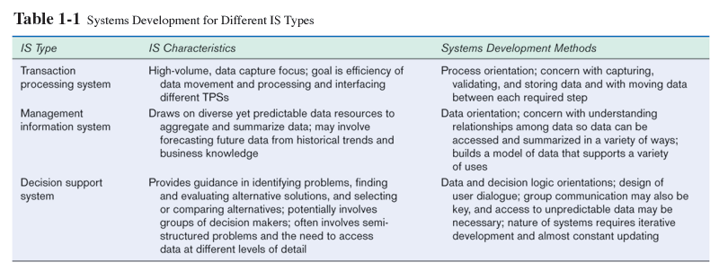
Types of Information Systems and Systems Development (cont.)

Slide 8
Developing Information Systems and the SDLC
System Development Methodology
  Standard process followed in an organization
  Consists of:
    Analysis
    Design
    Implementation
    Maintenance

Slide 9
Systems Development Life Cycle (SDLC)
Traditional methodology for developing, maintaining, and replacing information systems
Phases in SDLC:
  Planning
  Analysis
  Design
  Implementation
  Maintenance

Slide 10
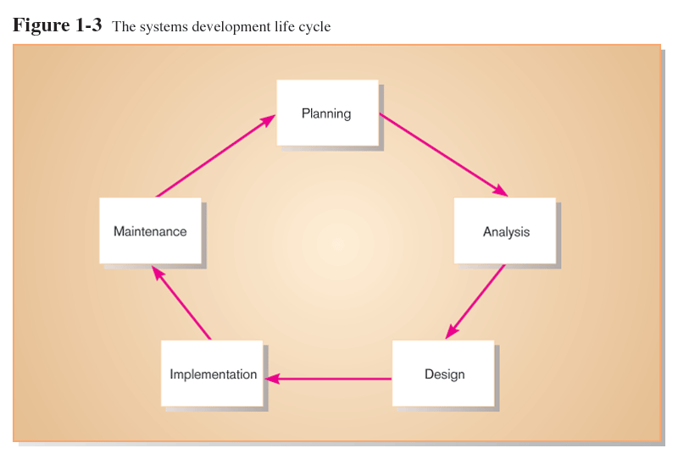
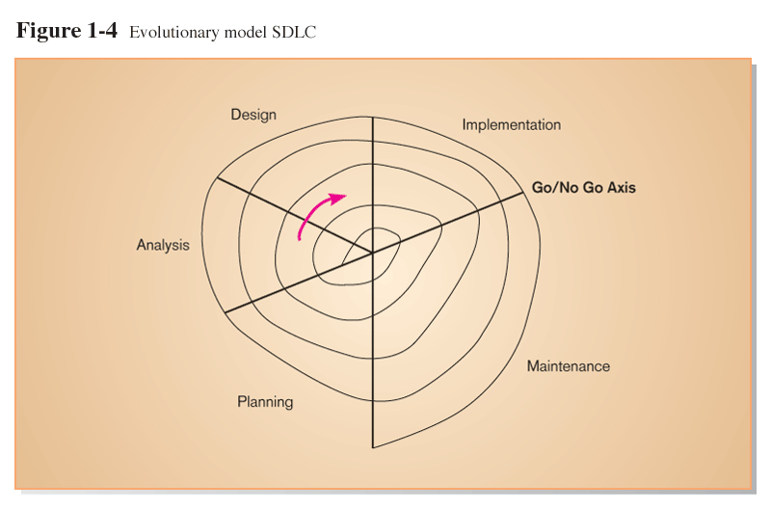
Standard and Evolutionary Views of SDLC

Slide 11
SDLC Planning Phase
Identify, analyze, prioritize, and arrange IS needs

Slide 12
SDLC Analysis Phase
Study and structure system requirements

Slide 13
SDLC Design Phase
Logical design: functional features described independently of computer platform
Convert recommended solution to system specifications
Physical design: logical specifications transformed to technology-specific details

Slide 14
SDLC Implementation Phase
Code, test, install, and support the information system

Slide 15
SDLC Maintenance Phase
Systematically repair and improve the information system

Slide 16
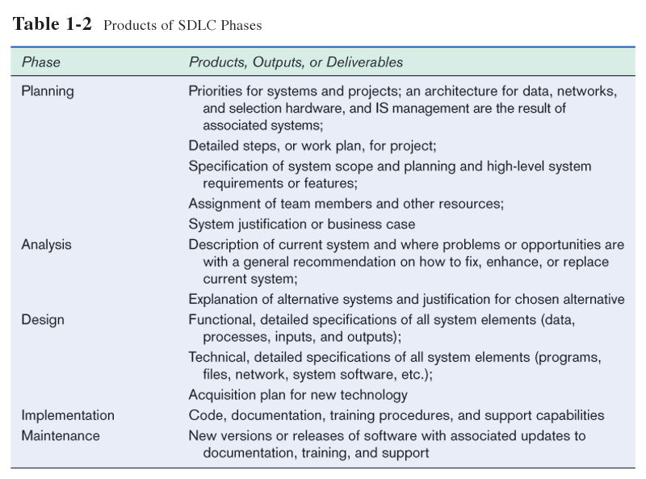

Slide 17
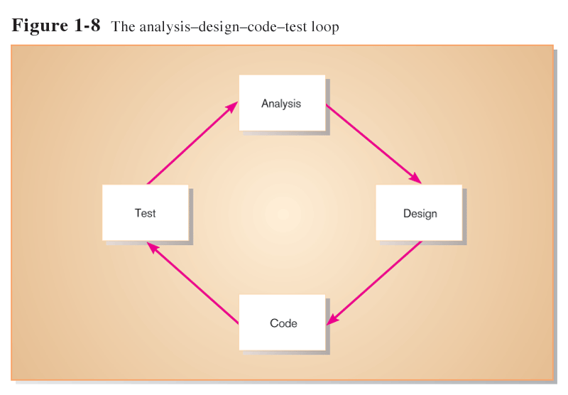
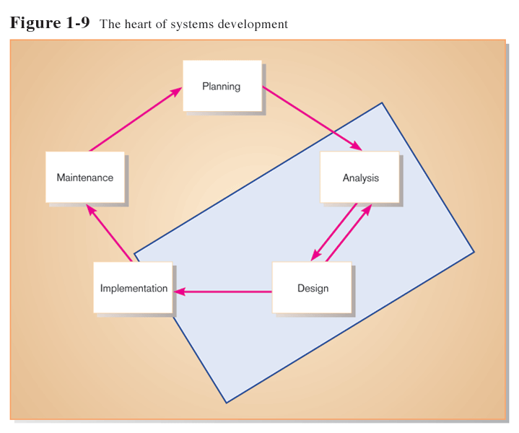
The Heart of the Systems Development Process
Current practice combines analysis, design, and implementation into a single iterative and parallel process of activities

Slide 18
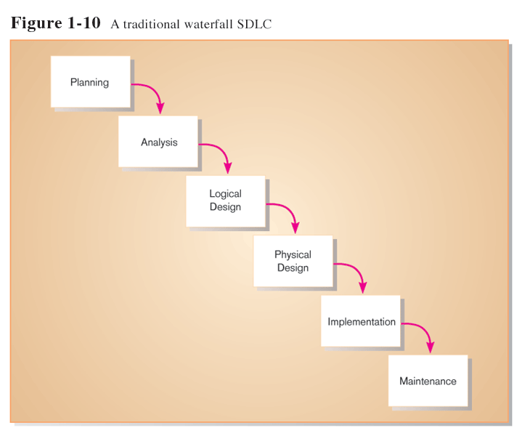
Traditional Waterfall SDLC
One phase begins when another completes, little backtracking and looping

Slide 19
Problems with Waterfall Approach
System requirements “locked in” after being determined (can't change)
Limited user involvement (only in requirements phase)
Too much focus on milestone deadlines of SDLC phases to the detriment of sound development practices

Slide 20
Alternatives to Traditional Waterfall SDLC
Prototyping
CASE tools
Joint Application Design (JAD)
Rapid Application Development (RAD)
Agile Methodologies
eXtreme Programming

Slide 21
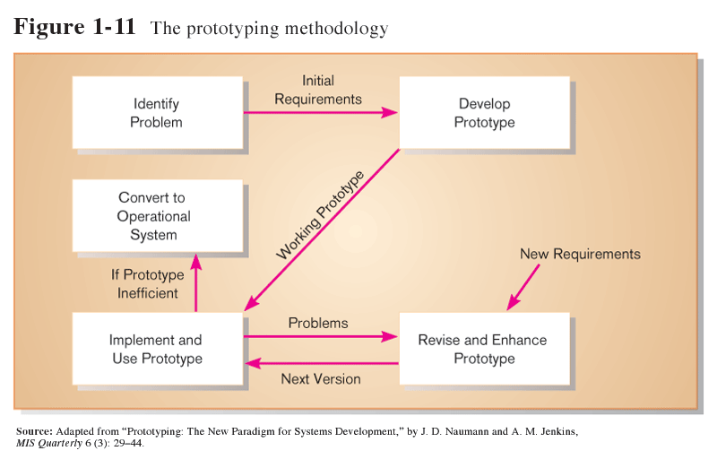
Prototyping
Iterative development process:
Requirements quickly converted to a working system
System is continually revised
Close collaboration between users and analysts

Slide 22
CASE Tools
Computer-Aided Software Engineering
Software tools providing automated support for systems development
Project dictionary/workbook: system description and specifications
Diagramming tools
Example products: Oracle Designer, Rational Rose

Slide 23
Joint Application Design (JAD)
Structured process involving users, analysts, and managers
Several-day intensive workgroup sessions
Purpose: to specify or review system requirements

Slide 24
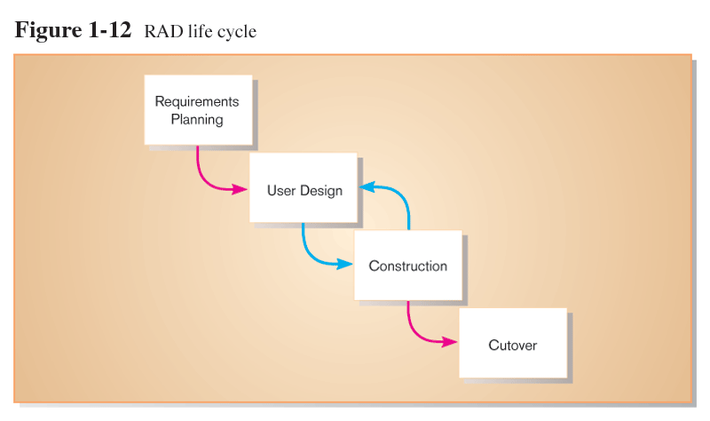
Rapid Application Development (RAD)
Methodology to decrease design and implementation time
Involves: prototyping, JAD, CASE tools, and code generators

Slide 25
Agile Methodologies
Motivated by recognition of software development as fluid, unpredictable, and dynamic
Three key principles
  Adaptive rather than predictive
  Emphasize people rather than roles
  Self-adaptive processes

Slide 26
eXtreme Programming
Short, incremental development cycles
Automated tests
Two-person programming teams
Coding and testing operate together
Advantages:
  Communication between developers
  High level of productivity
  High-quality code

Slide 27
Object-Oriented Analysis and Design
Based on objects rather than data or processes
Object: a structure encapsulating attributes and behaviors of a real-world entity
Object class: a logical grouping of objects sharing the same attributes and behaviors
Inheritance: hierarchical arrangement of classes enable subclasses to inherit properties of superclasses

Slide 28
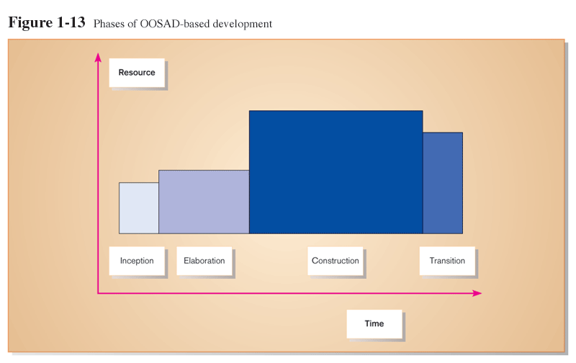
Rational Unified Process (RUP) involves an iterative, incremental approach to systems development

Slide 29
Summary
In this chapter you learned how to:
  Define information systems analysis and design.
  Describe the different types of information systems.
  Describe the information Systems Development Life Cycle (SDLC).
  Explain Rapid Application Development (RAD), prototyping, Joint Application Development (JAD), and Computer Aided Software Engineering (CASE).
  Describe agile methodologies and eXtreme programming.
  Explain Object Oriented Analysis and Design and the Rational Unified Process (RUP).

