Slide 1

Modern Systems Analysis
and Design
Fourth Edition
Jeffrey A. Hoffer
Joey F. George
Joseph S. Valacich
Chapter 2
The Origins of Software

Slide 2
Learning Objectives
Explain outsourcing.
Describe six different sources of software.
Discuss how to evaluate off-the-shelf software.
Explain reuse and its role in software development.

Slide 3
System Acquisition: Outsourcing
Turning over responsibility of some or all of an organization's information systems applications and operations to an outside firm
Reasons to outsource
  Cost-effective
  Take advantage of economies of scale
  Free up internal resources
  Reduce time to market
  Increase process efficiencies
  System development is a non-core activity for the organization

Slide 4
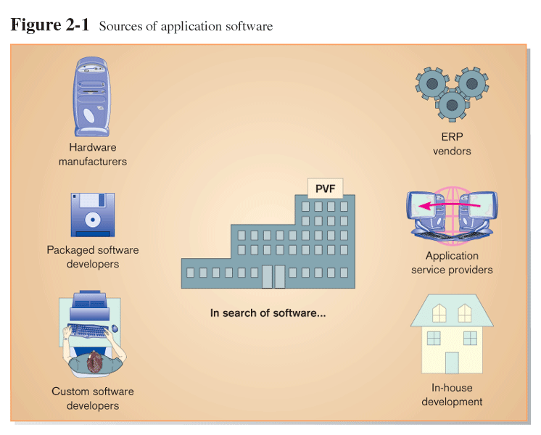
Sources of Application Software

Slide 5
Hardware Manufacturers
IBM is the leader in software sales and services.
Hardware manufacturers tend to focus on system software and utilities.

Slide 6
Packaged Software Producers
Microsoft is the leader in prepackaged software production.
Prepackaged software is off-the-shelf software.
Often, prepackaged software is turnkey software (i.e. not customizable).

Slide 7
Criteria for Choosing Off-the-Shelf Software
Cost
Functionality
Vendor support
Viability of vendor
Flexibility
Documentation
Response time
Ease of installation

Slide 8
Custom Software Producers
Firms like Accenture and EDS are leading custom software producers.
Consulting firms develop software to meet the client’s specific requirements.
Consulting firms are usually called when the client company does not have in-house expertise or manpower available to develop the system.

Slide 9
Enterprise Solutions Software
Enterprise Resource Planning (ERP) systems that integrate individual traditional business functions into modules enabling a single seamless transaction to cut across functional boundaries.
SAP AG is the leading vendor of ERP systems.

Slide 10
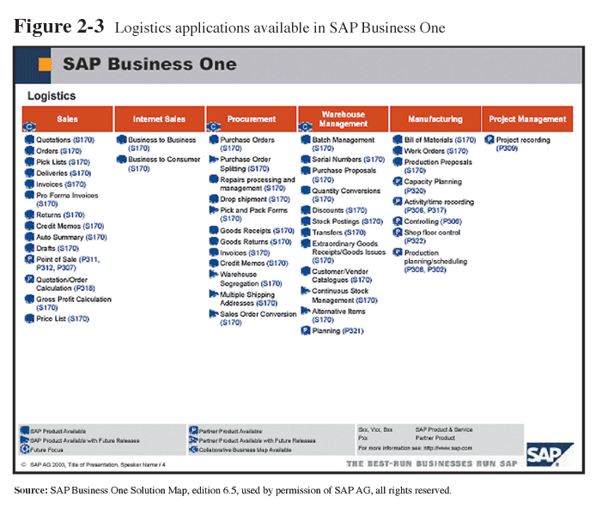
ERP System Example

Slide 11
Application Service Providers
ASP: an organization that hosts and runs computer applications for other companies, typically on a per-use or license basis

Slide 12
In-House Development
If sufficient system development expertise with the chosen platform exists in-house, then some or all of the system can be developed by the organization’s own staff.
Often, there are a variety of sources used, with in-house staff playing a role as well as consultants or ERP vendors.

Slide 13
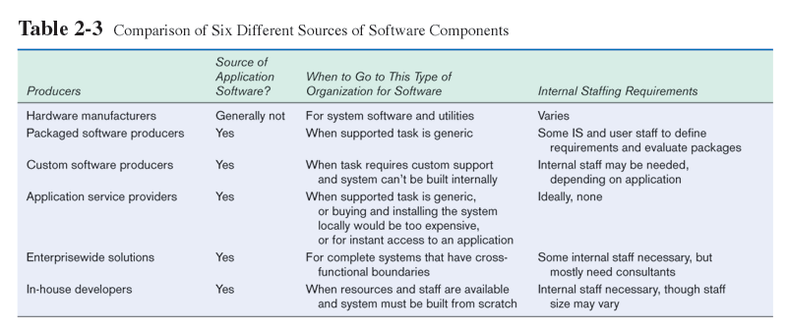

Slide 14
Validating Purchased Software Information
Use a variety of information sources:
  Vendor’s proposal
  Running software through a series of tests
  Feedback from other users of the vendor’s product
  Independent software testing services
  Articles in trade publications

Slide 15
What is an RFP?
Request for Proposal: a document provided to vendors to ask them to propose hardware and software products or services that will meet the requirements of a new information system.
Based on vendor bids, analyst selects best candidates.

Slide 16
Reuse
The use of previously written software resources in new applications
Primary enabling technologies
  Object-oriented development
    Object class encapsulates data and behavior of common organizational entities (e.g. employees)
  Component-based development
    Components can be single objects or functional groupings of objects

Slide 17
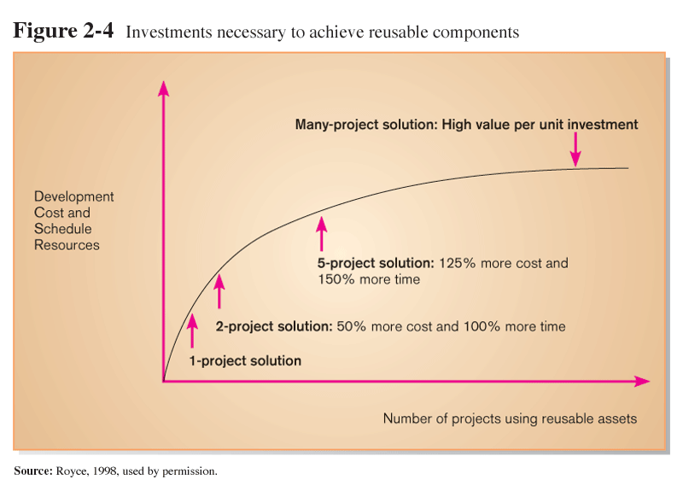
Costs and Benefits of Reuse

Slide 18
Approaches to Reuse
low
Ad hoc: individual, unplanned use
Facilitated: use informally managed and disseminated by expert guru evangelists
Managed: organizationally enforced reuse policies and practices
Designed: reusable components developed and maintained in-house
Cost and commitment
high

Slide 19
Summary
In this chapter you learned how to:
  Explain outsourcing.
  Describe six different sources of software.
  Discuss how to evaluate off-the-shelf software.
  Explain reuse and its role in software development.

