Slide 1

Modern Systems Analysis
and Design
Fourth Edition
Jeffrey A. Hoffer
Joey F. George
Joseph S. Valacich
Chapter 3
Managing the Information Systems Project

Slide 2
Learning Objectives
Explain the process of managing an information systems project.
Describe the skills required to be an effective project manager.
List project management activities during project initiation, planning, execution, and closedown.
Explain critical path scheduling, Gantt charts, and Network diagrams.
Explain the utility of commercial project management software tools.

Slide 3
Importance of Project Management
Project management may be the most important aspect of systems development.
Effective PM helps ensure
  Meeting customer expectations
  Satisfying budget and time constraints
PM skills are difficult and important to learn.

Slide 4
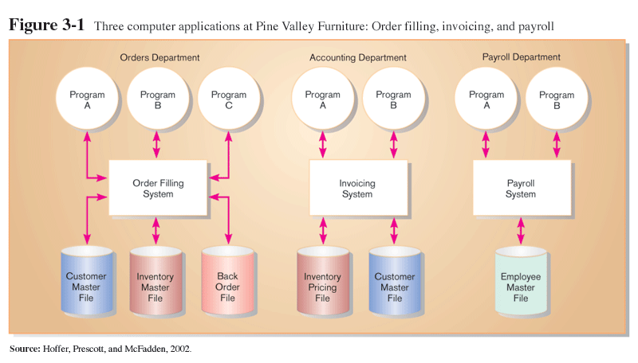
Pine Valley Application Project

Slide 5
Deciding on Systems Projects
System Service Request (SSR)
  A standard form for requesting or proposing systems development work within an organization
Feasibility study
  A study that determines whether a requested system makes economic and operational sense for an organization

Slide 6
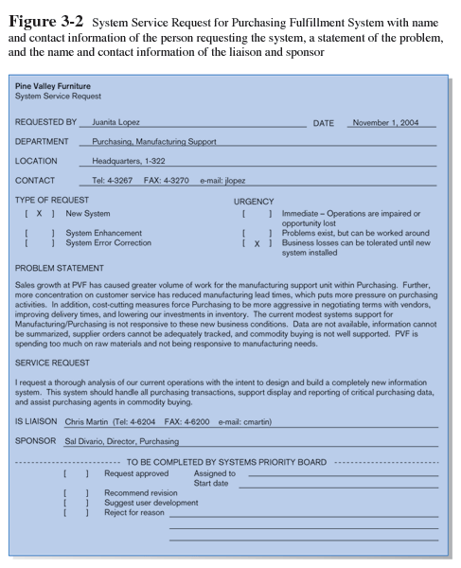
System Service Request (SSR) is a form requesting development or maintenance of an information system. It includes the contact person, a problem statement, a service request statement, and liaison contact information

Slide 7
Managing the Information Systems Project
Project
  A planned undertaking of related activities to reach an objective that has a beginning and an end
Project management
  A controlled process of initiating, planning, executing, and closing down a project

Slide 8
Managing the Information Systems Project (cont.)
Project manager
  Systems analyst with management and leadership skills responsible for leading project initiation, planning, execution, and closedown
Deliverable
  The end product of an SDLC phase

Slide 9
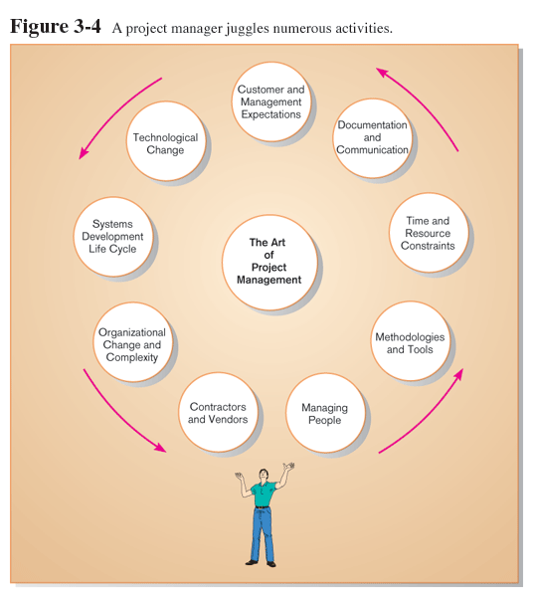
Project Management Activities

Slide 10
Phases of Project Management Process
Phase 1: Initiation
Phase 2: Planning
Phase 3: Execution
Phase 4: Closedown

Slide 11
PM Phase 1: Project Initiation
Assess size, scope and complexity, and establish procedures.
Establish:
  Initiation team
  Relationship with customer
  Project initiation plan
  Management procedures
  Project management environment
  Project workbook

Slide 12
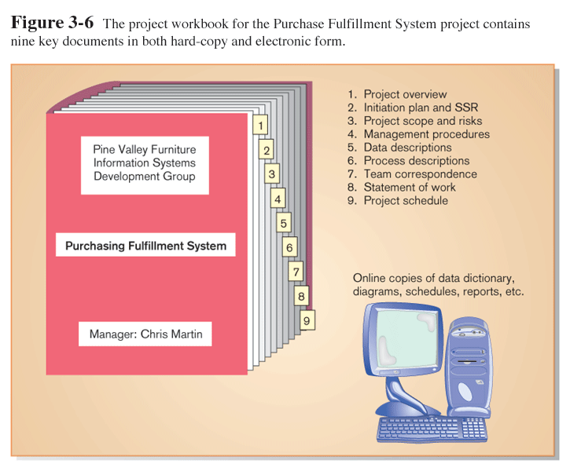

Slide 13
PM Phase 2: Project Planning
Define clear, discrete activities and the work needed to complete each activity
Tasks
  Define project scope, alternatives, feasibility
  Divide project into tasks
  Estimate resource requirements
  Develop preliminary schedule
  Develop communication plan
  Determine standards and procedures
  Risk identification and assessment
  Create preliminary budget
  Develop a statement of work
  Set baseline project plan

Slide 14
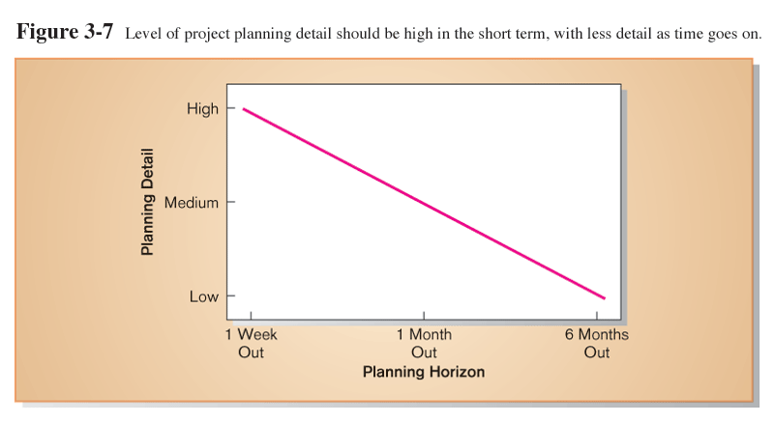
Planning Detail

Slide 15
Some Components of Project Planning
Statement of Work (SOW)
  “Contract” between the IS staff and the customer regarding deliverables and time estimates for a system development project
The Baseline Project Plan (BPP)
  Contains estimates of scope, benefits, schedules, costs, risks, and resource requirements
Preliminary Budget
  Cost-benefit analysis outlining planned expenses and revenues

Slide 16
Some Components of Project Planning (cont.)
Work Breakdown Structure (WBS)
  Division of project into manageable and logically ordered tasks and subtasks
Scheduling Diagrams
  Gantt chart: horizontal bars represent task durations
  Network diagram: boxes and links represent task dependencies

Slide 17
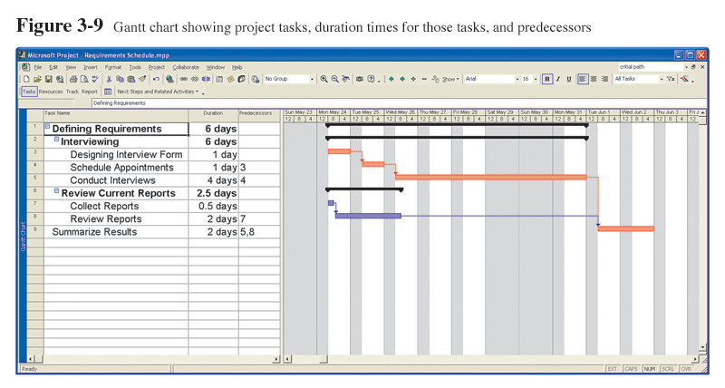
Scheduling Diagrams
Gantt Chart
Special-purpose project management software is available for this.

Slide 18
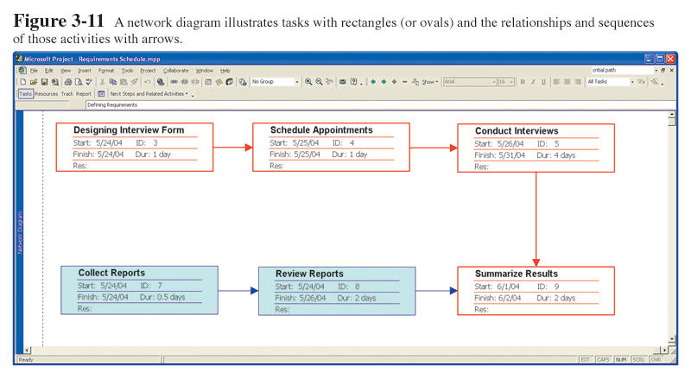
Scheduling Diagrams
Network Diagram
Special-purpose project management software is available for this.

Slide 19
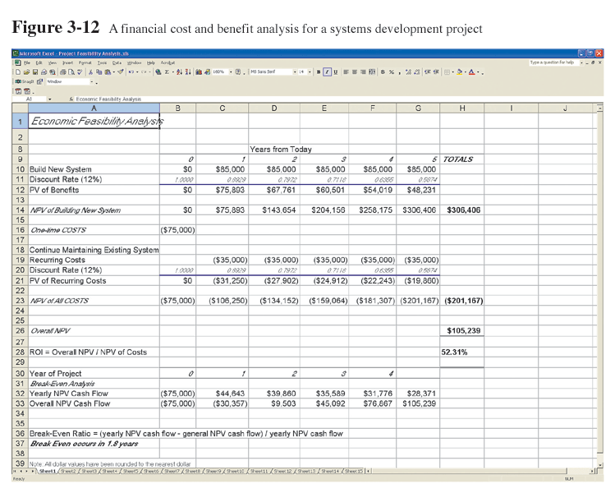
Preliminary Budget
Spreadsheet software is good for this.

Slide 20
PM Phase 3: Project Execution
Plans created in prior phases are put into action.
Actions
  Execute baseline project plan
  Monitor progress against baseline plan
  Manage changes in baseline plan
  Maintain project workbook
  Communicate project status

Slide 21
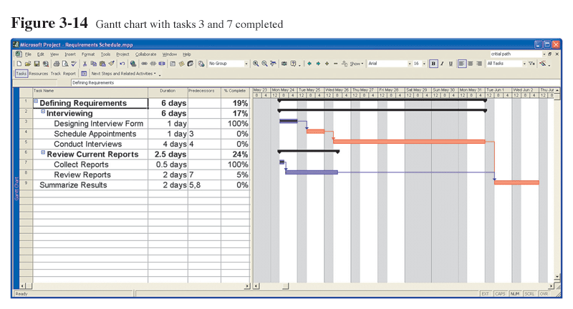
Monitoring Progress with a Gantt Chart
Red bars indicate critical path, lines through bars indicate percent complete.

Slide 22
Communication Methods
Project workbook
Meetings
Seminars and workshops
Newsletters
Status reports
Specification documents
Minutes of meetings
Bulletin boards
Memos
Brown bag lunches
Hallway discussions

Slide 23
PM Phase 4: Project Closedown
Bring the project to an end.
Actions
  Close down the project.
  Conduct post-project reviews.
  Close the customer contract.

Slide 24
Representing and Scheduling Project Plans
Gantt Charts
Network Diagrams
PERT Calculations
Critical Path Scheduling
Project Management Software

Slide 25
Gantt Charts vs. Network Diagrams
Gantt charts
  Show task durations.
  Show time overlap.
  Show slack time in duration.
Network diagrams
  Show task dependencies.
  Do not show time overlap, but show parallelism.
  Show slack time in boxes.

Slide 26
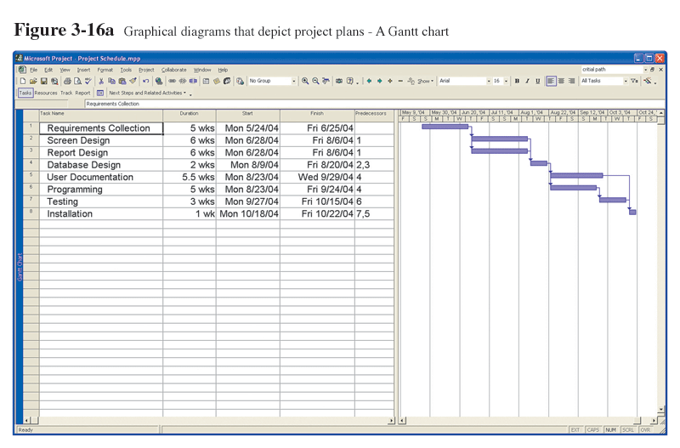
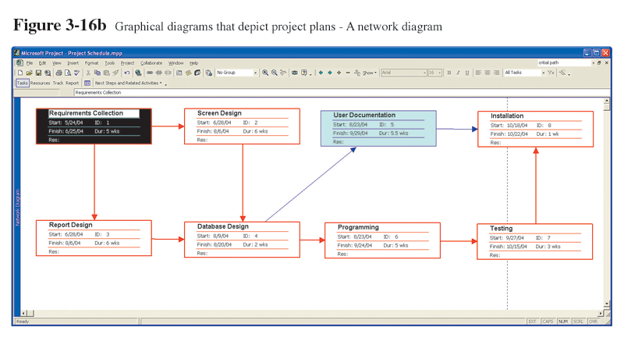
Gantt Charts vs. Network Diagrams (cont.)

Slide 27
Estimating Task Duration
PERT: Program Evaluation Review Technique
Technique that uses optimistic (o), pessimistic (p), and realistic (r) time estimates to determine expected task duration
Formula for Estimated Time:
  ET = (o + 4r + p)/6

Slide 28
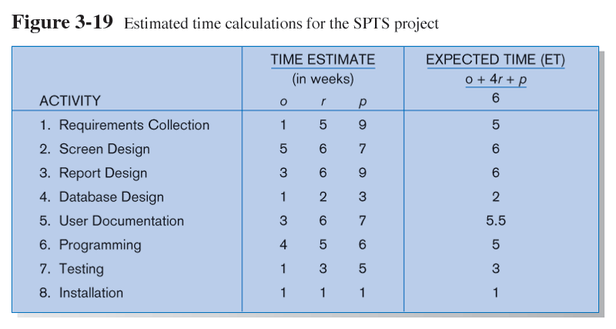
Example PERT Analysis

Slide 29
Critical Path Scheduling
A scheduling technique whose order and duration of a sequence of task activities directly affects the completion date of a project
Critical path: the shortest time in which a project can be completed
Slack time: the time an activity can be delayed without delaying the project

Slide 30
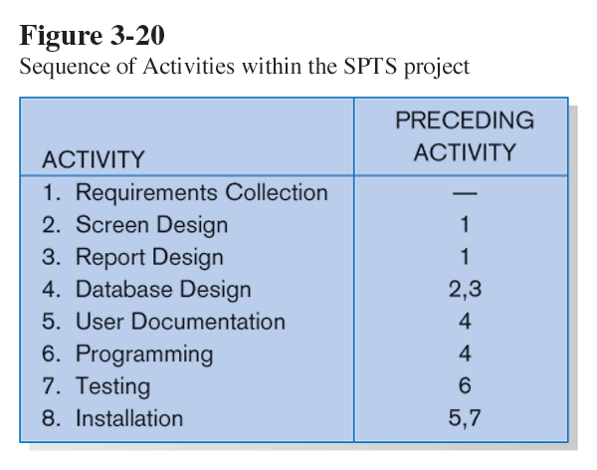
Critical Path Example
(dependencies between tasks)
PRECEDING ACTIVITIES indicate the activities that must be completed before the specified activity can begin (see Fig. 3.19 for time estimates).

Slide 31
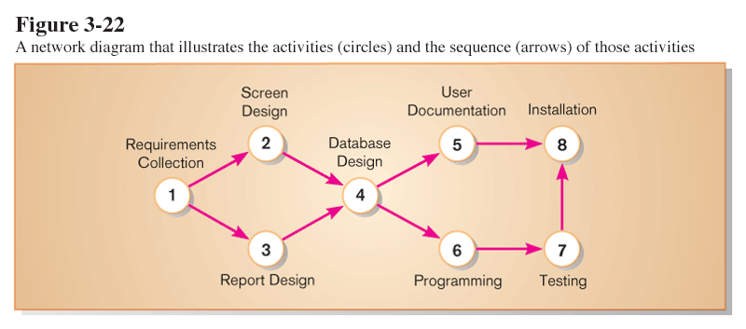
Critical Path Example
Network diagram shows dependencies
Network diagram provides graphical illustration of dependencies between activities (see previous slide).

Slide 32
Determining the Critical Path
Calculate the earliest possible completion time for each activity by summing the activity times in the longest path to the activity. This gives total expected project time.
Calculate the latest possible completion time for each activity by subtracting the activity times in the path following the activity from the total expected time. This gives slack time for activities.
Critical path – contains no activities with slack time.

Slide 33
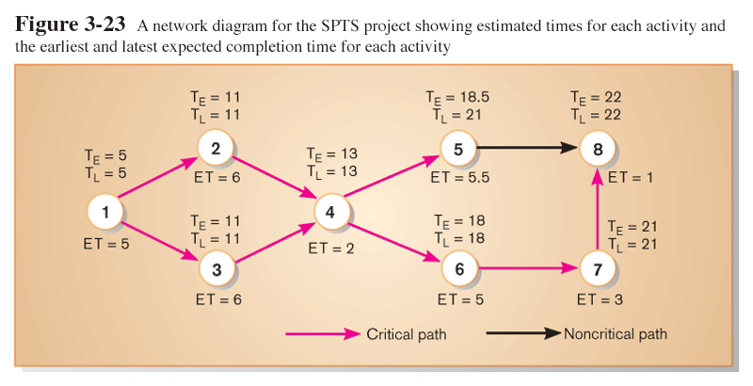
Critical Path Calculation
Early and late time calculations are determined and critical path established. (Note: Activity #5 can begin late without affecting project completion time).

Slide 34
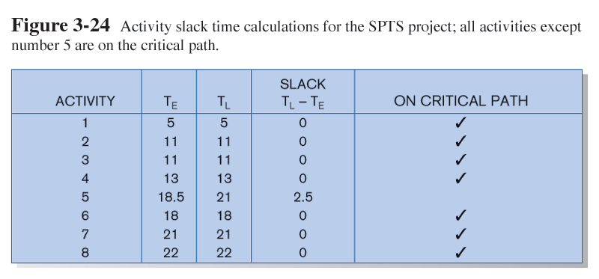
Critical Path Calculation (cont.)
Note the slack time in Activity #5.

Slide 35
Using Project Management Software
Many powerful software tools exist for assisting with project management.
Example: Microsoft Project can help with
  Entering project start date.
  Establishing tasks and task dependencies.
  Viewing project information as Gantt or Network diagrams.

Slide 36
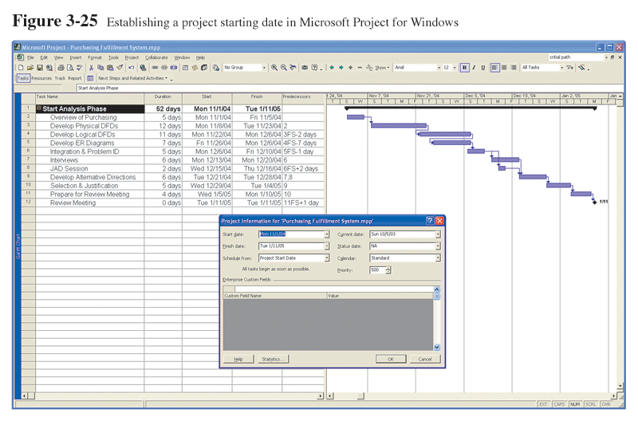
Project Start Date

Slide 37
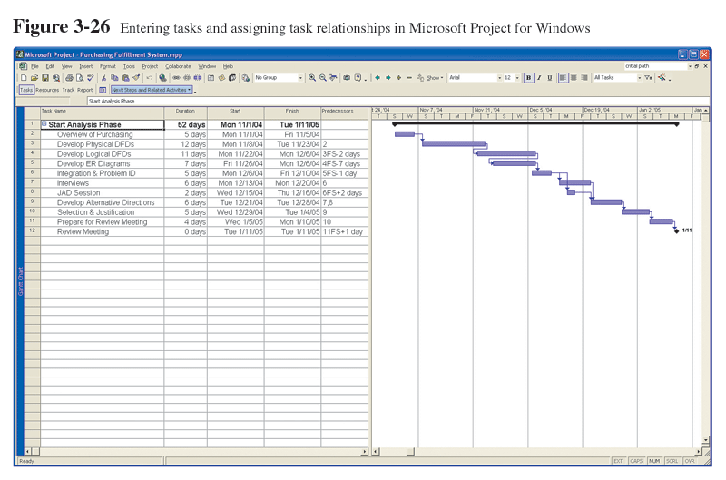
Entering Tasks

Slide 38
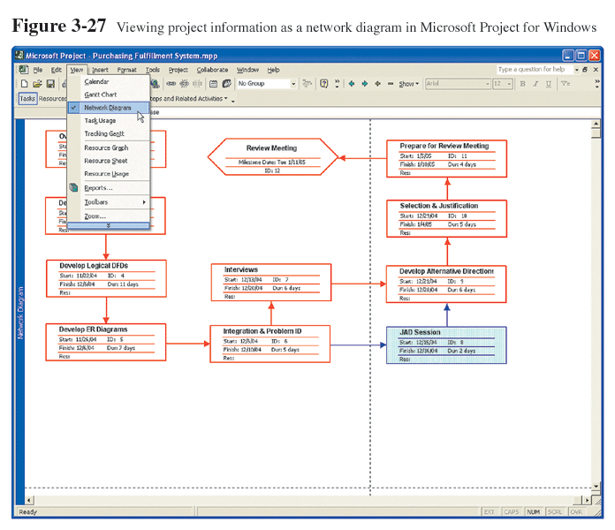
Viewing Network Diagram
Hexagon shape indicates a milestone.
Red boxes and arrows indicate critical path (no slack).

Slide 39
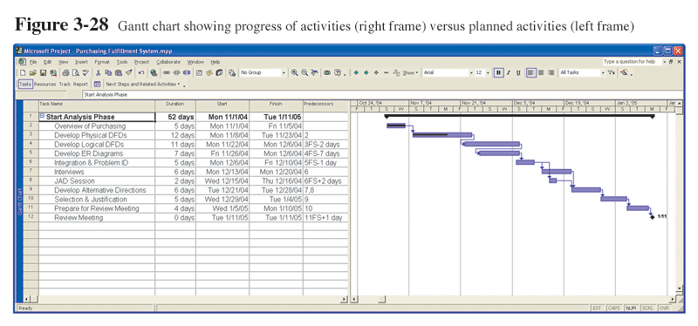
Viewing Gantt Chart
Black line at top indicates a summary activity (composed of subtasks).
Diamond shape indicates a milestone.

Slide 40
Summary
In this chapter you learned how to:
  Explain the process of managing an information systems project.
  Describe the skills required to be an effective project manager.
  List project management activities during project initiation, planning, execution, and closedown.
  Explain critical path scheduling, Gantt charts, and Network diagrams.
  Explain the utility of commercial project management software tools.

