Slide 1

Modern Systems Analysis
and Design
Fourth Edition
Jeffrey A. Hoffer
Joey F. George
Joseph S. Valacich
Chapter 4
Identifying and Selecting Systems Development Projects

Slide 2
Learning Objectives
Describe the project identification and selection process.
Describe corporate strategic planning and information systems planning.
Explain the relationship between corporate strategic planning and IS planning.
Describe how IS planning can assist in system development project identification and selection.
Analyze IS planning matrices.
Describe three classes of E-Commerce applications.

Slide 3
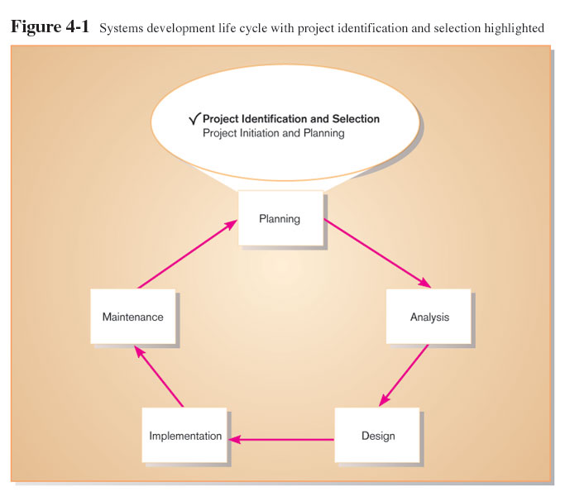

Slide 4
Project Identification Tasks
Identifying potential development projects
  Identification from a stakeholder group
Classifying and ranking potential IS projects
  Using value chain analysis or other evaluation criteria
Selecting projects
  Based on various factors

Slide 5
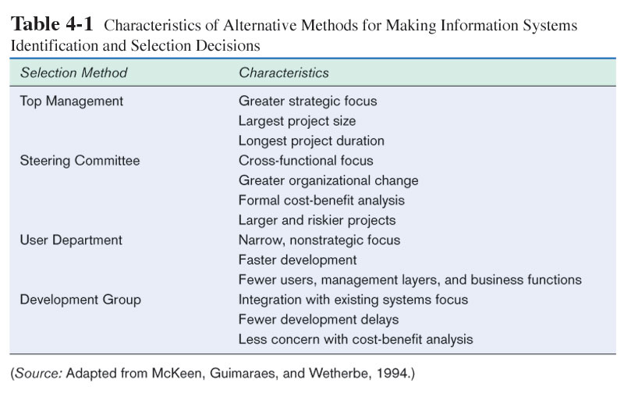
Each stakeholder group brings their own perspective and motivation to the IS decision.

Slide 6
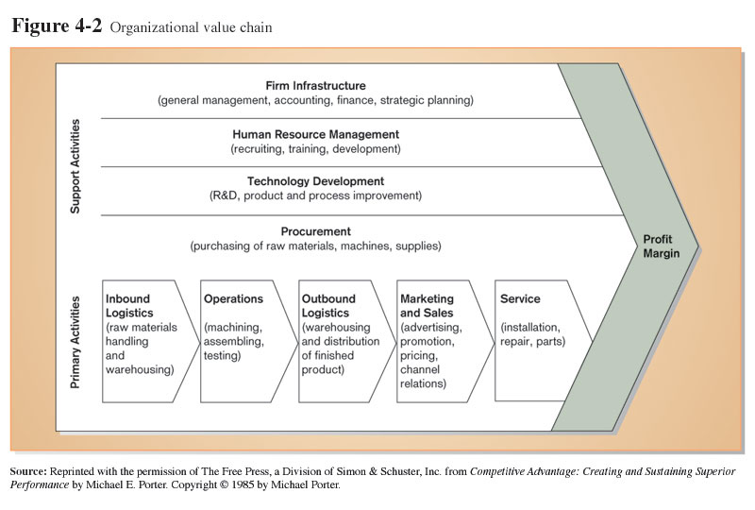
Value chain analysis: analyzing an organization's activities to determine where value is added to products/services and the costs incurred for doing so.

Slide 7
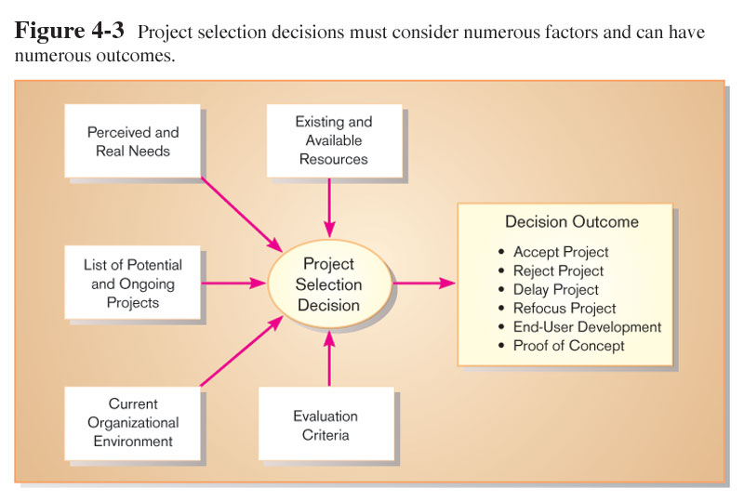
Factors for Project Selection

Slide 8
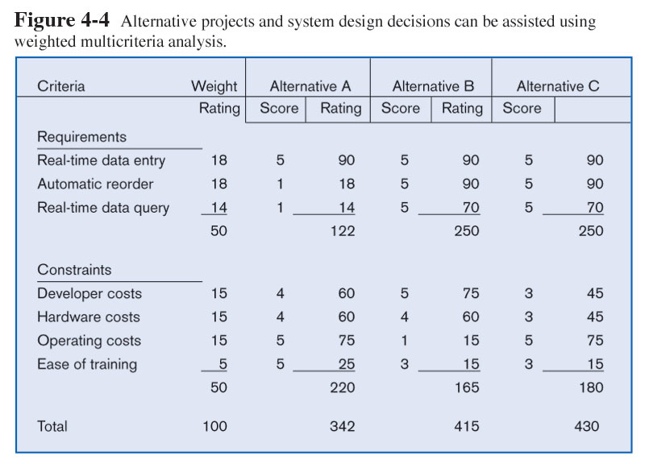
Multicriteria Analysis
Each requirement or constraint: Score = weight X rating
Each alternative: sum scores across requirements/constraints
Alternative with highest score wins

Slide 9
Corporate Strategic Planning
Ongoing process that defines mission, objectives, and strategies of an organization
Corporate strategy involves:
  Mission statement
  Objective statements
  Description of competitive strategy

Slide 10
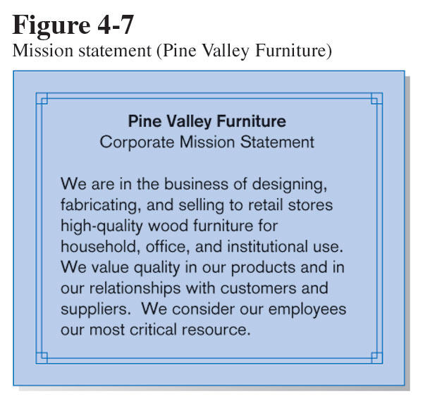
Mission Statement
Concise statement about the main business of the organization

Slide 11
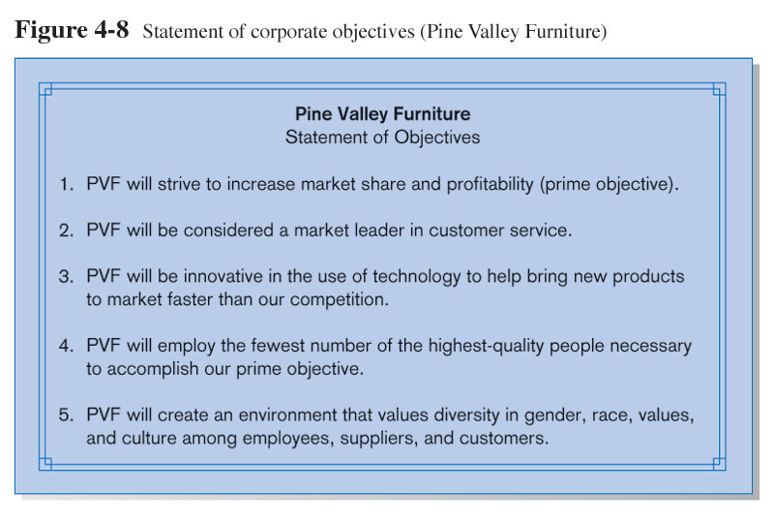
Statement of Objectives
A series of statements that express quantitative and qualitative goals for the future position of an organization

Slide 12
Competitive Strategy
The method by which the organization will attempt to satisfy its mission and objectives
Main types:
  Low-cost producer
  Product differentiation
  Product focus or niche

Slide 13
Information Systems Planning (ISP)
An orderly means of assessing the information needs of an organization and defining systems, databases, and technologies that will best meet those needs
ISP must be done in accordance with the organization's mission, objectives, and competitive strategy.

Slide 14
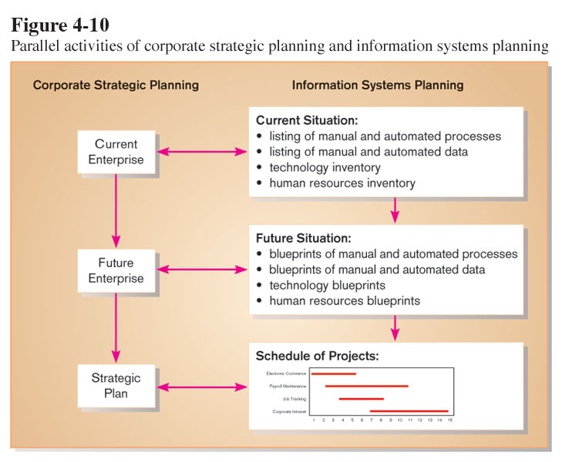
Strategic and IS Planning Relationships
IS planning must be kept in line with corporate strategic planning.

Slide 15
Approaches to IS Planning
Top-down planning
  Attempts to gain a broad understanding of information system needs of the entire organization
Bottom-up planning
  Identifies IS development projects based on solving specific operational business problems or taking advantage of specific opportunities

Slide 16
Benefits of Top-Down Planning
Broader perspective
Improved integration
Improved management support
Better understanding
But, bottom-up planning can be faster and less costly, so may be beneficial in certain circumstances

Slide 17
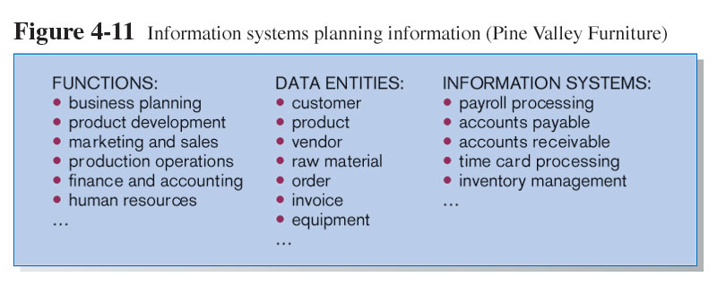
Identifying Functions, Processes, and Data Entities

Slide 18
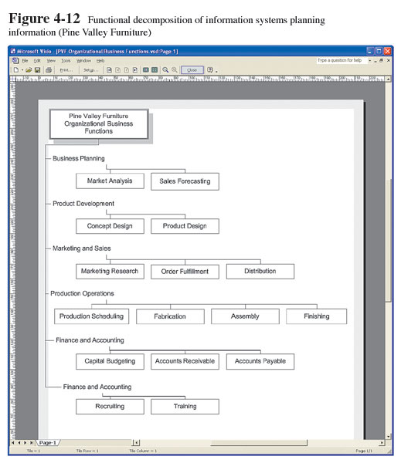
Functional Decomposition
Decomposition: breaking high-level abstract information into smaller units for more detailed planning

Slide 19
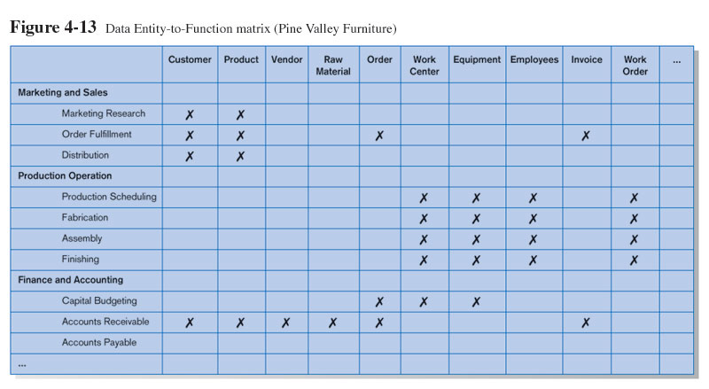
IS Planning Matrix
Matrices describe relationships between pairs of organizational elements (location, function, business unit, objective, process, data, information system).

Slide 20
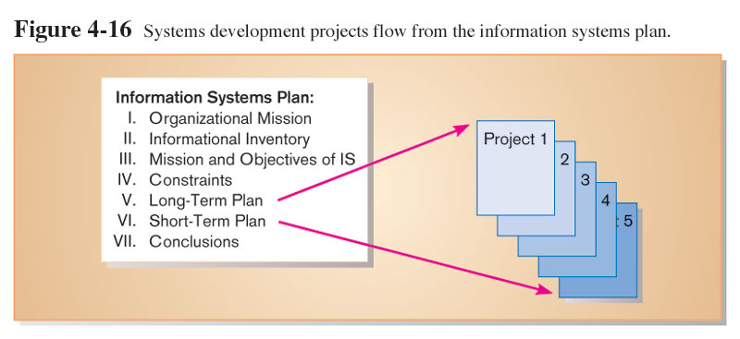
IS Plan Components
Briefly describe mission, objectives, and strategy of the organization

Slide 21
IS Plan Components (cont.)
Provide summary of current and future processes, functions, data entities, and information needs of the enterprise

Slide 22
IS Plan Components (cont.)
Describe primary role IS will play in the organization to transform enterprise from current to future state

Slide 23
IS Plan Components (cont.)
Describe limitations imposed by technology and current levels of financial, technical, and personnel resources

Slide 24
IS Plan Components (cont.)
Summarize overall information systems needs in the company and set long-term strategies for filling the needs

Slide 25
IS Plan Components (cont.)
Show detailed inventory of present projects and systems and detailed plan for the current year

Slide 26
IS Plan Components (cont.)
Describe unknown but likely events that can affect the plan, presently known business change elements, and description of their impact on the plan

Slide 27
Electronic Commerce Applications
The Internet
  A large worldwide network of networks that use a common protocol to communicate with each other
Electronic Commerce
  Internet-based communications to support day-to-day business activities

Slide 28
Three Modes of E-Commerce
Internet-based
  Supports business activities between a business and individual consumers
Intranet-based
  Supports business activities within a single organization
Extranet-based
  Supports business-to-business activities
  A form of Electronic Data Interchange (EDI) – use of telecommunications for direct transfer of business documents between organizations

Slide 29
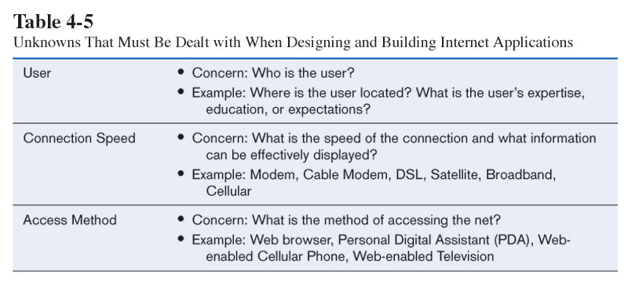
Issues in Internet Application Development

Slide 30
Summary
In this chapter you learned how to:
  Describe the project identification and selection process.
  Describe corporate strategic planning and information systems planning.
  Explain the relationship between corporate strategic planning and IS planning.
  Describe how IS planning can assist in system development project identification and selection.
  Analyze IS planning matrices.
  Describe three classes of E-Commerce applications.

