Slide 1

FINAL PROJECT REVIEW
AI-Powered RF Digital Twin Using
ADALM-PLUTO
Automatic modulation classification on real over-the-air signals
23AID203 – Software-Defined Communication Systems
GROUP A-16
Faculty: Kavitha K
B. Suryacharantej – CB.AI.U4AID25009
B. Sai Srikar – CB.AI.U4AID25006
P. Sathwik – CB.AI.U4AID25041
M. Neeraj – CB.AI.U4AID25031
Notes:
Introduce the team and the project title. Say: In the mid review we showed the AI working on a dataset. Today we show the same AI working on a real radio, the ADALM-Pluto, over the air.

Slide 2
Introduction
Wireless systems send information using different modulation schemes (AM, FM, BPSK, QPSK, QAM)
A receiver must know the modulation type before it can demodulate the signal
Automatic Modulation Classification (AMC) identifies the type directly from the received I/Q samples
Our project: an AI-based RF Digital Twin – validated on the RadioML dataset, then deployed on a real ADALM-Pluto SDR
RF signal (over the air)
I/Q samples (2 × 128)
1D CNN
Modulation type
Problem: How can an unknown RF signal be identified automatically and reliably – not only in simulation, but on real radio hardware?
2
Notes:
Explain modulation simply: different ways of putting data onto a radio wave. A receiver must know the type before decoding. AMC does that automatically. Our project does it with a CNN, first on a dataset and now on a real radio.

Slide 3
Literature survey
Paper (Year) | Platform | Method used | Key findings and gaps
Automatic Modulation Classification with Deep Neural Networks (2023) | MDPI – Electronics | CNN architectures with dilated convolution, statistics pooling and squeeze-and-excitation | Findings: Achieved strong AMC performance on RadioML 2018.01A; best model reached 98.9% peak accuracy. Gap: Focuses mainly on model architecture and dataset evaluation rather than real-time hardware implementation.
Real-time Modulation Classification Architecture in Software Defined Radio (2024) | ScienceDirect – Physical Communication | Low-complexity 1D CNN + SDR-based receiver | Findings: Demonstrated real-time AMC using SDR; CNN achieved fast inference suitable for real-time operation. Gap: Uses a more complete/complex receiver architecture; scope remains for a simpler AI-to-hardware workflow.
Modulation Recognition Based on Multi-modal Fusion of ResNet and Traditional Signal Processing (2025) | IEEE Xplore – IEEE MTT-S IWS | ResNet-18 + traditional signal processing + ADALM-PLUTO | Findings: Tested modulation recognition using ADALM-PLUTO; ResNet-18 achieved >98% accuracy with faster inference than ResNet-50. Gap: Uses a more complex multimodal approach compared with a simpler CNN-based pipeline.
A Novel Deep Learning Automatic Modulation Classifier with Fusion of Multichannel Information Using GRU (2023) | Springer Nature – Journal on Wireless Communications and Networking | GRU-based fusion of I/Q and amplitude/phase information | Findings: Combined I/Q and A/P features to improve AMC, especially at low SNR; evaluated using RadioML data with 128-sample inputs. Gap: Multi-channel feature fusion increases model complexity for practical deployment.
Our approach: a simple 1D CNN on raw 2 × 128 I/Q – validated on RadioML, then deployed and fine-tuned on a real ADALM-Pluto.
3
Notes:
Four papers from our survey. The first got 98.9 percent on RadioML 2018 but only on the dataset, not on hardware. The second showed real-time AMC on an SDR but with a more complex receiver. The third used ADALM-Pluto with ResNet-18 and signal-processing fusion, which is more complex than our CNN. The fourth fused I/Q with amplitude and phase using a GRU, which helps at low SNR but adds complexity. Our project fills the gap with a simple 1D CNN on raw I/Q, validated on the dataset and then deployed and fine-tuned on a real ADALM-Pluto.

Slide 4
Objectives – all achieved
✓
Train a CNN on raw 2 × 128 I/Q samples with separate training, validation and test sets
Achieved
✓
Configure the ADALM-Pluto to transmit and receive all 5 modulations over the air
Achieved
✓
Capture real-time I/Q samples and feed them to the trained CNN
Achieved
✓
Classify live RF signals in a real-time digital-twin dashboard
Achieved
✓
Evaluate real-time performance and compare dataset vs. hardware accuracy
Achieved
✓
Close the simulation-to-reality gap by fine-tuning the CNN on real Pluto data
Achieved
4
Notes:
Read the six objectives. All six are complete; the last one, fine-tuning on real data, was added after we measured the gap between simulation and hardware.

Slide 5
Methodology: the RF digital twin
VIRTUAL TWIN – simulation (mid review)
PHYSICAL TWIN – ADALM-Pluto hardware (now)
RadioML 2016.10a dataset
MATLAB generates the modulated waveform
2 × 128 I/Q frames
Pluto TX → antenna → air → antenna → Pluto RX
1D CNN
Frame + normalise to 2 × 128 I/Q
Predicted modulation
Same 1D CNN
Compare with dataset label
Live prediction vs. transmitted label
Measure the gap → fine-tune the CNN on real Pluto data → re-test on a fresh capture
5
Notes:
Two halves of the twin. Left: the virtual side we had at mid review. Right: the physical side we built now, using the same CNN. Comparing them shows the gap, which we then close by fine-tuning.

Slide 6
Hardware setup
915 MHz over the air
Component | Details
ADALM-Pluto | AD9363, 325 MHz – 3.8 GHz, 1 TX + 1 RX
2 SMA antennas | On TX1 and RX1, about 2 cm apart
USB cable | Micro-B data port: I/Q samples + power
MATLAB R2026b | Communications, DSP, Signal Processing and Deep Learning toolboxes
Support package | Communications Toolbox Support Package for ADALM-PLUTO Radio
ADALM-Pluto
AD9363 SDR
Laptop
MATLAB R2026b
+ CNN
USB (data + power)
TX1
RX1
One board transmits and receives at the same time (full duplex)
TX and RX share one clock, so frequency offset is negligible
Antennas give a real wireless channel: noise, reflections
6
Notes:
Point to the diagram. One Pluto both transmits and receives. The laptop sends the waveform over USB, the TX antenna radiates it, the RX antenna picks it up 2 cm away, and the samples come back over USB to MATLAB and the CNN.

Slide 7
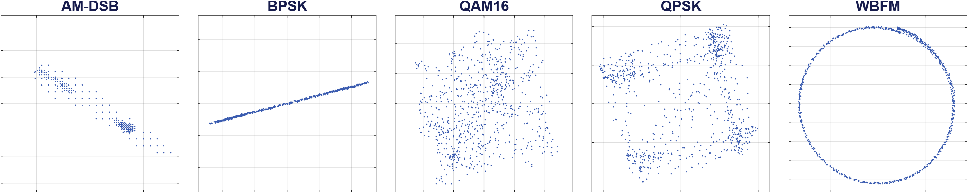
What the receiver sees
7
Notes:
These are real constellations captured over the air by our Pluto. Each modulation has a clear shape: BPSK a line, QPSK four clusters, WBFM a ring. The CNN learns these differences directly from the raw I/Q numbers.

Slide 8
CNN architecture
Input
2 × 128
Conv1D 5 × 32
+ ReLU
Conv1D 5 × 64
+ ReLU
Global avg
pooling
Fully
connected (5)
Softmax
→ class
Training on RadioML (dataset)
Fine-tuning on Pluto data (now)
70 / 15 / 15 split: training / validation / test
Adam, learning rate 0.001, mini-batch 128
Early stopping on validation loss (max 30 epochs)
5 classes, SNR ≥ 10 dB
Test accuracy: 85.25%
Starts from the trained weights
Same 70 / 15 / 15 split on real Pluto frames
Learning rate 0.0005, early stopping
10,500 real + 5,000 RadioML training frames
About 11 k parameters – real time on a laptop CPU
8
Notes:
The same small CNN from the mid review: two 1D convolution layers that slide pattern detectors along the I/Q signal, then pooling and a 5-way classifier. Only about eleven thousand parameters, so it runs in real time on a laptop.

Slide 9
Training, validation and testing
Training 70%
Validation 15%
Testing 15%
Stratified split: every modulation (and every power level) appears in all three sets in the same proportion
Set | Purpose | RadioML CNN | Pluto fine-tuning
Training | The network learns from these frames | 17,500 frames | 84.9% | 10,500 + 5,000 RadioML | 99.7%
Validation | Checked during training: best model kept, early stopping | 3,750 frames | 83.3% | 2,250 frames | 99.5%
Testing | Used only once, after training | 3,750 frames | 85.3% | 2,250 frames | 99.6%
Fresh recording | New capture, new random data, never seen | - | 9,600 frames | 96.7%
Training, validation and test accuracy agree within 1-2 points: the model generalises and does not over-fit.
Pluto recording: 25,000 frames (5 power levels). Train / val / test use the 3 strongest levels = 15,000 frames (10,500 / 2,250 / 2,250); the 2 weakest levels (10,000 frames, near noise) are used only to test accuracy vs SNR.
9
Notes:
Explain the three sets. Training: the network learns from it. Validation: checked during training to keep the best version and stop early, so it does not memorise. Testing: used only once at the end for the reported score. We did this for both stages, and then tested on a completely new recording. Training, validation and test accuracy are within one or two points of each other, which shows there is no over-fitting.

Slide 10
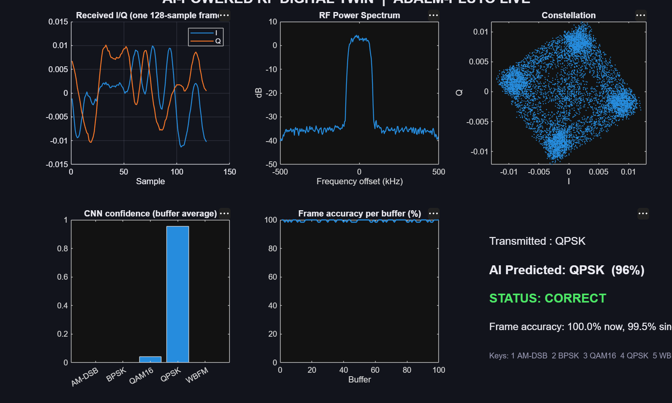
Live RF digital twin dashboard
I/Q frame: exactly what the CNN sees
Spectrum: about 170 kHz wide, ~35 dB above noise
Constellation: 4 QPSK clusters
Confidence bars: CNN probability per class
Frame accuracy: 99.5% of frames correct
Keys 1-5 switch the transmitted modulation live
All 5 modulations classified correctly in the live test with antennas
Live run: QPSK transmitted, QPSK predicted with 96% confidence
10
Notes:
This is our live demo. The Pluto transmits one modulation, the CNN classifies every frame in real time, and the screen shows the result. Press keys 1 to 5 to switch modulation. In the live test with antennas, all five were classified correctly.

Slide 11
Results: dataset vs. real hardware
85.25%
74.1%
96.7%
Simulation: RadioML test set
Real signals: original CNN
Real signals: fine-tuned CNN
-11.2 pts
+22.6 pts
9,600 frames
simulation-to-reality gap
gained by fine-tuning on real data
fresh recording, never used in training
Note: the 96.7% comes from an independent fresh recording (9,600 frames, never used for training or validation). The dataset and hardware numbers are measured under different conditions (RadioML: many simulated channels; ours: one short-range lab link after fine-tuning on that link), so they are not a like-for-like comparison.
11
Notes:
The three key numbers. 85.25 percent on the RadioML test set, in simulation. The same CNN on real signals drops to 74.1 percent - the simulation-to-reality gap. After fine-tuning on real data it reaches 96.7 percent on a completely new recording. Do not claim it beats simulation: the dataset covers many simulated channel conditions, while our test is one short-range lab link that the network was fine-tuned on, so the numbers are not directly comparable.

Slide 12
Accuracy per modulation (real signals)
Digital modulations (BPSK, QPSK, QAM16) were already above 94%
AM-DSB: 4% → 91% (+87 pts)
WBFM: 74% → 95% (+21 pts)
Analog signals change most between simulation and real hardware, so they gain most from real training data
12
Notes:
Digital modulations were already strong for the original CNN. The big gains are the analog ones: AM-DSB from 4 to 91 percent and WBFM from 74 to 95 percent, because their real-hardware appearance differs most from the simulated data.

Slide 13
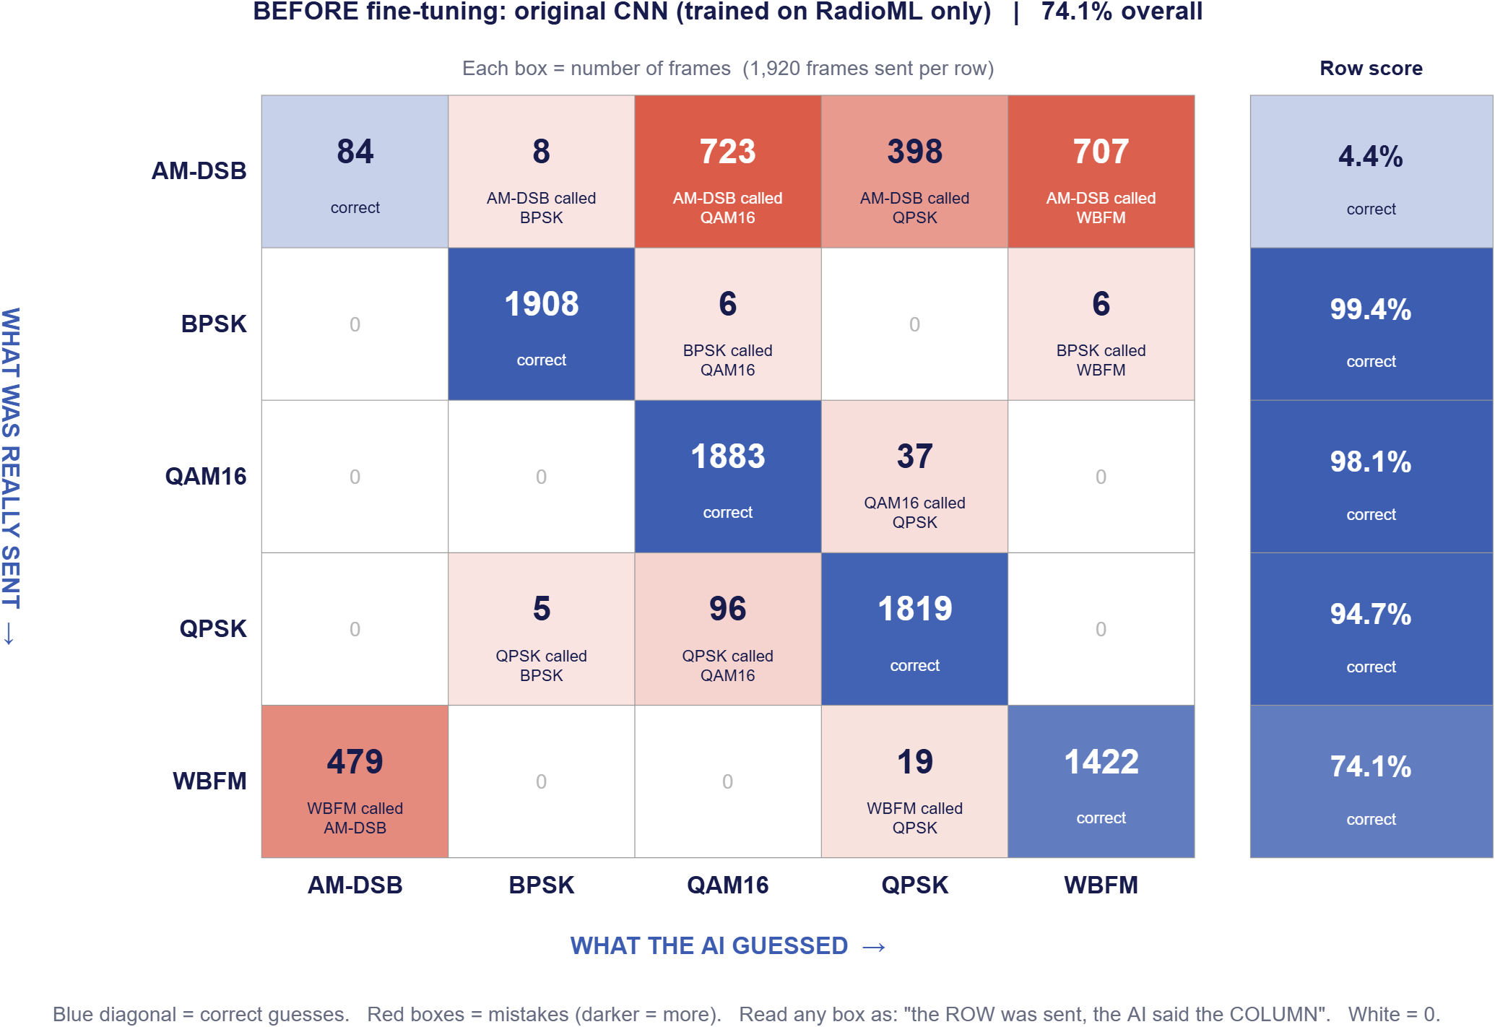
Confusion matrix: before fine-tuning
How to read it
Row = what was really sent (1,920 frames each)
Column = what the AI guessed
Blue diagonal = correct
Red box = mistake
What it shows
Digital (BPSK, QAM16, QPSK): already 95-99% correct
AM-DSB: only 84 of 1,920 right (4.4%) – mostly called QAM16 (723) or WBFM (707)
WBFM: 479 called AM-DSB
13
Notes:
Explain how to read it: each row is what was really sent, 1,920 frames per row; each column is what the AI guessed; the blue diagonal is correct and red boxes are mistakes. Before fine-tuning, the digital modulations are already fine, but AM-DSB is almost always wrong: only 84 of 1,920 correct, mostly called QAM16 or WBFM. WBFM is often called AM-DSB. Overall 74.1 percent.

Slide 14
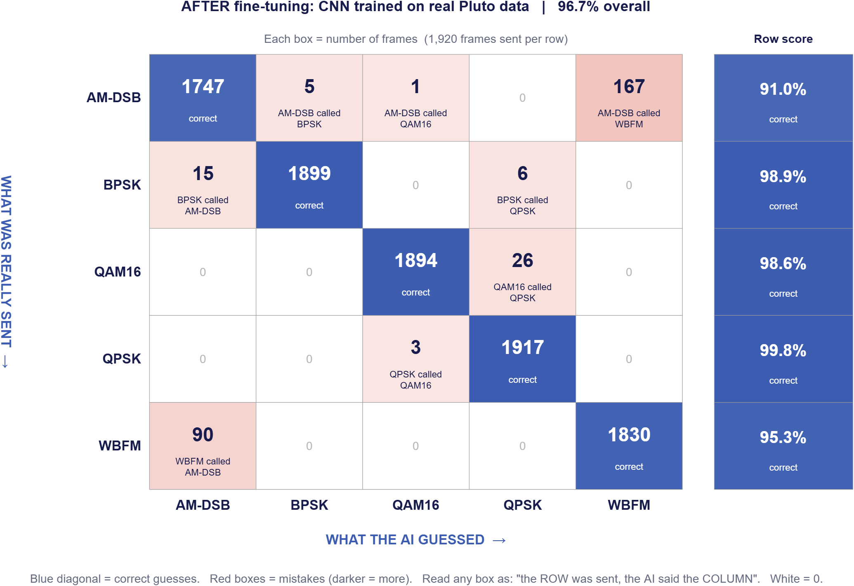
Confusion matrix: after fine-tuning
What changed
AM-DSB correct: 84 → 1,747 (91.0%)
WBFM correct: 1,422 → 1,830 (95.3%)
QPSK correct: 1,819 → 1,917 (99.8%)
Overall: 9,287 of 9,600 = 96.7%
Mistakes left
AM-DSB vs. WBFM (167 + 90): both analog, same audio
QAM16 vs. QPSK (26 + 3): QPSK points look like QAM16 corners
Fixed by deciding over more frames (next slide)
14
Notes:
After fine-tuning on real Pluto data the diagonal is strong for every class: 9,287 of 9,600 frames correct, 96.7 percent. AM-DSB went from 84 to 1,747 correct. The remaining mistakes are mostly AM-DSB versus WBFM, because both are analog and carry the same audio, and a few QAM16 versus QPSK, because QPSK points look like the corners of QAM16.

Slide 15
Deciding over more frames
96.7%
99.5%
100%
1 frame
Vote of 8 frames
Vote of 64 frames
0.13 ms of signal
1 ms of signal
8 ms of signal (live dashboard)
Same fresh recording (9,600 frames), fine-tuned CNN
AM-DSB: 91.0% per frame → 99.6% with 8 frames → 100% with 64 frames
WBFM: 95.3% per frame → 97.9% with 8 frames → 100% with 64 frames
8 ms is still instant for a person – this is how the live dashboard reaches 5 / 5 correct
15
Notes:
One frame is only 0.128 milliseconds of signal. If the system takes a majority vote over consecutive frames, the remaining AM-DSB and WBFM mistakes disappear: 99.5 percent with 8 frames and 100 percent with 64 frames, which is only 8 milliseconds. The live dashboard already averages 64 frames.

Slide 16
Thank you
Group A-16 | B. Suryacharantej – B. Sai Srikar – P. Sathwik – M. Neeraj
Notes:
Thank the panel and invite questions. Be ready to run the live dashboard if asked.

