Slide 1
A5016- ENGINEERING DESIGN THINKING
Team no: 09
Title of the Project : A Silent Voice
S.No. | Roll No. | Name of the students
1 | 19881A05A3 | Praneeth Sunkavalli
2 | 19881A0596 | Mattam Nithin
3 | 19881A05A8 | Shaik Salman
4 | 19881A05A2 | P.Karthiikeya
5 | 19881A0588 | Buchi Reddy
6 | 19881A05A4 | R.Suryachand

Slide 2
Outlines
Objective
Existing System
Proposed System
Requirements
Prototype
References
Conclusion

Slide 3
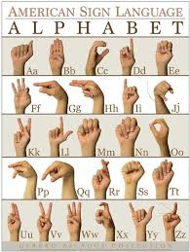
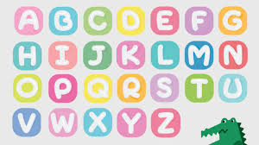
OBJECTIVE
The main objective of our project is to, “VOICE FOR THE VOICELESS”.
There are around 10,27,835 people, including 5,45,179 male and 482656 female, who suffer from hearing and speech impairment.
A World Health Organization report says around 63 million people in India suffer from either complete or partial deafness, and of these, at least 50 lakh are children.
We are trying to make a channel, where communication can be made much more easier.

Slide 4
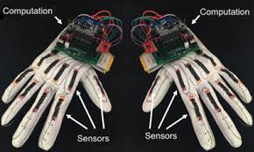
Existing System
In currently existent highly accurate image processing system requires certain physical components, which are to be worn by user, which includes sensors and other complex devices which increases level of inconvenience and also result in an increase in expense.
And later it has been improved to recognize the signs using machine learning, but it’s still doesn’t show higher accuracy and also gestures.

Slide 5
PROPOSED SYSTEM
We are developing an applications, which will be used for sign detection and conversion to audio and text.
In our application, we will be using the facial emotion and sign detection, which will be the key points for improving the accuracy of true meaning of the person.
We are using computer vision for capturing the sign and gestures of the person.
We had a made recommendation system, for faster identification of words.
After completion of the machine learning model, we are planning to make an application, we can accomplish the task in much faster, easier and accurate way

Slide 6
PROTOTYPE
I believe it better to demonstrate then presentate.

Slide 7
SOFTWARE REQUIREMENTS
Python 3.9
Tensorflow 1.11.0
OpenCV 3.4.3.18
NumPy 1.15.3
Matplotlib 3.0.0
Keras 2.2.1
PIL 5.3.0
Keras 2.4.0

Slide 8
REFERNCES
T.Yang, Y.Xu and ”A., Hidden Markov Model for Gesture Recognition”, CMU-RI-TR-94 10, Robotics Institute, Carnegie Mellon Univ., Pittsburgh, PA, May 1994
https://docs.opencv.org/2.4/doc/tutorials/imgproc/gausian_median_blur_bilateral_filter/gausian_median_blur_bilateral_filter.html
Mohammed Waleed Kalous, Machine recognition of Auslan signs using PowerGloves: Towards large-lexicon recognition of sign language.
Byeongkeun Kang , Subarna Tripathi , Truong Q. Nguyen ”Real-time
sign language fingerspelling recognition using convolutional neural
networks from depth map” 2015 3rd IAPR Asian Conference on Pattern
Recognition (ACPR)

Slide 9
CONCLUSION
In this report, a functional real time vision based American sign language recognition for D&M people have been developed for ASL alphabets.
We achieved an accuracy of 97.3% on our dataset.
Prediction has been improved after implementing two layers of algorithms in which we verify and predict symbols which are more similar to each other.
We are planning to achieve higher accuracy even in case of complex
backgrounds by trying out various background subtraction algorithms.
We are also thinking of improving the preprocessing to predict gestures in low light conditions with a higher accuracy.

Slide 10
THANK YOU.

