Slide 1

Vardhaman college of Engineering A5017-PRODUCT REALIZATION
Team : 09
Title of the Project : Voice For Voiceless
Guide details:
Dr. Chandra Chuda Mohanthy
(Professor ) Department of CSE
S.No. | Roll No. | Name of the students
1 | 19881A05A3 | Praneeth Sunkavalli
2 | 19881A0596 | Mattam Nithin
3 | 19881A05A8 | Shaik Salman
4 | 19881A05A2 | P.Karthiikeya
5 | 19881A0588 | Buchi Reddy
6 | 19881A05A4 | R. Suryachand

Slide 2
Outlines
Objective
Existing System
Proposed System
Software Requirements
Architectural Diagram
Output
Conclusion
Future Scopes
References

Slide 3
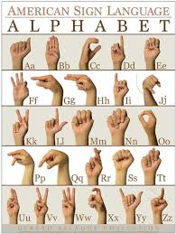
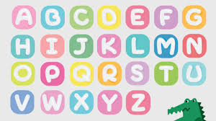
OBJECTIVE
The main MOTTO of our project is to provide, “VOICE FOR THE VOICELESS”.
There are around 10,27,835 people, including 5,45,179 male and 4,82,656 female, who suffer from hearing and speech impairment.
A World Health Organization report says around 13 million people in world suffer from either complete or partial deafness, and of these, at least 50 lakh are children.
We are trying to make a channel, where communication can be made much more easier.

Slide 4
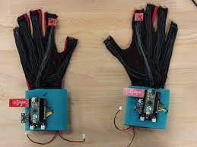
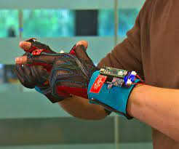
EXISTING SYSTEM
In currently existent highly system requires certain physical components, which are to be worn by user, which includes sensors and other complex devices which increases level of inconvenience and also result in an increase in expense.
And later it has been improved to recognize the signs using machine learning, but it’s still doesn’t show higher accuracy and also gestures.

Slide 5
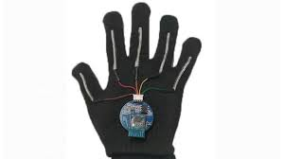
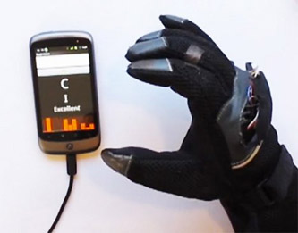
EXISTING MODEL(show & Tell)
Show and tell prototype Glove, which demonstrated at a recent Google developers event.
Accelerometer
Tilt sensor
Detect hand moments and orientation
to demonstrate as words

Slide 6
PROPOSED SYSTEM
We are developing an applications, which will be used for sign detection and conversion to audio and text.
In our application, we will be using the hand sign, which will be the key point for improving the accuracy of true meaning of the person.
We are using computer vision for capturing the sign and gestures of the person.
After completion of the machine learning model, we are planning to make an application, we can accomplish the task in much faster, easier and accurate way.

Slide 7

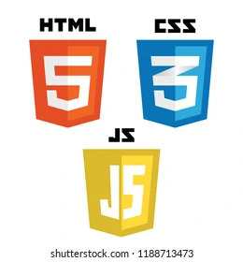
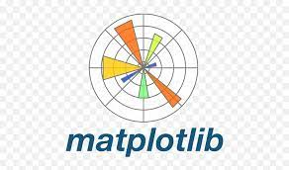




SOFTWARE REQUIREMENTS
SOFTWARE REQUIREMENTS
Languages:
Python 3.9
HTML
PHP
CSS
Java Script
Frameworks and Libraries:
Tensorflow 1.11.0
OpenCV 3.4.3.18
NumPy 1.15.3
Matplotlib 3.0.0
PIL 5.3.0
Keras 2.4.0
Flask 2.0.1

Slide 8
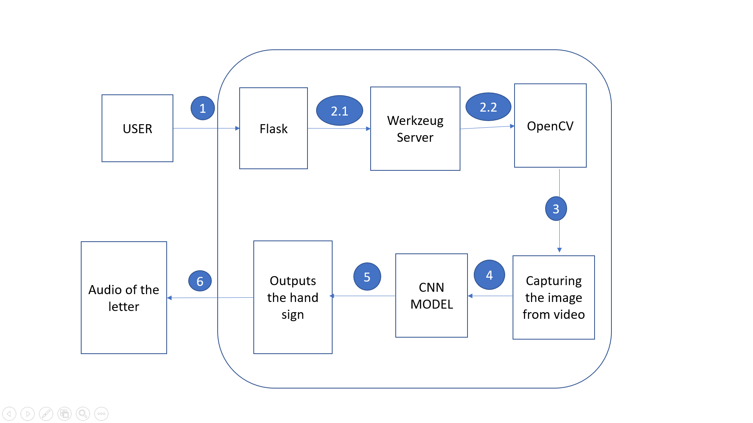
SCHEMA DIAGRAM

Slide 9
CONCLUSION
In this report, a functional real time vision based American sign language recognition for D&M people have been developed for ASL alphabets.
We achieved an accuracy of 97.3% on our dataset.
Prediction has been improved after implementing two layers of algorithms in which we verify and predict symbols which are more similar to each other.
We are planning to achieve higher accuracy even in case of complex
backgrounds by trying out various background subtraction algorithms.
We are also thinking of improving the preprocessing to predict gestures in low light conditions with a higher accuracy.

Slide 10
We will upgrade our project to detect facial expressions and body language, which are converted it into text and audio output.
We will be capable of achieving an accuracy of 90% by collecting real time dataset and training them using “ VGG16, VGG19, ResNet50V2” algorithms.
We are planning to remove gray scaling which make the application user friendly.
We are planning to make next version of this application where an audio message is converted into sign language using an avatar.

Slide 11
REFERNCES
T.Yang, Y.Xu and ”A., Hidden Markov Model for Gesture Recognition”, CMU-RI-TR-94 10, Robotics Institute, Carnegie Mellon Univ., Pittsburgh, PA, May 1994
https://docs.opencv.org/2.4/doc/tutorials/imgproc/gausian_median_blur_bilateral_filter/gausian_median_blur_bilateral_filter.html
Mohammed Waleed Kalous, Machine recognition of Auslan signs using PowerGloves: Towards large-lexicon recognition of sign language.
Byeongkeun Kang , Subarna Tripathi , Truong Q. Nguyen ”Real-time
sign language fingerspelling recognition using convolutional neural
networks from depth map” 2015 3rd IAPR Asian Conference on Pattern
Recognition (ACPR)

Slide 12
THANK YOU.

