Slide 1

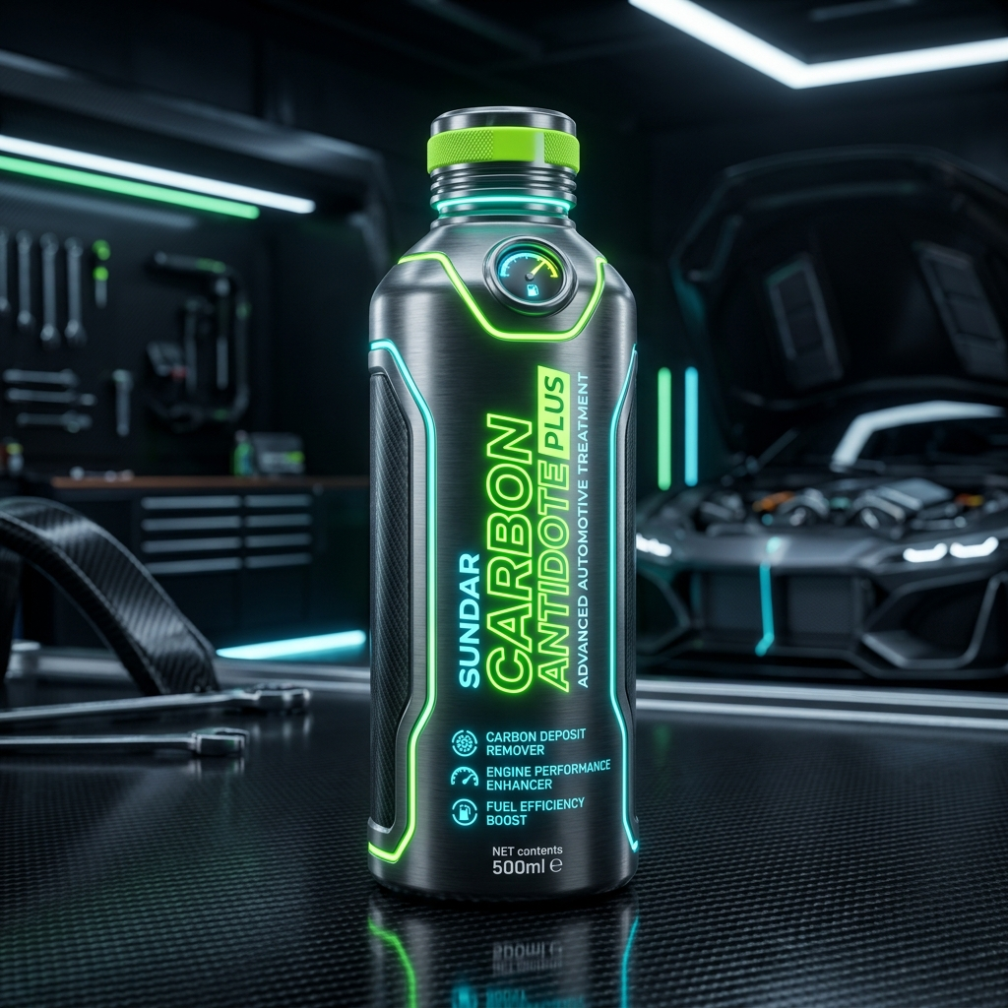
SUNDAR CARBON
ANTIDOTE PLUS
with Active Booster Dose (Ethanol Defense)
The ultimate engine rejuvenation, performance boost, and certified fuel system defense for BS4 & BS6 petrol vehicles.

Slide 2
THE THREAT
The Silent Engine Killer
Mandatory government ethanol-blending (up to 20%) in petrol creates high-risk scenarios for engines:
• Water Absorption (Hygroscopic): Ethanol actively absorbs moisture from air, creating a corrosive water-fuel mixture at the bottom of the fuel tank.
• Corrosive Attack: Damages metal tanks, rusts internal fuel lines, and degrades rubber seals and hose couplings.
• BS4 & BS6 Failure: High-pressure fuel injectors clog quickly due to separation deposits, leading to engine misfires, knocking, and power loss.
UNPROTECTED FUEL SYSTEM
⚠️ Phase separation isolates water layer at fuel tank base
⚠️ Corroding fuel pumps and rusting injectors
⚠️ Decreased thermal combustion efficiency
⚠️ Higher emissions & costly mechanical wear-and-tear

Slide 3
THE SHIELD
Active Ethanol Defense
The Booster Dose is engineered to chemically safeguard your entire fuel line:
• Combats Phase Separation: Keeps ethanol and moisture fully dispersed and bonded within the fuel. Prevents water pooling at the tank base.
• Micro-Coating Shield: Coats fuel pump parts, lines, and injectors with a molecular anti-corrosive layer that repels water molecules.
• Nozzle De-Clogging: Keeps high-precision BS4 and BS6 fuel injector spray orifices completely clean and clear of deposits.
BOOSTER DOSE SHIELD ON
✔️ Corrosion prevented on fuel lines, tanks, and valves
✔️ Clean, stable fuel combustion under all blended states
✔️ Maximum nozzle atomization (BS4 & BS6 optimized)
✔️ Extended life for high-pressure fuel pumps

Slide 4
PERFORMANCE SURGE
Certified Engine Output
Certified performance values representing significant operational efficiency improvements:
+30%
FUEL EFFICIENCY
Increases vehicle mileage and overall fuel economy by up to 30%.
+80%
TORQUE & POWER
Delivers up to an 80% increase in engine pickup, power, and torque.
-80%
COOLER RUNNING
Decreases external engine running temperatures by up to 80%.

Slide 5
MAINTENANCE & DURABILITY
Extreme Wear Reduction
Minimizes engine downtime and cuts vehicle maintenance overhead:
• 85% Less Wear & Tear: Decreases mechanical engine parts wear-and-tear by up to 85% by creating a resilient lubricant boundary layer.
• 5x Extended Oil Life: Reduces oil oxidation and soot contamination, extending oil longevity up to 5x.
• 5x Extended Engine Life: Protects internal components from micro-abrasions and combustion stress.
• Refined Smoothness: Engine noise drops by 60% and vibrations cut by 40% for a smooth drive. Increases AC performance by up to 60% by reducing load.
FINANCIAL IMPACT
₹ Fewer engine oil changes (saves ₹3,000+ per change)
₹ Zero premature fuel system replacement costs
₹ Less downtime for fleet vehicles, maximizing revenue
₹ Up to ₹15,000+ in annual fuel & maintenance savings

Slide 6
ENVIRONMENTAL IMPACT
Clean Combustion
A revolutionary leap in emission reductions and exhaust quality:
• 99.9% NOx & SOx Elimination: Near-complete removal of highly toxic nitrogen oxides and sulfur oxides in the exhaust stream.
• 90% Arsenic Reduction: Drastically minimizes toxic arsenic particulate exhaust by up to 90%.
• Oxygen Boost (+50% O₂): Dramatically increases clean, breathable oxygen levels in the tailpipe output.
• Neutralizes Footprint: Optimizes engine combustion to neutralize standard carbon footprint outputs.
ECOLOGICAL COMPLIANCE
🌱 Highly recommended for PUC emission compliance tests
🌱 Converts exhaust elements into cleaner air compounds
🌱 Neutralizes carbon output through extreme fuel efficiency
🌱 Reduces toxic smog-forming compounds to near-zero levels

Slide 7
PEACE OF MIND
Long-Term Reliability
Engineered for maximum duration and passenger peace of mind:
1,00,000 KM ACTIVE DURATION
A single complete application remains fully active in the vehicle's engine and lubrication systems for 1,00,000 kilometers, requiring zero top-ups or frequent treatment renewals.
PRESENTER NOTE:
Keep presentations focused on the long-term cost benefits, mechanical reliability, and peace of mind this 1,00,000 km timeline offers to individual car owners and corporate fleet managers.
1,00,000 KM
ACTIVE EFFICACY GUARANTEE
Certified to protect high-pressure fuel injectors and mechanical cylinders across a massive driving range.

