Slide 1

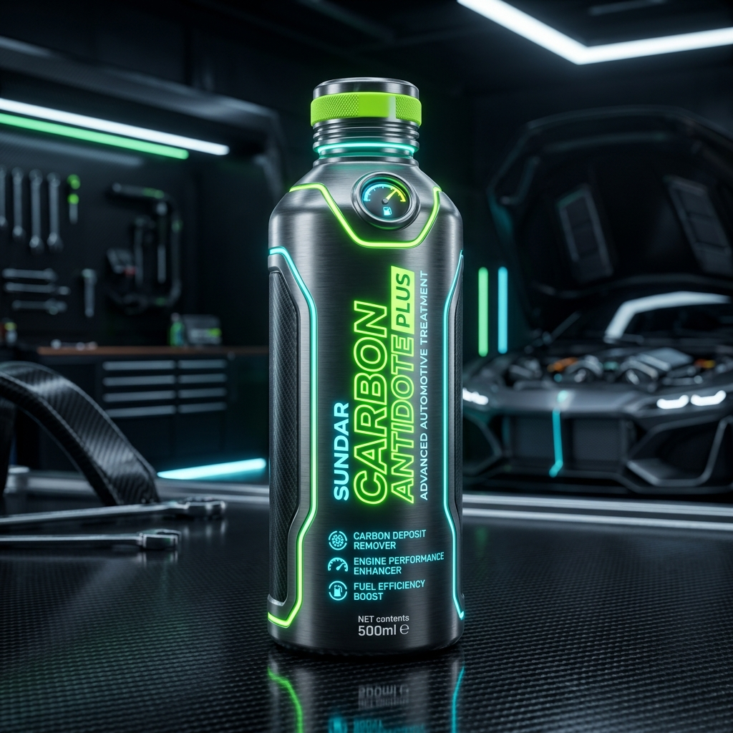
ಕನ್ನಡಿಗರ ವಾಹನಗಳಿಗೆ ಸುರಕ್ಷಾ ಕವಚ
SUNDAR CARBON
ANTIDOTE PLUS
with Active Booster Dose (Ethanol Defense)
The ultimate engine rejuvenation, performance boost, and fuel system defense calibrated for all Petrol & Diesel vehicles on Karnataka's roads.

Slide 2
THE THREAT
The Sugar State Fuel Challenge
Mandatory government E20 (20% Ethanol) blended petrol creates severe operational risks on local roads:
• High Ethanol Exposure: As a leading sugarcane state, Karnataka actively distributes high ethanol blends derived from crop molasses.
• Humidity & Water Phase separation: In humid climates like coastal Mangaluru, Udupi, and Karwar, ethanol quickly absorbs water. This causes phase separation, pooling corrosive water at the tank bottom.
• Clogged BS4 & BS6 Fuel Lines: High pressure injectors clog rapidly with chemical deposits, leading to engine knocking, lost power, and misfires on city roads.
UNPROTECTED VEHICLE STATE
⚠️ Water separation corrupts fuel tank composition
⚠️ Corroding fuel pumps and rusting injectors
⚠️ Decreased power during steep Western Ghats climbs
⚠️ Expensive breakdown repairs on city & highway commutes

Slide 3
THE SHIELD
Booster Dose (ಎಥನಾಲ್ ಇಂಜೆಕ್ಟರ್ ರಕ್ಷಕ)
The active Booster Dose provides an immediate chemical defense shield for petrol engines:
• Combats Phase Separation: Keeps ethanol and water fully bonded in the fuel, ensuring it burns off smoothly without pooling in the tank.
• Micro-Coating Shield: Coats fuel pump parts, lines, and injectors with a molecular anti-corrosive layer that repels acidic moisture.
• Restores Injector Spray: Disperses blockages and keeps high-precision BS4 & BS6 injector orifices completely clean for fuel compliance.
BOOSTER DOSE ACTIVE
✔️ Complete prevention of phase separation in local tanks
✔️ Corrosion shield active on fuel pumps and lines
✔️ Optimal fuel atomization (BS4 & BS6 optimized)
✔️ Ensures engine power on sugarcane-derived E20 fuel

Slide 4
PERFORMANCE SURGE
Conquering Karnataka's Terrains
Certified performance values representing major operational improvements on local routes:
+30%
MILEAGE BOOST
Increases mileage and overall fuel economy by up to 30%. Saves thousands of Rupees on long highway runs.
+80%
TORQUE & POWER
Delivers an 80% increase in power and pickup. Critical for steep Western Ghats climbs (Charmadi, Shiradi) and Nandi Hills.
-80%
COOLER RUNNING
Decreases external engine running temperatures by up to 80%. Prevents overheating in Bengaluru's bumper-to-bumper gridlock.

Slide 5
MAINTENANCE & DURABILITY
Extreme Wear & Cost Reduction
Minimizes engine downtime and cuts annual maintenance budgets:
• 85% Less Wear & Tear: Decreases mechanical engine parts wear by up to 85% by creating a resilient lubricant boundary layer.
• 5x Extended Oil Life: Reduces oil degradation and contamination, extending oil changes by 5 times.
• 5x Extended Engine Life: Protects internal components from micro-abrasions and heat stress.
• Refinement & Comfort: Drops engine noise by 60% and vibrations by 40% on rough roads. Enhances vehicle AC performance by up to 60% by easing engine strain.
FINANCIAL IMPACT IN RUPEES
₹ Fewer engine oil changes (saves ₹3,000+ per cycle)
₹ Zero premature fuel system repairs or replacement
₹ Estimated total savings of ₹15,000+ per year
₹ Calibrated for average Karnataka petrol price (~₹103/L)

Slide 6
ENVIRONMENTAL IMPACT
Green Karnataka Initiative
Supports clean air initiatives in cities like Bengaluru, Mysuru, and Hubballi-Dharwad:
• 99.9% NOx & SOx Elimination: Near-complete removal of toxic nitrogen oxides and sulfur oxides in the exhaust stream.
• 90% Arsenic Reduction: Drastically minimizes toxic arsenic particulate exhaust by up to 90%.
• Oxygen Boost (+50% O₂): Dramatically increases clean, breathable oxygen levels in the tailpipe output.
• Combustion Optimization: Optimizes engine combustion to neutralize standard carbon footprint outputs.
ECOLOGICAL COMPLIANCE
🌱 Highly recommended for PUC emission compliance tests
🌱 Converts exhaust elements into cleaner air compounds
🌱 Supports green emission targets for transport operators
🌱 Reduces toxic smog-forming compounds in urban centers

Slide 7
PEACE OF MIND
1,00,000 KM Efficacy Guarantee
Engineered for maximum duration and passenger peace of mind:
ಒಮ್ಮೆ ಬಳಸಿ, ದೀರ್ಘಕಾಲದವರೆಗೆ ಚಿಂತೆಮುಕ್ತರಾಗಿ
A single complete application remains fully active in the vehicle's engine and lubrication systems for 1,00,000 kilometers, requiring zero top-ups or frequent treatment renewals.
PRESENTER NOTE:
Keep presentations focused on the long-term cost benefits, mechanical reliability, and peace of mind this 1,00,000 km timeline offers to individual car owners and corporate fleet managers in Karnataka.
1,00,000 KM
ಖಾತರಿ ಯಶಸ್ಸು
Certified to protect high-pressure fuel injectors and cylinders across Karnataka's highway and transit networks.

Slide 8
COMPATIBILITY
Universal Fuel Adaptability
Formulated to optimize all standard combustible fuel engine configurations:
• Petrol Engines (Ethanol Defense): Actively guards delicate BS4 & BS6 injectors from corrosive sugarcane-blended E20 fuel deposits.
• Diesel Engines (Heavy Duty): Prevents cylinder scaling, exhaust soot buildup, and injectors carbonization under heavy-duty cargo demands.
• Multi-Fuel Performance: Works identically on petrol-powered commuter vehicles and diesel-powered cargo fleets, requiring no formula alterations.
PETROL & DIESEL DUAL ACTION
⚡ Two-Wheelers & Scooters (Petrol)
⚡ Passenger Cars, Hatchbacks & Sedans
⚡ Commercial Transit Buses & Coaches (Diesel)
⚡ Heavy Logistics Trucks & Cargo Fleets

