Slide 1

FOOD WASTE MANAGEMENT SYSTEM
Submitted in partial fulfilment of the requirements For the award of the degree of
BACHELOR OF SCIENCE IN COMPUTER SCIENCE
Submitted by
SURYAKANTA PRADHAN
Roll No :- 66503NT21028
DEPARTMENT OF COMPUTER SCIENCE
UNIITECH DEGREE COLLEGE
Nayagarh, Odisha Affiliated to Utkal University Bhubaneswar, Odisha
April-2024

Slide 2

Department Of Computer Science UNIITECH DEGREE COLLEGE, NAYAGARH
UTKAL UNIVERSITY
Certificate
This is certified that the project work entitled is “FOOD WASTE MANAGEMENT SYSTEM” the project work, done by SURYAKANTA PRADHAN bearing University Roll
No 66503NT21028 in partial fulfilment of the requirements for the award of the degree of Bachelor of Science in Computer Science at UNIITECH DEGREE COLLEGE is an authentic work carried out by his under my supervision and guidance.
SANDEEP PANIGRAHI
LECT. IN COMPUTER SCIENCE
Project Guide
Head of the Department
External Examiner
UNIITECH DEGREE COLLEGE NAYAGARH -752069

Slide 3
DECLARATION
We hereby declare that the project work entitled as “FOOD WASTE MANAGEMENT SYSTEM” is submitted in partial fulfilment of the requirements for the award of the degree of Bachelor of Science in Computer Science with Cognitive Systems. This is the record of the original work done by us during the period of project work and has not been presented anywhere for any award or title.
SURYAKANTA PRADHAN
University Roll No :- 66503NT21028

Slide 4
ACKNOWLEDGEMENT
I express my heartiest gratitude and respectful regards to Sandeep Panigrahi, Lecturer in department of Computer Science, UNIITECH DEGREE COLLEGE for his support and encouragement while doing the mini project.
I express my profound sense of gratitude to my guide for his valuable guidance, constructive criticism and consistent enthusiastic interest during the course of investigation and writing of manuscript that led this work to its successful completion.
I would also like to express gratitude to our principal for providing the support and facilities for the completion of this project. I would like to thank faculty members, computer science department for their constant encouragement.
I am also grateful to all friends for their support and for being actively involved in my step by step progresses. The discussion and conversation with these people was always very productive and motivating.
Finally, I would like to thanks my parents who have always been very supportive and understanding throughout my life.
SURYAKANTA PRADHAN
(B. Sc Computer Science)

Slide 5
CONTENT
S.NO | CONTENTS | PAGE NO
1. | INTRODUCTION 1.1 Synopsis | 5 7
2. | SYSTEM SPECIFICATION Hardware Requirement Software Requirement | 8 9 9
3. | SOFTWARE SPECIFICATION 3.1 About Software | 10 11
4. | SYSTEM ANALYSIS AND STUDY Existing System Proposed System System Study | 26 27 27 29
5. | PROJECT DESCRIPTION 5.1 Module Description | 30 31
6. | SYSTEM DESIGN Input Design Output Design Data Flow Diagram Table Description | 33 34 34 34 37
7. | SYSTEM TESTING | 40
8. | SYSTEM IMPLEMENTATION | 44
9. | APPENDIX Sample Code Screen Shots | 48 49 57
10. | CONCLUSION | 70
11. | FUTURE ENHANCEMENT | 72
12. | BIBLIOGRAPHY | 75

Slide 6
1. INTRODUCTION
SYNOPSIS
A drastic increase can be seen in food waste. As per data given by the Food and Agriculture Organization , 1/3rd of food produced for human consumption is wasted globally.
, which accounts for almost 1.3 billion tons per year. On the other hand, also as per WHO 20% of the population face extreme food shortages. Hence there is a need to come up with a solution
that can avoid food waste & can help feed the needy.
The basic concept of this project Food Waste Management is to collect the excess/leftover food from donors such as hotels, restaurants, marriage halls, etc and distribute to the needy people .We are focusing mainly on the food wastage in the office premises, wedding, events etc. This web application is used to manage wastage foods in a useful way. The system has three modules. They are
User
Administrator
Delivery
The User module is designed for people who wish to donate their excess or leftover food to help reduce food wastage.The User module is responsible for accepting food donations from users who have excess food, such as marriage halls, restaurants, or individuals.The module provides users with the ability to register, login, and donate food. Users can select the type and quantity of food they want to donate, and the system will match their donation with the nearest needy people or organizations.The module also allows users to view their donations.The User module provides the information to the Admin module for further processing.
The Administrator module is for trusts, NGOs, and charities that are registered on the platform. The Admin module is designed for system administrators who manage the food distribution process. The Admin module receives information about the food donation from the User module and lists it for NGOs and charities to choose from.Admins can view and manage

Slide 7
the list of donations received, including the type and quantity of food donated. NGOs and charities can select the food donation they need from the Admin module and request a pickup to the Delivery module.The Admin module is responsible for tracking the requests and keeping track of which organizations have taken which donations.
The Delivery Person module is for individuals who wish to participate in the food donation process by providing pickup and delivery services. Delivery personnel can register themselves on the platform .The Delivery Person module provides pickup and drop-off services for NGOs and charities who have requested a food donation.The Delivery Person module shows the pickup location and drop location of the food donation.
Overall, the Food Waste Management System is designed to efficiently manage excess food and ensure that it is distributed to those in need. The User module accepts food donations, the Admin module lists them for NGOs and charities to choose from, and the Delivery Person module provides pickup and drop-off services. This system benefits the community by reducing food waste and helping those in need.

Slide 8
2. SYSTEM SPECIFICATION
2.1. HARDWARE REQUIREMENT
Processor Ram
Key Board Mouse Hard Disk
:
:
:
:
:
Intel i3 512 MB
Multimedia Keyboard Optical Mouse
100 GB
2.2. SOFTWARE REQUIREMENT
Front End Back End RDBMS
Web Server
:
:
:
:
HTML, CSS, JavaScript PHP
MY SQL APACHE

Slide 9
3. SOFTWARE SPECIFICATION
3.1. ABOUT SOFTWARE
HTML - HyperText Markup Language :
HTML (HyperText Markup Language) is the standard markup language used to create web pages. It is the basic building block of the World Wide Web and is used to create the structure and content of web pages.
HTML was created by Tim Berners-Lee in 1990 while he was working at CERN in Switzerland. Berners-Lee was working on a project called the World Wide Web, which aimed to make it easier for scientists to share information and collaborate on research.Berners-Lee developed HTML as a way to create documents that could be easily viewed and linked together using the hypertext system he was developing. HTML allowed web developers to create pages with text, images, and links, and to link those pages together to form a web of information.
An HTML element is defined by a start tag, some content, and an end tag:
<tagname> Content goes here... </tagname>
The HTML element is everything from the start tag to the end tag:
<h1>My First Heading</h1>
<p>My first paragraph.</p>
Note: Some HTML elements have no content (like the <br> element). These elements are called empty elements. Empty elements do not have an end tag!

Slide 10
Here is a basic example of HTML code for a simple web page:
<!DOCTYPE html>
<html>
<head>
<title>My Web Page</title>
</head>
<body>
<h1>Welcome to my web page!</h1>
<p>This is a paragraph of text on my web page.</p>
</body>
</html>
Let's break down this example:
<!DOCTYPE html> declares that the document is an HTML5 document.
<html> indicates the beginning of the HTML document.
<head> contains meta information about the document, such as the title of the web page.
<title> specifies the title of the web page.
<body> contains the content of the web page.
<h1> indicates the beginning of a level 1 heading.
</h1> indicates the end of the level 1 heading.
<p> indicates the beginning of a paragraph.
</p> indicates the end of the paragraph.
As you can see, HTML is a fairly straightforward language that is easy to learn. By combining HTML with CSS (Cascading Style Sheets) and JavaScript, you can create dynamic and visually appealing web pages.

Slide 11
CSS - Cascading Style Sheets:
CSS stands for Cascading Style Sheets. It is a style sheet language used to describe the presentation of a document written in HTML (HyperText Markup Language). CSS is used to add colors, fonts, spacing, and other visual styling to web pages.CSS works by selecting HTML elements and applying styles to them. The styles are defined in a separate CSS file or in the head section of an HTML document.
CSS uses a set of rules to determine which styles apply to which elements. The rules are based on selectors that target specific elements or groups of elements.CSS has many features that make it powerful and flexible. It supports a wide range of selectors, including class and ID selectors, as well as pseudo-classes and pseudo-elements. CSS also includes features for creating responsive designs that adjust to different screen sizes and devices.Overall, CSS is an essential tool for creating visually appealing and well-designed web pages.
CSS has various types of selectors to target HTML elements and apply styles to them. Here are some commonly used CSS selectors:
Element Selector: Selects all the instances of an HTML element. For example, the CSS rule p { color: red; } applies the color red to all <p> elements on the page.
ID Selector: Selects an HTML element by its unique ID attribute. For example, the CSS rule #header { background-color: blue; } applies the blue background color to the element with the ID "header".
Class Selector: Selects all instances of an HTML element with a specific class attribute.
For example, the CSS rule .menu { font-size: 16px; } applies a font size of 16 pixels to all elements with the class "menu".
Descendant Selector: Selects elements that are descendants of another element. For example, the CSS rule ul li { list-style: square; } applies square bullet points to all <li> elements that are descendants of a <ul> element.
Attribute Selector: Selects elements based on their attribute values. For example, the
CSS rule input[type="text"] { border: 1px solid black; } applies a black border to all text input elements.

Slide 12
There are different ways to declare CSS styles:
Inline CSS: You can declare CSS styles directly in an HTML element using the style attribute. For example, <p style="color: blue;">This is a blue paragraph.</p> applies the blue color directly to the <p> element.
Internal CSS: You can declare CSS styles in the head section of an HTML document using the <style> tag. For example, <style> p { color: red; } </style> applies the red color to all <p> elements on the page.
External CSS: You can declare CSS styles in an external CSS file and link it to an HTML document using the <link> tag. For example, <link rel="stylesheet" type="text/css" href="styles.css"> links an external CSS file named "styles.css" to the HTML document.
Example :
body {
background-color: #E0FFFF; font-family: Arial, sans-serif; font-size: 16px;
padding: 20px;
}
p {
line-height: 1.5; margin-bottom: 20px;
}
As web technologies continue to evolve, CSS remains a fundamental skill for anyone working in web development or design. Whether you're building a simple blog or a complex web application, CSS provides the tools you need to create engaging and responsive user interfaces that work across a range of devices and platforms.

Slide 13
JavaScript :
JavaScript is a high-level, dynamic, object-oriented programming language used primarily for web development. It is a scripting language that is used to create interactive and dynamic web pages. JavaScript is executed on the client-side, meaning that it runs on the user's web browser rather than on a server.
JavaScript was first introduced in 1995 by Netscape Communications Corporation as a way to add interactivity to web pages. Since then, it has become one of the most popular programming languages in the world, with a vast array of applications and uses.
Some of the features that make JavaScript popular among developers include its flexibility, ease of use, and compatibility with a wide range of platforms and browsers. It is also an open-source language, which means that developers can use it and modify it without restrictions.
With JavaScript, developers can create interactive user interfaces, validate form data, perform calculations, manipulate the DOM (Document Object Model), and much more. In recent years, JavaScript has also been used to build server-side applications and mobile applications using frameworks like Node.js and React Native.
here's an example of how we can use HTML, CSS, and JavaScript together to create a simple interactive webpage:
<!DOCTYPE html>
<html>
<head>
<title>My Webpage</title>
<style>
/* CSS styles */
.highlight {
background-color: yellow;
}
</style>
</head>
<body>
<h1>My Webpage</h1>
<p>Click the button to highlight the text:</p>
<p id="myText">This is some text.</p>

Slide 14
<button id="myButton">Highlight</button>
<script>
// JavaScript code
const button = document.getElementById('myButton'); button.addEventListener('click', function() {
const text = document.getElementById('myText'); text.classList.add('highlight');
});
</script>
</body>
</html>
In this example, we have an HTML document that contains a heading, a paragraph, a button, and some JavaScript code that defines an event listener for the button.
The button has an id attribute of 'myButton', which we use to retrieve a reference to the button element using the 'getElementById ' method in the JavaScript code. We then add an event listener to the button using the addEventListener method, which takes two arguments: the event name (click in this case) and a function to be called when the event is triggered.
Inside the event listener function, we use the 'getElementById' method again to retrieve the paragraph element with the 'myText' ID, and then use the 'classList.add' method to add the highlight CSS class to the element.
The 'highlight' CSS class simply sets the background color of the element to yellow.So when the user clicks the button, the event listener function is called, which adds the highlight class to the paragraph element, causing it to be highlighted with a yellow background color.
This is just a simple example, but it shows how you can use HTML, CSS, and JavaScript together to create a dynamic and interactive webpage.
Overall, JavaScript is a versatile language that has revolutionized the way we interact with the web, and it will likely continue to play a significant role in the future of web development.

Slide 15
PHP - HyperText Preprocessor :
PHP, originally known as Personal Home Page, is a server-side scripting language primarily designed for web development. It was created in 1994 by Rasmus Lerdorf as a set of Common Gateway Interface (CGI) scripts for tracking visits to his personal website. Over time, PHP evolved into a powerful programming language that is widely used for building dynamic websites and web applications.
The name PHP originally stood for "Personal Home Page," but it was later changed to "Hypertext Preprocessor" to reflect its more general-purpose nature as a language for processing web content. The name "Hypertext Preprocessor" is also a recursive acronym, meaning that the first "P" in PHP stands for "PHP."
PHP is a server-side programming language used primarily for web development. It can be embedded within HTML or used to create standalone PHP files. PHP code is executed on the server, generating dynamic HTML content that is sent to the client's web browser.
PHP is popular for several reasons. First, it is open-source, meaning that it is free to use and distribute. Second, it is easy to learn, especially for developers who already know HTML and CSS. Third, it has a large and active community of developers who contribute to its development and support.PHP is popular for several reasons. First, it is open-source, meaning that it is free to use and distribute. Second, it is easy to learn, especially for developers who already know HTML and CSS. Third, it has a large and active community of developers who contribute to its development and support.
Here's an example of a simple PHP script that generates a dynamic web page:
<!DOCTYPE html>
<html>
<head>
<title>PHP Example</title>
</head>
<body>
<h1>Welcome to PHP Example</h1>
<?php
// Define a variable
$name = "John";
echo "<p>Hello, my name is $name</p>";
$fruits = array("Apple", "Banana", "Orange");
// Output the array values using a loop

Slide 16
echo "<ul>"; foreach($fruits as $fruit) {
echo "<li>$fruit</li>";
}
echo "</ul>";
// Define a function function add($x, $y) {
return $x + $y;
}
// Call the function and output the result
$result = add(5, 7);
echo "<p>The result is $result</p>";
?>
</body>
</html>
This example demonstrates the following concepts:
Variables: In PHP, you can define variables using the $ symbol followed by the variable name. In this example, the $name variable is defined and its value is output using the echo statement.
Arrays: PHP provides an array data structure that allows you to store multiple values in a single variable. In this example, the $fruits array is defined and its values are output
using a foreach loop.
Functions: You can define your own functions in PHP using the function keyword. In this example, the add function is defined and is used to calculate the sum of two numbers.
Overall, this example demonstrates some of the basic concepts of PHP programming and how they can be used to create dynamic web content.
PHP is still a widely used server-side scripting language today, and its popularity has not diminished over time. According to the latest statistics, PHP is used by approximately 79% of all websites with a known server-side programming language, making it one of the most widely used server-side scripting languages on the web.
PHP continues to evolve with the times, and the latest version of PHP 8 offers significant improvements in terms of performance and functionality. The latest version includes features such as JIT (Just-In-Time) compilation, union types, and named arguments, which provide better performance and make it easier to write and maintain code.
Additionally, PHP continues to be the language of choice for many popular web applications and content management systems such as WordPress, Drupal, and Joomla. Its flexibility and versatility have made it a popular choice for developers, and its large and active community ensures that it will continue to be a viable option for web development well into the future.

Slide 17
Introduction to Database :
A database is an organised collection of data that is stored and managed on a computer system. Databases are used to store and retrieve data efficiently, and they are an essential part of modern software systems.
Databases have been around since the 1960s, and they have evolved significantly over the years. Early databases were based on hierarchical and network models, which were complex and difficult to use. In the 1970s, Edgar F. Codd proposed the relational model, which became the basis for modern relational databases. Relational databases were much easier to use and quickly gained popularity. In the 1990s, object-oriented databases became popular, but they were eventually overshadowed by the continued dominance of relational databases.
RDBMS :
RDBMS stands for Relational Database Management System. It is a type of database management system that is based on the relational model of data. In an RDBMS, data is organized in tables consisting of rows and columns, where each row represents a record in the table and each column represents a specific attribute or field of the data.
The relationships between tables in an RDBMS are established using foreign keys, which allow you to link related data across multiple tables. For example, you could have a table for customers and a table for orders, with a foreign key linking the two tables based on the customer ID.
RDBMSs provide a wide range of functionality for managing and manipulating data, including the ability to create, read, update, and delete data. They also provide features such as constraints, which ensure the data meets certain conditions, and indexing, which allows for fast data retrieval.
Examples of popular RDBMSs include MySQL, Oracle, Microsoft SQL Server, and PostgreSQL. RDBMSs are widely used in a variety of applications, including web development, finance, healthcare, and more, and they are an essential tool for managing large amounts of structured data.

Slide 18
SQL:
SQL stands for Structured Query Language, and it is a programming language used to manage and manipulate data in a relational database. SQL is used to create, read, update, and delete data in a database, and it is also used to manage database objects such as tables, views, and indexes.
SQL is a declarative language, which means that you specify what you want to do with the data, and the database management system figures out how to do it. For example, you can use SQL to retrieve data from a table by specifying the columns you want to select and the conditions that the data must meet.
SQL is a standardised language, and there are many different implementations of it, including MySQL, Oracle, Microsoft SQL Server, and PostgreSQL, among others. While there are some differences between these implementations, the basic syntax and functionality of SQL is the same across all of them.
SQL was first developed in the early 1970s by Donald Chamberlin and Raymond Boyce at IBM. The original purpose of SQL was to provide a standardised way of querying and managing data stored in IBM's relational database management system (RDBMS).
Over the years, SQL has evolved into a powerful language with a wide range of features, including support for complex queries, data manipulation operations, and transaction control. SQL has become the de facto standard for managing data in relational databases, and it is supported by virtually all modern RDBMSs.
Today, SQL is used in a wide range of applications, including web development, business intelligence, and data analytics. It is a fundamental tool for managing and manipulating large datasets, and it is essential for many modern applications that rely on data storage and retrieval.

Slide 19
Example PHP code snippet that connects to a MySQL database, retrieves data from a users table using an SQL query, and outputs the results:
SQL query to create the users table :
CREATE TABLE users (
id INT(6) UNSIGNED AUTO_INCREMENT PRIMARY KEY,
name VARCHAR(30) NOT NULL, email VARCHAR(50),
password VARCHAR(50),
);
PHP code:
// Connect to the database
$host = "localhost";
$username = "root";
$password = "";
$database = "mydb";
$conn = mysqli_connect($host, $username, $password, $database); if (!$conn) {
die("Connection failed: " . mysqli_connect_error());
}
// Retrieve data from the users table
$sql = "SELECT id, name, email FROM users
$result = mysqli_query($conn, $sql);
// Output the results
if (mysqli_num_rows($result) > 0) { echo "<table>";
echo "<tr><th>ID</th><th>Name</th><th>Email</th></tr>"; while ($row = mysqli_fetch_assoc($result)) {
echo "<tr>";
echo "<td>" . $row["id"] . "</td>";
echo "<td>" . $row["name"] . "</td>";
echo "<td>" . $row["email"] . "</td>"; echo "</tr>";
}
echo "</table>";
} else {
echo "No results found.";
}
mysqli_close($conn);
This PHP code connects to a MySQL database using the mysqli_connect() function, retrieves data from a users table using an SQL query, and outputs the results in an HTML table format using a loop and the mysqli_fetch_assoc() function. It also includes error checking and closes the database connection at the end.

Slide 20
MYSQL:
MySQL is an open-source relational database management system (RDBMS) that uses Structured Query Language (SQL) to manage and manipulate data stored in tables. MySQL is one of the most widely used database systems in the world, and is often used in web applications as the back-end database.
It was first released in 1995 and has since become one of the most widely used database systems in the world. MySQL is maintained by Oracle Corporation and is available under both the GPL and commercial licences.
Some features of MySQL include:
Open source: MySQL is freely available under the GNU General Public License (GPL).
Cross-platform compatibility: MySQL can run on multiple operating systems, including Windows, Linux, and macOS.
High performance: MySQL is designed to be fast and efficient, even when dealing with large amounts of data.
Scalability: MySQL can handle large and complex databases, making it a popular
choice for enterprise-level applications.
Security: MySQL offers various security features, such as encryption and authentication, to protect data.
Flexibility: MySQL supports a wide range of data types and can be used with many programming languages and frameworks.
Ease of use: MySQL is easy to install and set up, with a simple and intuitive interface
for creating and managing databases.
Speed and performance: MySQL is designed to be fast and efficient, even when dealing with large amounts of data. It supports a variety of indexing techniques to optimise queries and improve performance.
MySQL is used by a wide range of companies and organizations, including Facebook, Google, Twitter, and Wikipedia, among others. It is particularly popular for web applications, where its speed, scalability, and ease of use make it a popular choice for back-end database systems.

Slide 21
4. SYSTEM ANALYSIS AND STUDY
EXISTING SYSTEM:
Presently people who wish to donate items need to personally visit the organizations and donate foods or other items. Otherwise, they have to search for some websites to donate surplus food. In general, the large manufacturers, wholesalers, and organized community provide food items to food banks or waste tons of foods daily. They have to search for some organization that needs food. This process involves a lot of time to contact the organization to check the requirement. If they do not need the food, then the person has to contact another organization. This makes the donor tired and exhausted.
PROPOSED SYSTEM:
The application for food donation acts as an interface between the users who are looking for a channel to give the excess food without wasting it. It enables us to donate the excess food by notifying nearby users with the details of the food that is available. The required users claim the notification. The system allocates the food items based on the priority. The food donation project system application is designed in such a way that the users have two options to select. If the user looking to donate food, login using username and password then add the below information in the application: name of the food item and the excess quantity.
FEASIBILITY STUDY
The objective of the feasibility study is not only to solve the problem but also to acquire a sense of its scope. The reason for doing this is to identify the most beneficial project to the organization.
There are three aspects in the feasibility study:
Technical Feasibility
Financial Feasibility
Operating Feasibility

Slide 22
TECHNICAL FEASIBILITY:
The Technical feasibility is the study of the software and how it is included in the study of our project. Regarding this there are some technical issues that should be noted they are as follows:
Is the necessary technique available and how it is suggested and acquired?
Is there a technique guarantees of accuracy, reliability in case of access of data and security the technical issues are raised during the feasibility study of investigating our System. Thus, the technical consideration evaluates the hardware requirements, software etc. This system uses JSP as front end and Oracle as back end. They also provide sufficient memory to hold and process the data.
As the company is going to install all the process in the system it is the cheap and efficient technique.
This system technique accepts the entire request made by the user and the response is
done without failure and delay. It is a study about the resources available and how they are achieved as an acceptable system. It is an essential process for analysis and definition of conducting a parallel assessment of technical feasibility. Though storage and retrieval of information is enormous, it can be easily handled by Oracle. As the oracle can be run in any system and the operation does not differ from one to another. So, this is effective.
FINANCIAL FEASIBILITY:
An organization makes good investment on the system. So, they should be worthful for the amount they spend in the system. Always the financial benefit and equals or less the cost of the system, but should not exceed the cost.
The cost of investment is analyzed for the entire system
The cost of Hardware and Software is also noted.
Analyzing the way in which the cost can be reduced.
Every organization want to reduce their cost but at the same time quality of the service should also be maintained. The system is developed according the estimation of the cost made by the concern. In this project, the proposed system will definitely reduce the cost and also the manual work is reduced and speed of work is also increased.

Slide 23
OPERATIONAL FEASIBILITY:
Proposed project will be beneficial only when they are turned into an information system and to meet the organization operating requirements. The following issues are considered for the operation:
Does this system provide sufficient support for the user and the management?
What is the method that should be used in this project?
Have the users been involved in the planning and development of the projects?
Will the proposed system cause any harm, bad result, loss of control and accessibility of the system will lost?
Issues that may be a minor problem will sometimes cause major problem in the operation. It is the measure of how people can able to work with the system. Finding out the minor issues that may be the initial problem of the system. It should be a user-friendly environment. All these aspect should be kept in mind and steps should be taken for developing the project carefully.
Regarding the project, the system is very much supported and friendly for the user. The methods are defined in an effective manner and proper conditions are given in other to avoid the harm or loss of data. It is designed in GUI interface, as working will be easier and flexible for the user. They are three basic feasibility studies that are done in every project.
4.3. SYSTEM STUDY
Design focuses the detailed implementation of the system. It is a “how to approach” to the creation of a new system. The important phase is composed of several steps. It provides the understanding and procedural details necessary for implementation of system.
Emphasis must be laid on translating the performance requirements into design specification. Design goes through logical design reviews the present physical system prepares input and output specifications. The physical design maps out the details of the physical system and the system implementation.

Slide 24
5. PROJECT DESCRIPTION
The Food Waste Management system is a web-based application designed to collect excess or leftover food from donors such as hotels, restaurants, marriage halls, offices, weddings, and events, and distribute it to those in need. The main aim of this project is to reduce food waste and help those who are struggling to meet their basic nutritional needs.The system has three modules: User ,Administrator and delivery.
The Food Waste Management system is expected to have a significant impact on reducing food waste and addressing food insecurity.
MODULES:
User
Administrator
Delivery
5.1. MODULE DESCRIPTION
User:
The User module is designed for people who want to donate their excess or leftover food to help reduce food wastage.The User module is responsible for accepting food donations from users who have excess food, such as marriage halls, restaurants, or individuals. The module provides users with the ability to register, login, and donate food. Users can select the type and quantity of food they want to donate, and the system will match their donation with the nearest needy people or organizations. The module also allows users to view their donations.The User module provides the information to the Admin module for further processing.
Administrator:
The Administrator module is for trusts, NGOs, and charities that are registered on the platform. The Admin module is designed for system administrators who manage the food distribution process. The Admin module receives information about the food donation from the User module and lists it for NGOs and charities to choose from.Admins can view and manage

Slide 25
the list of donations received, including the type and quantity of food donated. NGOs and charities can select the food donation they need from the Admin module and automatically request a pickup to the Delivery module.The Admin module is responsible for tracking the requests and keeping track of which organizations have taken which donations.
Delivery:
The Delivery Person module is for individuals who wish to participate in the food donation process by providing pickup and delivery services. Delivery personnel can register themselves on the platform .The Delivery Person module provides pickup and drop-off services for NGOs and charities who have requested a food donation.The Delivery Person module shows the pickup location and drop location of the food donation.
Overall, the Food Waste Management System is designed to efficiently manage excess food and ensure that it is distributed to those in need. The User module accepts food donations, the Admin module lists them for NGOs and charities to choose from, and the Delivery Person module provides pickup and drop-off services. This system benefits the community by reducing food waste and helping those in need.

Slide 26
6. SYSTEM DESIGN
INPUT DESIGN:
The input design is the link between the information system and user. The design of input focuse on controlling the amount of input required , controlling the errors, avoiding delay, avoiding extra steps and keeping the process simple. The input is designed in such a way so that it provides security and ease of use with retaining the privacy.
OBJECTIVES:
Given below are the objectives to guide the design of input:
Controlling amount of input.
Avoiding delay.
Avoiding errors in data
OUTPUT DESIGN:
A quality output is one, which meets the requirements of the end users and presents the information clearly. In output design it is determined how the information is to be displaced for intermediate need and also the hard copy output. It is the most important and direct source information to the user. Efficient output design improves the system’s relationship to help user decision – making.
DATA FLOW DIAGRAM
Data flow diagram is a graphical tool. It is used to describe and analyses the movement of data through a system – manual or automated. They focus on the data following into the system, between processes and in and out of data stores. This is a central tool and the basis from which the other components are developed. The system models are termed as Data Flow Diagram (DFD).

Slide 27
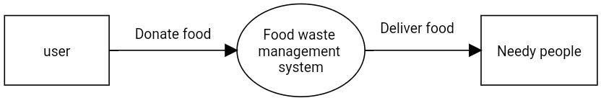
Developing a description of the system using the structured analysis follows a top-down process. A full description f a system actually consists of a set of DFD’s, which comprises of various levels. A level 0 DFD, also called as context model, represents the entire software element as single bubble with input and output data indicated by incoming and outgoing arrows. Each of the process represented at level 1 are sub functions of the overall system depicted in the context model.
DFD Symbols:
1.
2.
A square defines a source or destination of system date.
An arrow identifies data flow-data motion. It is a pipeline through which information flows.
A circle represents a process that transforms incoming data flows in to outgoing data flows.
An open rectangle is a data store-data at rest or a temporary repository of data.
3.
4.
DFD describes what flow (logical) rather than how they are processed. So it is not dependent on hardware, software, data structure of file organization.
Data flow diagram:
Level :0

Slide 28
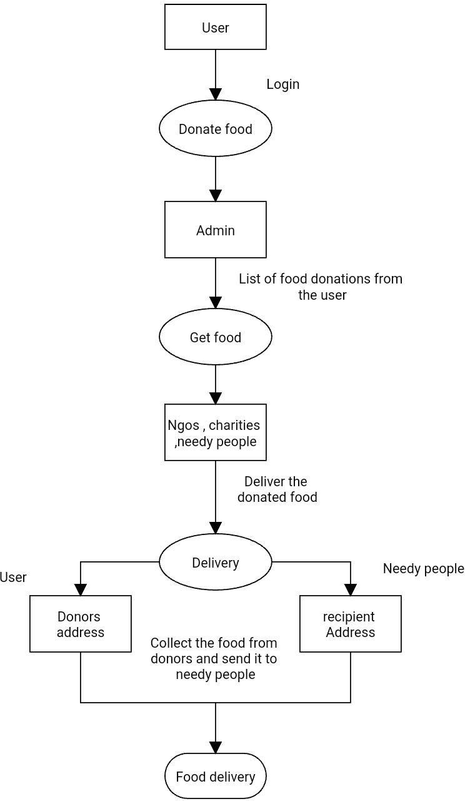
Level :1
Level:2

Slide 29
6.4. TABLE DESCRIPTION
Admin Table:
FIELD NAME | TYPE
NAME | VARCHAR [20]
AID | VARCHAR [20]
PASSWORD | TEXT
EMAIL | VARCHAR[60]
LOCATION | TEXT
ADDRESS | TEXT
User Table:
FIELD NAME | TYPE
ID | VARCHAR [20]
NAME | VARCHAR [20]
EMAIL | VARCHAR[60]
PASSWORD | TEXT
GENDER | VARCHAR [20]

Slide 30
Food Donate Details Table:
FIELD NAME | TYPE
FID | INTEGER [4]
NAME | VARCHAR [10]
EMAIL | VARCHAR [60]
TYPE | VARCHAR [10]
FOOD | VARCHAR[20]
CATEGORY | VARCHAR[20]
QUANTITY | VARCHAR[20]
DATE | DATETIME
ADDRESS | TEXT
LOCATION | VARCHAR[20]
PHONENO | VARCHAR[30]
ASSIGNED_TO | INT
DELIVERY_BY | INT

Slide 31
DELIVERY PERSON Table:
FIELD NAME | TYPE
DID | INT
NAME | VARCHAR [20]
EMAIL | VARCHAR [60]
PASSWORD | TEXT
CITY | VARCHAR [30]
User Feedback Table:
FIELD NAME | TYPE
ID | INT
NAME | VARCHAR [20]
EMAIL | VARCHAR [60]
MESSAGE | TEXT

Slide 32
7. SYSTEM TESTING
UNIT TESTING:
It is one of the very important methods in testing. Without this testing the project will not be completed or anybody cannot say it is bug’ free software’s in using the real time all these tests must be done. On using the lower bound and upper bound must be very specific. The check will be done for the starting record and ending record. So, all the errors will be rectified.
When conditional loops are used if it is true the correct data in project and for false answer wrong data will be seen. If any error has occurred they have to be replaced and checked. So, the line of code will be reduced.
To see an efficient project for how many lines of code has written and how many errors have been occurred will be seen.
TEST DATA:
The data, which is using for the testing must be related to the project to and to that particular function. Otherwise the testing will be very problematic. The function will not coincide with the data. So that it will be considered as error has occurred in it but actually it is not so here there are two data typed will there.
Sampled data for project testing
Actual data for project testing
SAMPLE DATA FOR PROJECT TESTING:
This sample data will be much more similar to the data which is collected in analysis phase only. On studying the collected data by the questioning, preliminary investigation, and documentation, the sample data usage the imagination is necessary. Depending on it choose the sample data. Use this data the white box testing for database or for external testing and black box testing for the internal loops and conditions.

Slide 33
All this data will be inserted into the database through browsers only for two or three days. It will be give as for practice to the end user. When they are interacting with data, the errors will remove and checked. Most of errors will be removed by using sample data only.
ACTUAL DATA USED FOR PROJECT TESTING:
This actual data is nothing but the original data, which have been collected in the analysis phase. Through the preliminary investigation, documents interviews. After collecting the data it will be sorted in an order and then it will be sorted in some place. Now to making the testing of the project this actual data will be used.
Here for the two test methods the data will be considered and each function and modules will be checked. Here using the actual data it is given to end users to make trail on the project. So, they can acquire the real environment. On working like this if any errors are occurred they will be removed and corrected. This actual data will be used for each function correctly and it will be removed. Here the occurrences are written and depending upon the occurrences the data will be supplied to the each function.
INTEGRATION TESTING:
Integration testing is a systematic technique for constructing the program structure while at the same time conducting tests to uncover errors associated with interfacing. The objective is to take unit-tested modules and build a program structure that has been directed by design. Top-Down integration and Bottom-up integration are tested finally.
Here there are two testing methods are there. They are white box testing and black box testing. Now here there is small introduction about the testing methods.
WHITE BOX TESTING:
This is one of the testing methods. This will be tested at the outside environment, which means accessing the server. i.e. Accessing data from the database. This will check whether data is retrieved correctly or not will be seen.
The main error in white box testing will be occurred due to the database connectivity. Here MS ACCESS is used as backend database. Here for the project some tables are created. In the programs they have to be clearly specified.

Slide 34
Whenever inserting data, updating data and selecting data from the database the queries must be written carefully. The separation between the string and numeric must be shown. The client side validations will be written in Visual Basic so that the data entered data is numbered or string will be known. Sometimes to access data from the database, the server may not be in running position.
So the database engine must be always on. This has to be monitored properly.
In this method only whether the server is on or not will be tested.
So this method is very important when handling with the database here the ODBC drivers must support all the requirements.
BLACK BOX TESTING:
This is another important test method will check only internal code loops, conditional loops will be checked. In the code if he is a particular user then only the user will get some privileges. So here comparison testing has been done. If there is any error has occurred an error message will be raised.
This method will check the loops like for loops for. Loops, repeat… while…all will be checked at their boundary conditions also. If the data at extreme conditions are correctly retrieved, there will be no error. If any error has occurred using some modification in code. The data can be retrieved at boundary conditions also. Here in the code while rs. EOF like this the code will be written so at the extreme conditions the error will be recovered. To do all these tests some data will be used it will be checked. So, the errors will be removed very easily.

Slide 35
8. SYSTEM IMPLEMENTATION
After proper testing and validation, the question arises whether the system can be implemented or not. Implementation includes all those activities that take place to implement the system.
The new system may be totally new or modification of the old one, in either case, proper implementation is essential to provide system to meet organization requirements.
A well-designed system, if not operated and used properly could fail. Training the users,
agent to administrate the system is important, as if not done well it could prevent the successful implementation of this information system.
Throughout the system development life cycle the user has been involved.
The system operators need training, during their training, they need to be given a trouble-shooting list that identifies possible problems and identifies remedies for the problem.
They should be advised of the common malfunctions that may arise and how to
solve them.
The training should cover:
Familiarization with the processing system itself (that is the equipment used for data entry or processing).
Training in using the application i.e., the software.
Good documentation is essential, but this cannot replace training. There are 3 types of implementation:
Implementation of a computer system to replace a manual system. The problems encountered are converting files, training users, creating accurate files and verifying printouts for integrity.
Implementation of a new computer system to replace an existing one. This is
usually a difficult conversion. If not properly planned, there can be many problems. Some large computer systems may take as long as a year to convert.
Implementation of a modified application to replace an existing one using the same computer. This type of conversion is relatively easy to handle, provided there are no major changes in the files.
This project deals with the first type of implementation, to replace manual system.

Slide 36
Validation:
Validation reports to the process of using software in a live environment in order to find errors. During the course of validating the software will be changed. Continued use may produce additional failure and the need for still more changes.
Validation typically invokes planning and execution of test cases. Validation is concerned with accessing the quality of software system in its actual operating environment. Thus validation is the process of evaluating software at the end of the software development process to determine compliance with the requirement.
Debugging:
Debugging is the process of isolating and correcting the cause of known errors. Success at debugging requires highly developed problem solving skills. Commonly used debugging methods include induction, deduction and back tracking.
IMPLEMENTATION PLAN
Implementation is the state in the system where the theoretical design is turned into a working system. The most crucial stage in achieving a new successful system and in giving confidence on the new system for the users that will work efficiently and effectively. The system can be implemented only after thorough testing in done and if found to work according to the specification.
It involves careful planning, investigation of the current system and its constraints on implementation, design of methods to achieve the changeover, an evaluation of changeover methods apart from planning. Two major tasks of preparing the implementation are education, training of the users and testing the systems. System analysis and design efforts will be more for complex systems beings implemented. Based on policies of individuals organization an implementation coordinating committee has been appointed.

Slide 37
IMPLEMENTATION PROCESS
The implementation process begins with preparing a plain for the implementation system. According to this plan, the other activities are to be carried out. In this plan, discussion has been made regarding the equipment, resources and how to test the activities. Thus a clear plan is preparing for the activities.
In User Manuals once planning has been completed the major effort of the computer department is to ensure that the user department consists of education and trained
staff, as the system becomes more complex. The success of a system depends upon how they are operated and used. Thus the quality of training, the personnel is connected to the success of the system.
For this purpose system and user manuals are prepared. In system manuals, details about the forms and blocks triggers. Which were used to develop them user.

Slide 38
9. APPENDIX
9.1. SAMPLE CODE
Home.html
<!DOCTYPE html>
<html lang="en">
<head>
<meta charset="UTF-8">
<meta http-equiv="X-UA-Compatible" content="IE=edge">
<meta name="viewport" content="width=device-width, initial-scale=1.0">
<title>Document</title>
<link rel="stylesheet" href="home.css">
<link rel="stylesheet" href="https://cdnjs.cloudflare.com/ajax/libs/font- awesome/4.7.0/css/font-awesome.min.css">
</head>
<body>
<header>
<div class="logo">Food <b style="color: #06C167;">Donate</b></div>
<div class="hamburger">
<div class="line"></div>
<div class="line"></div>
<div class="line"></div>
</div>
<nav class="nav-bar">
<ul>
<li><a href="#home" class="active">Home</a></li>
<li><a href="about.html" >About</a></li>
<li><a href="contact.html" >Contact</a></li>
<li><a href="profile.html" >Profile</a></li>
</ul>
</nav>
</header>

Slide 39
<script>
hamburger=document.querySelector(".hamburger"); hamburger.onclick =function(){
navBar=document.querySelector(".nav-bar");
navBar.classList.toggle("active");
}
</script>
<section class="banner">
<a href="fooddonate.html">Dontae Food</a>
</section>
<div class="content">
<!-- <h2>Love Food</h2>
<h3>Hate Wasting</h3> -->
<p style="font-size: 23px;">
“Cutting food waste is a delicious way of saving money, helping to feed the world and protect the planet.”
</p>
</div>
<div class="photo">
<br>
<p class="heading">Our Works</p>
<br>
<p style="font-size: 28px; text-
align: center;">"Look what we can do together."</p>
<br>
<div class="wrapper">
<div class="box"><img src="img/p1.jpeg" alt=""></div>
<div class="box"><img src="img/p4.jpeg" alt=""></div>
<div class="box"><img src="img/p3.jpeg" alt=""></div>
</div>
</div>
<div class="deli" style="display: grid;" >
<p class="heading">DOOR PICKUP</p>
<br>

Slide 40
<p class="para">
"Your donoate will be immediately collected and sent to needy people "</p>
<img src="img/delivery.gif" alt="" style="margin-left:auto; margin-right: auto;">
</div>
<div class="ser">
<p class="heading">Our Services</p>
</div>
<footer class="footer">
<div class="footer-left col-md-4 col-sm-6">
<p class="about">
<span> About us</span>The basic concept of this project Food Waste Manageme nt is to collect the excess/leftover food from donors such as hotels, restaurants, marriage halls , etc and distribute to the needy people .
</p>
</div>
<div class="footer-center col-md-4 col-sm-6">
<div>
<p><span> Contact</span> </p>
</div>
<div>
<p> (+00) 0000 000 000</p>
</div>
<div>
<p><a href="#"> Fooddonate@gmail.com</a></p>
</div>
<div class="sociallist">
<ul class="social">
<li><a href="#"><img src="https://i.ibb.co/x7P24fL/facebook.png"></a></li>
<li><a href="#"><img src="https://i.ibb.co/Wnxq2Nq/twitter.png"></a></li>
<li><a href="#"><img src="https://i.ibb.co/ySwtH4B/instagram.png"></a></li>
</ul>
</div>
</div>
<div class="footer-right col-md-4 col-sm-6">

Slide 41
<h2> Food<span> Donate</span></h2>
<p class="menu">
<a href="#"> Home</a> |
<a href="#"> About</a> |
<a href="#"> Services</a> |
<a href="#"> Contact</a>
</p>
<p class="name"> Food Donate &copy; 2023</p>
</div>
</footer>
</body>
</html>
Signin.php
<?php session_start();
$connection = mysqli_connect("localhost:3307", "root", "");
$db = mysqli_select_db($connection, 'demo');
$msg=0;
if (isset($_POST['sign'])) {
$email =mysqli_real_escape_string($connection, $_POST['email']);
$password =mysqli_real_escape_string($connection, $_POST['password']);
$sql = "select * from login where email='$email'";
$result = mysqli_query($connection, $sql);
$num = mysqli_num_rows($result); if ($num == 1) {
while ($row = mysqli_fetch_assoc($result)) {
if (password_verify($password, $row['password'])) {
$_SESSION['email'] = $email;
$_SESSION['name'] = $row['name'];
$_SESSION['gender'] = $row['gender']; header("location:home.html");
} else {
$msg = 1;

Slide 42
}
}
} else {
echo "<h1><center>Account does not exists </center></h1>";
}
}
?>
<!DOCTYPE html>
<html lang="en">
<head>
<meta charset="UTF-8">
<meta http-equiv="X-UA-Compatible" content="IE=edge">
<meta name="viewport" content="width=device-width, initial-scale=1.0">
<title>Document</title>
<link rel="stylesheet" href="loginstyle.css">
<link rel="stylesheet" href="path/to/font-awesome/css/font-awesome.min.css">
</head>
<body>
<style>
.uil {
top: 42%;
}
</style>
<div class="container">
<div class="regform">
<form action=" " method="post">
<p class="logo" >Food <b style="color:#06C167; ">Donate</b></p>
<p id="heading" > Welcome back ! </p>
<div class="input">
<input type="email" placeholder="Email address" name="email" value="" required />
</div>
<div class="password">
<input type="password" placeholder="Password" name="password" required />

Slide 43
<i class="uil uil-eye-slash showHidePw"></i>
<?php if($msg==1){
echo ' <i class="bx bx-error-circle error-icon"></i>'; echo '<p class="error">Password don\'t match.</p>';
}
?>
</div>
<div class="btn">
<button type="submit" name="sign"> Sign in</button>
</div>
<div class="signin-up">
<p id="signin-up">Don't have an account? <a href="signup.php">Register</a></p>
</div>
</form>
</div>
</div>
<script src="login.js"></script>
</body>
</html>
Signup.php
<?php
$connection=mysqli_connect("localhost:3307","root","");
$db=mysqli_select_db($connection,'demo'); if(isset($_POST['sign']))
{
$username=$_POST['name'];
$email=$_POST['email'];
$password=$_POST['password'];
$gender=$_POST['gender'];
$pass=password_hash($password,PASSWORD_DEFAULT);
$sql="select * from login where email='$email'" ;
$result= mysqli_query($connection, $sql);

Slide 44
$num=mysqli_num_rows($result); if($num==1){
echo "<h1><center>Account already exists</center></h1>";
}
else{
$query="insert into login(name,email,password,gender) values('$username','$email','$pass','$gender')";
$query_run= mysqli_query($connection, $query); if($query_run)
{
header("location:signin.php");
}
else{
echo '<script type="text/javascript">alert("data not saved")</script>';
}
}
}
?>
<DOCTYPE html>
<html lang="en">
<head>
<meta charset="UTF-8">
<meta http-equiv="X-UA-Compatible" content="IE=edge">
<meta name="viewport" content="width=device-width, initial-scale=1.0">
<title>Login</title>
<link rel="stylesheet" href="loginstyle.css">
<link rel="stylesheet" href="https://unicons.iconscout.com/release/v4.0.0/css/line.css">
</head>
<body>
<div class="container">
<div class="regform">
<form action=" " method="post">
<p class="logo">Food <b style="color: #06C167;">Donate</b></p>

Slide 45
<p id="heading">Create your account</p>
<div class="input">
<label class="textlabel" for="name">User name</label><br>
<input type="text" id="name" name="name" required/>
</div>
<div class="input">
<label class="textlabel" for="email">Email</label>
<input type="email" id="email" name="email" required/>
</div>
<label class="textlabel" for="password">Password</label>
<div class="password">
<input type="password" name="password" id="password" required/>
<i class="uil uil-eye-slash showHidePw" id="showpassword"></i>
</div>
<div class="radio">
<input type="radio" name="gender" id="male" value="male" required/>
<label for="male" >Male</label>
<input type="radio" name="gender" id="female" value="female">
<label for="female" >Female</label>
</div>
<div class="btn">
<button type="submit" name="sign">Continue</button>
</div>
<div class="signin-up">
<p >Already have an account? <a href="signin.php"> Sign in</a></p>
</div>
</form>
</div>
</div>
<script src="login.js"></script>
</body>
</html>

Slide 46
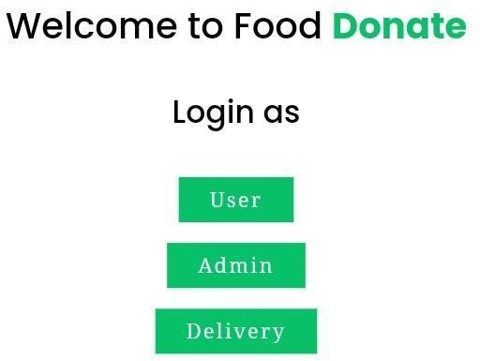
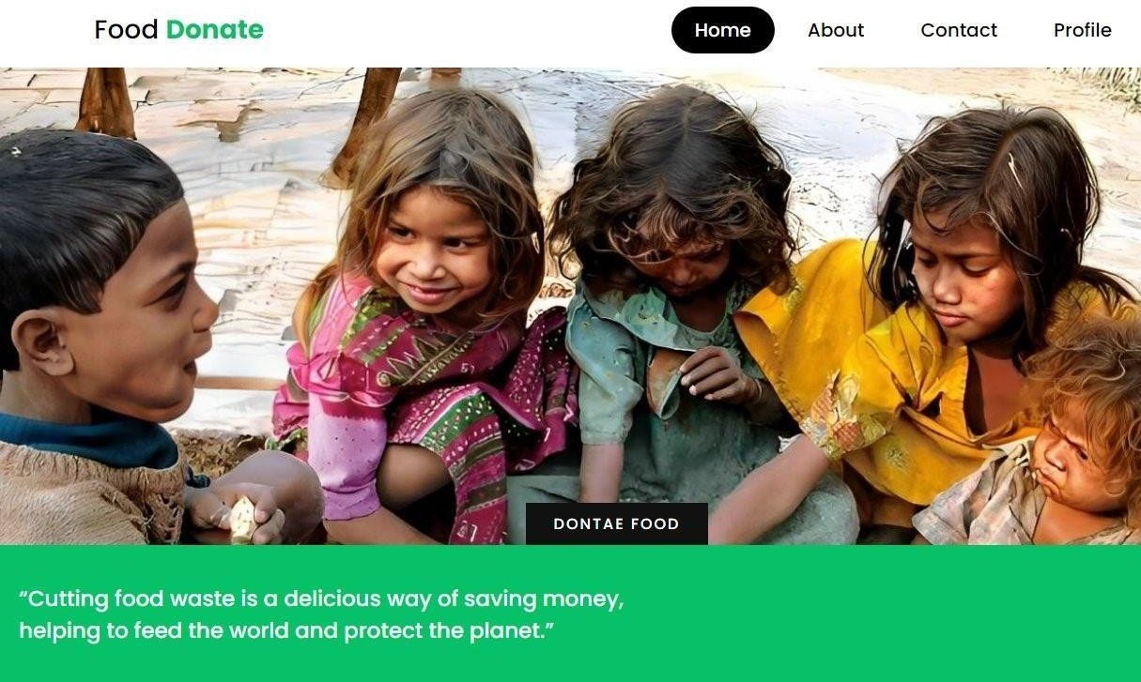
9.2. SCREEN SHOTS
Home :

Slide 47
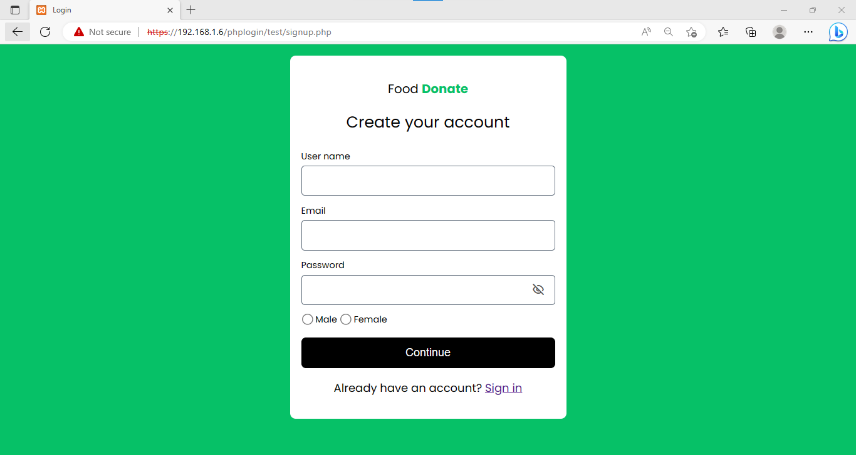
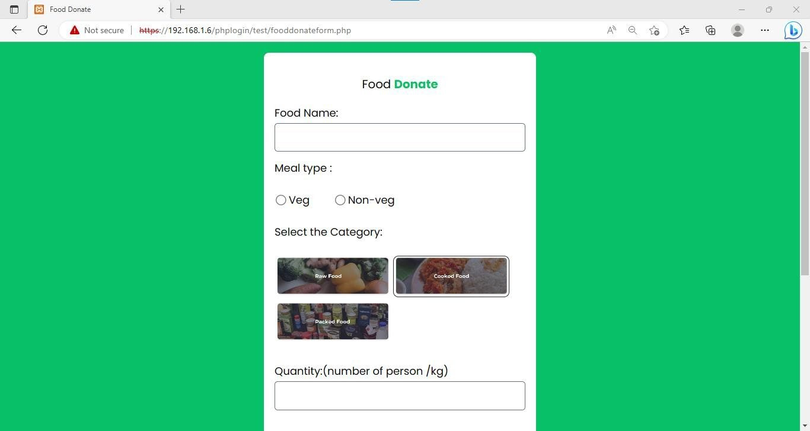
User Login:
Food donate Form :

Slide 48
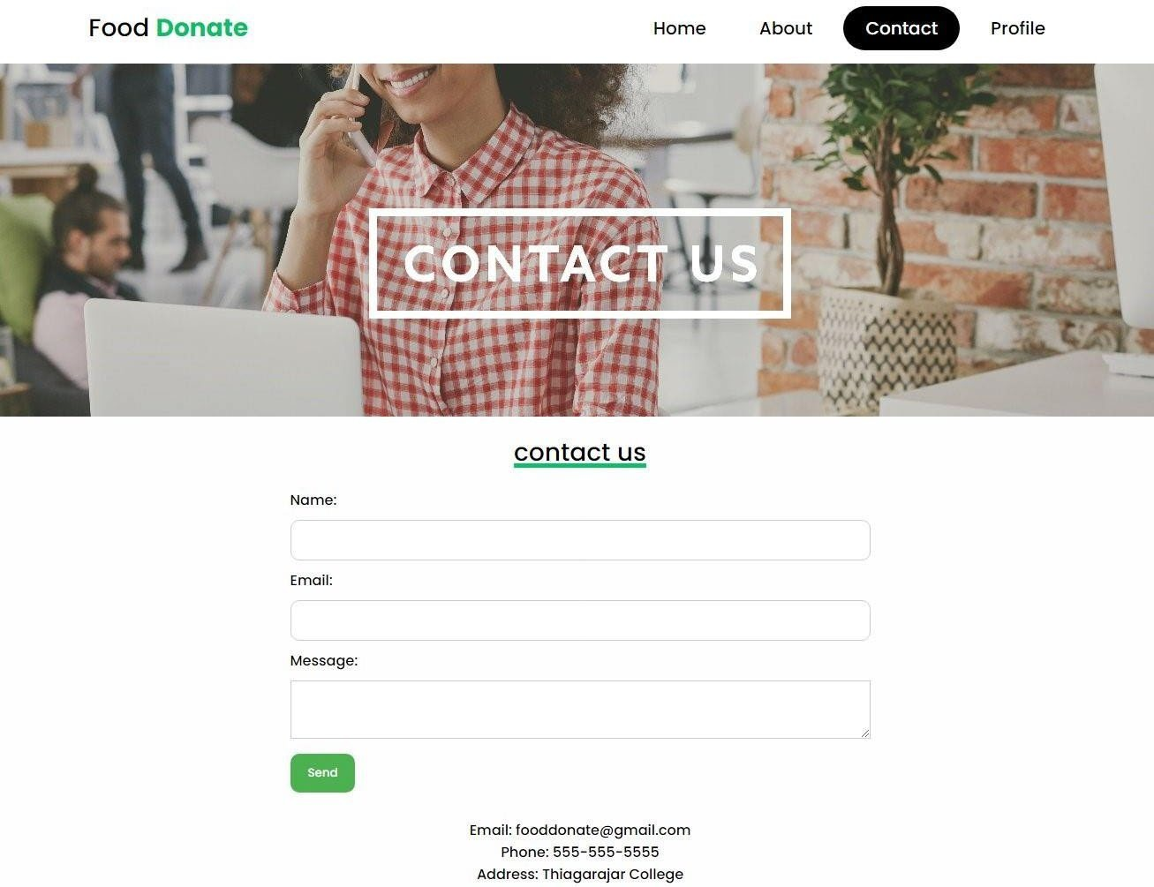
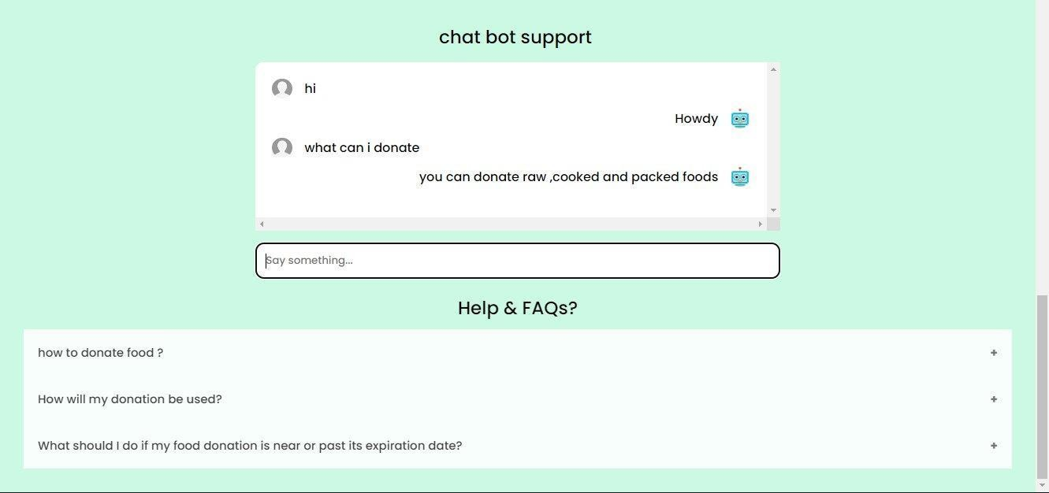
Contact :

Slide 49
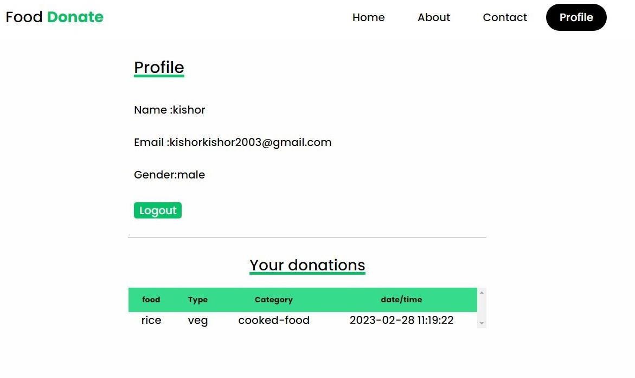
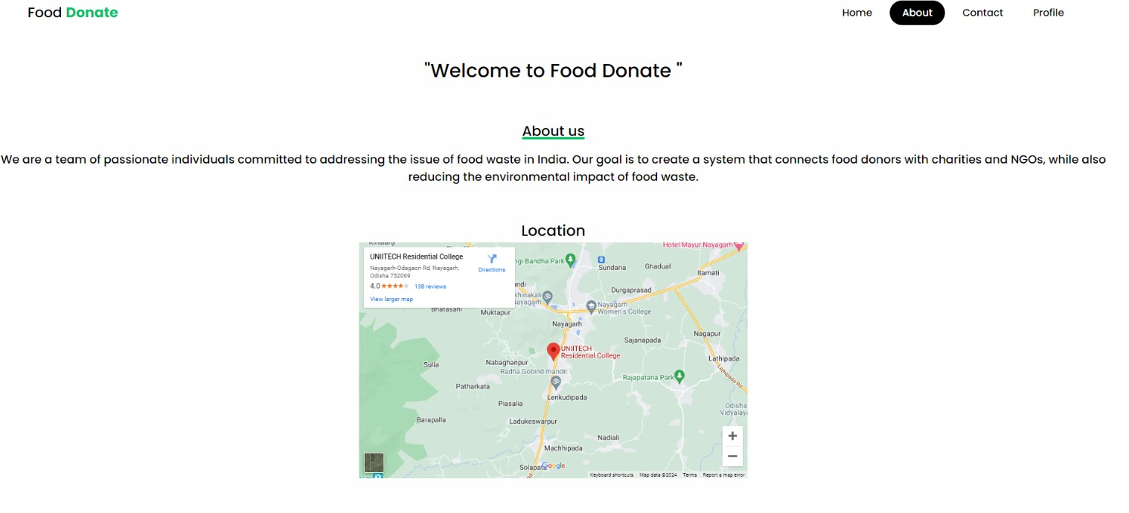
Profile:
About page :

Slide 50
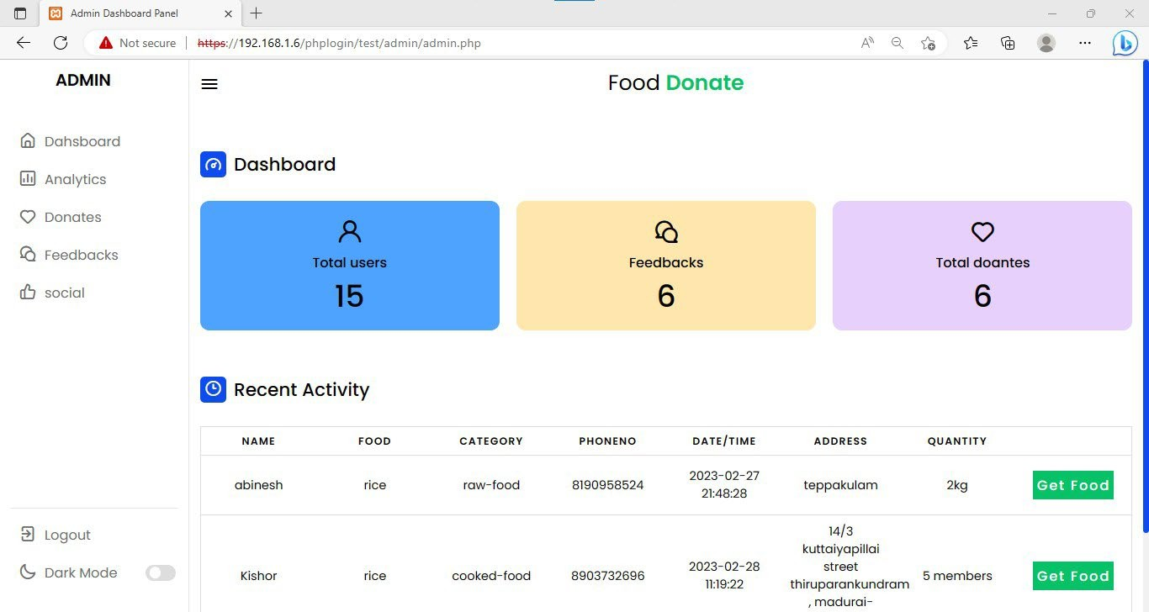
Admin Dashboard :

Slide 51
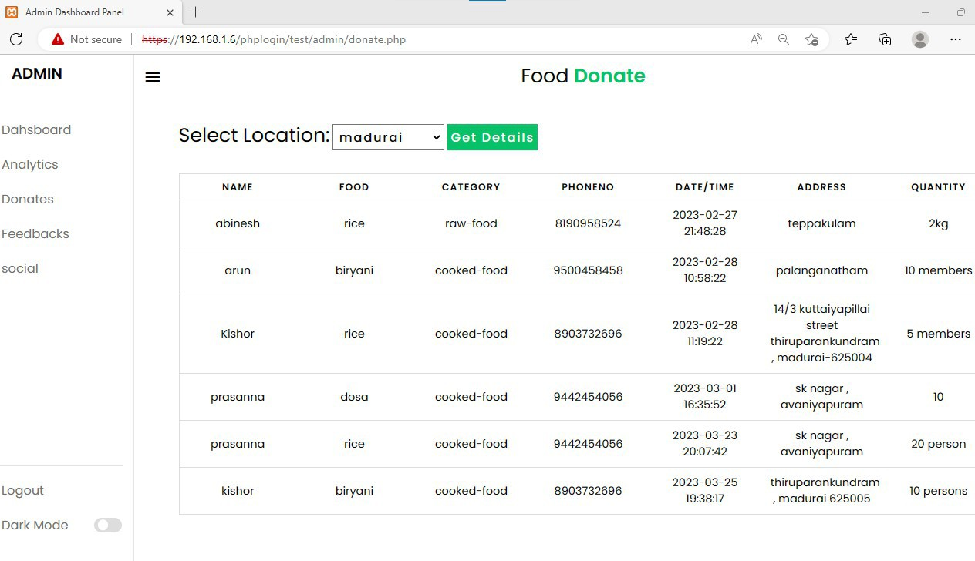
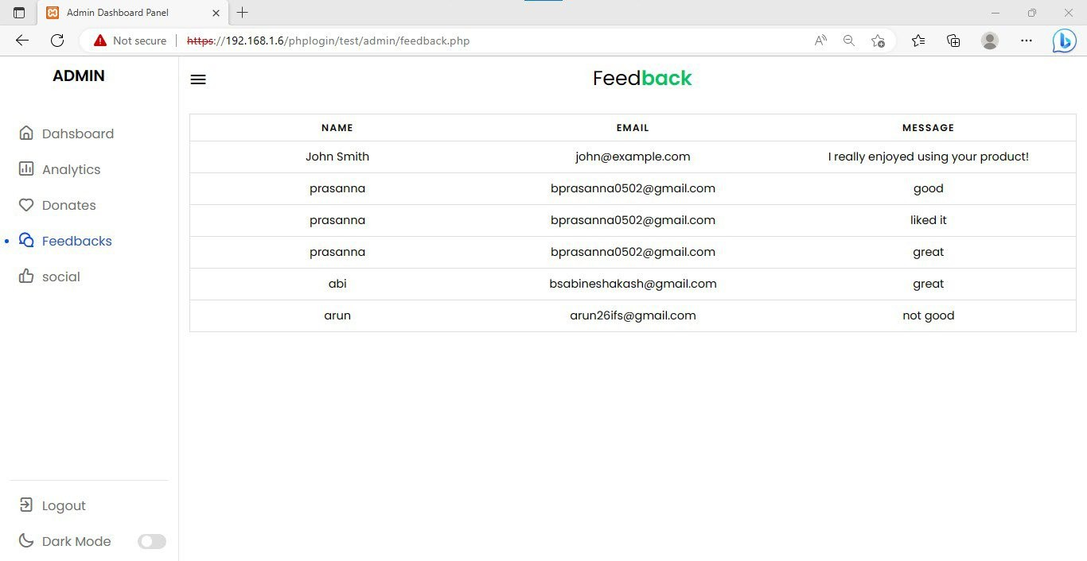
Donated food details :
Feedback details:

Slide 52
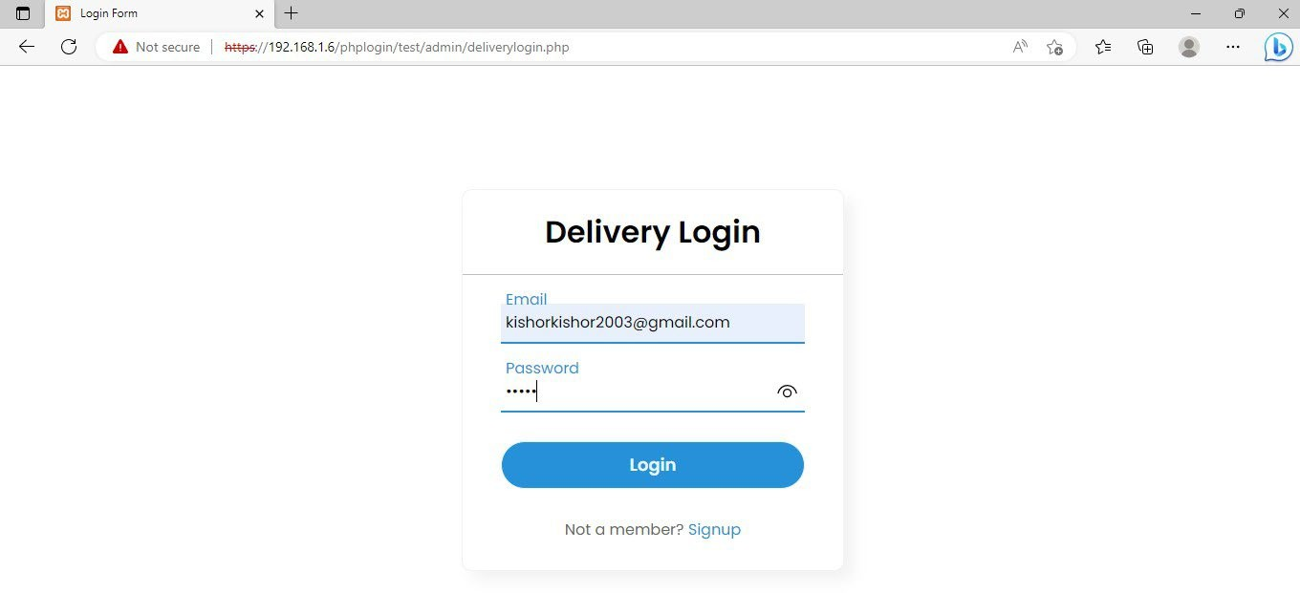
Delivery person Login:

Slide 53
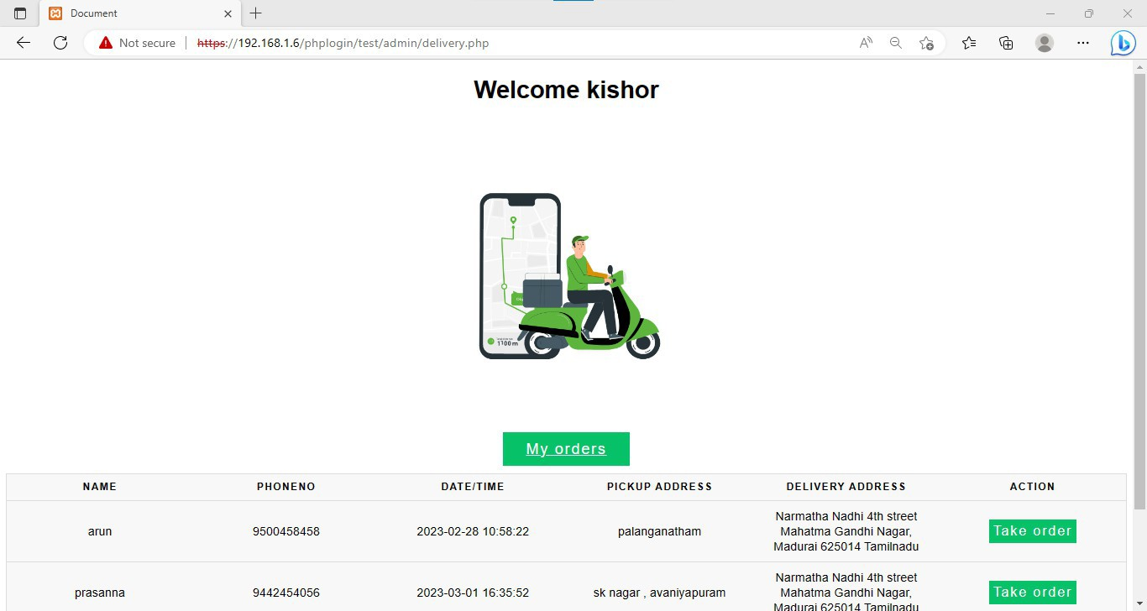
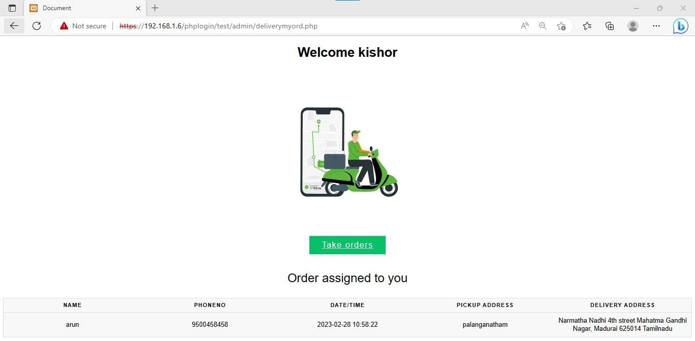
Take order:
View orders:

Slide 54
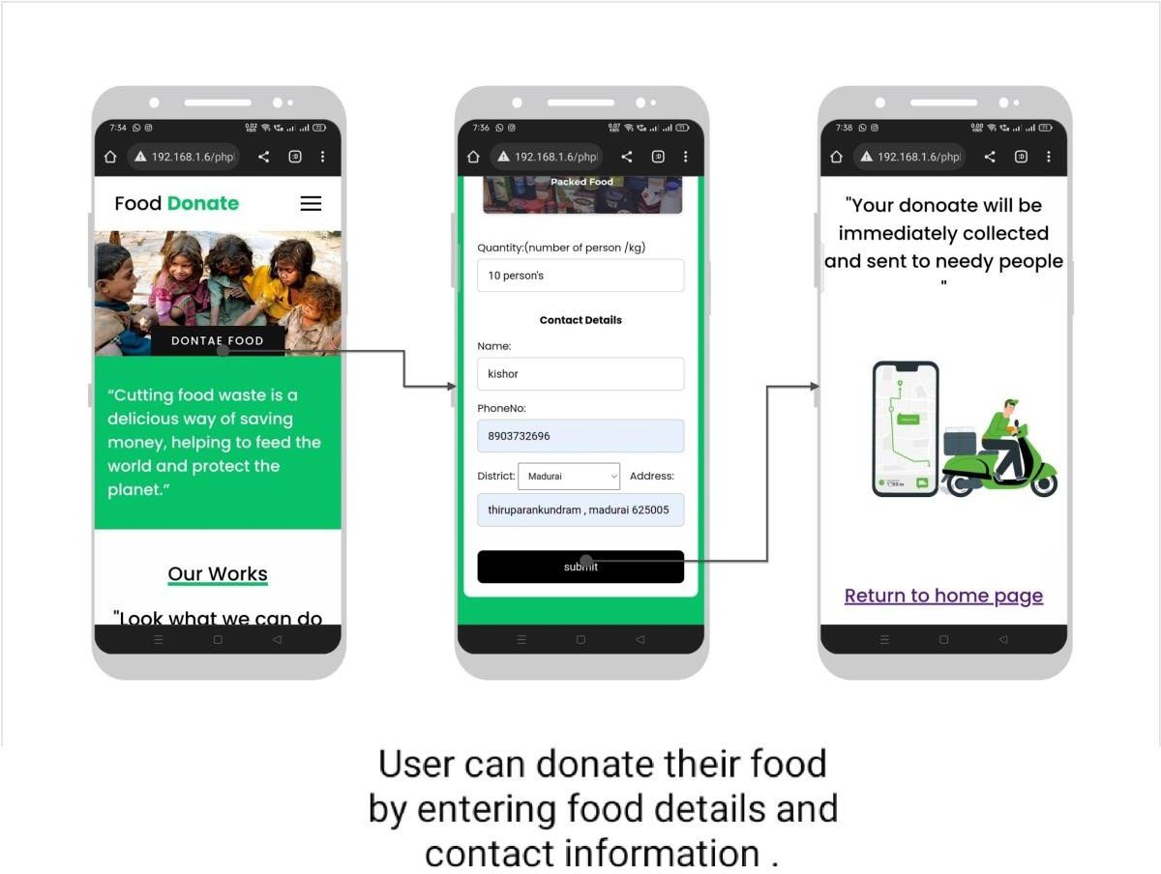
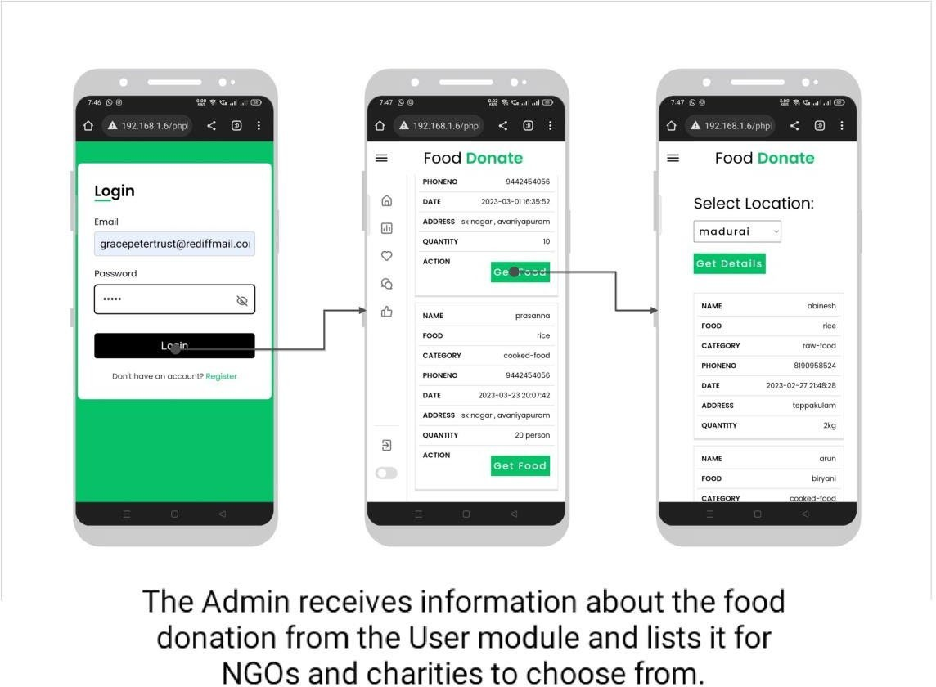
Mobile Screenshots:
User :
Admin :

Slide 55
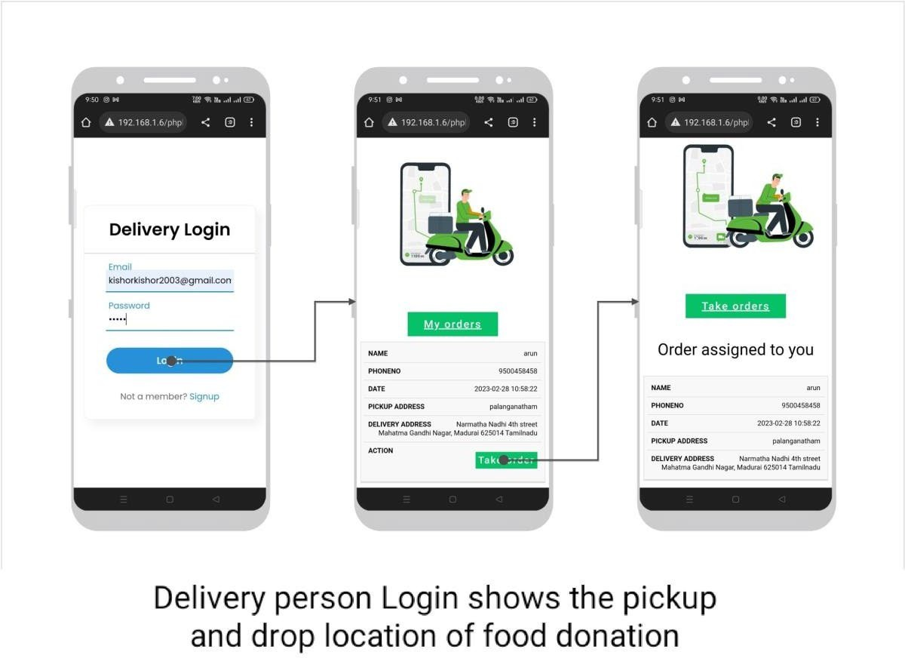
Delivery:

Slide 56
10. CONCLUSION
In today's world, food waste is a critical issue that not only affects the environment but also has serious social implications. Food wastage is a burden on society, particularly when there are millions of people who struggle with hunger and malnutrition. In our project, we are targeting the person who wants to donate excess food. This will create a greater impact on the cost saving as well as the food wastage management system, and there will be greater impact on the day by day food wastage. This system benefits the community by reducing food waste and helping those in need.

Slide 57
11. FUTURE ENHANCEMENT
Any software that is developed cannot be said to be perfect since computer science is a very dynamic field. Therefore, changes are unavoidable. Nothing can be said to be perfect at this age and time where every day scientific miracles take place.
As the requirements grow, solutions have to be found to meet all those new
requirements .Our project has been developed in such a way that it can be easily extended to meet new requirements.
Future enhancements that can be done with the system are,
The system can be integrated with an automated messaging or emailing system to provide users with real-time updates on the status at various stages of the donation process via message or email. This would allow user to receive information about the status of food donations without having to visit the website.
The system can be integrated with a GPS-based tracking system that allows delivery persons to be located in real-time.
Expansion to other types of donations: In addition to food, the system can be
expanded to accept other types of donations, such as clothing, household items, or school supplies, to address other needs in the community. This can help create a more comprehensive and sustainable support system for those in need.

Slide 58
12. BIBLIOGRAPHY
Book reference:
"Learning Web Design: A Beginner's Guide to HTML, CSS, JavaScript, and Web Graphics" by Jennifer Niederst Robbins
"PHP and MySQL for Dynamic Web Sites: Visual QuickPro Guide" by Larry Ullman
Web reference:
https://www.w3schools.com/
https://www.theodinproject.com/
https://www.w3schools.com/php/php_mysql_intro.asp

