Slide 1
INSTANCE SEGMENTATION 2.0

Slide 2
Mask RCNN

Slide 3
Mask RCNN Components
Region proposal Network with Backbone = Resnet50 fpn

Slide 4
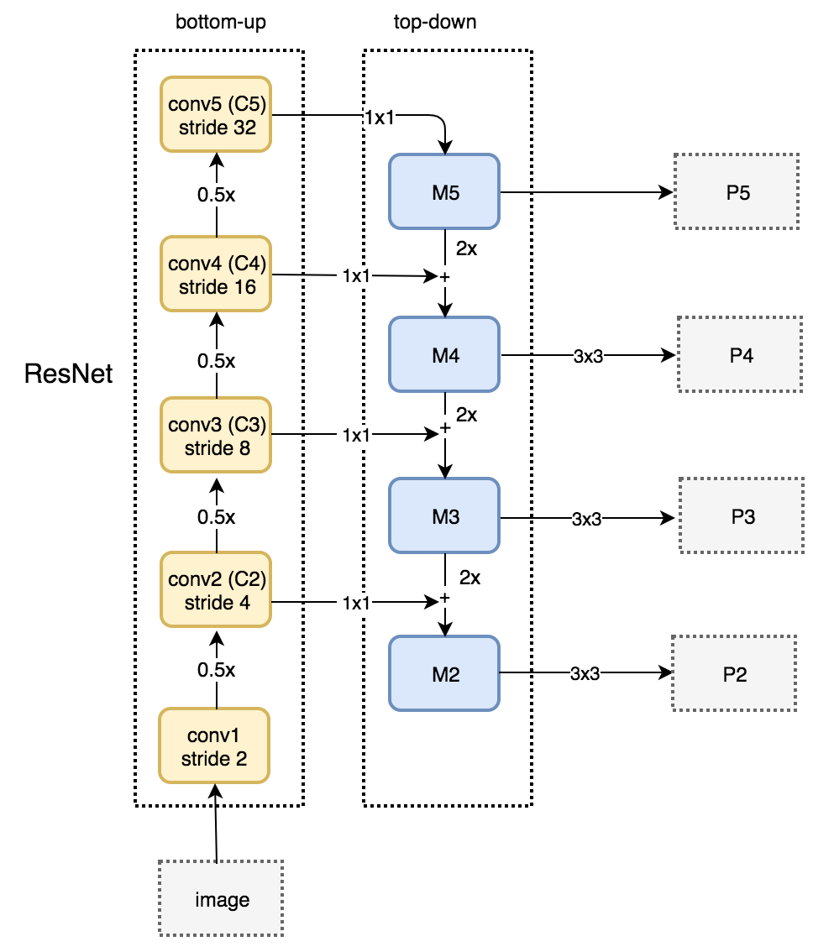
Backbone
Backbone = Resnet50 fpn
FPN can be constructed with any backbone with increasing depth (reducing spatial dimensions)
It fuses data from different resolution (~different semantic richness) with equal wieghts
FPN references
FPN arch explained Medium post
FPN review blog post
Reference

Slide 5
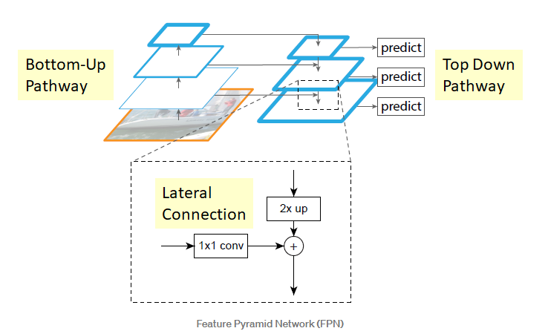
Backbone
Bottom-up pathway consists of decreasing resolution (normal conv feature extractor way)
Reference

Slide 6
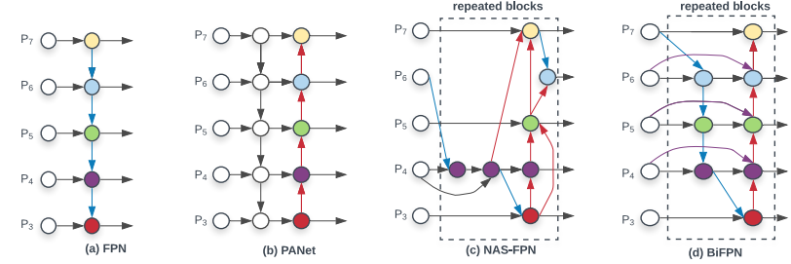
Backbone
Alternatively, you can choose importance to add each layer by introducing gating blocks – Bi FPN
Bi FPN introduced in EfficientDet paper
Reference

