Slide 1




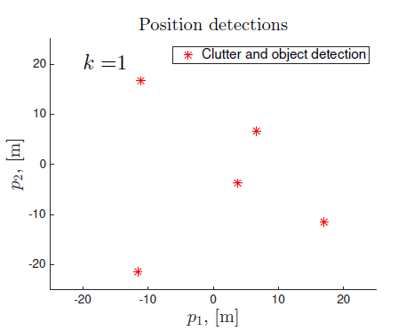
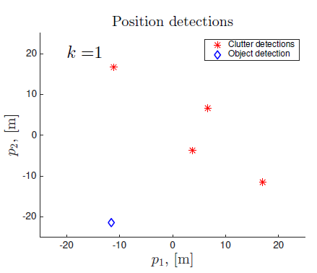
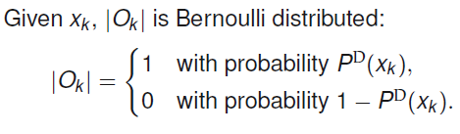


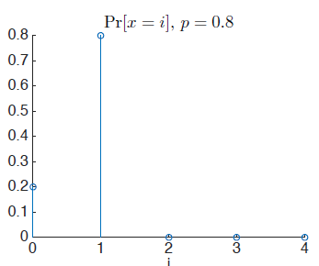
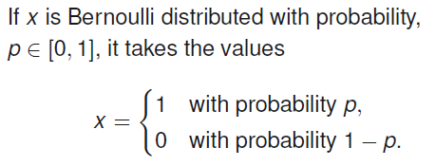
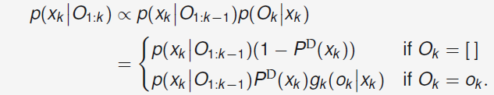
Single object Tracking in Clutter
Motion models
Special case of MOT
Assumption : at most 1 object in scene at all times
No need to find no of objects
No of DA hypo << MOT
Similar as in filtering
pi(k) indicates SOT context
Measurement models
Challenges
KF
SOT
Noisy measurements
Dynamic states
Missed detection
False detection
Unknown DA
Pd(x_k) used to model accuracy of detection
o_k stands for 1 of columns of total measurement O_k
o_k = [] if object’s undetected; measurement vector if detected
|O_k| stands for no. of columns in matrix O_k
P_d Captures prob of detection and gk captures distribution of detection
Given x_k , the set of vectors in Ok is a Bernoulli random finite set.
SOT with known DA
Bernoulli distribution
Recursively compute xk given O1:k. Objective :
Chapman-Kolmogorov equation for predict step:
Measurement model : (likelihood)
Update step : posterior α prior * likelihood
Normal update step when detected and no change when object is undetected
Expresses prob of success of 1 experiment
Defined by Pr[success] = p

Slide 2
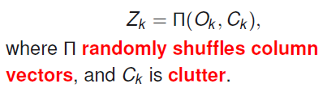
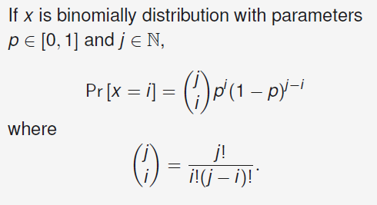
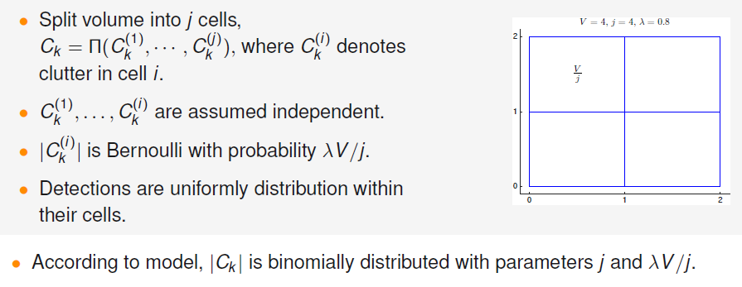
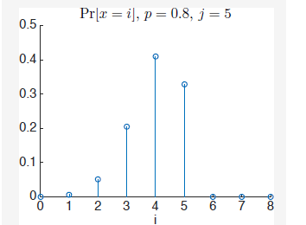
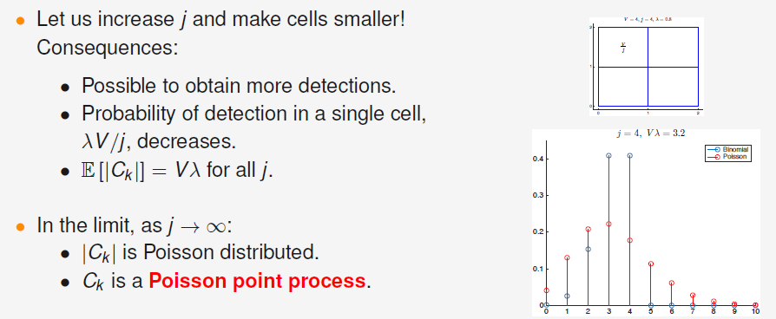
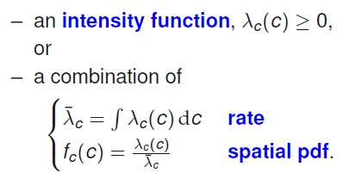
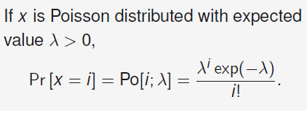
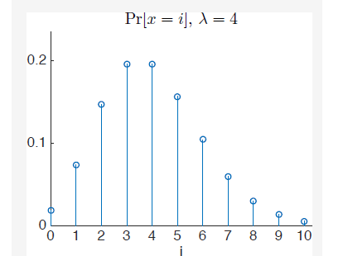
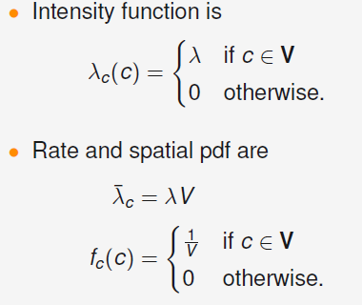
Binomial distribution
Modelling clutter
Expresses Pr[success] for independent trials each with Pr[success] = p
If Pr[x=4] = 0.4, you have 0.4 chance of succeeding in 4 out of j trials
Expected value is p*j
Clutter model (Ck) needed for a complete measurement model
Accounts for |Ck| and vectors in Ck
Assume sensor wit FOV of volume V, lambda expected number of clutter detections per unit volume
Sensor with limited resolution assumption
PPP
Default clutter model
mk_c = Po(lambda, V)
C_ki is uniform distributed within V
Parametrised by
lambda_c(c) – intensity fn (region wise how much clutter)
lambda_bar_c – total expected clutter and fc – spatial pdf (kinda normalized version of lambda_c
Poisson distribution
Sensor with unlimited resolution assumption
Parameterized by lambda
Exp. Value and variance are same
So one cant increase mean w/o increasing variance

Slide 3
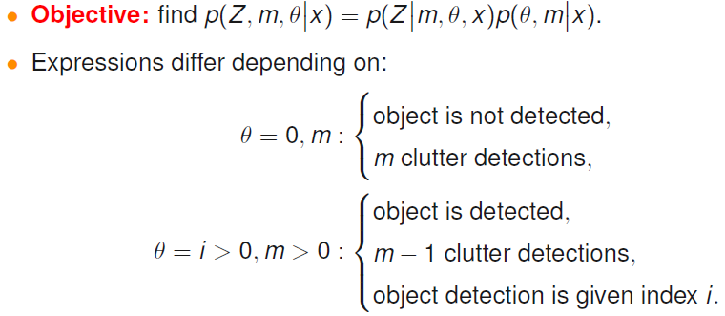
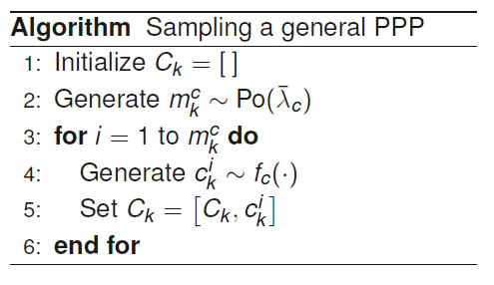
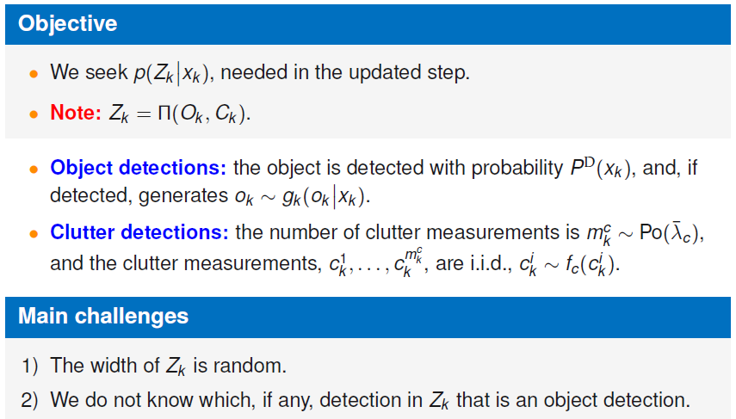
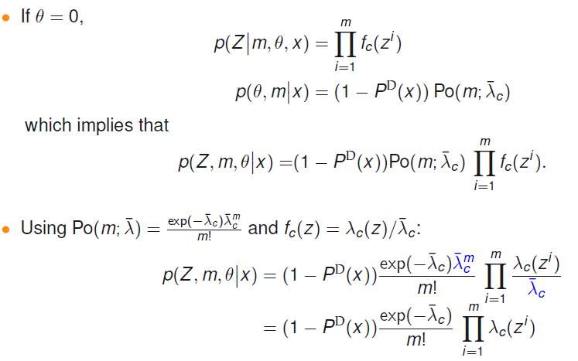
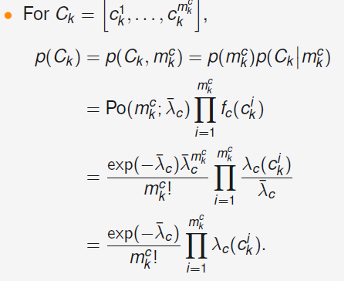
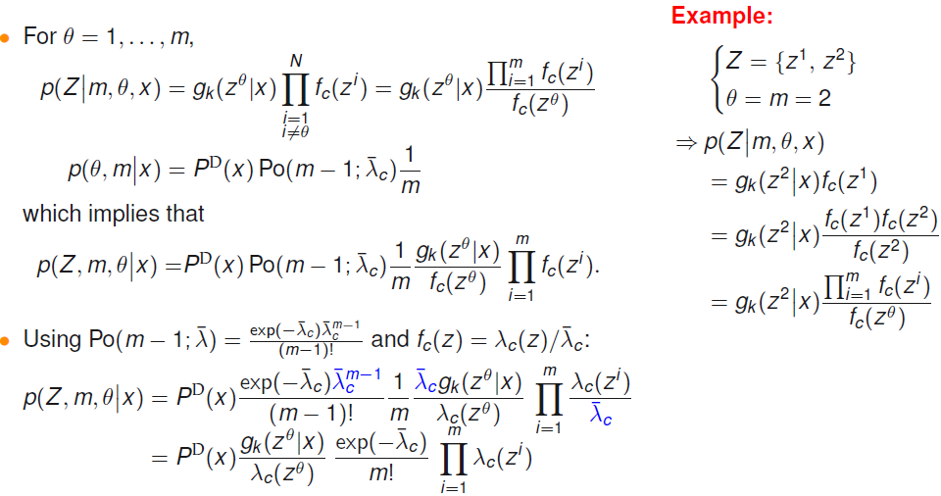
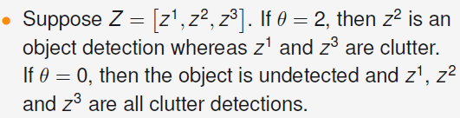
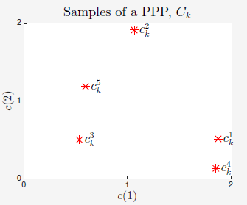
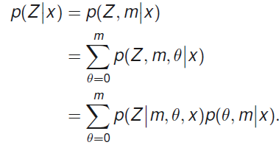
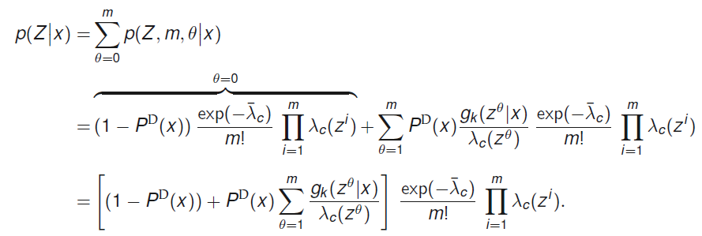
PPP continuation
Complete measurement model
We introduce 2 vars, theta and m
Theta = 0 if object is undetected, theta =i(i>0) means ith column is assumed to be object detection
m is no. of columns of Zk
By introducing theta and m and law of total probability, we decompose posterior density as product of two simpler distributions summed over all possible theta values

Slide 4
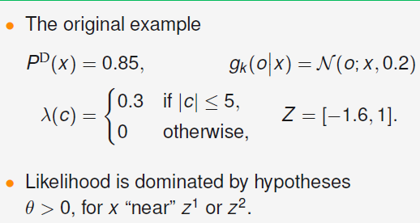
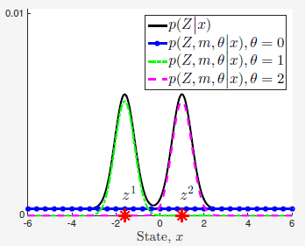
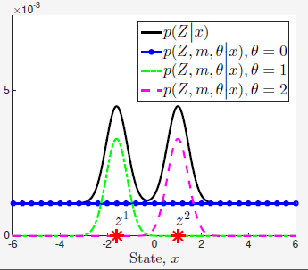
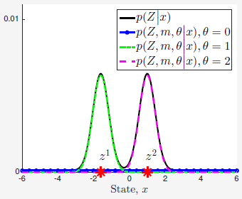
Pd = 0.85
There are two measurements, so theta can have 3 values from 0 to 2 (3 hypo in total)
As Pd value increases, area under the straight line decreases
Pd = 0.5
Pd = 0.95

