Slide 1
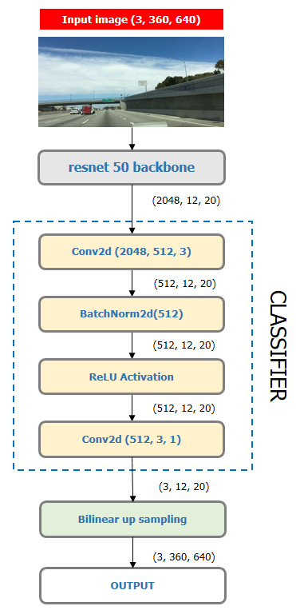

Slide 2
Input
(3, 360, 640)
Conv2d(3, 64, 3)
(64, 360, 640)
BatchNorm2d(64)
(64, 360, 640)
ReLU Activation
double_conv
(64, 360, 640)
Conv2d(3, 64, 3)
(64, 360, 640)
BatchNorm2d(64)
(64, 360, 640)
ReLU Activation

Slide 3
INPUT IMAGE
PREDICTION
(3, 360, 640)
(3, 360, 640)
double_conv(32, 3)
(32, 360, 640)
double_conv(3, 32)
double_conv(64, 32)
(32, 360, 640)
(64, 360, 640)
(32, 360, 640)
MaxPool2d
ConvTranspose2d(64, 32)
ENCODER
DECODER
(32, 180, 320)
(64, 180, 320)
double_conv(32, 64)
double_conv(128, 64)
(64, 180, 320)
(128, 180, 320)
(64, 180, 320)
MaxPool2d
ConvTranspose2d(128, 64)
(64, 90, 160)
(128, 90, 160)
Bottleneck : double_conv(64, 128)

Slide 4
Feature Map
(2048, 45, 80)
AdaptiveAvgpool2d (1)
(2048, 1, 1)
Conv2d(2048, 512, 3)
PYRAMID POOLING MODULE (bin=1)
(512, 1, 1)
BatchNorm2d(64)
(512, 1, 1)
ReLU Activation
(512, 1, 1)
Bilinear Up sampling
(512, 45, 80)
OUTPUT

Slide 5
PYRAMID POOLING MODULE
PPM (bin=1)
(512, 45, 80)
PPM (bin=2)
(512, 45, 80)
Feature Map
(2048, 45, 80)
(4096, 45, 80)
Conv2d(4096, 512, 3)
PPM (bin=3)
(512, 45, 80)
(512, 45, 80)
BatchNorm2d(512)
CLASSIFIER
PPM (bin=6)
(512, 45, 80)
(512, 45, 80)
ReLU Activation
(512, 45, 80)
Conv2d(512, 3, 3)
(3, 45, 80)
Bilinear Up sampling
(3, 360, 640)
Prediction

Slide 6
RESNET
BACKBONE
Layer 1
Layer2
AUXILIARY BRANCH
Layer 3
AUX CLASSIFIER HEAD
BILINEAR
UP SAMPLING
MAIN BRANCH PREDICTION
AUX
LOSS
* ALPHA
TOTAL LOSS
Layer4
PYRAMID POOLING
CLASSIFIER
HEAD 1
BILINEAR
UP SAMPLING
MAIN BRANCH PREDICTION
MAIN
LOSS
* (1 – ALPHA)
MAIN BRANCH

