Slide 1
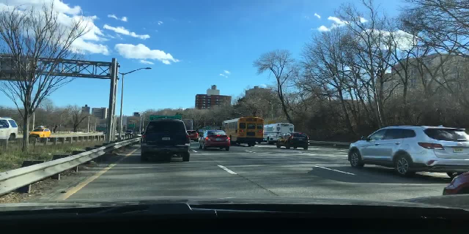
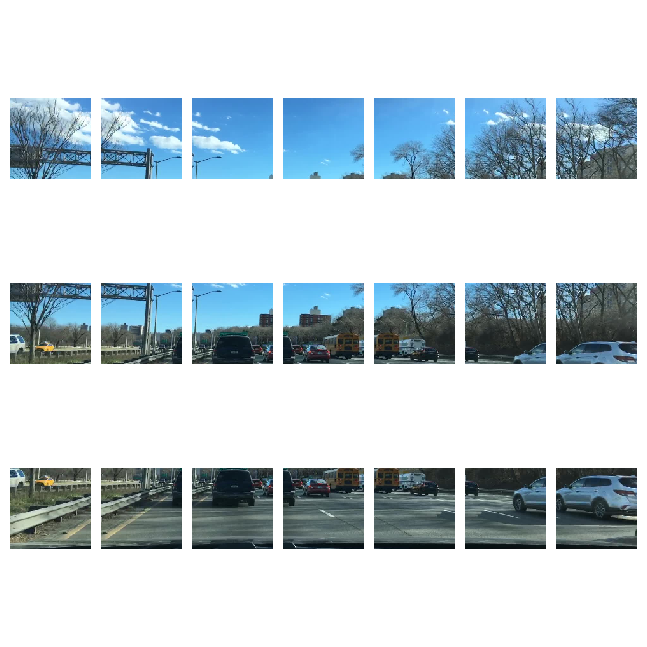
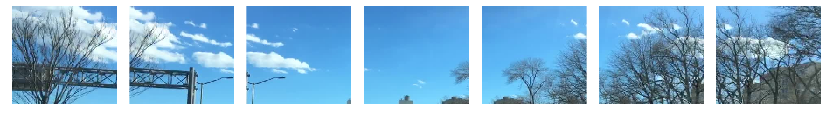
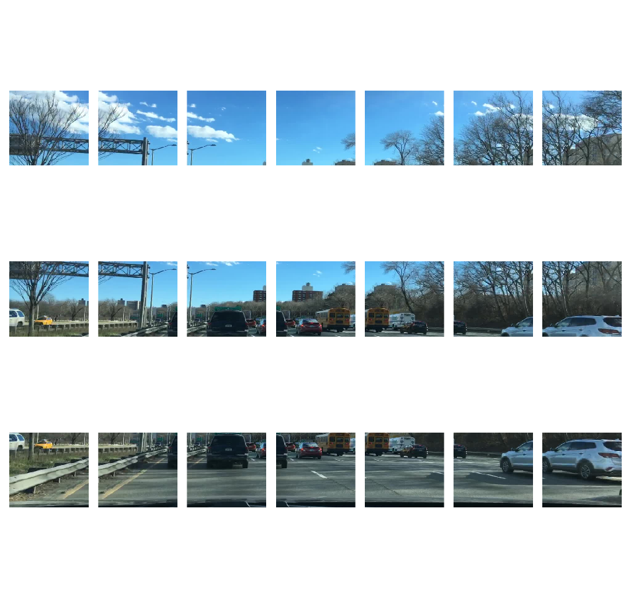
Original image
Overlapping patches
Conv2d()
rearrange()
Rearranged patches

Slide 2
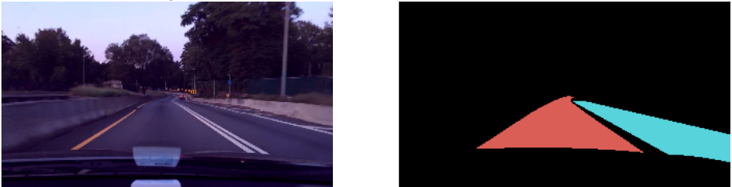
Classifier head
Input Image
Conv2d (2048, 512, 3)
Segmentation output
Resnet50 backbone
(512, 12, 20)
(2048, 12, 20)
BatchNorm2d (512)
(3, 12, 20)
(3, 360, 640)
(512, 12, 20)
Bilinear up sampling
ReLU Activation
(512, 12, 20)
Conv2d (512, 3, 1)

