Slide 1
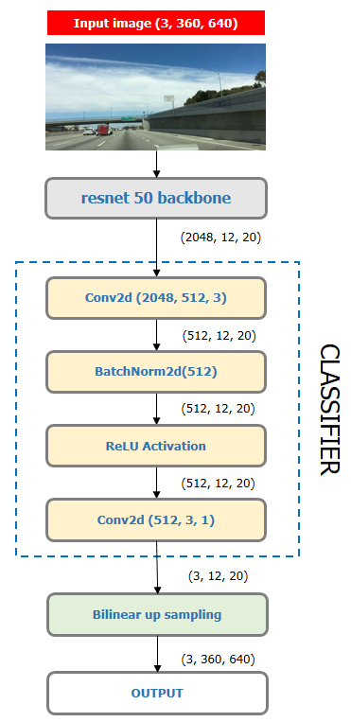

Slide 2
Input
(3, 360, 640)
Conv2d(3, 64, 3)
(64, 360, 640)
BatchNorm2d(64)
(64, 360, 640)
ReLU Activation
double_conv
(64, 360, 640)
Conv2d(3, 64, 3)
(64, 360, 640)
BatchNorm2d(64)
(64, 360, 640)
ReLU Activation

Slide 3
INPUT IMAGE
PREDICTION
(3, 360, 640)
(3, 360, 640)
double_conv(32, 3)
(32, 360, 640)
double_conv(3, 32)
double_conv(64, 32)
(32, 360, 640)
(64, 360, 640)
(32, 360, 640)
MaxPool2d
ConvTranspose2d(64, 32)
ENCODER
DECODER
(32, 180, 320)
(64, 180, 320)
double_conv(32, 64)
double_conv(128, 64)
(64, 180, 320)
(128, 180, 320)
(64, 180, 320)
MaxPool2d
ConvTranspose2d(128, 64)
(64, 90, 160)
(128, 90, 160)
Bottleneck : double_conv(64, 128)

