Slide 1
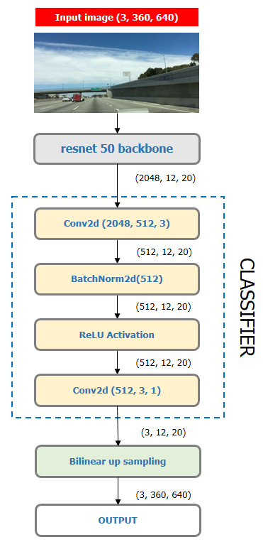

Slide 2
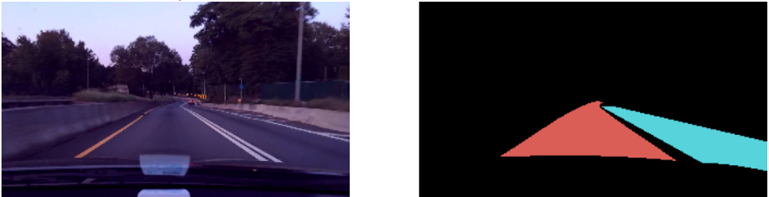
Resnet50 backbone
(3, 360, 640)
Conv2d(3, 64, 3)
(64, 360, 640)
BatchNorm2d(64)
(64, 360, 640)
ReLU Activation
double_conv
(64, 360, 640)
Conv2d(64, 64, 3)
(64, 360, 640)
BatchNorm2d(64)
(64, 360, 640)
ReLU Activation

Slide 3
Input
(3, 360, 640)
Conv2d(3, 64, 3)
(64, 360, 640)
BatchNorm2d(64)
(64, 360, 640)
ReLU Activation
double_conv
(64, 360, 640)
Conv2d(64, 64, 3)
(64, 360, 640)
BatchNorm2d(64)
(64, 360, 640)
ReLU Activation

Slide 4
INPUT IMAGE
PREDICTION
(3, 360, 640)
(3, 360, 640)
double_conv(32, 3)
(32, 360, 640)
double_conv(3, 32)
double_conv(64, 32)
(32, 360, 640)
(64, 360, 640)
(32, 360, 640)
MaxPool2d
ConvTranspose2d(64, 32)
ENCODER
DECODER
(32, 180, 320)
(64, 180, 320)
double_conv(32, 64)
double_conv(128, 64)
(64, 180, 320)
(128, 180, 320)
(64, 180, 320)
MaxPool2d
ConvTranspose2d(128, 64)
(64, 90, 160)
(128, 90, 160)
Bottleneck : double_conv(64, 128)

Slide 5
Feature Map
(2048, 45, 80)
AdaptiveAvgpool2d (1)
(2048, 1, 1)
Conv2d(2048, 512, 3)
PYRAMID POOLING MODULE (bin=1)
(512, 1, 1)
BatchNorm2d(64)
(512, 1, 1)
ReLU Activation
(512, 1, 1)
Bilinear Up sampling
(512, 45, 80)
OUTPUT

Slide 6
PYRAMID POOLING MODULE
PPM (bin=1)
(512, 45, 80)
PPM (bin=2)
(512, 45, 80)
Feature Map
(2048, 45, 80)
(4096, 45, 80)
Conv2d(4096, 512, 3)
PPM (bin=3)
(512, 45, 80)
(512, 45, 80)
BatchNorm2d(512)
CLASSIFIER
PPM (bin=6)
(512, 45, 80)
(512, 45, 80)
ReLU Activation
(512, 45, 80)
Conv2d(512, 3, 3)
(3, 45, 80)
Bilinear Up sampling
(3, 360, 640)
Prediction

Slide 7
PYRAMID POOLING MODULE
PPM (bin=1)
(512, 45, 80)
Resnet50 backbone
(512, 45, 80)
PPM (bin=2)
Feature Map
(2048, 45, 80)
(4096, 45, 80)
Conv2d(4096, 512, 3)
PPM (bin=3)
(512, 45, 80)
(512, 45, 80)
BatchNorm2d(512)
(512, 45, 80)
CLASSIFIER
PPM (bin=6)
(512, 45, 80)
ReLU Activation
(512, 45, 80)
Conv2d(512, 3, 3)
(3, 45, 80)
Bilinear Up sampling
(3, 360, 640)
Prediction

Slide 8
RESNET
BACKBONE
Layer 1
Layer2
AUXILIARY BRANCH
Layer 3
AUX CLASSIFIER HEAD
BILINEAR
UP SAMPLING
MAIN BRANCH PREDICTION
AUX
LOSS
* ALPHA
TOTAL LOSS
Layer4
PYRAMID POOLING
CLASSIFIER
HEAD 1
BILINEAR
UP SAMPLING
MAIN BRANCH PREDICTION
MAIN
LOSS
* (1 – ALPHA)
MAIN BRANCH

Slide 9
Feature Map
(2048, 23, 40)
Conv2d(2048, 256, 3,
dilation=12, padding =12)
ASPP Conv Module
(256, 23, 40)
BatchNorm2d(256)
(256, 23, 40)
ReLU Activation
(256, 23, 40)
OUTPUT

Slide 10
ATROUS SPATIAL PYRAMID POOLING MODULE
Conv2d(2048, 256, 1)
ASPP conv
(2048, 256,rate =6)
(256, 23, 40)
Feature Map
(2048, 23, 40)
ASPP conv
(2048, 256,rate =12)
(1280, 23, 40)
Conv2d(1280, 256, 3)
ASPP conv
(2048, 256,rate =18)
(256, 23, 40)
OUTPUT
(256, 23, 40)
ASPP pooling
(2048, 256)

Slide 11
DEEPLABV3+ DECODER
(256, 90, 160)
(48, 90, 160)
Low level feature map
Conv2d(256, 48, 1)
(304, 90, 160)
(256, 23, 40)
(256, 90, 160)
Conv2d(304, 256, 3)
ASPP output
Bilinear Up sampling
(256, 90, 160)
BatchNorm2d(256)
(256, 90, 160)
ReLU Activation
(256, 90, 160)
Conv2d(256, 256, 3)
CLASSIFIER
(256, 90, 160)
BatchNorm2d(256)
(256, 90, 160)
ReLU Activation
(256, 90, 160)
Conv2d(256, 3, 3)
(3, 90, 160)
Bilinear Up sampling
(3, 360,640)
PREDICTIONS

Slide 12

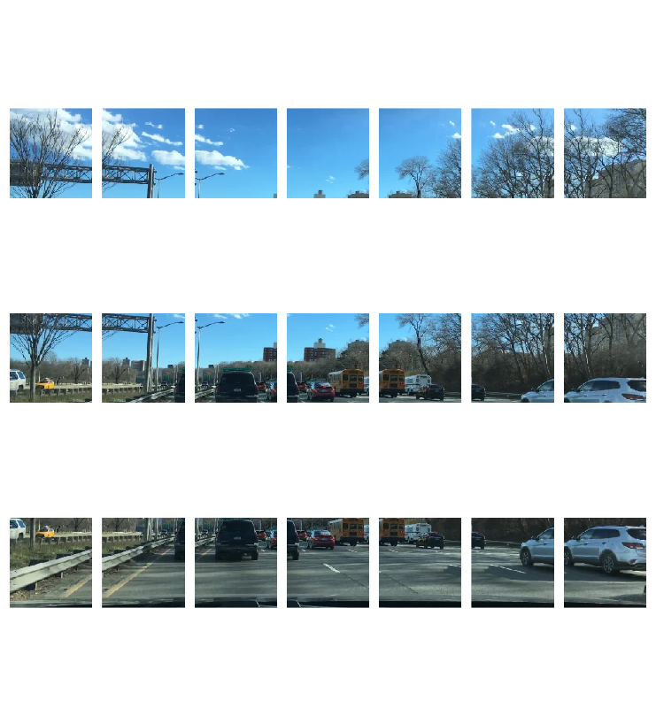
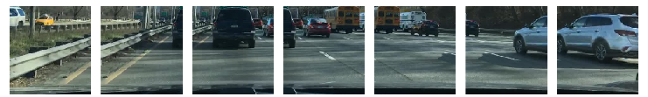
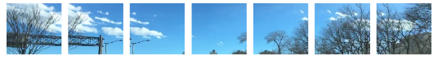
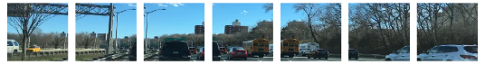
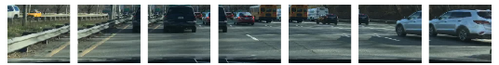
Original image
Overlapping patches
Conv2d()
rearrange()
Rearranged patches

Slide 13
TRANSFORMER BLOCK
Mix FeedForward
LayerNorm
Efficient
Self-Attention
LayerNorm
Embedded
patches

