Slide 1
BASELABS DYNAMIC GRID

Slide 2
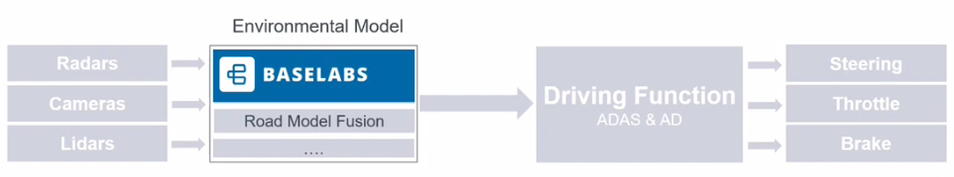
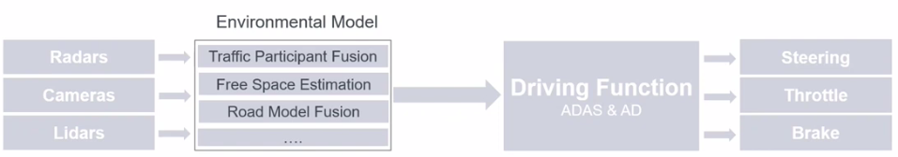
BASELABS GmbH
Sensor Fusion Products for Automated Driving
Support ADAS / AD functions
City AEBS, ACC
Traffic Jam Pilot / Highway Pilot
Automated Valet Parking
ASPICE / ISO26262 compliant
Capable of running on Off-the-shelf CPUs

Slide 3
BASELABS Perception Stack
BASELABS
Environment model
High Resolution Radar
Radar Detections
Dynamic objects
Smart Radar objects
Free space polygon
Camera Bounding Boxes
Camera Semantic information
Camera point cloud
Grid map
Lidar Point Cloud
Lidar Cluster
Parking spots
Smart Lidar Objects

Slide 4
AUTOMATED VALET PARKING

Slide 5
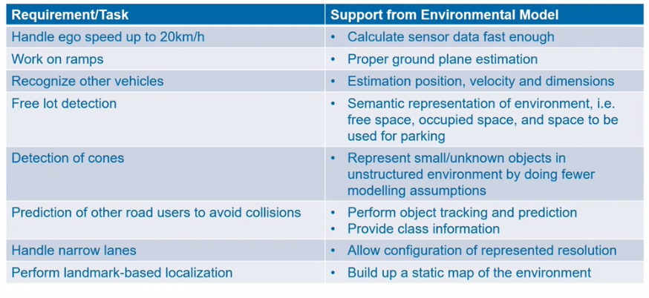
Requirements for Perception System for Automated Valet Parking

Slide 6
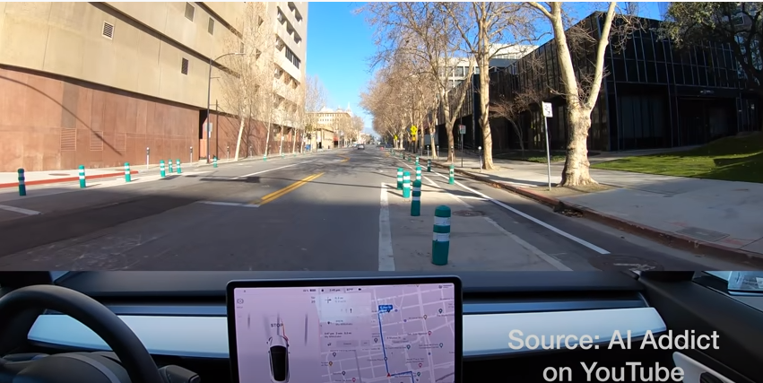
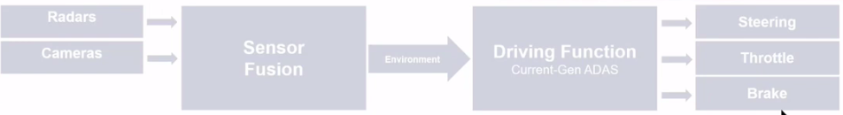
Existing Sensor Fusion Solutions
Existing Sensor Fusion Solutions work well for:
Well-structured environments
Similar Traffic Participants
Limited number of scenarios
Assisted Parking
Highway AEBS / ACC
Lane Keep, Lane Departure Warnings
2 Main components of Existing solutions
Dynamic Object Fusion
Static Grid Fusion

Slide 7
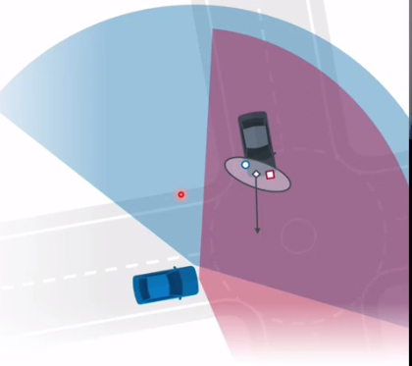
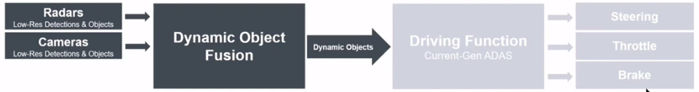
Dynamic Object Fusion
Required Low-resolution Sensor Inputs
Requires priori known object types
Based on Kalman filter – Unimodal, Gaussian, Non-Linearity limitations
Well suited for large distance tracking of Dynamic objects
Limited performance for near distance and extended objects
No support for static environments

Slide 8
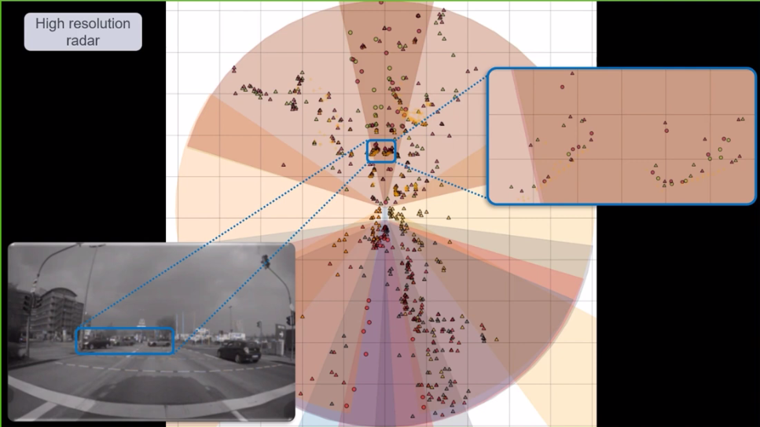
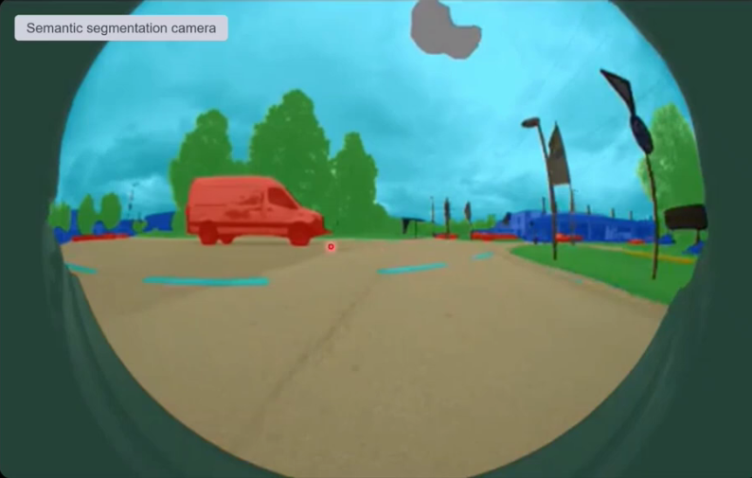
High Resolution Sensor Data
Radar Measurements
Dense Camera Detections
Range, Azimuth and Doppler velocity
Large number of detections per objects
Detection-level output for low-level fusion
Semantic annotation and / or depth
Pixel level class and / or depth information

Slide 9
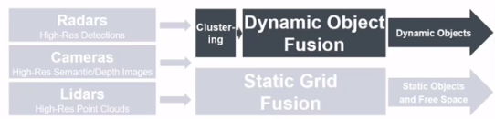
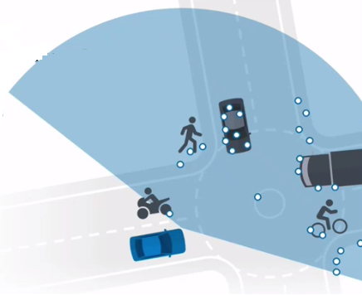
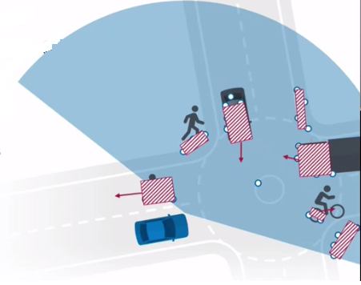
Limitations of Dynamic Object Fusion
Limited performance for close-range and extended objects
Requires clustering of high-res sensor data
Prone to errors due to early decision on data association
Required prior known object types
Inherent risk to miss unknown dynamic objects

Slide 10
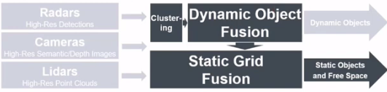
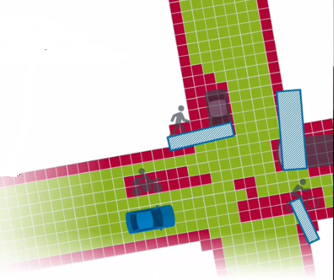
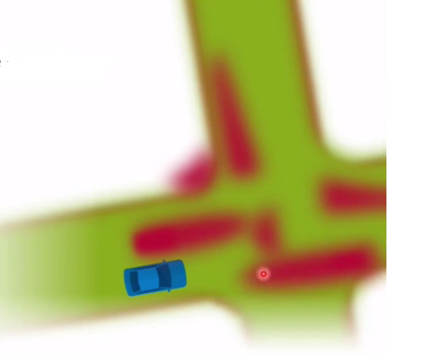
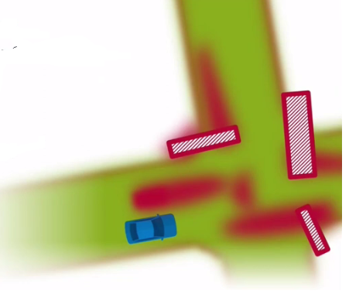
Static Grid Fusion and its limitations
Static grid map contains static objects only
Results in false negatives for free space
Workaround : Exclusion of measurements from dynamic objects
Error propagation from dynamic object fusion
High risk to fail in challenging scenarios

Slide 11
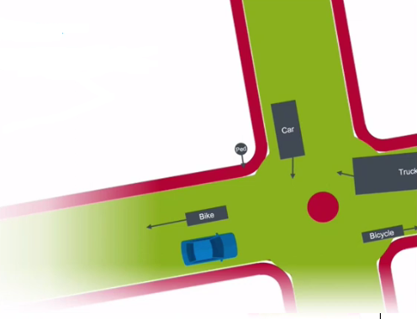
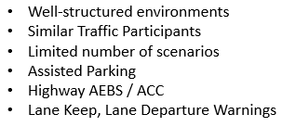
Perception System for Next Generation ADAS / AD
Provides Object Extensions
Object Motion Prediction
Provides static objects
Provides free space
Supports unknown object types
Supports high-resolution sensor inputs
Mismatch b/w problem and solution
Current solutions features

Slide 12
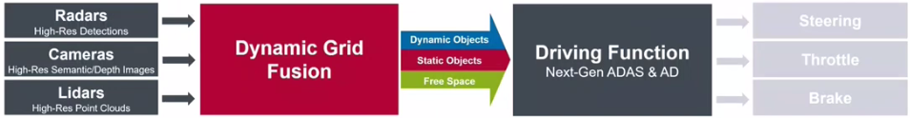
Dynamic Grid Fusion
Low level sensor fusion approach without early clustering
Integrated estimation of static and dynamic objects
No error propagation due to early decision
Supports high-resolution sensor inputs
Support for unknown object types
Fewer modelling assumptions

Slide 13
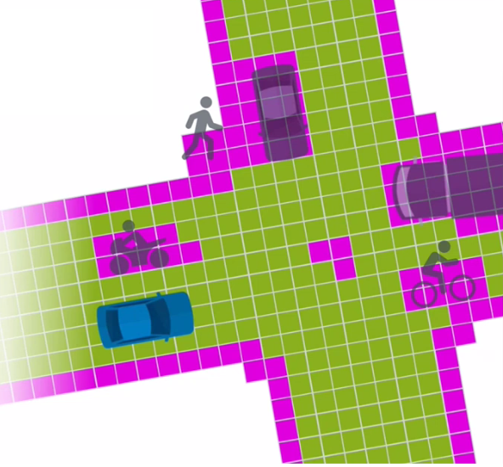
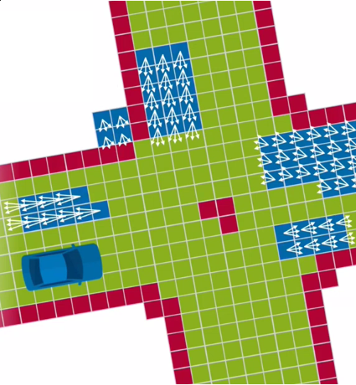
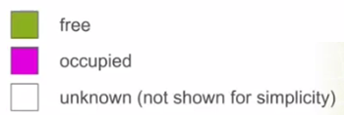
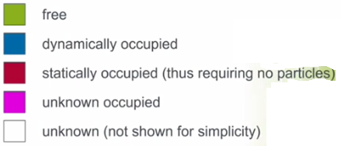
Dynamic Grid
First parent – Static occupancy grid
Second parent – Particle filtering on dynamic objects

Slide 14
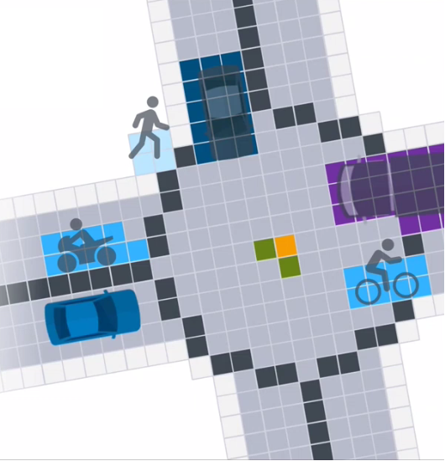
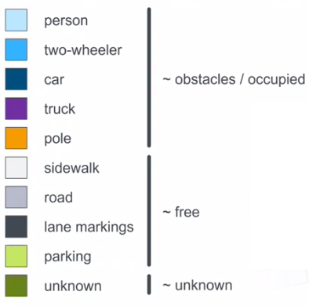
Dynamic Grid
Allows for additionally fusing Semantic information

Slide 15
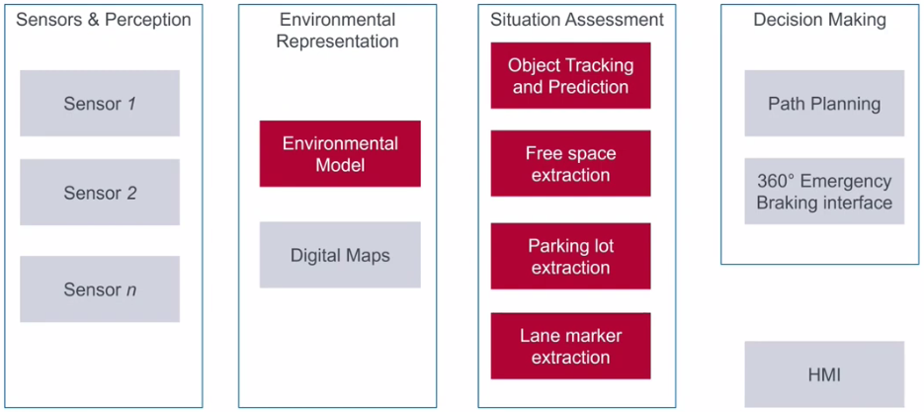
Software Stack for L4 Parking (SOTIF consideration)

Slide 16
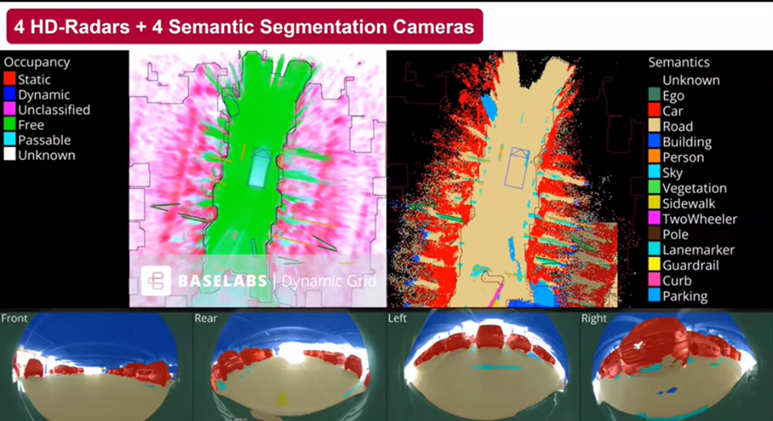
Dynamic grid using Radars + Cameras

Slide 17
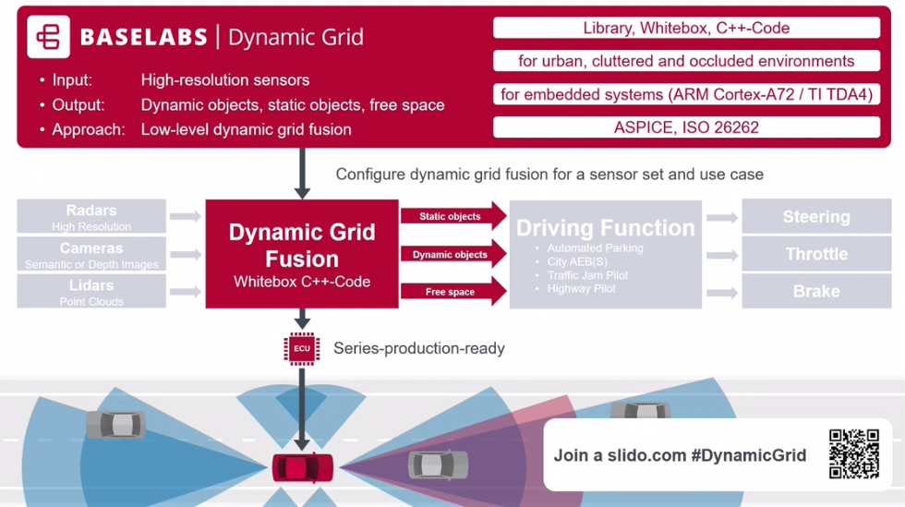
Dynamic grid Advantages
High Detection Rate
By Low-level sensor fusion without object extraction
Low False Alarm Rate
By Integrated estimation of static and dynamic objects
Runs on Automotive CPUs
By Minimizing particles in static areas

Slide 18
References
Baselabs Automated Parking webinar
Sensor Fusion Hub Baselabs
Sensor Fusion Literature
Next-gen Sensor Fusion Baselabs YT video

Slide 19
Backup slides

Slide 20
Dynamic grid Advantages

Slide 21
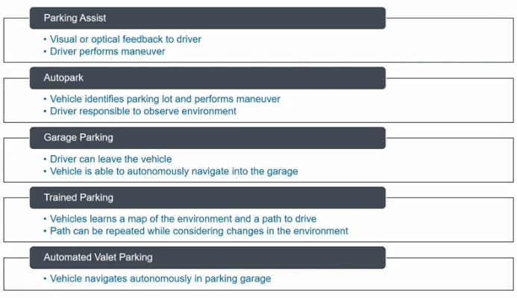
Levels of Automated Parking

