Slide 1
Background and Motivation
The single driven, damped, detuned nonlinear Schrodinger equation AKA the LLE, describing the nonlinear and dispersive processes in one microring is well studied.
Coupled mode equations analysis and the LLE temporal envelope analysis are equivalent when solved using FFT’s since coupled mode equations will assume a description of equidistant mode spacing. Instead of a sum of all energy matching modes in a particular FWM process which is convolution, you have a multiplication in the Fourier domain (Hence instead of O(n^3) complexity you have O(~NlogN + ~N) operations (wild guess, don’t trust me on this)). CM and LLE only differ by how you look at the system’s dynamics. You may be able to use less assumptions in CMT and be able to discover more interesting physics...
Scientifically speaking, stability analysis (steady state, types of combs), numerical analyses of the system is relatively well understood, the remaining things that we can play around with here is the engineering part (Stabilizing fceo, FSR) or more complicated physical processes that may require more difficult experiments. The age of turning on a high power pump and sweeping the laser across a resonance to observe interesting phenomena has long been over for a single ring.
What is less understood, more difficult to numerically study, and hasn’t had a ton of steady state analysis yet (although recent papers have indicated that Kippenberg’s group has already gotten a head start in this area) are coupled rings systems. So it’s actually possible that there are states of the system we don’t know about yet.
However, this requires a more rigorous mathematical/numerical study in order to understand the system and to be able to do that we need to have flexible tools to simulate the behavior.
Current tools available: Changling’s code (CMT), NIST open source (pyLLE), collaboration with Bath

Slide 2
Background and Motivation
The coupled rings system is not only interesting from a scientific point of view, it could potentially take advantage of our AlN platform if we couple a SHG ring with a Soliton ring. There may be even more possibilities if you look at the lithium niobate platform.
If we want to simulate a large number of modes at a higher power, it’s actually non trivial, because FFT algorithm is still ~O(NlogN), and as you increase the power you need to reduce the time step you take in the split step algorithm. A typical simulation of 500mW in the waveguide, 1000 modes, will require >1 hour of simulation time. Imagine now with multiple LLE’s how long a simulation might take… it would be slow even with the help of Yale’s HPC
A coupled rings system will require analysis of coupled LLE equations and possibly many modes, so an efficient simulation of the LLEs would be ideal. The code also needs to be easy to customize (something LLE or a code written by someone else might not have or be designed for), therefore a full python or mostly python version is beneficial to have. Imagine if you wanted to add the Raman effect into your code, but it’s all written in multiple languages with a very complicated file/functions structure and optimized for the LLE without the effect already, you might have to go through a lot of pain to add this.
For the purpose of learning and ease of customization, code was written from easiest to understand and customize while least optimized to most difficult to understand but highly optimized.

Slide 3
Benchmark comparisons
Comparison (on my home computer, which has a 6 cores and 12 threads)
Parameters: 500mW, 100um radius, 1024 modes, total time passed in simulation: 1 microsecond
Code used | PyLLE | No optimization | FFTW optimized | Numba optimized | Cython + parallelized
Time taken (mins) | 50 | 70 | 44 | 30 | 15

Slide 4
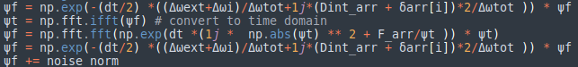
Code – simple, good for experimenting
Completely unoptimized, but uses numpy so only 1.4x slower than pyLLE
This no optimization version literally has the equation written out in code form, integrated in time. Even the symbols are familiar so starting here and customizing it shouldn’t be too big of a problem.
Can be found under comb_main.py
Run using

Slide 5
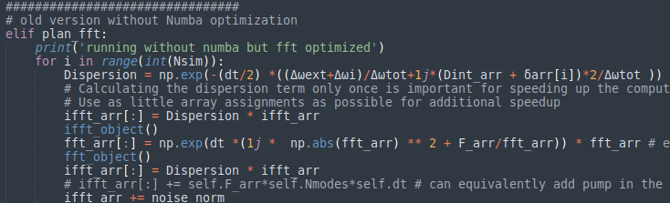
Code – intermediate, good for semi optimized code that’s easy to read still
FFT optimized:
No numba optimization, but is 1.6x the unoptimized speed
This code uses pyfftw which is a wrapper around an implementation of FFT in C code
Already on the order of pyLLE simulation time (1.14x faster than pyLLE).

Slide 6
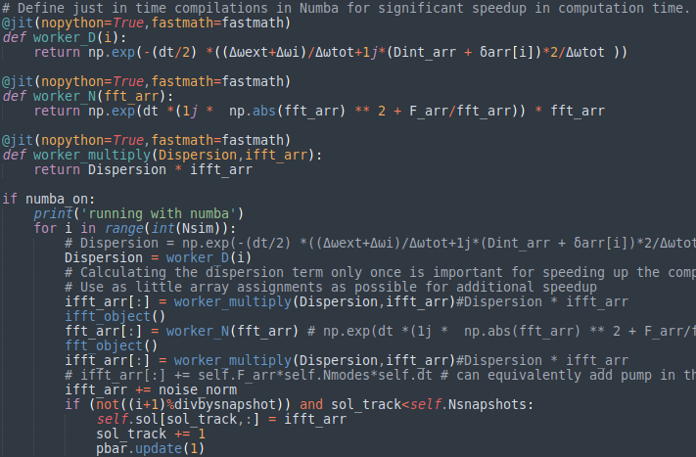
Code – intermediate, good for semi optimized code that’s easy to read still
Numba and FFT optimized:
Numba optimization takes the computationally heavy code and converts it into machine language to remove Python function overheads. This speeds up the code a great deal even over the FFT optimized version, since the heavy lifting portion of the code has been all laid out and optimized in machine code prior to it actually being used.
This still is not fully optimized because the Numba functions are being called inside a python loop so there is a bit of overhead there. This had to be done because Numba does not support pyfftw objects so they cannot be enclosed inside a Numba function.
2.2x faster than unoptimized
1.6x pyLLE

Slide 7
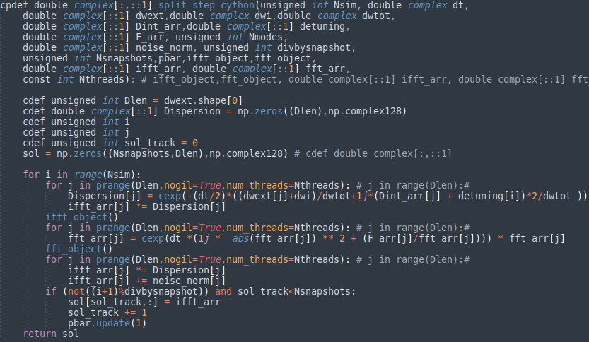
Code – Advanced, highly optimized but a bit harder to read
FFT optimized, most of the computation converted to C code using Cython:
This version of the code is the most optimized and is the closest to C++ code, but has the benefit of still being much easier to use and read than actual C++, by using Cython.
The optimization is done by defining all data types of all variables and converting all code related to the LLE comutation to C (which is similar to what numba does). Where it differs from numba is it also parallelizes some of the calculations for additional speed gains (maybe this can also be done on Numba but probably requires more work because some of the numpy math operations need to be unrolled).
This can be used with multithreading, but the users must decide for themselves how many threads to use
4.7x faster than unoptimized
3.4x pyLLE, can go even faster with more threading and more modes simulated. This code will be able to take full advantage of Yale’s HPC.
*Note that you need to experiment with the number of threads depending on the computer and sometimes the overhead of initiating more threads at the start of each multi-threaded block of code is not worth the gain in parallel computation

Slide 8
Usage
Main files: (→ means calls)
comb_main.py → comb_utils.py
comb_main_cython.py → comb_utils_cy_pyfile.py → comb_utils_cython.pyx
Need to compile comb_utils_cython.pyx once before subsequent runs.
Computation code is written in comb_utils_cython.pyx
The setup.py file compiles the code in comb_utils_cython.pyx
When you run the program you need to type in something like this
There are more options, make sure to use “python comb_main.py -h” to see all options, like saving your solution and whatever. Or just look at the source file...

Slide 9
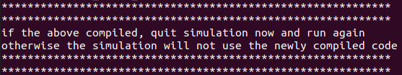
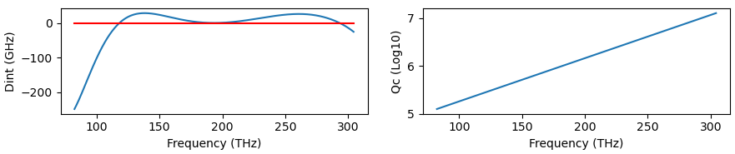
Example 1
Run:
The code will determine if a compilation of the .pyx is required (it checks if there are any changes, if there was a compilation, make sure to re-run the program.)
Pthreads tells the program how many threads to use, for me the optimal was 6 (I have a 6 core CPU). This is only a valid variable when you are using the Cython version.
Some details about the parameters will show up, as well as a plot of the Qc and Dint for you to double check.

Slide 10
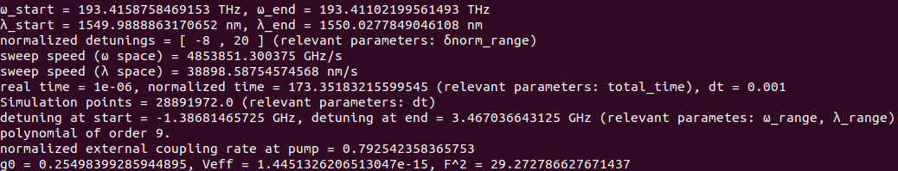
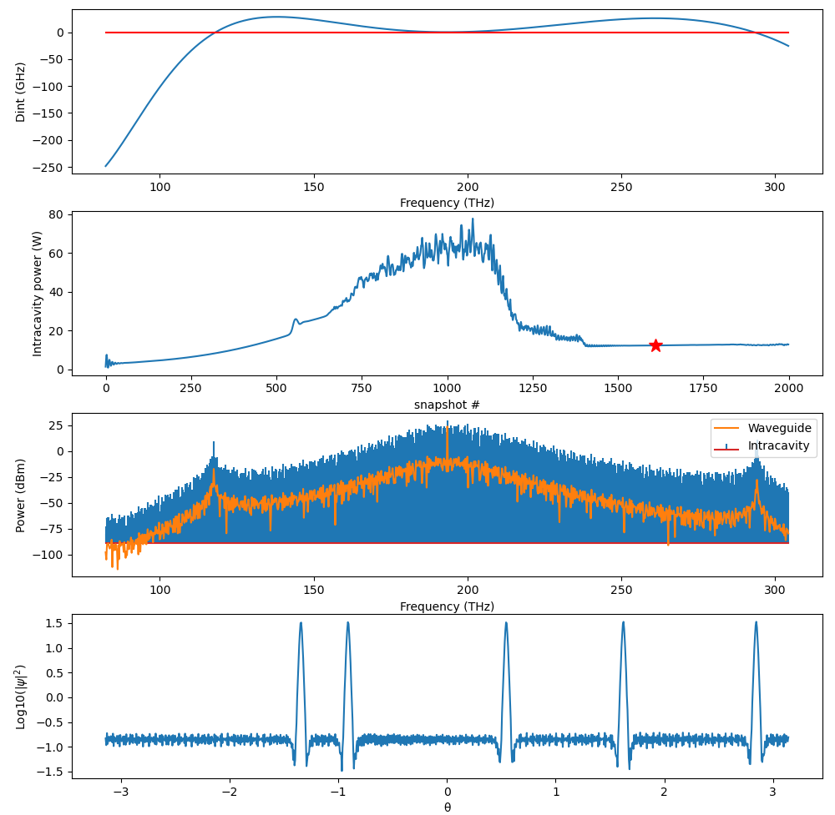
Example 1
Run:
Details of the parameters:
When you close the Dint/Qc plot, you will be prompted to start the simulation, simply enter “y” or “n”.
When the simulation has completed, you will see a plot of the characteristics of the comb
When you close the plot you will be asked to quit simulation or not.
If you say n, you can choose a new index (from 0 to number of snapshots) for plotting

