Slide 1

G2M Case Study
Virtual Internship
14-AUG-2024

Slide 2
Background –G2M(cab industry) case study
XYZ is a private equity firm in US. Due to remarkable growth in the Cab Industry in last few years and multiple key players in the market, it is planning for an investment in Cab industry.
Objective : Provide actionable insights to help XYZ firm in identifying the right company for making investment.
The analysis has been divided into four parts:
Data Understanding
Forecasting profit and number of rides for each cab type
Finding the most profitable Cab company
Recommendations for investment

Slide 3
Data Exploration
Cab_Data.csv
Customer_ID.csv
Transaction_ID.csv
City.csv
Merge_df data
17 Features
Total data points : 359392
Assumptions:
Outliers are present in Price_Charged feature but due to
unavailability of trip duration details ,we are not treating this as outlier.

Slide 4
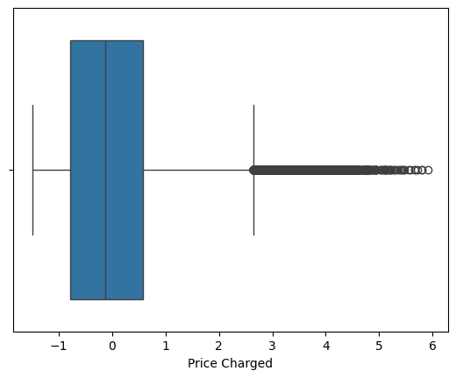
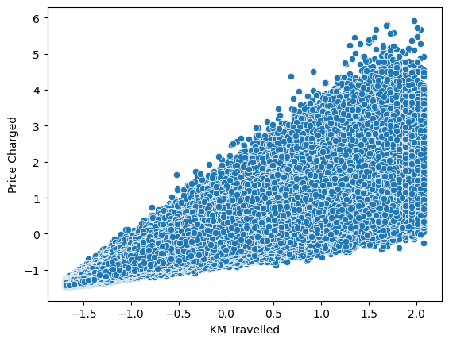
Profit Analysis
Analysis

Slide 5
Price Charged Analysis
Correlation: 0.83575315802094

Slide 6
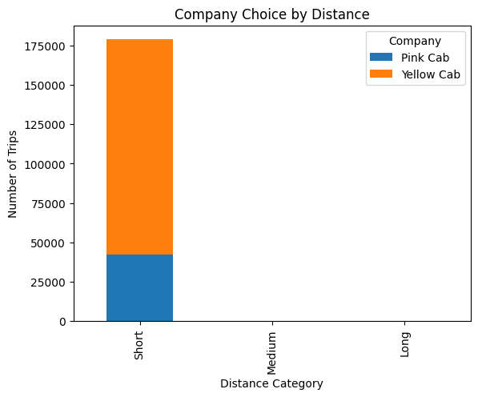
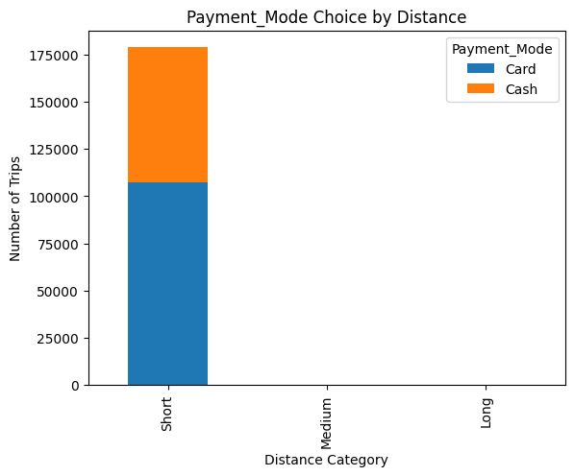
Customers traveling longer distances are more likely to choose a specific company or payment method.
Company Pink Cab Yellow Cab
Short 42117 136747
Medium 0 0
Long 0 0
Payment Mode Card Cash
Short 107286 71578
Medium 0 0
Long 0 0

Slide 7
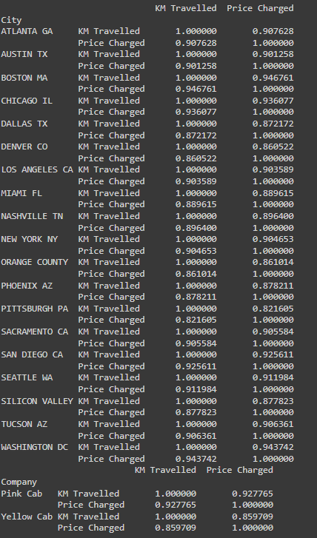
Other
Other factors like time of day or demand might also influence the price, but distance remains the primary
This strong correlation holds true across different cities and companies
Mean Squared Error: 0.30274850525392716
Coefficients: [0.83523086 0. 0. 0. ]

Slide 8
Recommendations
Pricing Strategy:
Distance-Based Pricing: Given the strong correlation between distance and price, ensure your pricing model accurately reflects this relationship. Consider a base fare plus a per-kilometer charge, as suggested by Hypothesis 3.
Time and Demand Sensitivity (Further Exploration): While initial analysis didn't show a strong linear impact of time or demand, explore non-linear relationships or interactions. If you find significant patterns, consider dynamic pricing strategies that adjust fares based on time of day, day of the week, or demand levels.
Target Marketing: Based on the preliminary findings (with the caveat of binning adjustments), Pink Cab might focus on attracting customers for longer trips, while Yellow Cab could leverage its dominance in the short-distance market. Tailor marketing messages and promotions accordingly.
Service Offerings: Consider if each company could offer specialized services to cater to different distance preferences. For example, Pink Cab might offer premium services for longer journeys, while Yellow Cab could optimize for quick, short trips.
Payment Options:
Promote Card Payments: Given the higher prevalence of card payments for short trips, consider incentivizing card usage further, especially for convenience-seeking customers on shorter journeys.
On the basis of above point , we will recommend Yellow cab for investment.

Slide 9
Thank You

