Slide 1
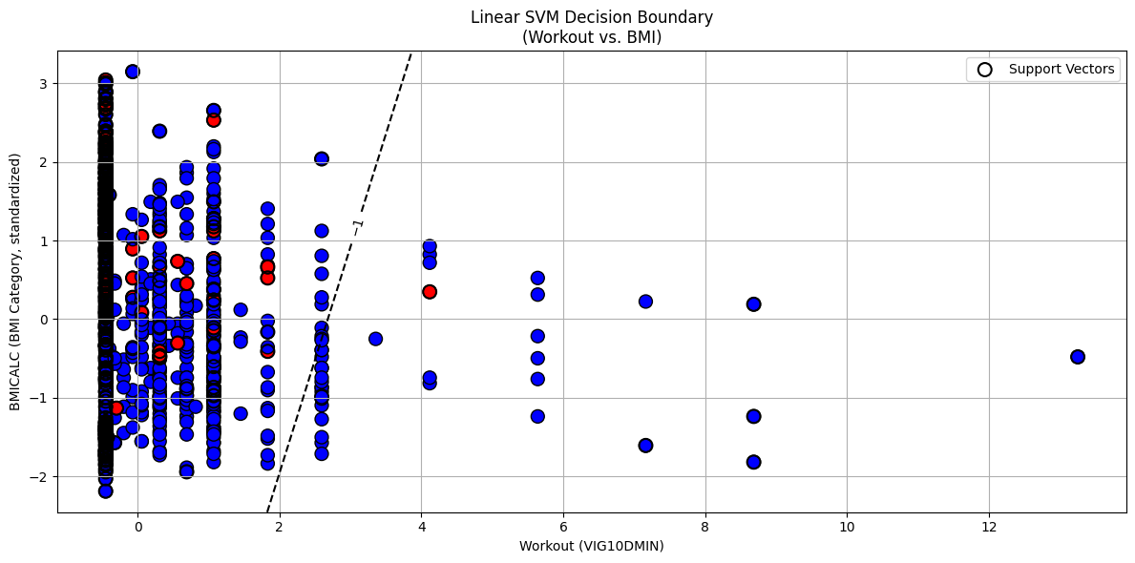
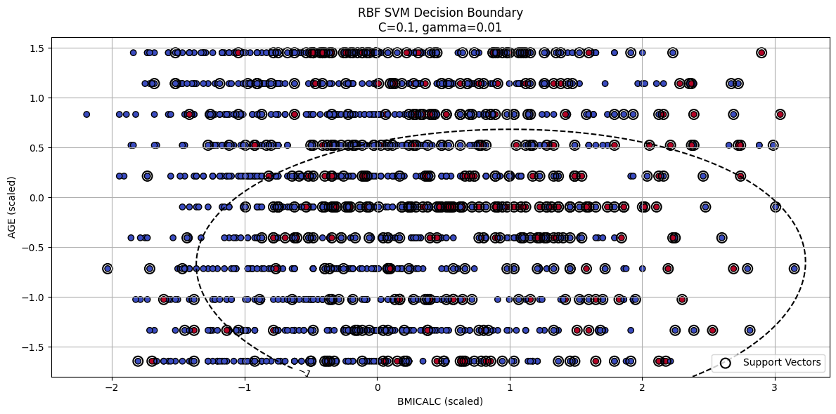
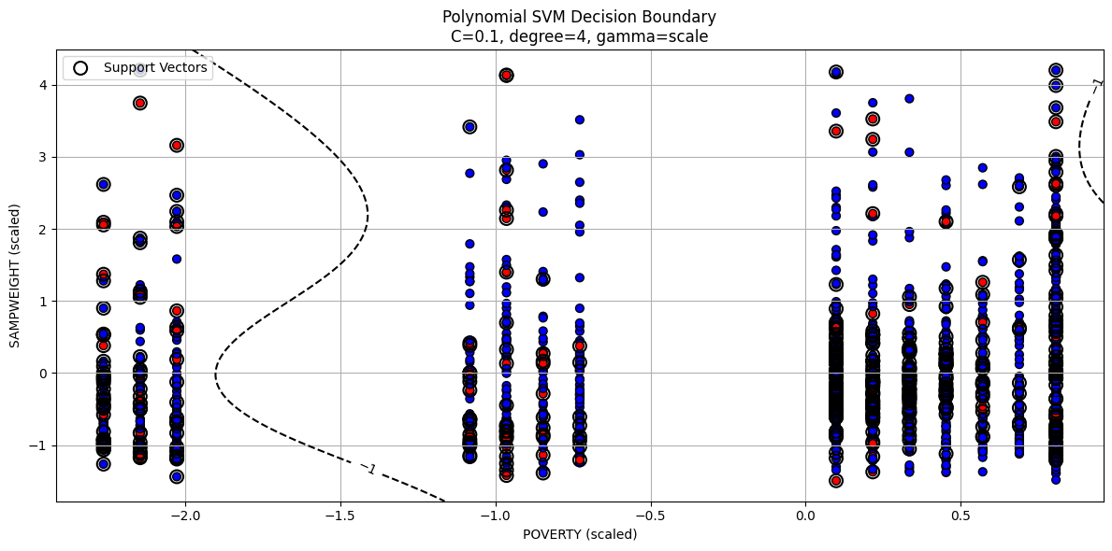
Predicting Diabetes Outcomes Using Support Vector Machines (SVMs)
Evidence from NHIS 2022 Health Survey
Abstract
This project investigates the relationship between health behaviors and the diagnosis of diabetes among U.S. adults using the 2022 National Health Interview Survey (NHIS) dataset. I have apply Support Vector Machine (SVM) classifiers with linear, radial basis function (RBF), and polynomial kernels to predict diabetes presence based on demographic, sleep, diet, and physical activity variables. Feature selection, hyperparameter tuning, and decision boundary visualizations are presented to highlight key predictors of health outcomes.
Methodology
Data Preparation:
Variables selected: AGE, SEX, BMICALC, CIGDAYMO, HRSLEEP, VIG10DMIN, PIZZANO, FRIESPNO, SODAPNO.
Target variable: DIABETICEV (diagnosed with diabetes or not).
Categorical values cleaned (unknowns 7-9, 97-999 treated as NA).
Feature Selection:
Linear SVM: L1-penalized SVC + RFE.
RBF/Poly: Top 5 features via Random Forest.
Modeling: Kernels: Linear, RBF, Polynomial.Tuned using GridSearchCV (5-fold CV).
Introduction
Goal: Predict diabetes diagnosis using demographic and behavioral data.
Data: NHIS 2022, ~9 health behavior variables selected based on codebook.
Research Question: Which daily habits and characteristics are predictive of diabetes risk?
Models Used: SVMs (Linear, RBF, Polynomial).
Computational Results
Model | Best Params | Accuracy
Linear SVM | C=0.01 | 0.8559
RBF SVM | C=0.1, gamma=0.01 | 0.8559
Poly SVM | C=0.1, degree=4, gamma: scale | 0.8579
Technical Background
Support Vector Machines (SVMs) are supervised learning models mainly used for classification. SVM finds the optimal hyperplane that separates classes with the largest possible margin, improving the model’s ability to generalize.
Key Concepts:
Hyperplane: A boundary that separates classes, defined by \( w^T x + b = 0 \).
Support Vectors: The closest data points to the hyperplane, critical in shaping it.
Margin: The distance between support vectors and the hyperplane; larger margins are better.
Kernel: A function that maps data to higher dimensions to handle non-linear separation.
Hard Margin vs. Soft Margin: Hard margins require perfect separation; soft margins allow some misclassification to better handle real-world data.
C Parameter: Controls the trade-off between maximizing margin and minimizing errors.
Discussion
Data Preparation:
Variables selected: AGE, SEX, BMICALC, CIGDAYMO, HRSLEEP, VIG10DMIN, PIZZANO, FRIESPNO, SODAPNO.
Target variable: DIABETICEV (diagnosed with diabetes or not).
Categorical values cleaned (unknowns 7-9, 97-999 treated as NA).
Feature Selection: Used L1-penalty Linear SVM (Linear SVC) to select nonzero-coefficient features.[1]
Model Training:
  GridSearchCV for each SVM kernel.
  Cross-validation: 5-fold.
  Separate standardization for each model.
"sklearn.svm.LinearSVC." scikit-learn: Machine Learning in Python, version 1.6.1, 2025, https://scikit-learn.org/stable/modules/generated/sklearn.svm.LinearSVC.html.
GeeksforGeeks. "Feature Selection Using Random Forest." GeeksforGeeks, 2025, https://www.geeksforgeeks.org/feature-selection-using-random-forest/.

